Slide 1
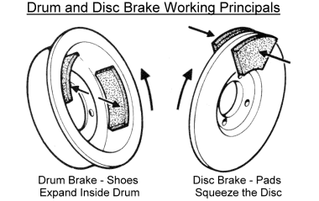
Systematic Thinking Fostered by Illustrations in Scientific Text
Mayer (1989)

Slide 2
Understanding Expository Text by Building Mental Models
Focus on explanative information in text
Build internal connections among ideas in text
Develop external connections between text ideas and prior knowledge
How do illustrations help readers build useful mental models?
Notes:
Assimilation theory - learning involves integrating new info with existing knowledge; above are 3 primary functions of cognitive processes; instructional manipulations such as illustrations may promote these cognitive processes

Slide 3
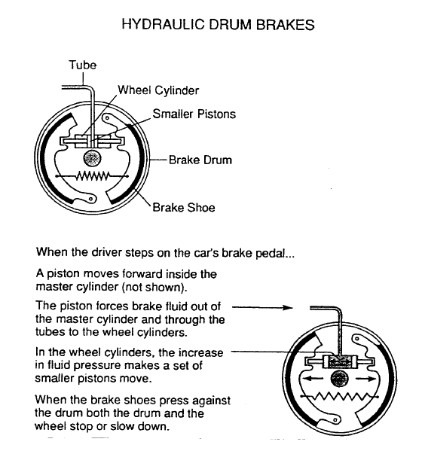
The Illustration
Notes:
Illustration = graphic + words and arrows

Slide 4
Learning from Text and Illustrations (T + I) vs. Text Alone (T)
Explanative information : T + I should recall more explanative information vs. T alone
Building connections : T + I should perform better on transfer (but not verbatim recognition) vs. T alone

Slide 5
Instructional Methods (e.g. illustration): Criteria for Research
Meaningful material such as explanative text, specifically how systems work
Novice status of learner - non-spontaneous engagement
Instructional manipulation (illustration) focuses on explanative information and helps reader build connections
Evaluation - systematic thinking used for superior problem solving transfer
See also: Figure 2, p. 242.
Notes:
Sequential nature of systems perhaps insert figure 2 on next blank slide

Slide 6
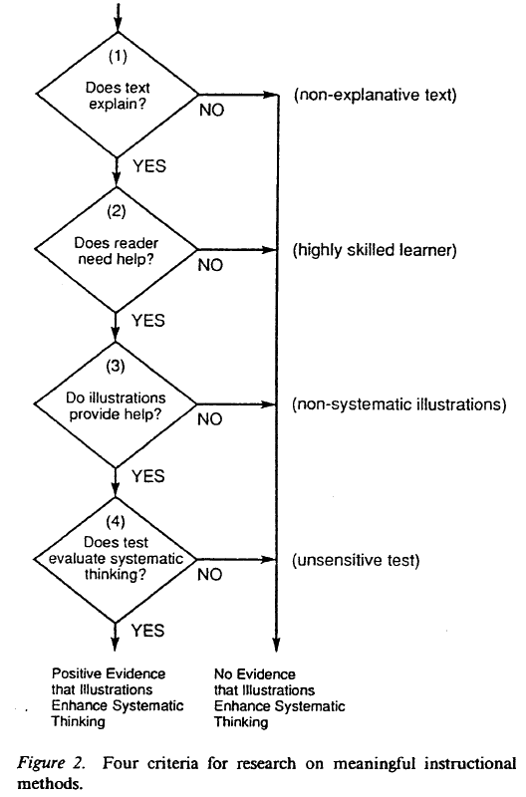

Slide 7
Experiment 1
Subjects: 34 novice female college students
Materials
Text + labeled illustrations and text alone
Experience questionnaire
Posttests (recall, transfer, recognition)
Procedure
Random assignment
Experience questionnaire
Recall test - 8 minutes
Transfer test - 10 minutes divided
Verbatim recognition test - 2 minutes
Notes:
Perhaps insert a slide with Figure 1 on it (diagram)

Slide 8
Experiment 1 Data Analysis
Recall Test
Idea Units: 35 explanative (causal) vs. 60 nonexplanative
Transfer Test
5 questions; total possible score = 15
Recognition Test
8 pairs of sentences; total possible score = 8

Slide 9
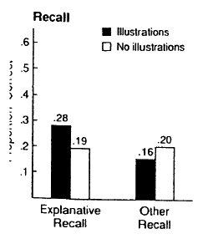
Results: Recall (idea units) Figure 3
No illustrations: same rate of recall of explanative and nonexplanative idea units
Group x Type interaction: illustration group has more explanative than other recall
Significance ???? (p < .06) of explanative recall difference between illustrations and non illustrations group
Notes:
Illustrations group recalled “marginally” more explanatative information than did no -illustrations group

Slide 10
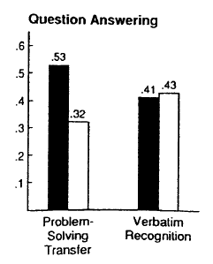
Results: Transfer and Recognition Figure 3
Illustrations group > no illustrations group on transfer scores; p =.01
Illustrations group = no illustrations group on recognition scores
Notes:
Need figure 3 (right) inserted here

Slide 11
Experiment 2
Possible confound in Experiment 1: are effects of illustrations due to labels, graphics, or both?
Add two new control groups to Experiment 1 protocol (illustrations = graphics + labels)
Text + graphics only
Text + labels only

Slide 12
Experiment 2
Subjects: 44 novice female college students
Materials
Text, questionnaire, posttests identical to Experiment 1
Illustrations without labels: pointer lines and words deleted (new group)
Labels without illustrations: graphics and pointer lines deleted (new group)
Procedural differences from Experiment 1
No text alone group; added two groups (see materials)
Recall test: 10 minutes
Transfer test: 12.5 minutes

Slide 13
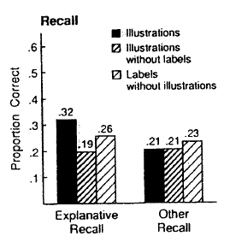
Results: Recall (idea units) Figure 4
Group x type interaction: illustration group has more explanative than other recall
For explanative recall: illustrations > labels- without-illustrations > illustrations-without-labels
Notes:
Need figure 4 (left) inserted here

Slide 14
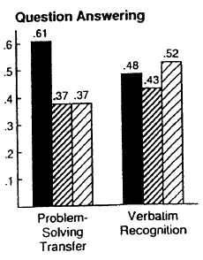
Results: Transfer and Recognition Figure 4
Illustrations group > other groups on transfer scores; p = .05
No significant differences among the groups on recognition scores
Notes:
Need figure 4 (right), p.244 inserted here

Slide 15
Conclusions
“…a diagram is (sometimes) worth a thousand words.” (Larkin & Simon, 1987)
Coherent diagrams (labeled graphics) that integrate information in the text affect cognitive processing of reader by focusing attention (recall of explanative over nonexplanative information) and building connections (problem-solving transfer)

