Slide 1
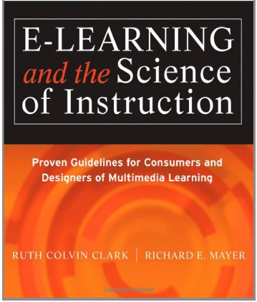
Evidence-based
Practice
Chapter 3
Ken Koedinger
Based on slides from Ruth Clark

Slide 2
Chapter 3 objectives
Apply evidence-based practice
Identify
  research approaches to study instructional effectiveness
  features of good experiments
  reasons for no effect
  research relevant to your organization
Interpret significance in statistics

Slide 3

Features of a professional learning engineer
Know what to do AND WHY
Factor evidence into educational decisions
Participate in a community of practice
Notes:
Discuss the features of a professional versus paraprofessional versus craft approaches. One feature of a professional is knowledge and application of evidence to practice.

Slide 4
Sources for e-learning design decisions
Evidence
Politics
Ideology
Fads
Opinions
Design
Decisions
Notes:
Discuss how design decisions are made in their projects. Ask for examples of decisions based on politics, ideology, fads, and opinions.

Slide 5
Three roads to instructional research
Research Question | Example | Research Method
What works? | Does an instructional method cause learning? | Experimental comparison
When does it work? | Does an instructional method work better for certain learners or environments? | Factorial experimental comparison
How does it work? | What learning processes determine the effectiveness of an instructional method | Observation Interview
Notes:
Give an example of each question and match the method to it. For example: Does adding a relevant graphic to text improve learning? Are graphics equally effective for males and females? Do graphics affect allocation of attention? Stress that which method is best depends on the research question.

Slide 6


Experimental comparison
Random Assignment
Treatment 1:
Text + Graphics
Treatment 2:
Text Only
VALID
TEST
Mean = 80%
Mean = 75%
Standard deviation = 5
Standard deviation = 8
Sample size = 25 in each version
Notes:
Discuss key features: random assignment, treatments similar in all respects except for the variable of interest. Discuss treatment group versus control group. Experiment should report the mean, standard deviation and sample size.

Slide 7
Factorial experimental comparison
 | Graphics | No Graphics
Men
Women
 | Examples | Problems
Low Variability
High Variability
Notes:
Discuss a 2 by 2 experiment in which 2 different groups are assigned to treatment and control groups. What groups might be considered other than men and women? Draw bar graphs showing different outcomes.

Slide 8
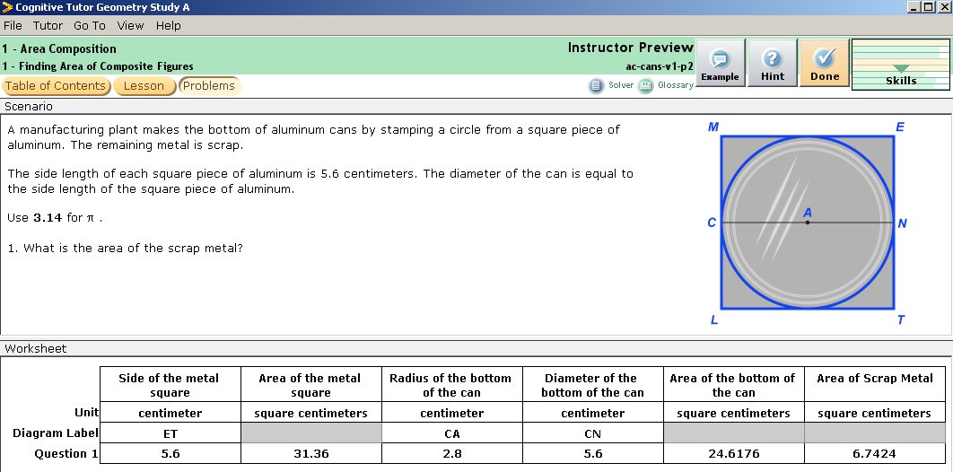
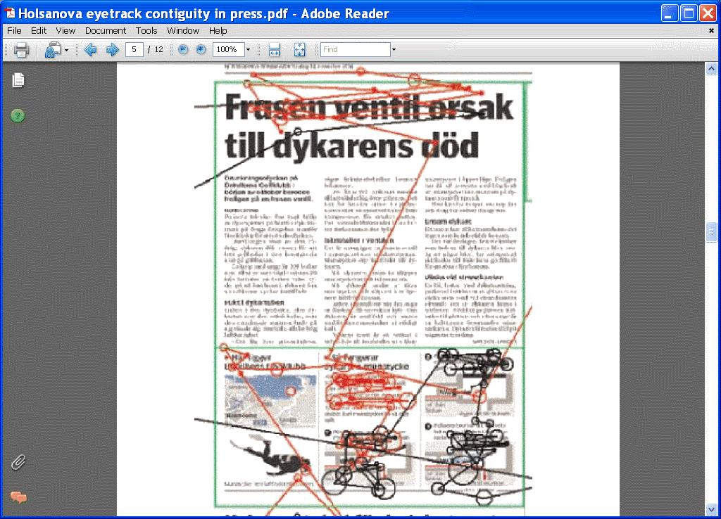
Examples of Process Observation
Ed Tech Logs
Eye Tracking
Student | Step (Item) | Skill (KC) | Opportunity | Success
S1 | prob1step1 | Circle-area | 1 | 0
S1 | prob2step1 | Circle-area | 2 | 1
S1 | prob2step2 | Square-area | 1 | 1
S1 | prob2step3 | Compose | 1 | 0
S1 | prob3step1 | Circle-area | 3 | 0
Others: video, think aloud, physiological measures, brain imaging …
Notes:
Recent experiments have used eye tracking to indicate where learners direct their attention on an instructional layout.

Slide 9
No effect
Test Scores
Graphics No Graphics
Notes:
No effect means that there were no significant differences in outcomes between the treatment group and the control group

Slide 10
Reasons for no effect?

Slide 11
Reasons for no effect
instructional treatment did not influence learning
insufficient number of learners
learning measure is not sensitive enough to detect differences in learning
treatment & control groups are not different enough from each other
learning materials were too easy for all learners so no additional treatment was helpful
other variables confounded the effects of the treatment
Notes:
Discuss some reasons why the previous slide comparing graphics to no graphics may have shown no effect.

Slide 12
Means for test and control groups
Lesson with
Music
Mean = 80%
Lesson without
Music
Mean= 90%
Number of Students
80 90 100
Test Scores
Notes:
If you want to introduce some statistics, use the following slides to illustrate: means, standard deviations, probability, and effect size.

Slide 13
Means and standard deviations
Lesson with
Music
Mean = 80%
Lesson without
Music
Mean= 90%
Number of Students
Standard
Deviation = 10
Standard
Deviation = 10
80 90 100
Test Scores
Notes:
Standard deviation is the amount of dispersion around the mean. Less dispersion equals more consistency among outcomes.

Slide 14
Statistical significance
The probability that the results could have
occurred by chance.
p < .05
Notes:
Introduce the concept of statistical significance. Stress that even a small difference in scores may be statistically significant but not necessarily of practical significance.

Slide 15
Effect size
Lesson with
Music
Mean = 80%
Lesson without
Music
Mean= 90%
Number of Students
Standard
Deviation = 10
Standard
Deviation = 10
Effect Size = 90-80 = 1
10
80 90 100
Test Scores
Notes:
Effect sizes tell you the practical significance of the results. The effect size indicates the amount of change in the standard deviation of the control group that would accrue with the tested instructional method. Look for effect sizes of at least .5.

Slide 16
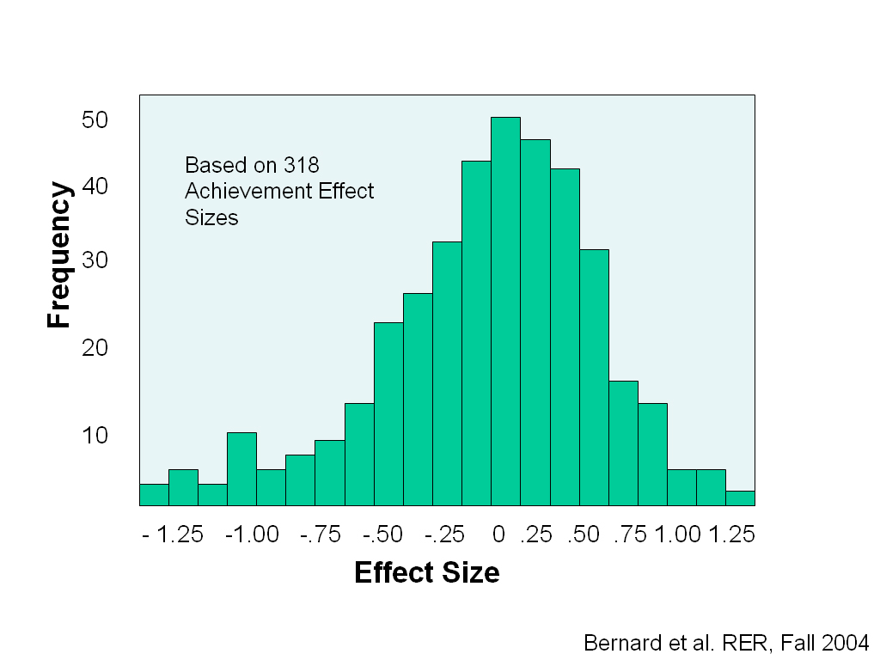
Notes:
A histogram of effect sizes we reviewed in Chapter 1. The comparisons 318 studies that compared learning via ILT and electronic distance learning environments.

Slide 17
Research relevance
Similarities of the learners to your learners.
Notes:
Discuss possible differences and similarities: age, culture, prior experience,

Slide 18
Research relevance
Features of a good experimental design (starting with most important)
Test group
Control group
Representative sample
Post test
Pre test
Random assignment
Notes:
Review quality of the research design discussed previously .

Slide 19

Research relevance
Replication
External validity:
Does principle generalize to different content, students, context, etc.?
Review of
Educational
Research
Notes:
Reviews of research give a more robust picture than single experiments.

Slide 20
Research Relevance
Recall
Or
Application?
Learning Measures
In most contexts, it is what a person can do, not what they say that really matters.

Slide 21
Research Relevance
p < .05
Effect Size ≥ .5
Significance?
Nothing magical about these numbers!
Poor treatments can look good by chance
  P=.05 => 1 in 20 chance that treatment just happened, by chance, to be better.
Good treatments may not
  Small p & effect size values can be associated with reliable & valuable instructional programs
Look for results across multiple contexts (external validity)
Notes:
Review of previous concepts

Slide 22
KLI learning processes & instructional principles

Slide 23
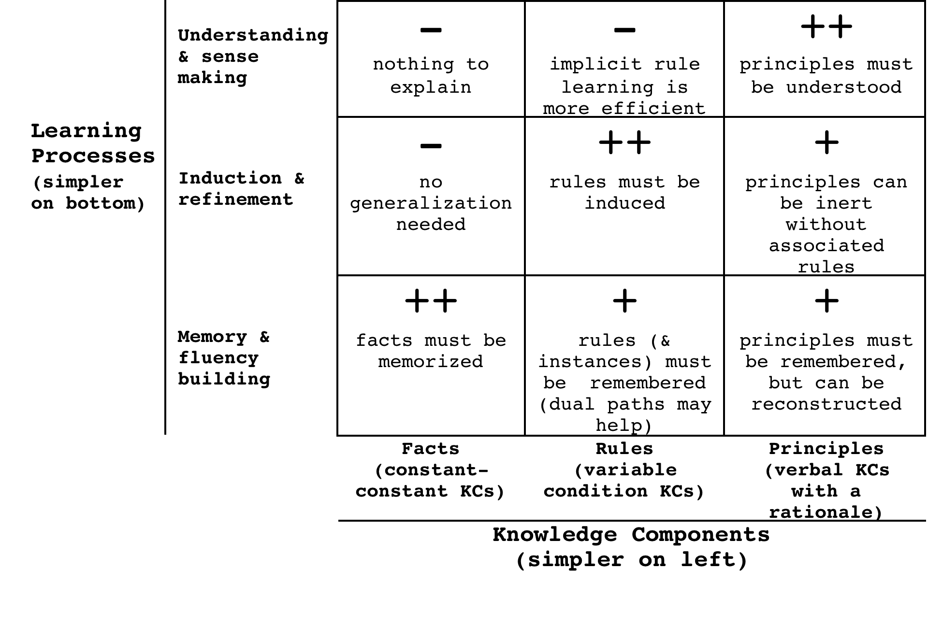
KLI: More complex learning processes are needed for more complex knowledge
Notes:
More complex knowledge requires more complex learning processes
Constant vs. variable condition & response
Facts (constant condition KCs) require memory
Rules (variable condition KCs) require induction
Non-verbal vs. verbal knowledge
KCs can be in non-verbal or verbal form or both
Require different learning processes
KCs with rationales can be (re)discovered in addition to be instructed
Principles (verbal, variable, with rationale) require sense making

Slide 24

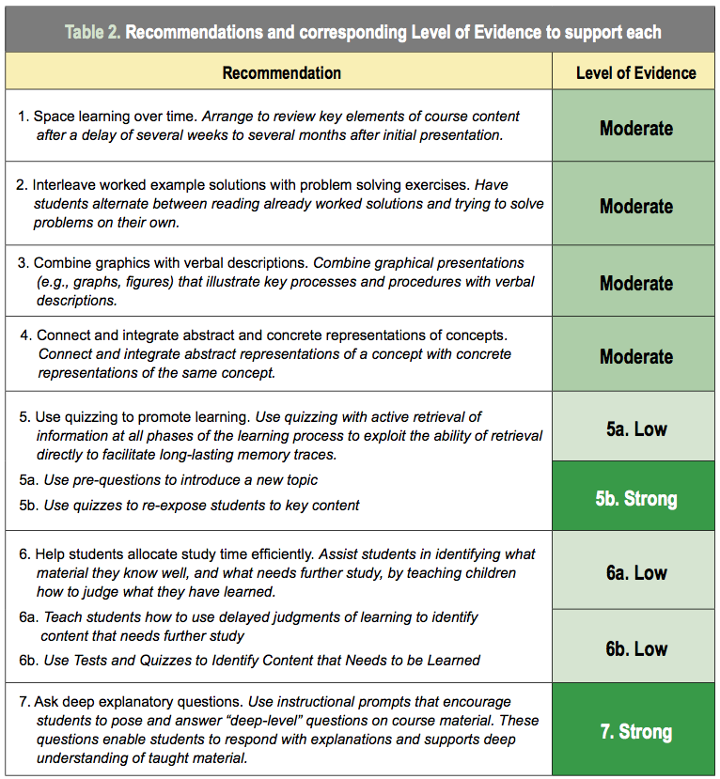
Instructional Principles

Slide 25
Can interactive tutoring of rule KCs be improved by adding examples?
No by “desirable difficulties” & testing effect
  Eliciting “retrieval practice” is better when students succeed
  Feedback provides examples when they do not
Yes by cognitive load theory & worked examples
  Examples support induction & deeper feature search
  Early problems introduce load => shallow processing & less attention to example-based feedback
Test with lab & in vivo experiments …

Slide 26
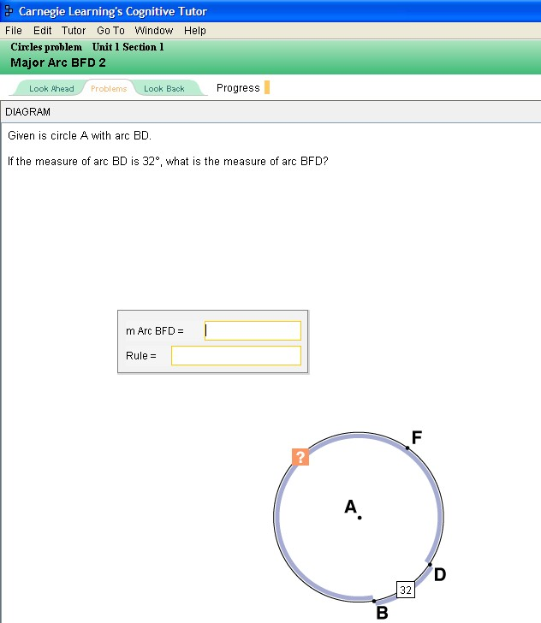
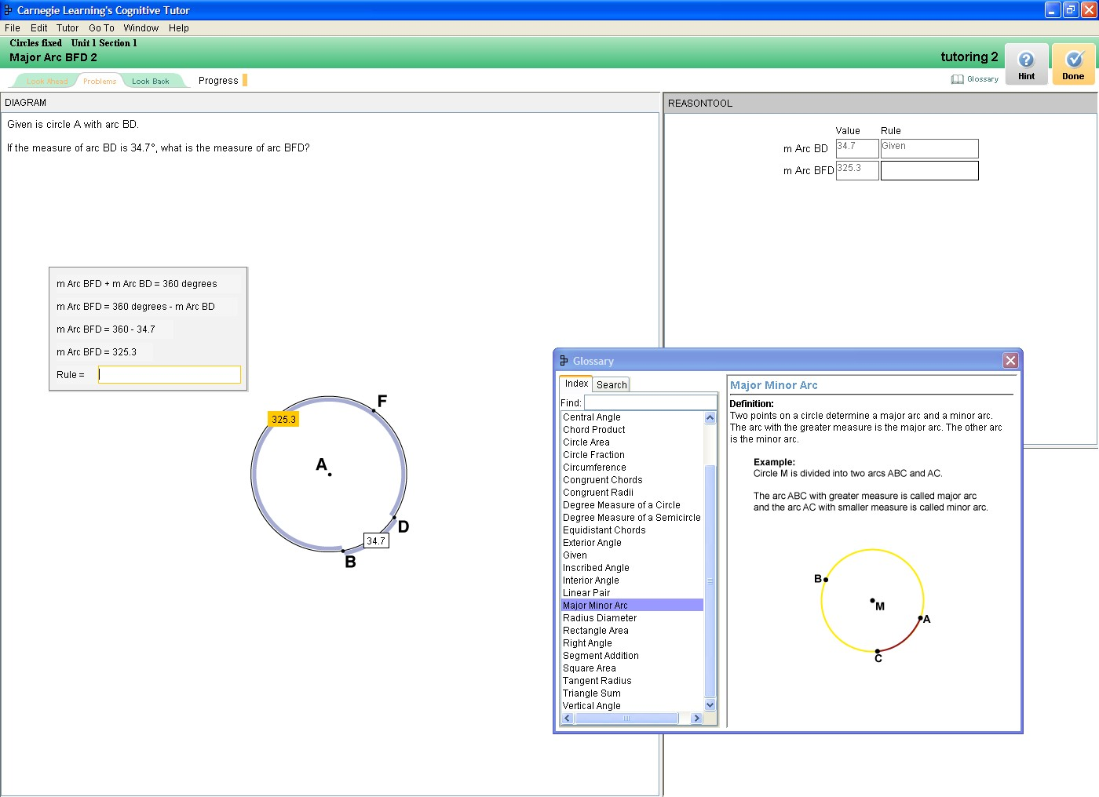
Ecological Control = Standard Cognitive Tutor Students solve problems step-by-step & explain

Slide 27
Treatments:
1) Half of steps are given as examples
2) Adaptive fading of examples into problems
Worked out steps with calculation shown by Tutor
Student still has to self explain worked out step
Notes:
27

Slide 28
Lab experiment: Adding examples yields better conceptual transfer & 20% less instructional time
d = .73 *

Slide 29
Course-based “in vivo” experiment
Result is robust in classroom environment:
adaptive fading examples > problem solving

Slide 30
Similar results in multiple contexts
LearnLab studies in Geometry, Algebra, Chemistry
  Consistent reduction in time to learn
  Mixed benefits on robust learning measures

Slide 31
“KLI dependency” explanation:
Target Knowledge => Learning processes => Which kinds of instruction are optimal
Many examples support
Worked examples
Worked examples
Eliciting recall supports
Testing effect
Testing effect
Aids fact learning, but suboptimal for rules
Aid rule learning, but suboptimal for facts

Slide 32
Self-explanation prompts: Generally effective?

Slide 33
Is prompting students to self-explain always effective?
Risks:
Efforts to verbalize may interfere with implicit learning
  E.g., verbal overshadowing (Schooler)
Time spent in self-explanation may be better spent in practice with feedback
  English article tutor (Wylie)

Slide 34
KLI: Self-explanation is optimal for principles but not rules
Prompting students to self explain enhances
Self-explain
Self-explain
Supports verbal knowledge & rationale
Impedes non-verbal rule induction

Slide 35
KLI Summary
Fundamental causal chain:
  Changes in instruction yield
  changes in learning yield
  changes in knowledge yield
  changes in robust learning measures.
Observed
Inferred
Design process starts at the end
  What is the knowledge students are to acquire?
  What learning processes produce those kinds of KCs?
  What instruction is optimal for those learning processes?
Bottom line: Which instructional methods are effective depend on fit with knowledge goals

