Slide 1
E-Learning To Build Thinking Skills (Chapter 15)
Ken Koedinger

Slide 2
Chpt 15 Topics
Types of Thinking Skills
Features of Successful Programs
Whole Task Instruction
Building Thinking Skills Training

Slide 3
Learning Objectives
Distinguish among 3 types of thinking skills
Apply thinking skills principles
Focus on job-specific thinking skills
Design whole-task learning environments
Make thinking processes explicit
Base lessons on cognitive task analysis.
www.Clarktraining.com

Slide 4
Three types of thinking skills
Type | Description | Examples
Creative thinking | Generating novel and useful ideas | Design an e-learning course
Critical thinking | Evaluating products and ideas | Assess validity of an Internet resource
Metacognition | Monitoring thinking and learning processes | Monitor your learning progress
www.Clarktraining.com
Notes:
Ask students to identify lessons they have taken or taught that focused on each of these skills. Make the distinction among the three types.

Slide 5
Successful thinking skills programs
Feature | Examples
Focus on a few well-defined skills | Criteria for distinguishing valid from invalid sources on the Internet
Contextualize those skills within authentic tasks | Complete Internet research to write a paper with valid resources
Incorporate social learning | Work with a partner to identify 10 sources and evaluate each
www.Clarktraining.com
Notes:
Ask students to identify lessons they have taken or taught that incorporated or ignored these features

Slide 6
Focus on job-specific skills
Evaluate
Ideas
Goals
Framing
Assuming
Chunk
Define the Problem
Generate
Ideas
Plan and
Implement
Brainstorm
Visualize
Metaphors
Mindmap
Notes:
Contrast a general plan like this one with a more specific plan shown on the next slide.

Slide 7
Focus on job-specific skills
Notes:
Contrast a job specific design like this one with a more general plan shown on the prior slide.

Slide 8
Part vs whole-task designs
Excel Outline
Whole Task
Excel Outline
Part Task
What is a cell
Cell references
What is a formula
Formats
Operators
Input a formula
Chart types
Chart procedures
Add data in column
What is a cell
Cell references
Average Sales
What is a formula
Formats
Operators
III. Make a Sales Chart
Type of charts
Notes:
Discuss the organizational differences between a part task and whole task design. Discuss possible tradeoffs.

Slide 9
Problem-Based Learning: Example
PBL Case
Instructional Scaffolding
The Miserable Life of a Stomach
The protagonist of our story is the stomach of a truck driver who
used to work shifts and who smokes a lot. The stomach developed
a gastric ulcer and so the smoking stopped. Stomach tablets are not
a regular part of the intake.
While on the highway in Southern Germany, our stomach had to
digest a heavy German lunch. Half an hour later, a sever abdominal
pain developed. The stomach had to expel the meal. Two tablets
of acetylsaliclic acid were inserted to relieve the pain.
A second extrusion some hours later contained a bit of blood. In
a hospital in Munich an endoscope was inserted. The stomach
needed to be operated upon in the near future. Explain
1. Clarify unknown terms and concepts.
2. Define the problem in the case.
3. Brainstorm to analyze the problem by identifying plausible explanations (creative thinking).
4. Critique explanations produced and draft a coherent description of the problem (critical thinking).
5. Define the learning issues (metacognitive thinking).
6. Engage in self-directed study to fill the gaps specified by the learn- ing issues (metacognitive thinking).
7. Reconvene to debrief the case and share lessons learned.
Notes:
PBL was started in 1970’s at McMasters University in Canada and has migrated to nearly all medical schools world wide. Contrast the PBL approach with traditional science-based lecture and lab approach.
Typically, a team of five to seven students facilitated by a faculty member reviews a case together and reaches a common understanding of the case followed by individualized self-study to learn more about the issues in the case. After a period of time, the team reconvenes to debrief lessons learned. Most PBL programs follow a structured process such as:1.Clarify unknown terms and concepts.2.Define the problem in the case.3.Brainstorm to analyze the problem by identifying plausible explana- tions (creative thinking).4.Critique explanations produced and draft a coherent description of the problem (critical thinking).5.Define the learning issues (metacognitive thinking).6.Engage in self-directed study to fill the gaps specified by the learn- ing issues (metacognitive thinking).7.Reconvene to debrief the case and share lessons learned.

Slide 10
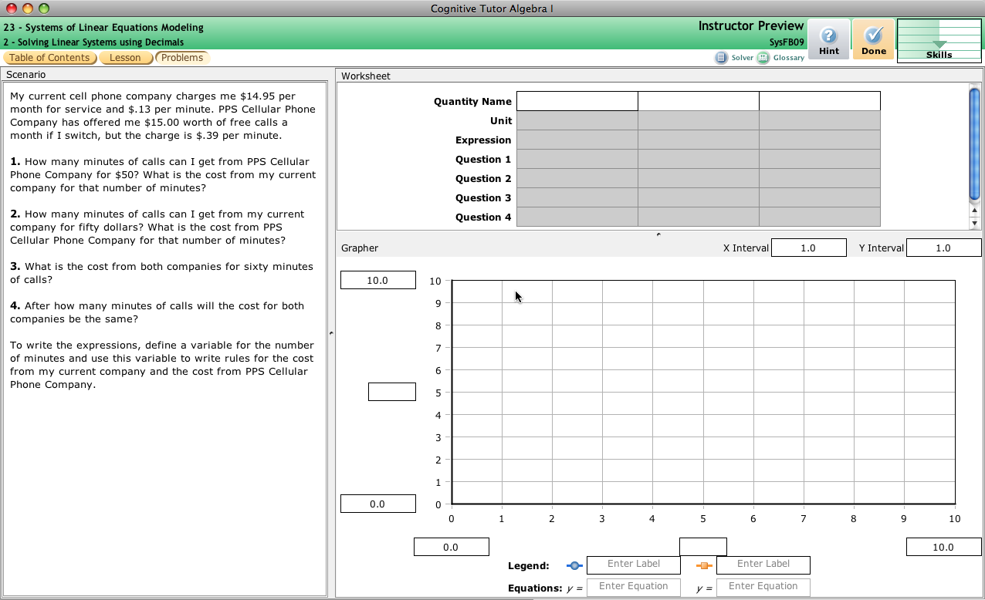
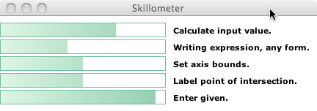
Cognitive Tutor Whole-Task Activity
Authentic problems
Feedback within complex solutions
Progress…
Personalized instruction
Challenging questions
… individualization

Slide 11
Whole-task multimedia learning
Notes:
Discuss synonyms: scenario-based learning, case-based learning, immersive learning etc. If possible, demonstrate a whole-task multimedia course.

Slide 12
Features of whole-task instruction
Feature | Description | Example
Problem-centered | Learning takes place in context of authentic task or problem | Defining a diagnosis and treatment plan for a case patient
Guided | Learning support provided in various formats | Virtual advisors Modeled examples Tutorials
Inductive learning | Learning occurs by trying and reflecting on outcomes including errors | In the automotive troubleshooting lesson, an incorrect diagnosis shows continuation of failure symptoms.
www.Clarktraining.com
Notes:
Ask students to identify lessons they have taken or taught that incorporated these features

Slide 13
Evidence for whole-task learning
“Research on the effectiveness of PBL (problem- based learning) has been somewhat disappointing to those who expected PBL to be a radical improvement in medical education. Several reviews of PBL over the past 20 years have not shown the gains in performance that many had hoped for.”
- Albanese, 2010
Notes:
Evidence has been mixed. This is a good place to review in Chapter 3 – reasons for no effects and discuss why some comparisons of whole and part task training may show no effects.

Slide 14
Part vs whole-task designs
Excel Outline
Whole Task
Excel Outline
Part Task
What is a cell
Cell references
What is a formula
Formats
Operators
Input a formula
Chart types
Chart procedures
Add data in column
What is a cell
Cell references
Average Sales
What is a formula
Formats
Operators
III. Make a Sales Chart
Type of charts
Notes:
Review the research comparing Excel training: part task versus whole task.

Slide 15
Excel: Part vs whole-task lessons
Part Task
Whole Task
95
Effect Size = .71
90
Effect Size = 1.14
85
SD
SD
80
Test Score %
75
70
65
60
Part-task test
Whole-task test
Transfer test
SD = Significantly Different
.
Based on data from Lim, Reiser & Olina, 2009.
Notes:
Note that many experiments on whole task learning use different assessments as in this example. Ask: based on this data, what are the benefits of whole-task learning?

Slide 16
Do Not Think Whole Task vs. Part Task!
Lesson from Cognitive Task Analysis
Whole > Sum_of_parts
Whole – Sum_of_parts = Hidden integrative KCs
Use CTA to find these
Do part training on hidden integrative KCs
Examples:
Heffernan & Koedinger DFA on symbolization => substitution part-task
Koedinger et al learning curve analysis => planning part-task
Klahr CTA of scientific inquiry => CVS part task

Slide 17
Better: Whole to part and back
Rather than compare whole-task designs with alternative designs, a more productive path is to (1) define the situations under which whole-task designs are more effective than part-task designs and (2) to isolate elements of whole-task designs requisite for optimal learning

Slide 18
Metacognitive questions
What are you doing now?
Why are you trying that approach?
What other approaches might you consider?
How do you know if you are making progress?
www.Clarktraining.com
Notes:
Compare teaching skills versus teaching meta-skills. Discuss the techniques Schoenfeld used to focus on metacognitive rather than cognitive skills.

Slide 19
Metacognitive skill comparison
NOVICE
EXPERT
Read
Read
Analyze
Analyze
Explore
Explore
Plan
Plan
Implement
Implement
Verify
Verify
Time
Time
Notes:
Discuss analysis of problem solving skills of expert versus novice mathematicians.

Slide 20
Examples of making thinking visible in Cognitive Tutors
Subgoal reification
LISP programming tutor
Geometry proof tutor
Geometry problem decomposition
Inductive support
Arithmetic to algebra

Slide 21
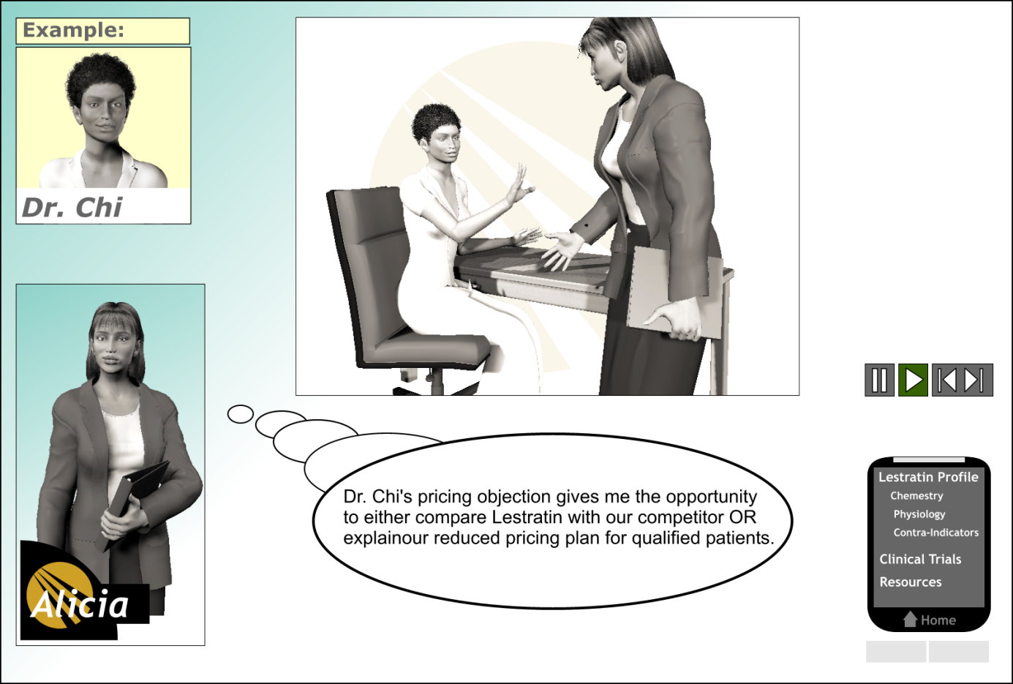
Make thinking processes explicit
Click play to resume
Audio
Alicia: Are many of your overweight and obese patients already taking weight-reducing drugs?
Dr. Chi: No, you see many of my patients can’t afford expensive weight management drugs so I’m not sure how viable this drug is to my practice.
Notes:
Distinguish between teaching skills and teaching the rationale or mental processes of experts

Slide 22
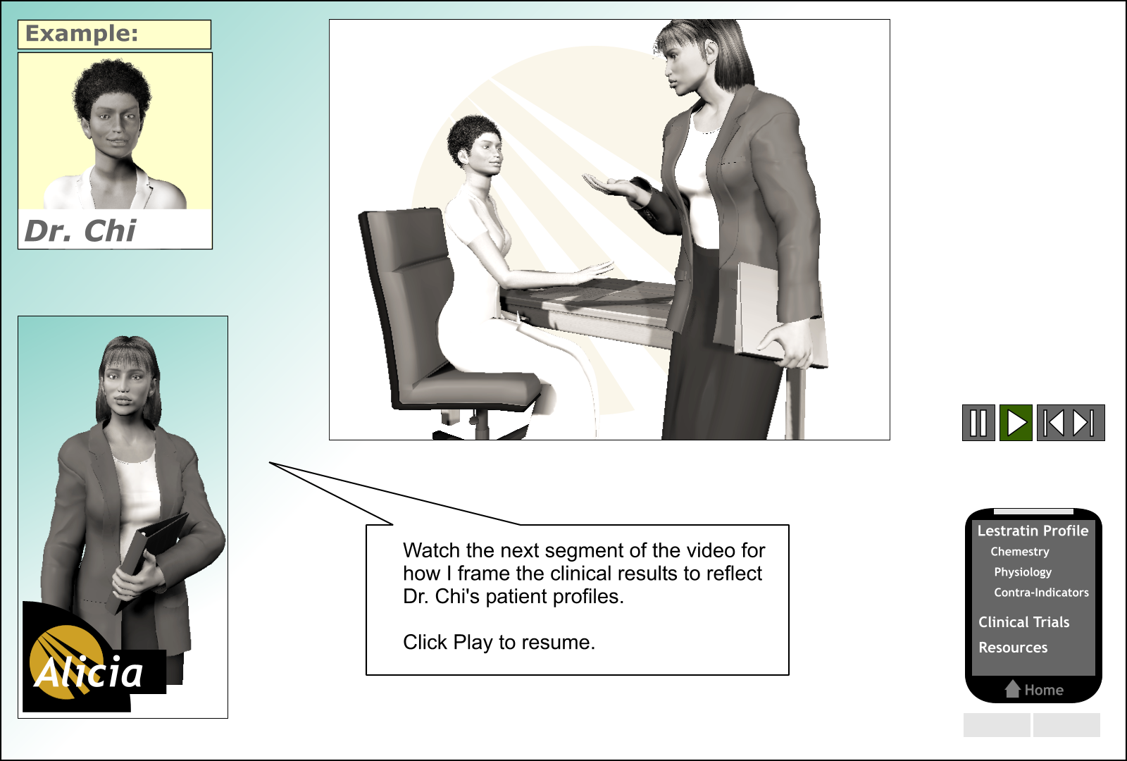
Focus attention to expert behaviors
Audio
Dr. Chi: I have been hearing from my colleagues that the results in field have been good.
Notes:
Research shows that interspersing expert commentary with ‘what to look for’ increased attention to important behaviors during the modeled example.

Slide 23
Issues in Transfer & Learning
Associated reference:
Singley, M. K. & Anderson, J. R. (1989). Transfer of Cognitive Skill. Cambridge, MA: Harvard University Press.

Slide 24
Read this story …
The General
A small country was ruled from a strong fortress by a dictator. The fortress was situated in the middle of the country, surrounded by farms and villages. Many roads led to the fortress through the countryside. A rebel general vowed to capture the fortress. The general knew that an attack by his entire army would capture the fortress. He gathered his army at the head of one of the roads, ready to launch a full-scale direct attack. However, the general then learned that the dictator had planted mines on each of the roads. The mines were set so that small bodies of men could pass over them safely, since the dictator needed to move his troops and workers to and from the fortress. However, any large force would detonate the mines. Not only would this blow up the road, but it would also destroy many neighboring villages. It therefore seemed impossible to capture the fortress.
However, the general devised a simple plan. He divided his army into small groups and dispatched each group to the head of a different road. When all was ready he gave the signal and each group marched down a different road. Each group continued down its road to the fortress so that the entire army arrived together at the fortress at the same time. In this way, the general captured the fortress and overthrew the dictator.

Slide 25
Can you paraphrase it (to yourself)?
Want to see it again?
How plausible is the story?
(Not at all) 1 2 3 4 5 (Very)
How comprehensible is it?
(Not at all) 1 2 3 4 5 (Very)

Slide 26
General vs. specific transfer
General: Doctrine of formal discipline
Mind is muscle you exercise with subjects like Latin and geometry
General faculties of mind: Observation, attention, discrimination, reasoning
=> Transfer is broad & general, across domains
Example: Training in chess transfers to computer programming b/c both involve reasoning faculty
Specific: Thorndike’s theory of identical elements
Mind is made up of stimulus-response elements
Transfer only occurs between tasks with elements in common
=> Transfer is narrow, within domains

Slide 27
Thorndike’s 1922 Experiment on Transfer
Slight changes in equations led to significantly worse performance
Familiar: Multiply xª & x^{b} -> 44% correct
Novel: Multiply 4ª & 4^{b} -> 30% correct
Thorndike’s point:
Slight changes in stimulus -> stimulus-response element does not apply -> no transfer
BUT!
Note, there is substantial transfer as performance on novel tasks is far above 0%

Slide 28
Meaningful vs. rote learning
Between the general-specific extremes:
Breadth of transfer dependent on type of instruction
Transfer depends on whether a common representation can be found & communicated

Slide 29
Judd’s refraction study
Aim at where target appears through water & dart misses!
Task: Throw darts at underwater target
Exper group instructed on refraction theory
Control group just practiced
Training task: Target was 12” under water
Transfer task: Target was 4” under water
What happened during training?
> No difference in performance
What happened during transfer task?
> Experimental group did much better. Why?
> Exper group had a better representation of the task & more flexibly adapted to new conditions

Slide 30
Katona’s Puzzle Experiments
Task: Move 3 sticks to make 4 squares
Contrasted instruction on:
Rote strategy that applied to a particular problem
General strategy based on structural relations of an entire set of problems
Here are five squares composed of sixteen equal lines. We want to change these five squares into four similar squares. Since we have sixteen lines and want four squares, each square must have four independent side lines, which should not be side lines of any other square at the same time. Therefore, all lines with a double function, that is, limiting two squares at the same time, must be changed into lines with a single function (limiting one square only)”
Rote Ss ~ better on trained problem, meaningful Ss much better on transfer

Slide 31
Lateral vs. vertical transfer
Lateral transfer: Spreads over sets of same level of complexity
E.g., between different programming languages
Vertical transfer: Spreads from lower-level to higher-level skills, from parts to whole
E.g., writing loops in isolation transfers to doing so in the context of a large problem
Vertical transfer is common, lateral is rare
Vertical transfer was applied in early instructional design theories
Gagne & programmed instruction (Behaviorist)
Identify hierarchy of parts that need to be learned
Sequence instruction so that smaller parts are mastered first before larger wholes

Slide 32
And now another task …

Slide 33
Try this problem
Suppose you are a doctor faced with a patient who has a malignant tumor in his stomach. It is impossible to operate on the patient, but unless the tumor is destroyed the patient will die. There is a kind of ray that can be used to destroy the tumor. If the rays reach the tumor all at once at a sufficiently high intensity, the tumor will be destroyed. Unfortunately, at this intensity the healthy tissue that the rays pass through on the way to the tumor will also be destroyed. At lower intensities the rays are harmless to healthy tissue, but they will not affect the tumor either. What type of procedure might be used to destroy the tumor with the rays, and at the same time avoid destroying the healthy tissue?

Slide 34
How many think they have the answer?
Here’s a hint:
Remember that story we started with …
How many think they have it now?
Here’s another hint …

Slide 35
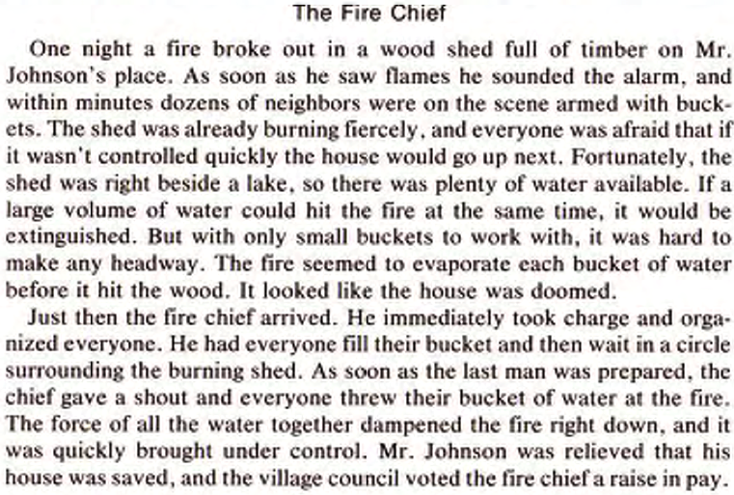

Slide 36
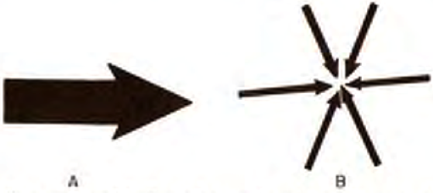
How many think they have it now?
Here’s another hint … Success in these stories can be attributed to this important principle: If you need a large force to accomplish some purpose, but are prevented from applying such a force directly, many smaller forces applied simultaneously from different directions may work just as well.
How many think they have it now?
Here’s another hint …

Slide 37
Analogical transfer
These were materials from
Gick, M. L., & Holyoak, K. J. (1983). Schema induction and analogical transfer. Cognitive Psychology, 15, 1-38.
Baseline results
Less than 10% solve Radiation problem at first exposure
After reading General story, only 29% without hint
After a hint of story relevance, 79% solve
G & H had six experiments addressing various instructional strategies & some of their combinations …

Slide 38
Instructional options explored by Gick & Holyoak
More help Basics
More challenge Understanding
What’s best?
Two Similar Examples
Two Dissimilar Examples
One Example
Abstract Solution Diagram
Verbal Principle
No Help
Abstract Solution Diagram
Verbal Principle
No Help
Abstract Solution Diagram
Verbal Principle
No Help
94%
79%
90% 82%
83%
81% 80% 79%

Slide 39
Simple 2-Stage Model of Analogical Transfer
1. Retrieve a similar prior problem
2. Map it on to your current situation
Many studies, like G & H, show difficulties with retrieval (#1)
But in more complex domains, mapping (#2) is also a challenge
Need deep, not surface feature encodings of problems to make a productive mapping

Slide 40
Deep vs. Shallow Features -- Chi, Feltovich, Glaser
Novice physics students categorize problems by surface features
pulley or inclined plane in diagram, similar words in problem text
Experts categorize based on abstract, solution-relevant features
Problems solved using the same principle, e.g., conservation of momentum

Slide 41
The Ghost of General Transfer
General transfer could “liberate students & teachers from the shackles of narrow, disciplinary education”
Is general transfer possible?

Slide 42
Evidence Against General Transfer
Thorndike’s original experiments disconfirming formal discipline
Latin & geometry courses don’t increase reasoning test scores any better than bookkeeping or shop courses
Problem solving study (Post & Brennan)
Heuristics: determine given, check result
Did not transfer to word problem solving

Slide 43
Evidence for General Transfer
No evidence for General transfer!
Some evidence for limited general transfer:
LOGO programming (Carver & Klahr)
LOGO programming & debugging instruction transfers to other debugging tasks
Math problem solving (Schoenfeld)
Heuristics with a specific “if-part” led to transfer, heuristics with a vague if-part did not transfer

Slide 44
Why is even limited general transfer hard to produce?
Knowledge is largely domain specific
Simon estimate from chess studies: Expert’s acquire > 10,000 chunks of knowledge
General methods are often either:
Too vague to effectively apply
Heuristics like “avoid detail” depend on substantial domain-specific knowledge (which novices lack!) to distinguish irrelevant detail from key features
“Search paths simultaneously, use signs of progress” again depends on dom spec k to detect signs of progress
Effective ones may already be known by novices
Working backwards, means-ends analysis

Slide 45
Fundamental Design Challenge
Specificity of transfer:
“The fundamental issue concerns the acquisition of a particular use of knowledge and the range of circumstances over which that use will extend.”
If-part of production rules model this range of knowledge applicability
Design challenge: How to identify this range in the domain we want to tutor?
Cognitive Task Analysis!

Slide 46
Knowledge component (KC) analysis to model transfer
Two key kinds of KCs: declarative chunks & production rules (e.g., ACT-R theory)
Transfer occurs to the extent components overlap between instructional tasks & target tasks
Productions & chunks can be acquired at varying levels of generality
Analogy process induces productions of limited generality
Depends on how person encodes or views the task, what features they notice

Slide 47
Transfer-Enabling Knowledge Components (the “germs”)
In the Card Selection task, what are the relevant KCs that explain partial transfer?
What are “transfer-enabling” KCs that apply in novel versions of concrete task?
If entering country, then cholera test
Why don’t these KCs apply in abstract task?
In other words, what KC is general, but not too general?

Slide 48
How is the Gick & Holyoak task like academic learning?
Is the following a good analogy?!
Convergence problems
Algebra story problems
Convergence solution
Algebraic equation solution
s
800 - 40x
d - 1/3d
(n - 20)/3 …

Slide 49
How is the Gick & Holyoak task like academic learning?
Is the following a good analogy?!
Improve transfer across convergence problems
Improve transfer across algebra problems
Optimal instruction for convergence
Optimal instruction for algebra

Slide 50
Instructional options explored by Gick & Holyoak
More help Basics
More challenge Understanding
What’s best?
Explicit “example”
More like school!
Incidental “analog”
…
Two Similar Examples
Two Dissimilar Examples
One Example
Abstract Solution Diagram
Verbal Principle
No Help
Abstract Solution Diagram
Verbal Principle
No Help
Abstract Solution Diagram
Verbal Principle
No Help
94%
79%
90% 82%
83%
81% 80% 79%

Slide 51
Summary
Enhancing performance does not necessarily enhance learning
Enhancing learning requires transfer
Transfer depends on how students encode instructional tasks & target tasks
General transfer occurs only in quite limited circumstances
People must learn “details” of a domain
If-part of production determines generality
KC analysis provides a way to:
think about learning & transfer issues
assess how much vertical/lateral transfer is likely from instructional tasks to real world tasks
For more information on this topic see:
Singley, M. K., & Anderson, J. R. (1989). Transfer of Cognitive Skill. Hillsdale, NJ: Erlbaum.

Slide 52
END

Slide 53
Promote learner reflection
.
With permission from Raytheon Professional Services.
Notes:
What questions could be added to ensure that learners reflect on their processes? What other techniques could be used to prompt reflection in this example?

Slide 54
Cognitive task analysis
NOVICE
EXPERT
Read
Read
Analyze
Analyze
Explore
Explore
Plan
Plan
Implement
Implement
Verify
Verify
Time
Time
Notes:
Discuss techniques to define the thinking skills of experts. When might these techniques be justified? .

