Slide 1
Using Think-Aloud Protocols to Understand Student Thinking
Related readings:
Lovett, M. C. (1998). Cognitive task analysis in service of intelligent tutoring system design: a case study in statistics. In Goettl, B. P., Halff, H. M., Redfield, C. L., & Shute, V. J. (Eds.) Intelligent Tutoring Systems, Proceedings of the Fourth International Conference. (pp. 234-243). Lecture Notes in Computer Science, 1452. Berlin: Springer-Verlag.
Gomoll, K. (1990). Some Techniques for Observing Users. In B. Laurel (Ed.), The Art of Human-Computer Interface Design (pp. 85-90). Reading, MA: Addison-Wesley.
Principles of E-Learning 2014
Ken Koedinger
Makes use of improvements from Vincent Aleven

Slide 2
Instructional Design Process: The BIG PICTURE
Goal
Setting
Assessment Task Design
Data
Model
Instructional Design
Data
Theory
Intuition & experience
Goals guide assessment tasks guide instruction
Theory, data, & model building support decisions
Intuition & experience still relevant (but are nearly imperceptible)

Slide 3
What is Cognitive Task Analysis?
Notes:
Clark & Estes reference Cooke (1992a) for the first bullet and (Redding, 1989) for the third.
Cooke, N.J. (1992). The implications of cognitive task analyses for the revision of the Dictionary of Occupational Titles. In W. J. Camara (Ed.), Implications of Cognitive Psychology and Cognitive Task Analysis for the Revision of the Dictionary of Occupational Titles, Washington D.C.: American Psychological Association.
Clark and Estes (1996) define Cognitive Task Analysis (CTA) as "the general term used to describe a set of methods and techniques that specify the cognitive structures and processes associated with task performance. The focal point is the underlying cognitive processes, rather than observable behaviors. Another defining characteristic of CTA is an attempt to describe the differences between novices and experts in the development of knowledge about tasks (Redding, 1989)."
The definition of CTA suggested by this quote from Feldon (2007) "the use of structured knowledge elicitation techniques (e.g., cognitive task analysis)" emphasizes the approach of eliciting knowledge from experts, presumably through more direct approaches of interviews or think alouds. Whether the more indirect approach of using extensive student performance data to do knowledge component analysis via educational data mining would be a version of CTA is thus perhaps open.
Clark and Estes (1996) highlight the general value of task analysis: "Prior to task analysis, job training was accomplished almost exclusively by observational learning on-the-job ("sit by Nelly") and formal apprenticeships. Both these methods required a great deal of time and produced variable results for a couple of reasons. First, the role model did not always know what behaviors to highlight for the learner, for reasons discussed later. Second, some very critical steps or decisions occur very rarely and so are inefficient to observe in real-time."
Redding, R.E. (1989). Perspectives on cognitive task analysis: The state of the state of the art. Proceedings of the Human Factors Society 33rd Annual Meeting. Clark and Estes (1996) define Cognitive Task Analysis (CTA) as "the general term used to describe a set of methods and techniques that specify the cognitive structures and processes associated with task performance. The focal point is the underlying cognitive processes, rather than observable behaviors. Another defining characteristic of CTA is an attempt to describe the differences between novices and experts in the development of knowledge about tasks (Redding, 1989)."
The definition of CTA suggested by this quote from Feldon (2007) "the use of structured knowledge elicitation techniques (e.g., cognitive task analysis)" emphasizes the approach of eliciting knowledge from experts, presumably through more direct approaches of interviews or think alouds. Whether the more indirect approach of using extensive student performance data to do knowledge component analysis via educational data mining would be a version of CTA is thus perhaps open.
Clark and Estes (1996) highlight the general value of task analysis: "Prior to task analysis, job training was accomplished almost exclusively by observational learning on-the-job ("sit by Nelly") and formal apprenticeships. Both these methods required a great deal of time and produced variable results for a couple of reasons. First, the role model did not always know what behaviors to highlight for the learner, for reasons discussed later. Second, some very critical steps or decisions occur very rarely and so are inefficient to observe in real-time."

Slide 4
What is Cognitive Task Analysis (CTA)?
Some definitions:
The general term used to describe a set of methods and techniques that specify the cognitive structures and processes associated with task performance
The focal point is the underlying cognitive processes, rather than observable behaviors.
Another defining characteristic of CTA is an attempt to describe the differences between novices and experts in the development of knowledge about tasks
From: Clark, R. E., & Estes, F. (1996). Cognitive task analysis. International Journal of Educational Research, 25(5), 403–417.
Notes:
Clark & Estes reference Cooke (1992a) for the first bullet and (Redding, 1989) for the third.
Cooke, N.J. (1992). The implications of cognitive task analyses for the revision of the Dictionary of Occupational Titles. In W. J. Camara (Ed.), Implications of Cognitive Psychology and Cognitive Task Analysis for the Revision of the Dictionary of Occupational Titles, Washington D.C.: American Psychological Association.
Clark and Estes (1996) define Cognitive Task Analysis (CTA) as "the general term used to describe a set of methods and techniques that specify the cognitive structures and processes associated with task performance. The focal point is the underlying cognitive processes, rather than observable behaviors. Another defining characteristic of CTA is an attempt to describe the differences between novices and experts in the development of knowledge about tasks (Redding, 1989)."
The definition of CTA suggested by this quote from Feldon (2007) "the use of structured knowledge elicitation techniques (e.g., cognitive task analysis)" emphasizes the approach of eliciting knowledge from experts, presumably through more direct approaches of interviews or think alouds. Whether the more indirect approach of using extensive student performance data to do knowledge component analysis via educational data mining would be a version of CTA is thus perhaps open.
Clark and Estes (1996) highlight the general value of task analysis: "Prior to task analysis, job training was accomplished almost exclusively by observational learning on-the-job ("sit by Nelly") and formal apprenticeships. Both these methods required a great deal of time and produced variable results for a couple of reasons. First, the role model did not always know what behaviors to highlight for the learner, for reasons discussed later. Second, some very critical steps or decisions occur very rarely and so are inefficient to observe in real-time."
Redding, R.E. (1989). Perspectives on cognitive task analysis: The state of the state of the art. Proceedings of the Human Factors Society 33rd Annual Meeting. Clark and Estes (1996) define Cognitive Task Analysis (CTA) as "the general term used to describe a set of methods and techniques that specify the cognitive structures and processes associated with task performance. The focal point is the underlying cognitive processes, rather than observable behaviors. Another defining characteristic of CTA is an attempt to describe the differences between novices and experts in the development of knowledge about tasks (Redding, 1989)."
The definition of CTA suggested by this quote from Feldon (2007) "the use of structured knowledge elicitation techniques (e.g., cognitive task analysis)" emphasizes the approach of eliciting knowledge from experts, presumably through more direct approaches of interviews or think alouds. Whether the more indirect approach of using extensive student performance data to do knowledge component analysis via educational data mining would be a version of CTA is thus perhaps open.
Clark and Estes (1996) highlight the general value of task analysis: "Prior to task analysis, job training was accomplished almost exclusively by observational learning on-the-job ("sit by Nelly") and formal apprenticeships. Both these methods required a great deal of time and produced variable results for a couple of reasons. First, the role model did not always know what behaviors to highlight for the learner, for reasons discussed later. Second, some very critical steps or decisions occur very rarely and so are inefficient to observe in real-time."

Slide 5
How to Collect Data in a Think-Aloud Study (Gomoll, 1990, is a good guide)
1. Set up observation
write tasks
recruit students
Describe general purpose of observation
3. Tell student that it’s OK to quit at any time
4. Explain how to “think aloud”
give a demonstration
give an unrelated practice task, e.g., add digits
5. Explain that you will not provide help
6. Describe tasks
7. Ask for questions before you start; then begin observation
say “please keep talking” if the participant falls silent for 5 seconds or more
be sensitive to a severe desire to quit
8. Conclude the observation
Reduced from: Gomoll, K. (1990). Some Techniques for Observing Users. In B. Laurel (Ed.), The Art of Human-Computer Interface Design (pp. 85-90). Reading, MA: Addison-Wesley.

Slide 6
Where does Gomoll’s Think Aloud Study steps fit with Clark’s CTA steps?
Clark’s steps for CTA:
Collect preliminary knowledge
Identify major subtasks & types of knowledge necessary to perform them
Apply focused knowledge elicitation methods
Analyze and verify data acquired
Format results for intended application

Slide 7
Clark’s steps 1 & 2
Collect preliminary knowledge
Identify major subtasks & types of knowledge necessary to perform them
Goal: CTA to aid designing instruction for factoring quadratic equations.
Step 1 includes reviewing domain:
(x + 6)(x + 4) = ??
Factoring is reversing this process

Slide 8
Clark Step 2: Tasks, subtasks & types of knowledge
What are some tasks?
Subtasks?
Types of knowledge necessary to perform?

Slide 9
Comparisons with Gomoll steps?
1. Set up observation
write tasks
recruit students
Describe general purpose of observation
3. Tell student that it’s OK to quit at any time
4. Explain how to “think aloud”
give a demonstration
give an unrelated practice task, e.g., add digits
5. Explain that you will not provide help
6. Describe tasks
7. Ask for questions before you start; then begin observation
say “please keep talking” if the participant falls silent for 5 seconds or more
be sensitive to a severe desire to quit
8. Conclude the observation
Reduced from: Gomoll, K. (1990). Some Techniques for Observing Users. In B. Laurel (Ed.), The Art of Human-Computer Interface Design (pp. 85-90). Reading, MA: Addison-Wesley.

Slide 10
Kinds of Cognitive Task Analysis
2 Kinds of Approaches
Empirical: Based on observation, data, exp.
Rational: Based on theory, modeling.
2 Kinds of Goals
Descriptive: How students actually solve (or fail to solve) problems. What Ss need to learn.
Prescriptive: How students should solve problems. What Ss need to know.
4 Combinations ...

Slide 11
Kinds of Cognitive Task Analysis
= Rational

Slide 12
Cognitive Analysis & HCI Methods
Theory (for rational CTA)
Goal trees, ACT-R, production rules in English, etc.
Quantitative Experimental data
Difficulty Factors Assessments
Parametric experiments with system alternatives
Quantitative analysis of log data
Qualitative data
Think alouds, tutor-student log files
Structure interviews, classroom observations
Contextual inquiry
Participatory Design
Practitioners (teachers) are paid team members, 50% teaching + 50% on design team

Slide 13
What is a Think-Aloud Study?
Basically, ask users to “think aloud” as they work...
... on a task you believe is interesting or important
... while you observe (& audio or videotape)
... either in context (school) or in a “usability lab” equipped for this purpose
... possibly using paper/storyboard/interface you are interested in improving

Slide 14
The Roots of Think-Aloud Usability Studies
“Think-aloud protocols”
Allen Newell and Herb Simon created the technique in 1970s
Applied in ‘72 book: “Human Problem Solving”
Anders Ericsson & Herb Simon wrote a book explaining and validating the technique, “Protocol Analysis: Verbal Reports as Data” 1984, 1993

Slide 15
The Cognitive Psychology Theory behind Think-Aloud Protocols
People can easily verbalize the linguistic contents of Working Memory (WM)
People cannot directly verbalize:
The processes performed on the contents of WM
Procedural knowledge, which drives what we do, is outside our conscious awareness, it is “tacit”, “implicit” knowledge.
People articulate better external states & some internal goals, not good at articulating operations & reasons for choice
Non-linguistic contents of WM, like visual images
People can attempt to verbalize procedural or non-linguistic knowledge, however, doing so:
May alter the thinking process (for better or worse)
May interfere with the task at hand, slowing performance

Slide 16
“Interview methods are quite different from those covered in this paper; they primarily rely on people’s introspections about the knowledge required for good performance in a domain.”
Lovett, 1998, p. 242

Slide 17
Expert protocol excerpt From Lovett (1998)
So it looks like what the problem is asking for is a comparison between Breeder A and Breeder B puppies and specifically it says that Breeder A wants to compare the heights of the Great Dane puppies.
So actually the information on weight and litter is not necessarily going to be useful …
So, we’ve got 2 variable heights, well actually 1 var which is height.
And that would be the response variable and he explanatory variable is breeder.
So one of the first things to do is do a boxplot to compare the heights for Breeder A vs. Breeder B.
Note: no reasons for actions
(“if-part” not articulated)

Slide 18
“try to find people who have the same experience level as the typical user for your product” (p. 87)
alternatively, find people of varying levels of experience

Slide 19
The Value of Think-Aloud Studies in HCI Practice
“...may be the single most valuable usability engineering method” (Nielsen, 1993, Usability Engineering: p. 195)

Slide 20
Ethics of Empirical Studies with Human Participants
Informed consent
Testing the task/interface, NOT the participant
Maintain anonymity
Store the data under a code number
Store participant’s name separately from their data
Voluntary
always make it OK for people to quit
be sensitive to the many ways people express a desire to quit

Slide 21
Think Alouds in Statistics Tutor Development
Task: Exploratory Data Analysis
Given problem description and data set
Inspect data to generate summaries & conclusions
Evaluate the level of support for conclusions
Example Problem
In men’s golf, professional players compete in either the regular tour (if they’re under 51 years old) or in the senior tour (if they are 51 or older). Your friend wants to know if there is a difference in the amount of prize money won by the players in the 2 tours. This friend has recorded the prize money of the top 30 players in each tour. The variable money contains the money won by each of the players last year. The variable tour indicates which tour the player competed in, 1=regular, 2=senior. The variable rank indicates player rank, 1=top in the tour.

Slide 22
Task Analysis of Major Goals in Statistical Analysis
This is an “analytic prescriptive” form of CTA
ACT-R emphasizes “goal-factored” knowledge elements
Break down task:
7 major goals
Each goal has multiple steps or subgoals to perform
Key productions react to major goals & set subgoals

Slide 23
Sample Transcript: How would you analyze?

Slide 24
Observations about this verbal report
No evidence for goal 3, characterize the problem
Line 10: student simply jumps to selecting a data representation (goal 4) without thinking about why.
No evidence for goal 7, evaluate evidence
Minor interpretation error
Line 13: student mentions the “average” when in fact boxplots display the median not the mean
Note: These observations should be indicated in the annotation column of the transcript (I left them off given limited space).

Slide 25
Comparing Think Aloud Results with Task Analysis
20%
Percentages to the right of each step represent the percentage of students in the think-aloud study who showed explicit evidence of engaging in that step.
Step 3 is totally absent!
A tutor can help students to do & remember to do step 3

Slide 26
Inspiration for Production Rules
Missing production (to set goal 3): Characterize problem If goal is to do an exploratory data analysis & relevant variables have been identified then set a subgoal to identify variable types
Buggy production (skipping from goal 2 to 4): Select any data representation If goal is to do an exploratory data analysis & relevant variables have been identified then set a subgoal to conduct an analysis by picking any data representation

Slide 27
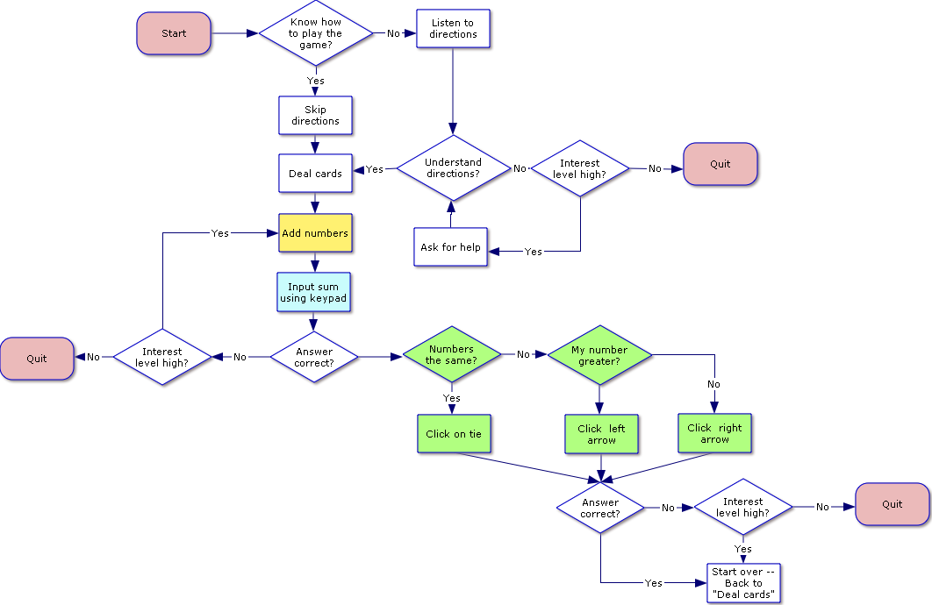
Alternative way of describing a model: Flow charts
Legend
Diamonds= junctures in thought process
Rectangles = actions
Rounded Rectangles = start or termination of cognitive process or procedure
Yellow = simple addition
Light blue = numerical notation
Light green = numerical magnitude comparison

Slide 28
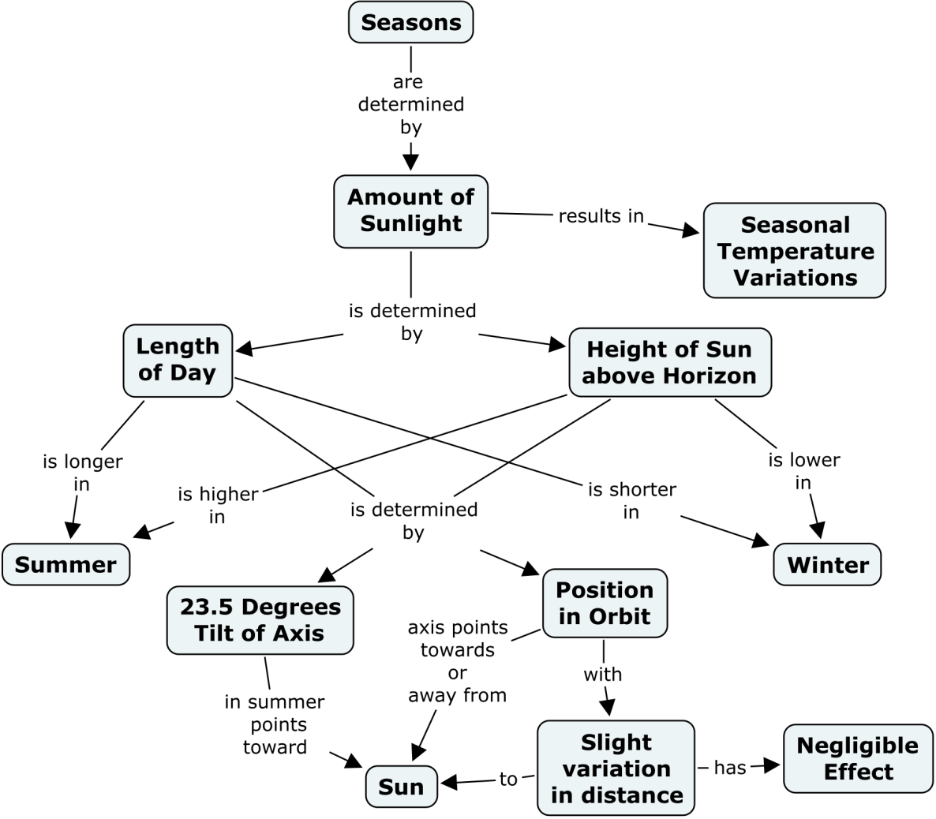
Alternative way of describing a model: Concept map
Source: http://cmap.ihmc.us/publications/researchpapers/theorycmaps/theoryunderlyingconceptmaps.htm

Slide 29
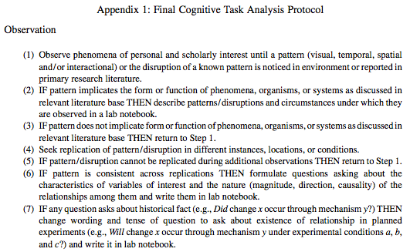
Feldon’s CTA Output: IF-THEN rules

Slide 30
Using think aloud results for instructional design
Example from Lovett

Slide 31
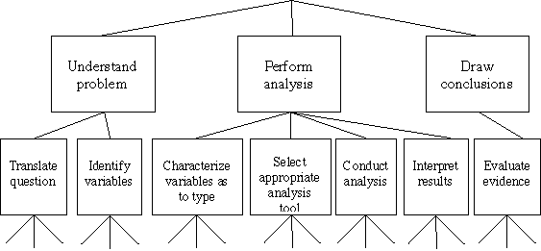
Statistics Tutor: Original Goal Scaffolding Plan

Slide 32
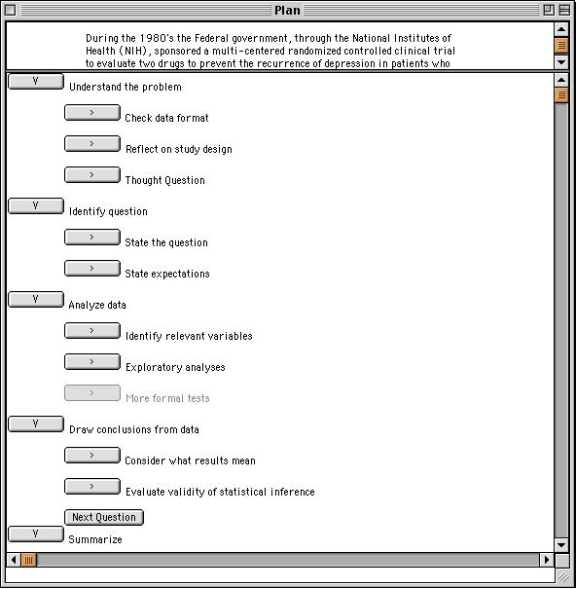
Statistics Tutor: “Transfer Appropriate” Goal Scaffolding

Slide 33
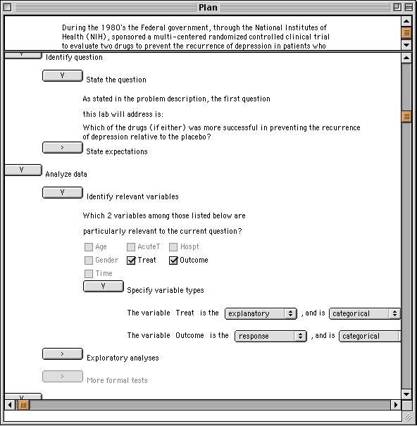

Slide 34
Summary
4 Kinds of Cognitive Task Analysis
Descrip vs. Prescrip; Empirical vs. Analytic
Empirical CTA Methods
Think aloud & difficulty factors assessment
Think aloud
Get subjects to talk while solving, do not have them explaining
Prescrip: What do experts know -- identify hidden thinking skills
Descrip: What is difficult for novices

