Slide 1
Selecting Instructional Principles
Ken Koedinger
Reading: KLI paper sections 6-7

Slide 2
Key points
Learning is mostly subconscious/tacit/implicit
Be skeptical of your own intuitions & conscious reflections/beliefs about learning & instruction
Human learning is substantially influenced by existing knowledge
What you already know changes how & how well you learn => subject-matter/domain analysis is crucial
Optimal instruction is knowledge-dependent, not domain-general
Need cognitive models of domains (from CTA) to guide selection & application of instructional principles

Slide 3
Cognitive Psychology: Implicit knowledge examples
What you know
Declarative
Procedural
Working memory
Visual contents of WM
Conditions & logic behind decisions, planning
Structure of perceived world/objects
Linguistic memories: Words, definitions, verbal rules
Physical actions, verbal expressions
Linguistic contents of WM
L1 grammar, face recognition, chess board, deep features
Perceptual chunks: expand experts’ memory, organize “intuitive” reasoning & evaluation,

Slide 4
Cognitive Psychology: Implicit knowledge examples
What you know
Declarative
Procedural
Working memory
Visual contents of WM
Conditions & logic behind decisions, planning
Structure of perceived world/objects
Linguistic memories: Words, definitions, verbal rules
Physical actions, verbal expressions
Linguistic contents of WM
Choices in surgery, planning a proof, social/design decisions
Amnesic “HM” learns tower of Hanoi but no declarative k.

Slide 5
How much of each?
What you know
Declarative
Procedural
Working memory
Visual contents of WM
Conditions & logic behind decisions, planning
Structure of perceived world/objects
Linguistic memories: Words, definitions, verbal rules
Physical actions, verbal expressions
Linguistic contents of WM
What you don’t know you know ~ 70%
What you know you know ~ 30%

Slide 6
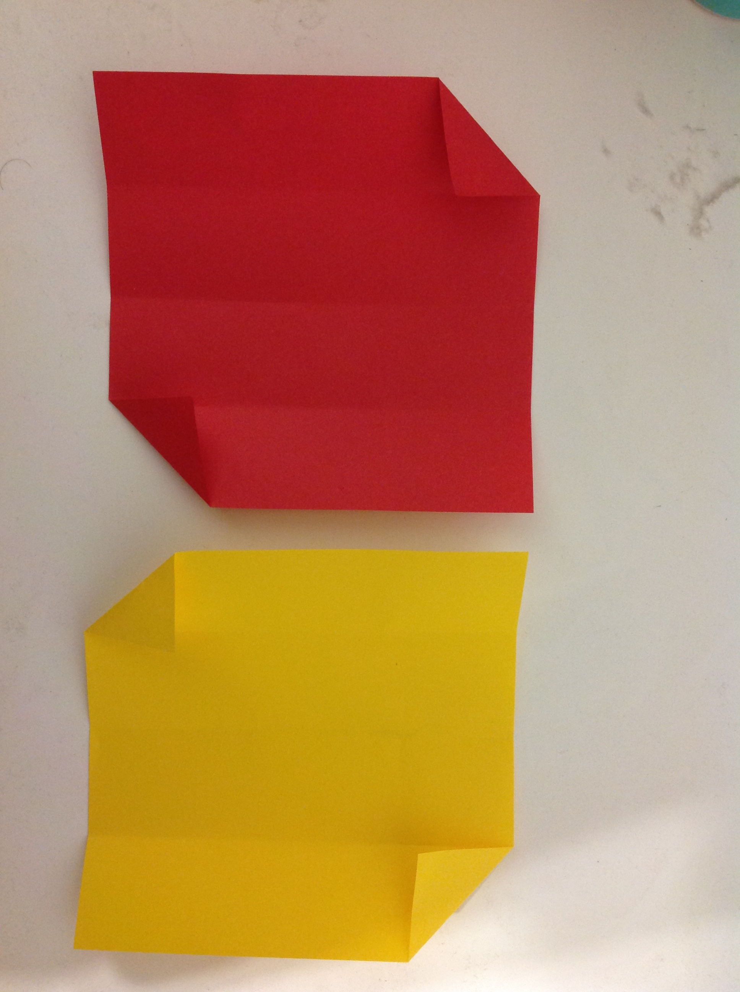
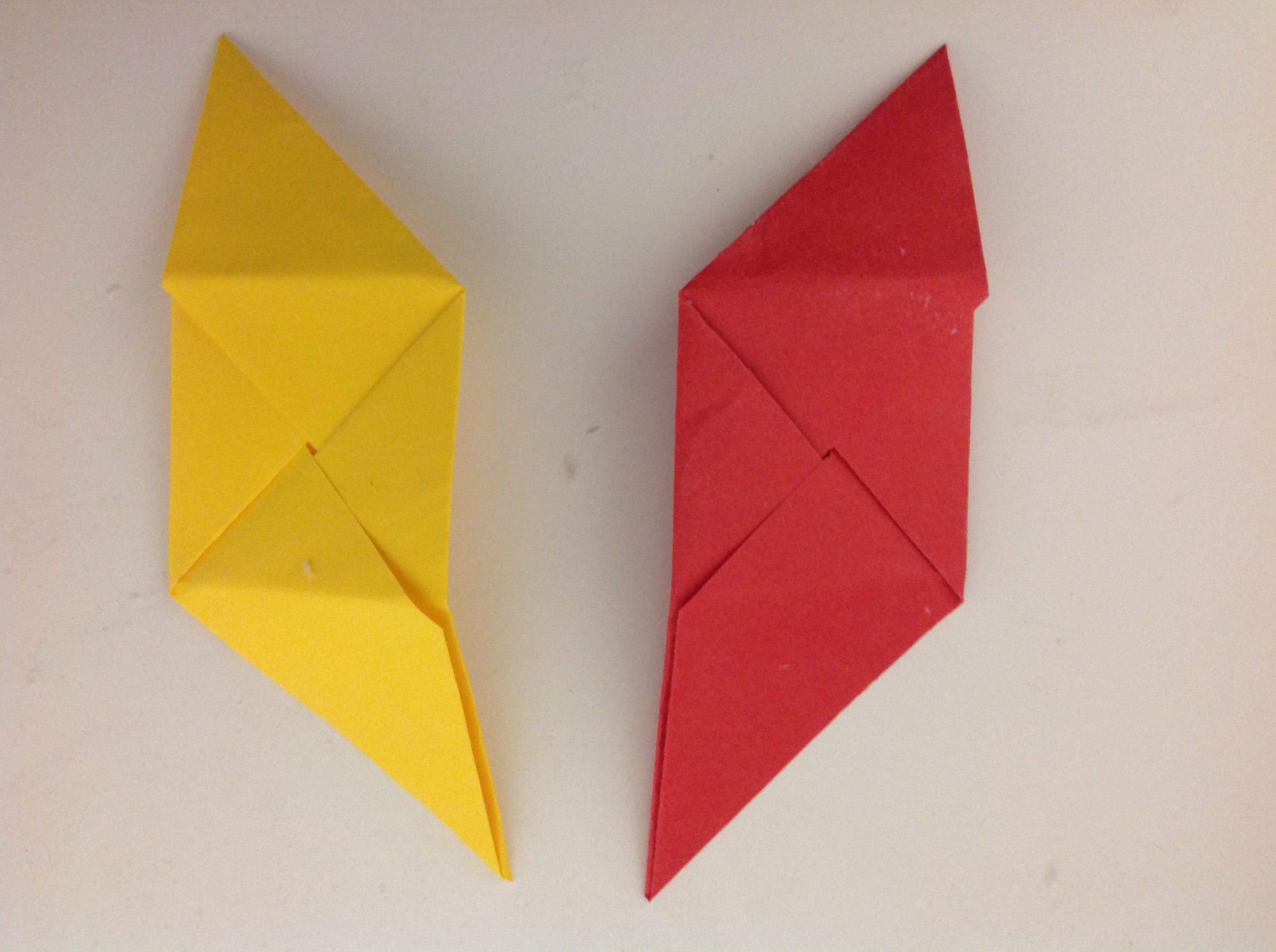
Experts don’t know what they know
Example think aloud from Arka’s project:
“ok I am recalling[1]…um ok first fold it in half first[2]….umm[3]…ok I got it, I think I got it[4]….so at this point it’s kind of routine but the real point where I start to think …ok I have to remember this is at this point…ok so the top left side is going down[5]…so the rest of my models have to be this way…..so I believe you tuck this in….and then just…and then at this part just…..folding it in…oh gosh![6]...am I right ?...folding it in..this part is just kinda[7]…tucking it in..there you go…and..we are done

Slide 7
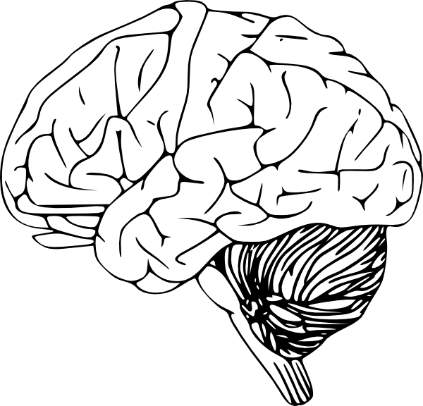
KLI Blank slate learning and
KLI: Blank slate learning + knowledge-based learning
KLI: Blank slate learning + knowledge-based learning
Instructional events
Explanation, practice, text, rule, example, teacher-student discussion
Assessment events
Question, feedback, step in ITS
Exam, belief survey
KEY
Ovals – observable
Rectangles - inferred
Arrows – causal links
Learning events
Knowledge Components
Koedinger et al. (2012). The Knowledge-Learning-Instruction (KLI) framework: Bridging the science-practice chasm to enhance robust student learning. Cognitive Science.

Slide 8
Cognitive Tutor Principles
Problem solving context (testing)
Minimize working memory
Base instruction on a model of student skills & concepts
Domain-general
Domain-specific

Slide 9
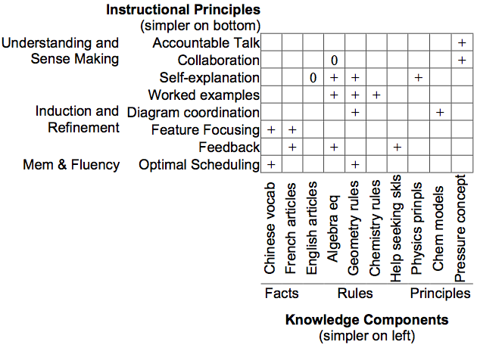
>300 LearnLab in vivo experiments: Correlation between complexity of knowledge & complexity of instruction that best produces it
Koedinger et al. (2012). The Knowledge-Learning-Instruction (KLI) framework: Bridging the science-practice chasm to enhance robust student learning. Cognitive Science.
Notes:
A key goal of the KLI framework is as tool to generate novel hypotheses … The “knowledge-dependency” hypothesis: Effectiveness of instructional methods depends on kinds of KC. This hypothesis is in contrast to plausible competing hypotheses like 1) instructional principles are domain general, 2) instructional principles are dependent on domain characteristics.
Defining KC complexity: See slide further below for theory and slide above for empirical grounding (time course of execution).
Instructional complexity: Also, defined in terms of description length and time course of execution (step time in DataShop).

Slide 10
KLI Dependency
Optimal Instructional choices depend on which of many possible Learning processes are needed to achieve which of many possible Knowledge acquisition goals
“the size of the spacing effect declined sharply as conceptual difficulty of the task increased” (Donovan & Radosevich, 1999)
“situations with low processing demands benefit from practice conditions that increase the load … whereas practice conditions that result in extremely high load should benefit from conditions that reduce the load” (Wulf & Shea, 2002)
Koedinger et al. (2012). The Knowledge-Learning-Instruction (KLI) framework: Bridging the science-practice chasm to enhance robust student learning. Cognitive Science.

Slide 11
KLI: More complex learning processes are effective for more complex knowledge
Notes:
More complex knowledge requires more complex learning processes
Constant vs. variable condition & response
Facts (constant condition KCs) require memory
Rules (variable condition KCs) require induction
Non-verbal vs. verbal knowledge
KCs can be in non-verbal or verbal form or both
Require different learning processes
KCs with rationales can be (re)discovered in addition to be instructed
Principles (verbal, variable, with rationale) require sense making

Slide 12
Desirable difficulties vs. cognitive load theory/direct instruction
Desirable difficulties (Bjork et al)
Spacing, delayed feedback, testing effect
“Tests enhance later retention more than additional study of the material”(Roediger & Karpicke)
Cognitive load theory & direct instruction (Sweller, Mayer, Klahr)
Multimedia principles, worked examples
“a worked example constitutes the epitome of strongly guided instruction” (Kirschner, Sweller, Clark)

Slide 14
How are testing effect & worked examples paradigms similar?
High
Assistance
Low
Instructors
 | Give |  | Elicit
Low
Difficulty/Load
High
Students
 | Study |  | Do
Testing Effect | Study lao3shi1 -> teacher |  | Test lao3shi1 -> ?
Worked Examples | Example Solve (a+b)/c = d -> (a+b)/c = d a+b = dc a = dc - b |  | Problem Solve (a+b)/c = d -> ?
Notes:
Educational science is fundamentally an “interaction science”

Slide 15
Study & example give, test & problem elicit
High
Assistance
Low
Instructors
 | Give |  | Elicit
Low
Difficulty/Load
High
Students
 | Study |  | Do
Testing Effect | Study A -> B |  | Test A -> ?
Worked Examples | Example A -> B |  | Problem A -> ?
Notes:
Educational science is fundamentally an “interaction science”

Slide 16
Results are contradictory!
High
Assistance
Low
Instructors
 | Give |  | Elicit
Low
Difficulty/Load
High
Students
 | Study |  | Do
Testing Effect | Study (SSST) 57% |  | Test (STTT) 64%
Worked Examples | Examples (EP EP EP EP) 88% |  | Problems (PP PP PP PP) 42%
Roediger & Karpick, 06
Sweller & Cooper, 85

Slide 17
KLI helps explain discrepancy
 | Knowledge | Learning | Instruction
Testing effect | Constant-constant facts | Memory | Eliciting is better
Worked examples | Variable-variable rules | Induction | More giving is better
Different knowledge goals => different learning processes => different instruction is optimal

Slide 18
Target Knowledge => Learning processes => Instruction
Many examples support
Worked examples
Worked examples
Eliciting recall supports
Testing effect
Testing effect
Aids fact learning, but suboptimal for rules
Aid rule learning, but suboptimal for facts

Slide 19
Worked Examples Specific to KCs
See example from Fraction Numberline game

Slide 20
END

Slide 21
Can interactive tutoring of rule KCs be improved by adding examples?
No by desirable difficulties/testing effect
Eliciting is better when it works
Feedback provides examples when it doesn’t
Yes by cognitive load theory/worked examples
Examples support induction & deeper feature search
Early problems introduce load => shallow processing & less attention to example-based feedback
Test with lab & in vivo experiments …

Slide 22
Ecological Control = Standard Cognitive Tutor Students solve problems step-by-step & explain

Slide 23
Treatments: 1) Half of steps are given as examples
2) Adaptive fading of examples into problems
Worked out steps with calculation shown by Tutor
Student still has to self explain worked out step
Notes:
23

Slide 24
Lab results: Adding examples yields better conceptual transfer & 20% less instructional time
d = .73 *

Slide 25
Results: In Vivo study
Result is robust in classroom environment:
adaptive fading examples > problem solving

Slide 26
Comments on discussion board posts from 2013
Worked examples should be focused on solving real-world-like tasks that promote learning transfer.
Interesting claim, which has merit, but for which the empirical evidence is mixed, with a number of results that better transfer is achieved with more abstract, less real-world examples (and tasks)
We should avoid creating "regurgitated" work examples that are just repetitions of the instructional or practice tasks presented in the manner of a worked example. Fading worked examples into exercises is generally good practice. For example, instead of having the worked example for an Excel lesson be gradually filling out sentences like: "Cells are spaces where ______, formulas are ________", a real-world calculation scenario should be presented: ”
Are we clear on what a worked example is and how it is different from a problem?
Mary needs to find out how much she has earned from the book she has sold using Excel. We first fill out the names of the books and the initial inventory...".
Worked examples should never exceed practice exercises. Usually, two worked examples per type of problems suffice in subjects like mathematics. After this, they can be made to gradually fade out to practice exercises.
Not “per type of problem” but “per knowledge component”

