Slide 1
Applying the Redundancy Principle (Chapter 7) And using e-learning data for CTA
Ken Koedinger

Slide 2
Redundancy Principle
Which is better for student learning?
A. When words as narration & identical text are presented in the presence of corresponding graphics
B. When words as narration (without identical text) is presented in the presence of corresponding graphics
Example: Lightning process is illustrated along with a narration and the identical text is or is not also on the screen

Slide 3
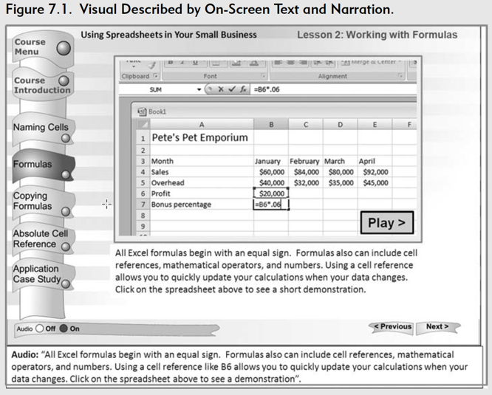
Redundancy Principle
Which is better for student learning?
A. When words as narration & identical text are presented in the presence of corresponding graphics
B. When words as narration (without identical text) is presented in the presence of corresponding graphics
Graphics, narration, & text
Graphics & narration

Slide 4
Redundancy Principle
Which is better for student learning?
A. When words as narration & identical text are presented in the presence of corresponding graphics
B. When words as narration (without identical text) is presented in the presence of corresponding graphics
Example: Lightning process is illustrated along with a narration and the identical text is or is not also on the screen
B. Spoken narration (without identical text) & graphics
Why?
We use separate channels for processing verbal and pictorial materials, but each channel is limited. Thus, adding text overloads the visual channel.

Slide 5
Redundancy Principle: Theory & Evidence
Contrasting theoretical predictions
Information delivery theory: 3 delivery routes are better than 2
Assumes that people learn by adding information to memory
Multimedia learning theory
Separate channels for processing verbal and pictorial materials
Each channel is limited – adding text overloads visual channel
Experimental evidence => Redundant text produces overload & hurts learning
Notes:
Cognitive Constraints on Multimedia Learning:
When Presenting More Material Results in Less Understanding - Mayer, Heiser, Lonn 2001 –
How should a theory of learning and cognition inform instruction? - Anderson, Douglass, Qin 2003 –

Slide 6
Overloading of Visual Channels With Two Visual Media Elements
MULTIMEDIA PRESENTATION
SENSORY MEMORY
WORKINGMEMORY
ANIMATION
EYES
VISUAL
COMPONENT
PRINTED WORDS
EARS
AUDITORY
COMPONENT
NARRATION

Slide 7
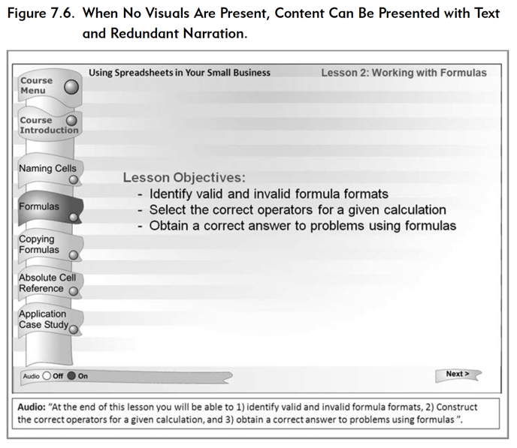
Exceptions to Redundancy Principle
Consider using both narration & onscreen text when:
There is no pictorial presentation
The learner has ample time to process the pictures and words
Presented sequentially
Presentation pace is sufficiently slow
The learner is likely to have difficulty processing spoken words
Highlighting a few key words next to corresponding parts of the graphic
Psychological Reasons for Exceptions
When onscreen text does not add to learner’s processing demands (does not overload)
When spoken material may be hard to process
Seeing & hearing the words provides a benefit
Technical subjects with jargon, Foreign language learning

Slide 8
Might CTA results change how you apply the Redundancy Principle?

Slide 9
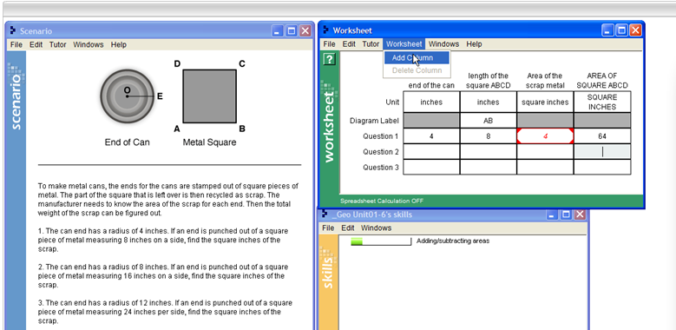
Geometry Tutor Scaffolding problem decomposition
Problem decomposition support
Performance on many steps in many problems produce learning curves …

Slide 10
Sample of log data used to generate learning curves
Steps within problems that are assessed
Map of steps to knowledge comp’s (Q-matrix)
Opportunities student has had to learn KC
Was student’s first attempt on this step a correct one?
Student | Step (Item) | Textbook KCs | Opportunity | Success
A | prob1step1 | Circle-area | 1 | 0
A | prob2step1 | Circle-area | 2 | 1
A | prob2step2 | Rectangle-area | 1 | 1
A | prob2step3 | Compose-by-addition | 1 | 0
A | prob3step1 | Circle-area | 3 | 0
Single skill | Opportunity
Geometry | 1
Geometry | 2
Geometry | 3
Geometry | 4
Geometry | 5
Different KC hypotheses change learning curve

Slide 11
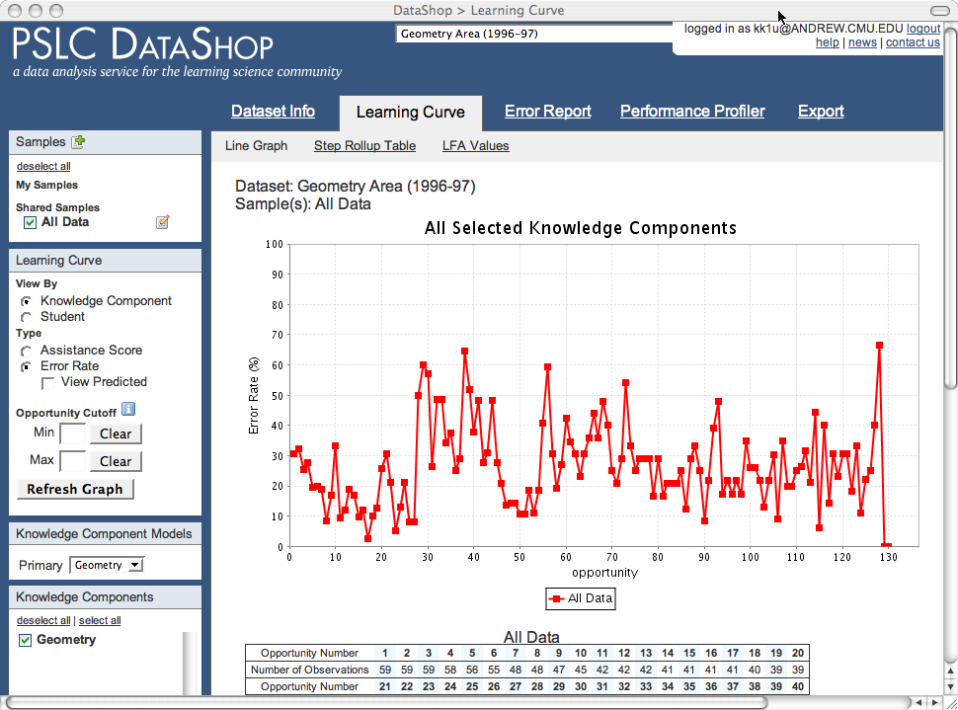
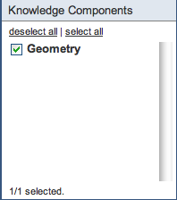
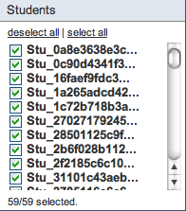
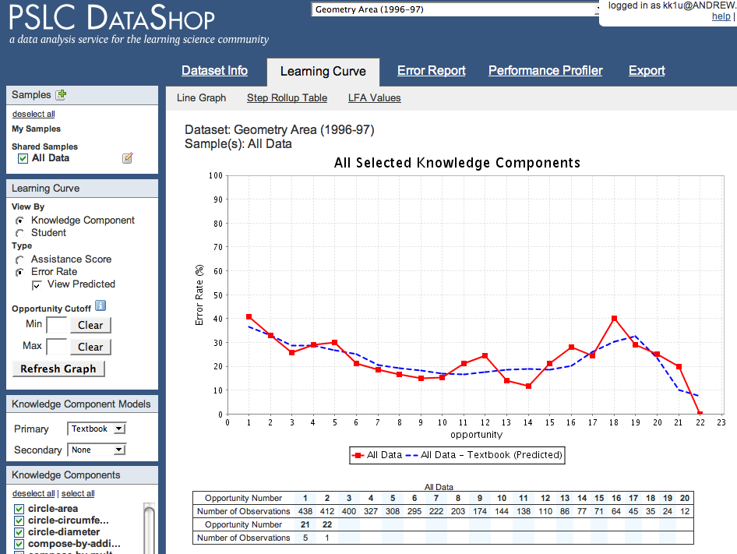
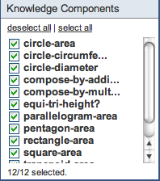
Cognitive Task Analysis using DataShop’s learning curve tools
Without decomposition, using just a single “Geometry” KC,
no smooth learning curve.
But with decomposition, 12 KCs for area concepts,
a smoother learning curve.

Slide 12
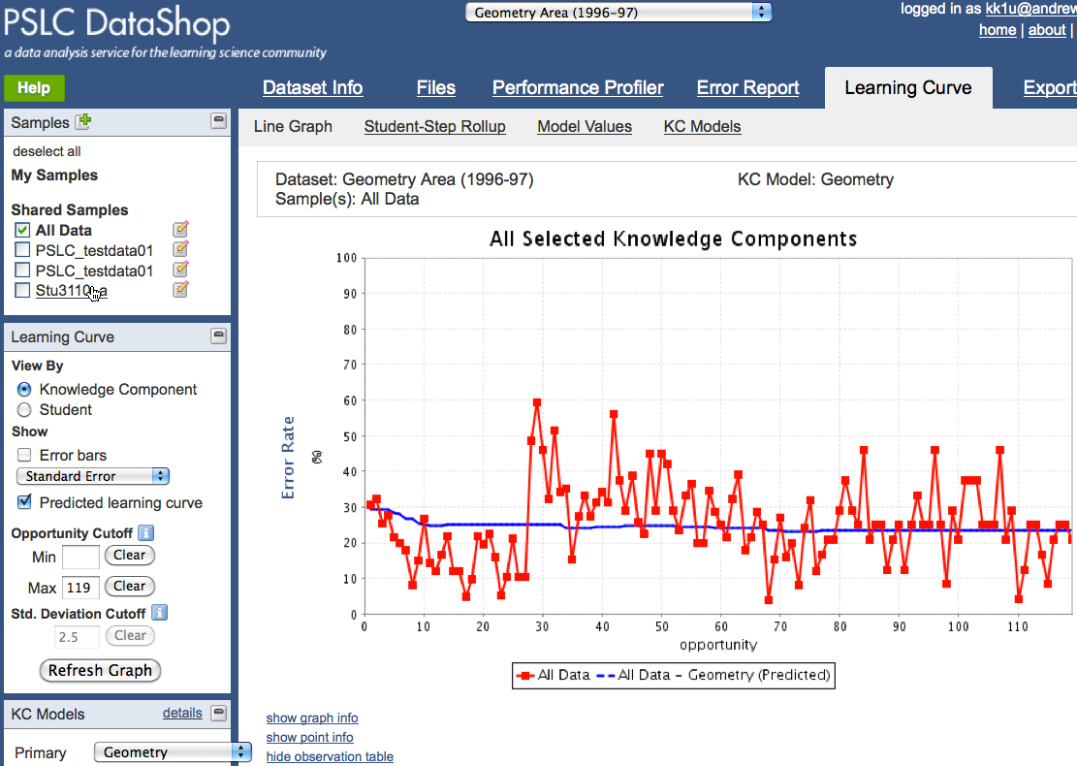
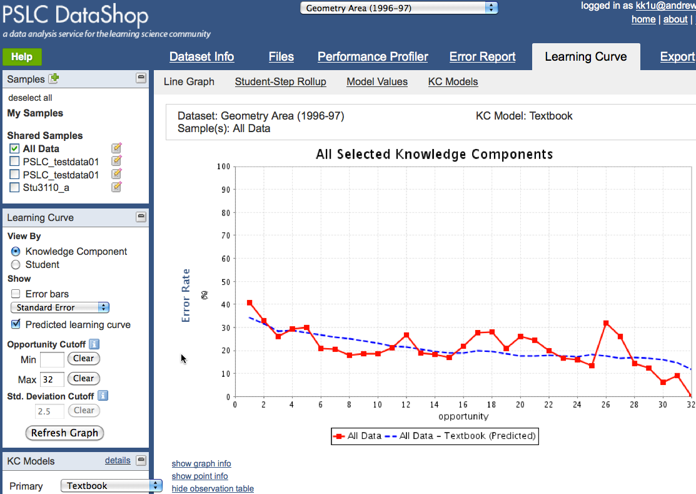
Cognitive Task Analysis using DataShop’s learning curve tools
Without decomposition, using just a single “Geometry” KC,
no smooth learning curve.
But with decomposition, 12 KCs for area concepts,
a smoother learning curve.

Slide 13
Visualizing learning curves to find opportunities for improvement
Low, long curve => remove busy work
High rough curve => concept/skill is more complex
Cen et al (2007)

Slide 14
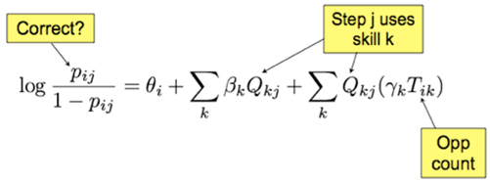
Can statistically test for “smoothness” of learning curve => Additive Factors Model (AFM)
GIVEN:
p_{ij} = probability student i gets step j correct
Q_{kj} = each knowledge component k needed for this step j
T_{ik} = opportunities student i has had to practice k
ESTIMATED:
θ_{i} = proficiency of student i
β_{k} = difficulty of KC k
γ_{k} = gain for each practice opportunity on KC k
Cen, Koedinger, & Junker (2006) Draney, Pirolli, & Wilson (1995)
Spada & McGaw (1985)

Slide 15
“Compose-by-addition” KC shows no apparent learning, slope is flat, γ_{k} = 0

Slide 16
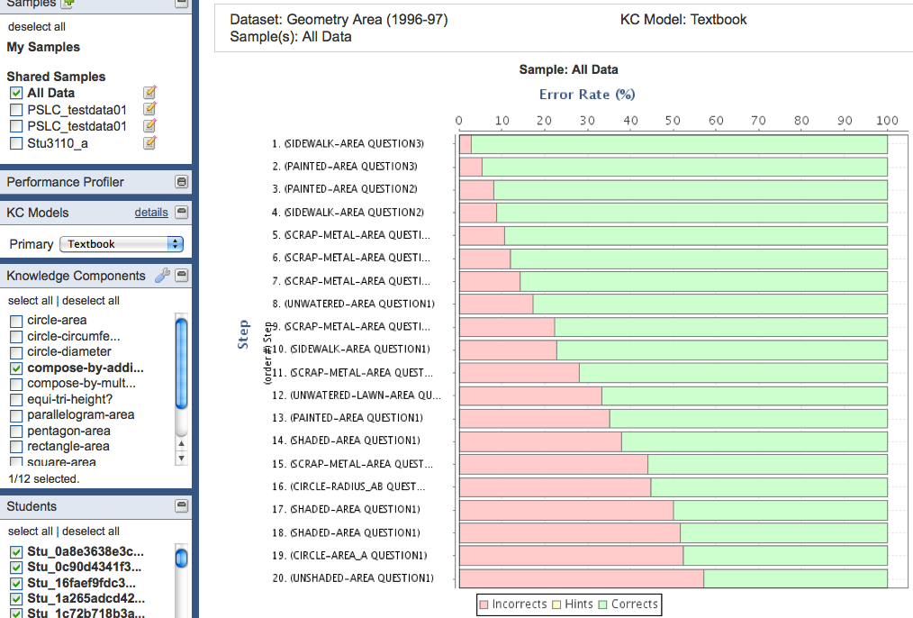
Labeled steps vary in error rate => KC labeling is wrong => Inspect problems to find new difficulty factors

Slide 17
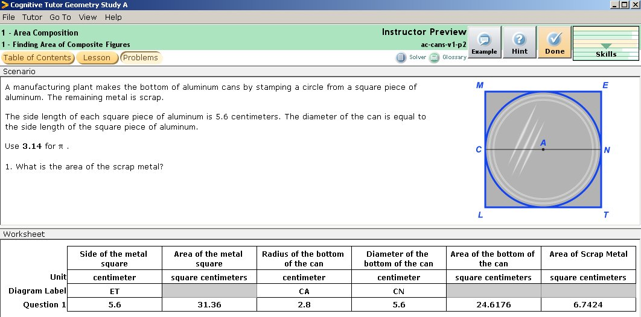
Why are some “compose-by-addition” steps harder than others?
Compose-by-addition

Slide 18
Why are some “compose-by-addition” steps harder than others?
Hard
Easy
Medium

Slide 19
Hypothesis: Difference is in how much planning is needed
Decompose
Subtract
Compose-by-addition

Slide 20
Problem steps with new KC labels
Subtract
Compose-by-addition
Subtract
Decompose
Compose-by-addition
Decompose
Compose-by-addition

Slide 21
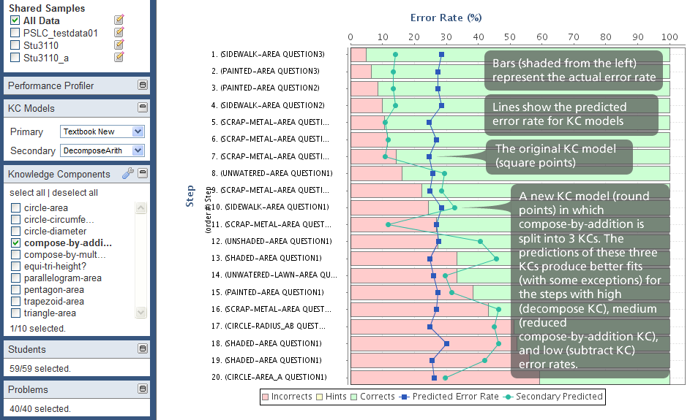
New KC labeling (green line) produces a better fit than original KC model (blue line)

Slide 22
New KC model better predicts data: Verified by AIC, BIC, cross validation
New KC model (DecomposeArith) splits “compose-by-addition” into 3, producing two new KCs
Predicts data better than prior model (Textbook New)
Small, but significant prediction improvement. Is it practically important?

Slide 23
Use data-driven model to redesign tutor
Enter given values
Find regular area
1. Change adaptive prob selection
New bars for discovered skills
Adjust optimization parameters
2. Sequence for gentle slope
Simple problems first
3. Create new problems to focus on planning KCs
Next slide ..
Combine areas
Track planning separately!
Enter given values
Find regular area
Plan to combine areas
Combine areas
Subtract
Fade scaffolding!

Slide 24
Study 2: Redesign to focus support on greatest student need
Isolate practice on planning step – decomposing complex problem into simpler ones

Slide 25
Model-based instruction is a better student experience
More efficient: 25% less time
And better learning of planning skills
Instructional time (minutes) by step type
Post-test % correct by item type

