Slide 1

How Do People Learn
From e-Courses?
Chapter 2
Ken Koedinger
Based on slides from Ruth Clark

Slide 2
Chapter 2 objectives
Distinguish:
  technology-centered vs. learner-centered
  learning vs. instruction
  3 forms of cognitive load during learning
Identify:
  3 metaphors for learning
  3 learning principles & processes
Apply four key events of learning

Slide 3
Hot technologies?
3-d printing, head-mounted display (occulus rift), google glass, myo (muscle movement), leap motion, Kinnect
Mobile technologies – connecting to robots
Near field communication (NFCs) – tracking
Notes:
Ask: What are some hot technologies that are or may be relevant to learning? And take notes.
Social media, simulations, games, virtual worlds, search engines, tangible interaction

Slide 4
A technology-centered vs. learner-centered approach to e-learning
Some hot technologies:
Social media, simulations, games, virtual worlds, search engines, tangible interaction
Central focus of e-learning design?
No, meeting learners’ needs should be
Should these be avoided?
No. These technologies may help & are worth consideration, but should be evaluated
Notes:
Make a list of ‘hot’ technologies. Then frame questions that reflect a technology-centric and learner-centric views of these technologies. Give examples of technology-centered approaches versus learner-centered approaches.

Slide 5
What is learning?
A change in what the learner knows – demonstrated by behavior
The change is caused by the learner’s experience
This experience can be changed by instruction
Can learning occur without instruction? Examples?
Notes:
What are some ways that students can demonstrate learning?
What are some forms of learning that are NOT the result of an instructional episode?

Slide 6
What is instruction?
A manipulation of the learner’s experiences to foster learning
  Something the instructional professional does
  The goal of the manipulation is to change what the learner knows
Notes:
Give some examples of things that instructional professionals do intended to cause learning. When might instruction be successful and when not successful?

Slide 7
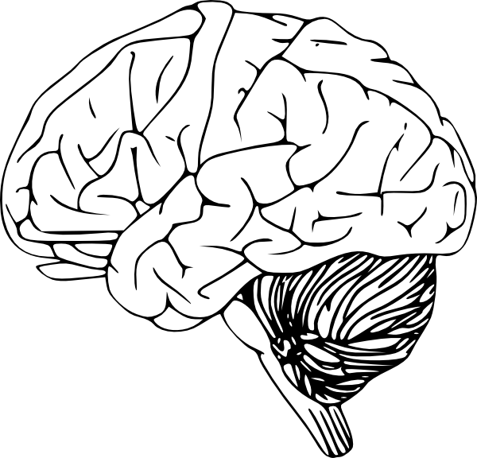
How do definitions compare with KLI?
Instructional events
Explanation, practice, text, rule, example, teacher-student discussion
Assessment events
Question, feedback,
step in ITS
Exam, belief survey
KEY
Ovals – observable
Rectangles - inferred
Arrows – causal links
Learning events
Knowledge Components
Notes:
Learning: A change in what the learner knows – demonstrated by behavior.
The change is caused by the learner’s experience

Slide 8
Mapping onto KLI
Learning is
a change in
Instruction is a manipulation of the learner’s experiences to foster learning
what the learner knows
demonstrated by behavior
Change is caused by the learner’s experience
Instructional events
Explanation, practice, text, rule, example, teacher-student discussion
Assessment events
Question, feedback,
step in ITS
Exam, belief survey
Learning events
Knowledge Components
Notes:
Differences:
Behavior is broader than assessment event, which is observed/recorded behavior that if often elicited by provided tasks
The “learner’s experience” has a psychological component (the learning event) and an observable component, which can be different than the instructional event (e.g., if learner does not look at a provided diagram)

Slide 9
Three metaphors for learning
S R
1. Response Strengthening
Outsourcing
2. Information Acquisition
3. Knowledge Construction
Notes:
Ask students to give examples of instruction based on each metaphor. Discuss behavioral views of learning, receptive views of learning, and knowledge construction views. Discuss how the 3 architectures of learning (receptive, directive, guided discovery) may reflect each of these metaphors.

Slide 10
Three metaphors for learning
Metaphor of Learning | Learning Is: | Learner is: | Instructor is:
Response strengthening | Strengthening or weakening of associations | Passive recipient of rewards and punishments | Dispenser of rewards and punishments
Information acquisition | Adding information to memory | Passive recipient of information | Dispenser of information
Knowledge construction | Building a mental representation | Active sense maker | Cognitive guide
For next time: How are these similar or different from KLI’s learning processes?

Slide 11
Three learning principles
Limited capacity
Dual channels
Active processing
Notes:
Do the word list activity to illustrate the 3 learning principles. No one recalls all of the words due to limited capacity but the words most recalled are concrete due to dual channels and active processing.

Slide 12
Experiment
Listen and then write
Pens down, listen to list A
Write as many as you can recall
Pens down, listen to list B
Write as many as you can recall
Notes:
Tell students you will state a list of words and when you are done, they should write down all they can recall. Read aloud list A and allow students time to write. Repeat with list B. Then show the list on the next slide and take average numbers of words listed.
A: Rose Computer Bird Cloud Scissors Book Dress Marker Bedroom Chair Calendar Pink Ocean Gutter Bread Clock
B: Ethics Hire Terse Noun Problem Manage Design Retro First Solution Color Liquid Pattern Basic Account Integrity

Slide 13
Count how many in each list
List A
Rose
Computer
Bird
Cloud
Scissors
Book
Dress
Marker
Bedroom
Chair
Calendar
Pink
Ocean
Gutter
Bread
Clock
List B
Ethics
Hire
Terse
Noun
Problem
Manage
Design
Retro
First
Solution
Color
Liquid
Pattern
Basic
Account
Integrity
Notes:
Calculate average numbers of words listed. Ask why usually more words are recalled in list A than in list B. Use this exercise to discuss the limits of working memory and dual channels.

Slide 14
How do three learning principles apply to example
Limited capacity?
You can’t remember all words
Dual channels
Concrete words easier <= 2 channels: visual & verbal
  Abstract words <= 1 verbal channel
Active processing
Recall better words you rehearse more or try to elaborate by connecting to other knowledge
Notes:
Do the word list activity to illustrate the 3 learning principles. No one recalls all of the words due to limited capacity but the words most recalled are concrete due to dual channels and active processing.

Slide 15
Cognitive theory of multimedia learning
MULTIMEDIA
SENSES
WORKING MEMORY
LONG-TERM
PRESENTATION
MEMORY
Words
Ears
selecting
Sounds
organizing
Verbal
words
words
Model
integrating
Prior
Prior
Knowledge
Knowledge
Pictures
Eyes
selecting
Images
organizing
Pictorial
images
images
Model
Notes:
We’ll talk more about later …

Slide 16
Cognitive load theory
Extraneous processing – depresses learning
Essential processing – complexity of content
Generative processing – facilitates learning
Note: Above is Mayer’s terminology
Many use the following instead:
  Extraneous load
  Intrinsic load
  Germane load
Notes:
Introduce 3 forms of cognitive load. Discuss cognitive load theory as an important modern psychological theory of learning.

Slide 17
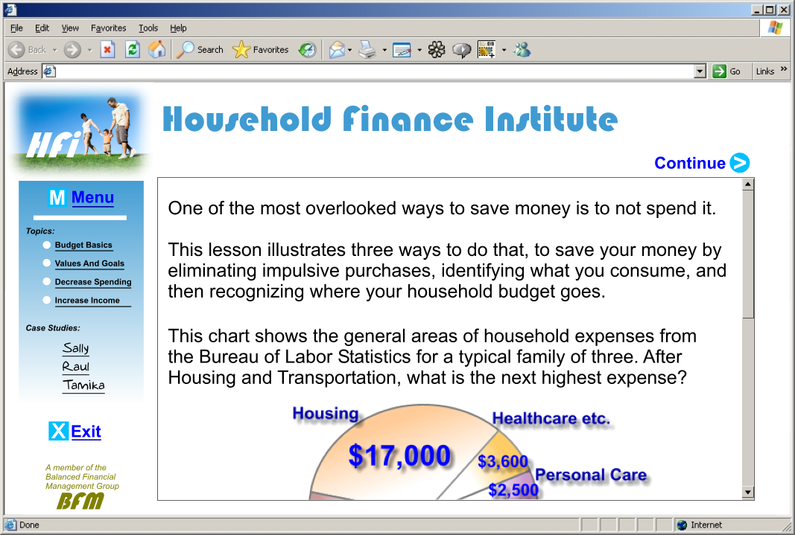
Extraneous processing
Notes:
Extraneous processing is undesirable mental load caused by poor instructional design decisions such as this split attention screen caused by poor placement of graphic and text on a scrolling screen. An instructional goal is to minimize extraneous processing.

Slide 18
Essential processing
Which demands more mental processing?
A. Write the meaning of this phrase: A che ora parte il treno?
B. Respond to this question: “Di che colore sono i suoi capelli?”
Notes:
Essential processing refers to the complexity of the learning demand. In language, listening to a verbal question and framing an answer requires more mental capacity than reading and interpreting a written phrase.

Slide 19



Generative processing
Using Spreadsheets in your Small Business
Lesson 2: Working with Formulas
Which formula is
most efficient to calculate all commissions:
= B4*B9
= B4/B9
=B4*$B9$
=B4*$B$9
Notes:
Generative processing is useful mental work that leads to learning. A good practice exercise is one form of generative processing. Relate generative processing to the engagement matrix introduced in Chapter 1. Generative processing depends on psychological processing not behavioral activity.

Slide 20
Managing cognitive load
Challenge | Description | Solution | Examples
Too much extraneous processing | The mental load from extraneous and essential processes exceeds capacity | Use instructional methods that decrease extraneous processing | Use audio to describe complex visuals Write lean text and audio narration
Too much essential processing | The content is so complex that it exceeds capacity | Use techniques to reduce content complexity | Segment content Use pretraining
Insufficient generative processing | The learner does not engage enough to learn | Incorporate methods to promote psychological engagement | Add practice Add relevant visuals
Insert table 2.2
Notes:
This is table 2.2 .

Slide 21
Key learning processes
Selection
Load management
Integration
Retrieval
Notes:
This is an introductory overview slide

Slide 22

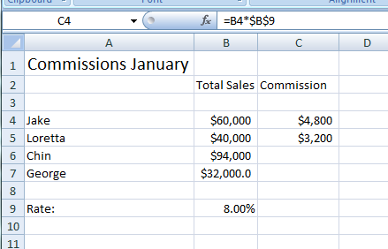
Selection, load management, integration, retrieval
Using Spreadsheets in your Small Business
Lesson 4: Absolute Vs Relative Cell
Cell B9 is designated as an absolute cell reference.
When you want to keep a cell value in a copied formula the same, you need to use an absolute cell reference. Place a dollar sign in front of the column letter and row number of the cell value you want to maintain.
Note above in column C the value in each B column will be multiplied by 10%
when the formula in Cell C4 is copied to C5 –C7.
Notes:
Discuss how this storyboard does or does not support selection, load management, integration, and retrieval. You may have additional storyboards to use for this discussion.

Slide 23
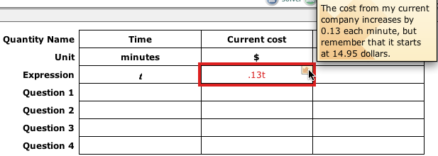
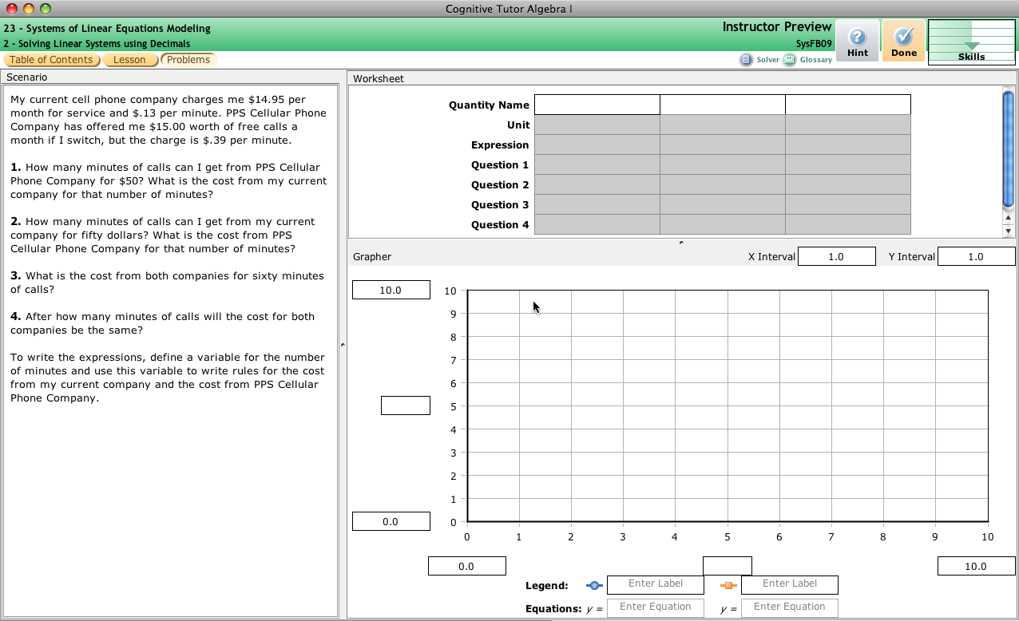
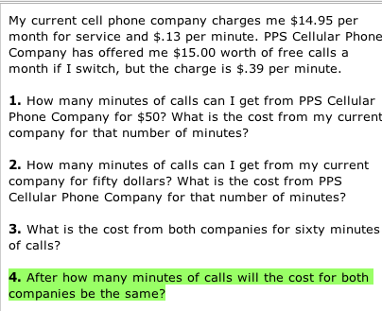
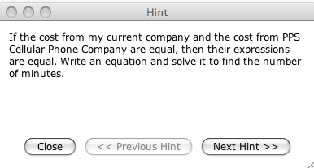
Selection, load management, integration, retrieval

Slide 24

PSLC Vision
Why? Chasm between science & ed practice
    Low success of randomized control trials (<10%)
LearnLab = bridging infrastructure
  Educational technology as scientific instrument
  Science-practice collaboration structure
Purpose: Identify the conditions that cause robust student learning
A Key Output: KLI Framework
Notes:
Say: One of 6 science of learning centers”
The vision for the PSLC starts with the broad goals of understanding human learning and using that understanding to improve education. More specifically, we are working to fill the chasm that currently exists between learning science research and educational practice. A key indicator is the low hit rate of costly large-scale randomized control trials . It appears the science behind many of these trials may not have been sound and reliable enough (we believe in RFTs, but we need more science to build up to them).
2) Toward this end, we have created LearnLab …
Goals are to: Do rigorous science at scale. Create a two-way street. Have problems from practioners guide psychological research goals.
3) In general, our purpose is to “leverage cognitive … learning”.

Slide 25
What is Robust Learning?
Robust Learning is learning that
  transfers to novel tasks
  retained over the long term, and/or
  accelerates future learning
Robust learning can be achieved by developing both
  conceptual understanding & sense-making skills
  procedural fluency with basic skills
Notes:
The robust learning concept emerges from a recognition that “education wars” stem from a false dichotomy between understanding and basics. A fundamental PSLC hypothesis is that “robust learning can be achieve by developing …”. To understand robust learning, we need to measure it and we operationalize the concept with three kinds of measures: transfer, long-term retention, and accelerated future learning.

Slide 26
Knowledge Components
Definition: An acquired unit of cognitive function or structure that can be inferred from performance on a set of related tasks
Includes:
  skills, concepts, schemas, metacognitive strategies, malleable habits of mind, thinking & learning skills
May also include:
  malleable motivational beliefs & dispositions
Does not include:
  fixed cognitive architecture,
  transient states of cognition or affect
Components of “intellectual plasticity”

Slide 27
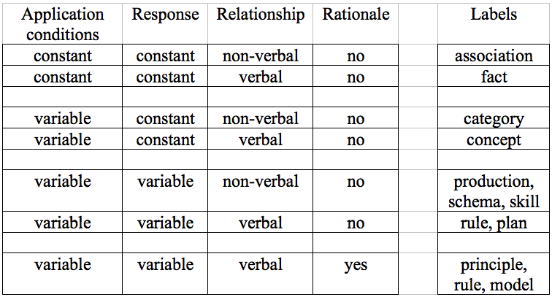
KCs vary in generality, explicitness & discoverability
Different KCs require different learning processes: memory, categorization, schema induction, reasoning & sense making

Slide 28
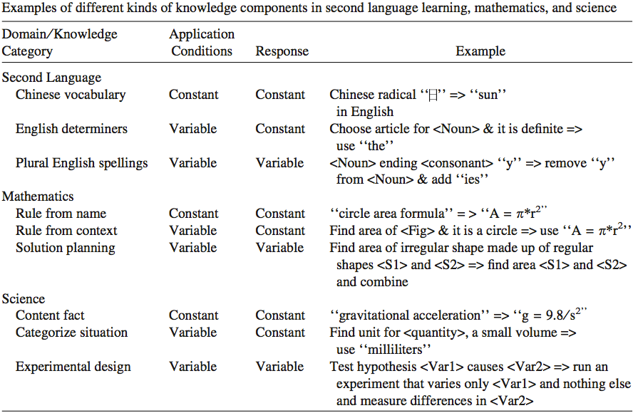
Examples of kinds of KCs

Slide 29
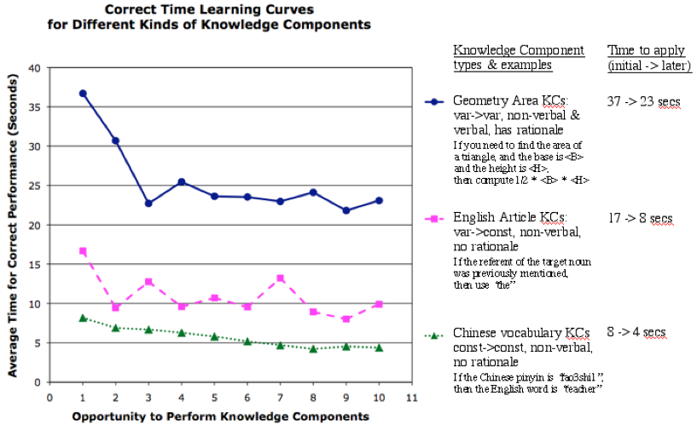
Kinds of KCs vary in complexity
& thus require different learning processes …
Principles are more complex as indicated by time & description
Rules are less complex
Facts are simplest

Slide 30
KLI allows for general knowledge components for sense-making, motivation, social intelligence
Possible domain-general KCs
Metacognitive strategy
  Novice KC: If I’m studying an example, try to remember each step
  Desired KC: If I’m studying an example, try to explain how each step follows from the previous
Motivational belief
  Novice: I am no good at math
  Desired: I can get better at math by studying & practicing
Social communicative strategy
  Novice: If an authority makes a claim, it is true
  Desired: If considering a claim, look for evidence for & against it
Koedinger & Stampfer (in press) Accounting for Socializing Intelligence with the Knowledge-Learning-Instruction Framework. In Resnick, Asterhan, & Clarke, (Eds.), Socializing Intelligence through Academic Talk and Dialogue.

Slide 31
Chapter 2 Objectives Summary
Distinguish:
  technology-centered vs. learner-centered
  learning vs. instruction
  3 forms of cognitive load: extraneous, intrinsic, generative/germane
Identify:
  3 metaphors for learning: association, storage/reception, sense making
  3 learning principles & processes: limited capacity, dual channels, active processing
Apply four key events of learning

Slide 32
KLI Summary
Fundamental causal chain:
  Changes in instruction yield
  changes in learning yield
  changes in knowledge yield
  changes in robust learning measures.
Observed
Inferred
Design process starts at the end
  What is the knowledge students acquire?
  KC type indicates what learning processes are needed, what instruction is optimal
KC types: condition, response, verbal, rationale
Next time: learning processes & instructional options

Slide 33
Class Activities
Questions about project ideas? Step 1?
  Who has a firm project idea? Less firm?
Review e-learning example for learning principles & KC types (next slide)

Slide 34
Class activity 2
1. Review sample of e-learning brought to class
Find an application or violation of:
  Directing selection of information
  Managing WM capacity limits
  Promoting integration
  Supporting retrieval and transfer
Identify a KC that is targeted
Indicate the kind of KC, by selecting dimensions:
  Condition: constant or variable
  Response: constant or variable
  Non-verbal or verbal
  Arbitrary or has a rationale
  Other: probabilistic? integrated?

Slide 35
Assignment for next time
Look at text to pick a chapter to summarize
  Goal: Prepare a 20 minute presentation
  I will provide a framework (slide outline)
  Purpose: Practice summarizing & presenting; hear others’ views (I’ll extend with related content)
Read Chapter 3
  Do quiz
Read KLI Framework, sections 4-5
  Do one post on Blackboard discussion board
DUE: Example assignment
  Turn in on Blackboard. Any questions?

