Slide 1
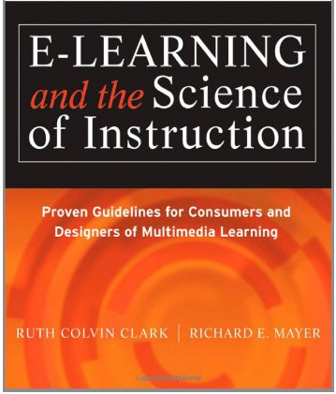
Applying the Multimedia Principle: Use Words and Graphics Rather than Words Alone Chapter 4
Ken Koedinger

Slide 2
Media Element Principles of E-Learning
1. Multimedia
2. Contiguity
3. Coherence
4. Modality
5. Redundancy
6. Personalization

Slide 3
Multimedia Principle
Which is better for student learning?
A. Learning from words and pictures
B. Learning from words alone
Example: Description of how lightning works with or without a graphic

Slide 4
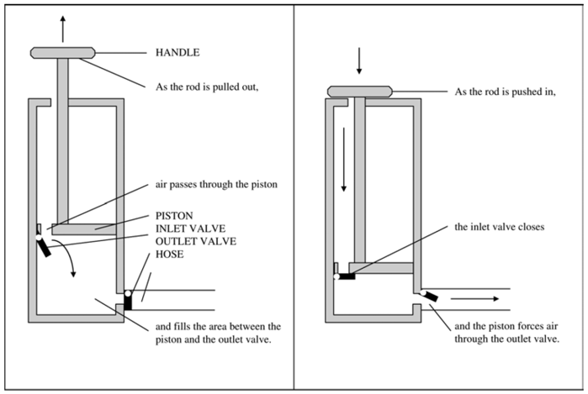
Example: How a Bicycle Pump Works
Explained with words alone
Explained with words & graphics
Which leads to better learning?

Slide 5
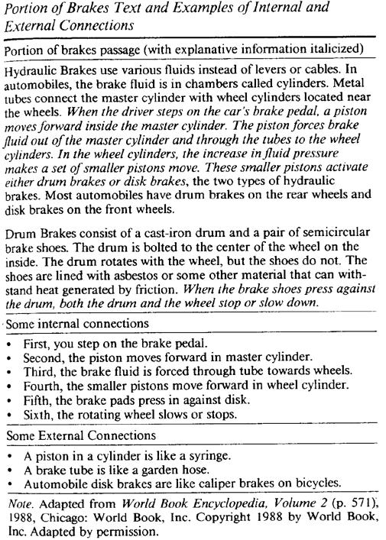
Example: How Brakes Work
Explained with words alone
Explained with words & graphics
Which leads to better learning?

Slide 6
How could you find out?

Slide 7
How could you find out?
Run an experiment!
Create an assessment to measure knowledge of bike pumps
Randomly assign students to either use
Words alone – the “control group”
Words and graphics – the “treatment group”
Have students take the assessment

Slide 8
Example assessment tasks
Transfer assessment tasks:
(These are examples of the kinds of tasks or assessment items you need to create for project step 2a.)

Slide 9
Brakes Experiment 1
Subjects: 34 novice female college students
Materials
Text + labeled illustrations versus text alone
Experience questionnaire
Posttests (recall, transfer, recognition)
Procedure
Random assignment
Experience questionnaire
Recall test - 8 minutes
Transfer test - 10 minutes divided
Verbatim recognition test - 2 minutes
Notes:
Perhaps insert a slide with Figure 1 on it (diagram)

Slide 10
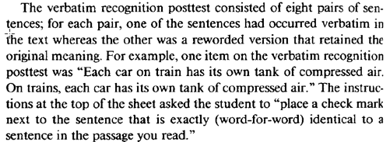
Results: Transfer and Recognition
Illustrations group > no illustrations group on transfer scores; p =.01
Illustrations group = no illustrations group on verbatim recognition
Multimedia helps learning of principles not facts

Slide 11
Scientific Evidence That Principles Really Work
Summary of Research Results from the Six Media Elements Principles. (From Mayer, 2001)
Principle | Percent Gain | Effect Size | Number of Tests
Multimedia | 89 | 1.50 | 9 of 9
Contiguity | 68 | 1.20 | 5 of 5
Coherence | 82 | 1.17 | 10 of 11
Modality | 80 | 1.17 | 4 of 4
Redundancy | 79 | 1.24 | 2 of 2
Personalization | 67 | 1.24 | 5 of 5
* Used similar instructional materials in the same lab.

Slide 12
Multimedia Principle
Which is better for student learning?
A. Learning from words and pictures
B. Learning from words alone
Example: Description of how lightning works with or without a graphic
A. Words & pictures
Why?
Students can mentally build both a verbal & pictorial model & then make connections between them

Slide 13
Cognitive Processing of Instructional Materials
Instructional material is:
Processed by our eyes or ears
Stored in corresponding working memory (WM)
Must be integrated to develop an understanding
Stored in long term memory
Narration
Auditory WM
Build Referential Connections
Long Term Memory
OnScreen Text
Animation
Visual WM

Slide 14
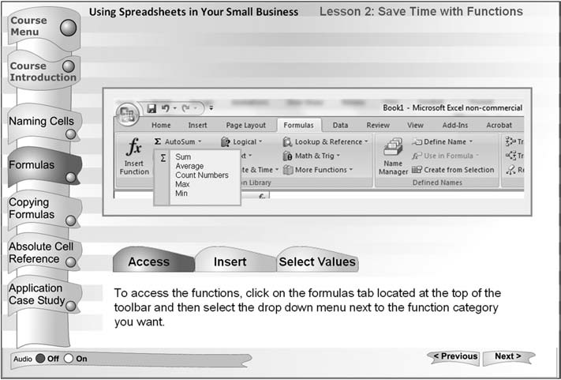
Is this a good application of the multimedia principle?
Yes, graphic illustration is relevant.
Notes:
YES

Slide 15
Is this a good application of the multimedia principle?
No, illustration is not relevant but decorative.

Slide 16
Are instructional principles completely domain general?
Principles, like the multimedia principle, are intended to be domain general
Will they actually apply across all domains?
No matter what the content or the knowledge component (KC) goals?
Hint: Recall the KLI Framework
Cognitive Task Analysis (CTA) is about the domain or subject-matter
CTA is domain specific
Can CTA help more appropriately & successfully apply principles to particular domains & KC goals

Slide 17
Interaction of lab CTA & experiments on general principles
Instructional Causal
Solutions Hypotheses
 | Lab experiments
Design research & field trials | in vivo experiments
In the Lab
In the classroom

Slide 18
Example from Chemistry (Equilibrium): Multimedia Principle ¹
Hypothesis: Diagram+Text vs. Text only
 | Multi-media results (Mayer 2001) & others
In the Lab
In the classroom
¹ cf Mayer (2001)

Slide 19
Example from Chemistry (Equilibrium): Multimedia Principle
Hypothesis: Diagram+Text vs. Text only
 | 4 in vivo experiments at CMU & UBC (n=1000)
In the Lab
In the classroom
Graphics diagrams were designed to illustrate aspects of the existing text
--> No benefit!
Why?
Hypothesis: Diagrams were not illustrating the KCs that were most difficult for students to acquire

Slide 20
Example from Chemistry (Equilibrium): Multimedia Principle
Question: What is underlying knowledge acquisition challenge?
 | CTA of expert & novices: Missing concept in instruction (progress of reaction)
In the Lab
In the classroom

Slide 21
Empirical prescriptive CTA: Think alouds of experts
Experts:
use qualitative reasoning about progress of a reaction
Use same principles for any equilibrium system
consider constraints when reasoning
identify where system is, where it’s going & how it will get there

Slide 22
Empirical descriptive Cognitive Task Analysis: Think alouds of novices
Driving research question: Do students lack of ability to understand core chemistry chemistry or failure to apply that knowledge?
Students know constraints, but fail to apply this knowledge in equilibrium problem solving
Huge barrier to transfer of learning!

Slide 23
Results from analyses of novice errors revealed in think alouds
Students fail to coordinate problem solving with core processes
2H₂S_{(g)} + O_{2(g)} <----> 2S_{(s)} + 2H₂O_{(g)}
How will adding O₂ influence the amount of S?
Common errors violate conservation of matter:
“The addition of O2 would only influence the amount of H2O.”
“Although an increase in O2 will cause the reaction to move forward, it does not affect S”
“The amount of S does not contain any oxygen, thus it doesn’t affect the amount of S.”

Slide 24
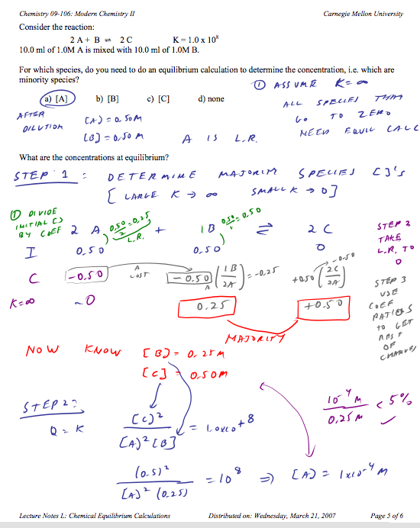
CTA is used to redesign instruction
Hyotheses
Coordination of concepts & procedures enhances learning
Problem solving that is grounded in chemical concepts encourages sense making & is more memorable.
Step 1: Consider Strongest reaction
Step 2: Consider Weaker reaction

Slide 25
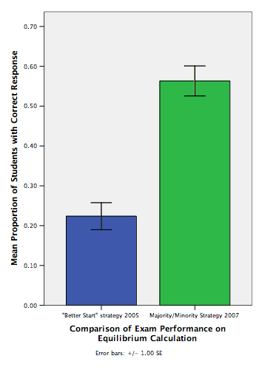
Course-based “in vivo” experiment
Problem-solving linked to progress of reaction showed ~250% improvement on final exam item.

Slide 26
Example from Chemistry (Equilibrium): Multimedia Principle
Hypothesis: Diagram + Text vs. Text only
 | CTA of expert & novices: Missing concept in instruction (progress of reaction)
 | New in vivo Study--> Robust learning effects (transfer)
In the Lab
In the classroom

Slide 27
Apply multimedia principle again
This time: diagram design is informed by Cognitive Task Analysis
Hypothesis: Coordination of visual representations with chemistry notation enhances learning for low performers
Diagrams scaffold the development of mental model

Slide 28
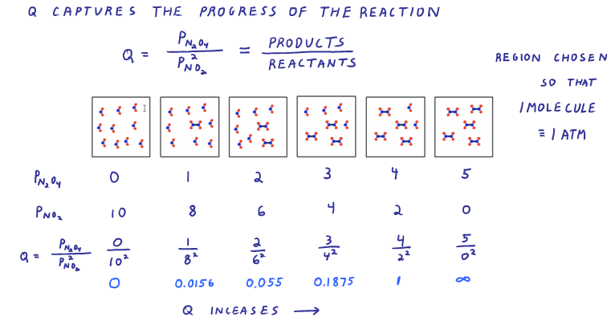
Treatment: Progress of reaction with diagrams
Example new diagram added to online text

Slide 29
Control: Progress of reaction with chemistry notation
Control group saw symbolic notation instead of diagram (also added to the online text)

Slide 30
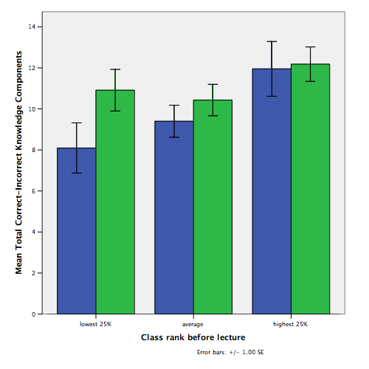
Significant advantage for low performers.
Diagrams led to enhanced learning on transfer test for low performers.
Lowest 25% in class rank before study

Slide 31
Using CTA to better apply the multimedia principle
Through CTA, instructional designers are able to elicit the types of KCs required to perform the respective tasks
These KCs may in turn inform the types of graphics useful in teaching specific lesson content
For instance,
representational or organizational graphics may be used to effectively explain facts
transformational or interpretive graphics are recommended for clarifying principles
From prior student Danny Koh

Slide 32
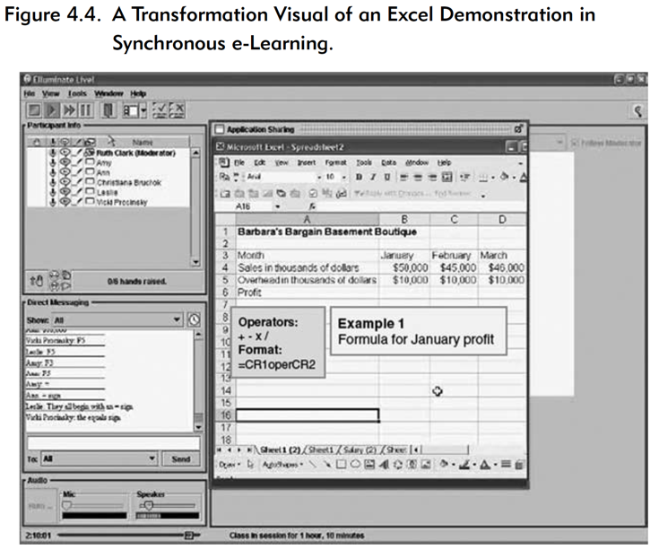
Transformation visual for processes, procedures, & principles

Slide 33
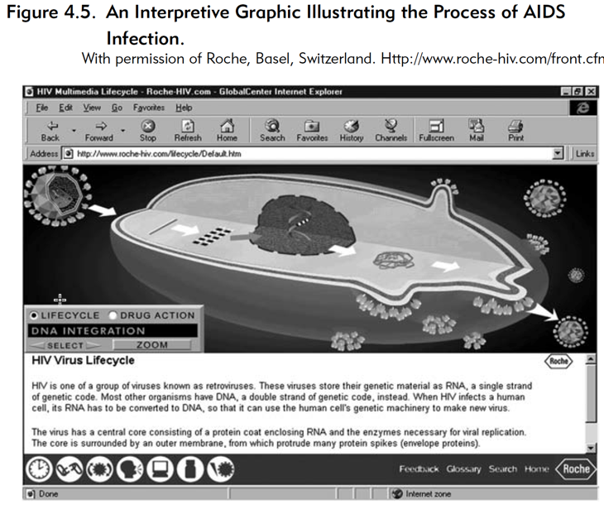
Interpretive illustrations for relationships among variables or to make invisible phenomena visible

Slide 34
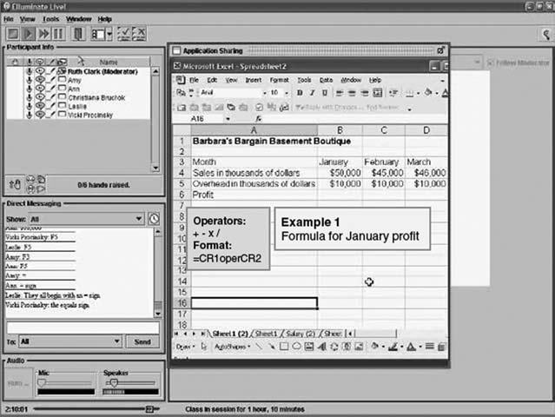
Multimedia Principle Summary
Adding graphics to text improves learning when graphics are relevant rather than decorative
Use Cognitive Task Analysis to determine relevance
Different kinds of graphics are effective for different kinds of knowledge goals
Representative graphics for concrete facts, concepts, & their parts
Transformational visual for processes, procedures, & principles
Organizational graphics for relationships among ideas or lesson topics
Interpretive illustrations for relationships among variables or to make invisible phenomena visible

