Slide 1
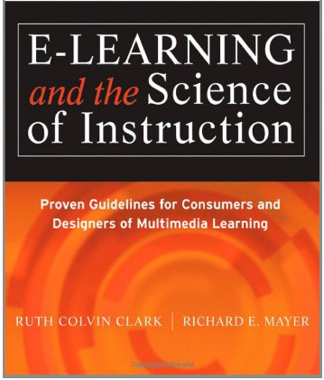
Simulations and Games in E-learning (Chapter 16)
Ken Koedinger

Slide 2

Lessons About A/B Testing
Dan Siroker: The importance of A/B testing
Global optimization
Notes:
Dan Siroker, Co-Founder & CEO, Optimizely; Former Director of Analytics for the Obama 2008 Presidential Campaign
http://www.youtube.com/watch?v=yY-HBW5CNcg&feature=player_embedded#t=8
http://www.youtube.com/watch?feature=player_detailpage&v=42jSf4kfJlM#t=957

Slide 3
Example: e-learning A/B test in a game
See separate slide deck

Slide 4
Simulations and Games Topics
What are Games & Simulations
Matching game types to learning goals
Use
  Proven strategies
  Guidance & structure
Manage complexity
Make relevance salient

Slide 5

Games and Learning
Low High
Psychological Activity
Low High
Behavioral Activity
Adapted from Stull & Mayer, 2007
Notes:
Review the activity matrix. Since simulations and games by definition are learner centered, focus on the differences between low and high psychological activity in games and sims. Ask for examples that fall in top and bottom quadrant.

Slide 6
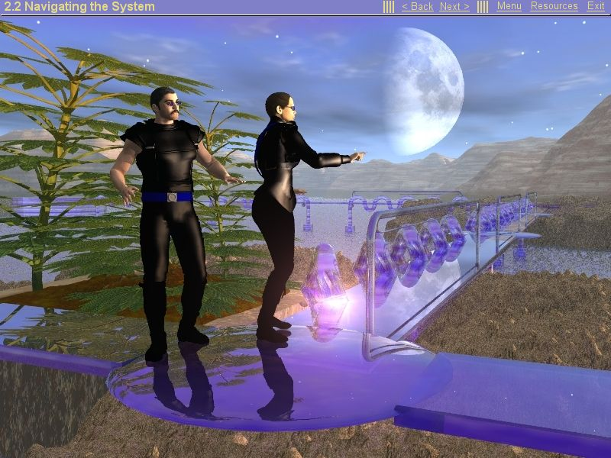
A fantasy theme game
Notes:
Use this as an example of high behavioral activity but psychological activity unrelated to the learning goals.

Slide 7
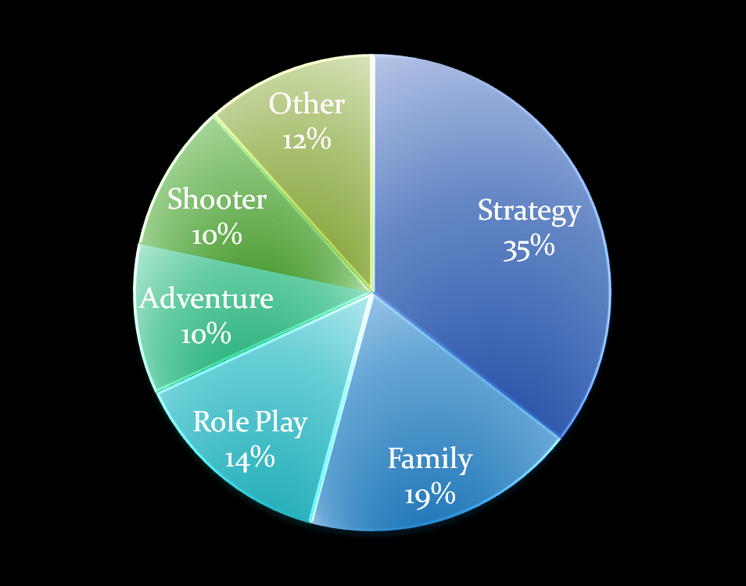
Sales of computer games
Source: Entertainment Software Association, 2010 Report.
Notes:
Ask learners what computer games they play. How would they classify them?

Slide 8
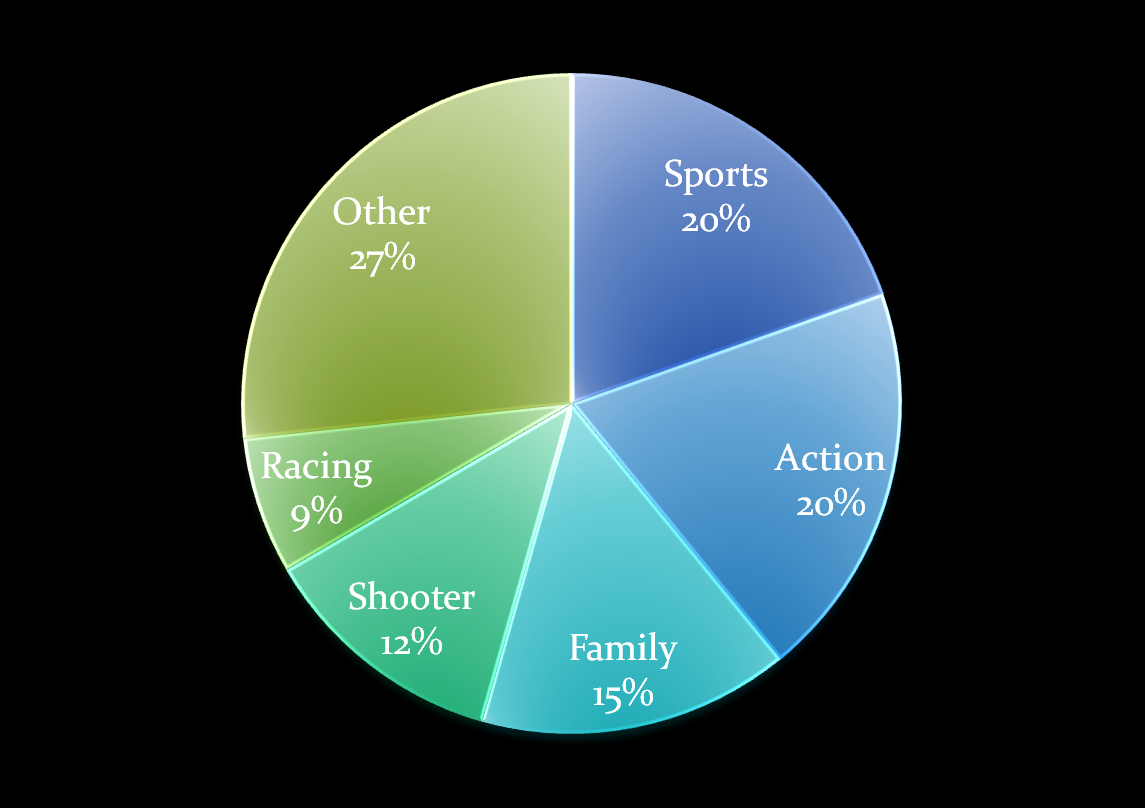
Sales of video games
Source: Entertainment Software Association, 2010 Report.
Notes:
Ask learners what video games they play. How do games designed specifically for video differ than games designed for computer? How do these different features reflect on the best types of games for learning purposes? Discuss the categories of video games in table 16.1 and ask how students might modify these categories.

Slide 9
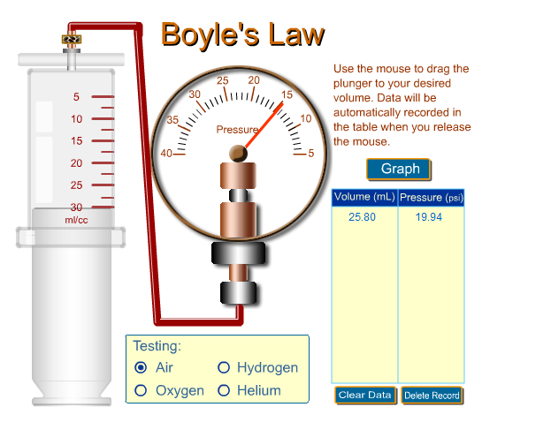
What is a simulation ?
A model of a real-world system
Responds in dynamic and rule-based ways to user responses
Notes:
In this simple simulation, the pressure gauge changes as the user alters the volume with the plunger and the graph shows the values. Ask for examples of simulations students have used.

Slide 10
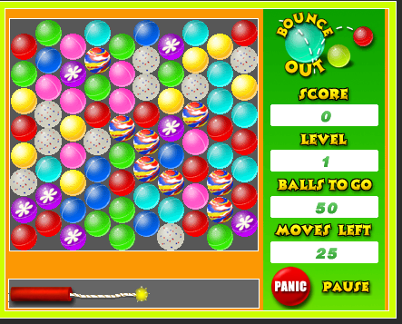
What is a game ?
A rule-based environment with goals
Responsive to learner actions
Challenging
Cumulative so the current state
reflects previous actions and
show progress toward goals
Notes:
Ask for examples of learning games students have used. Discuss how games differ from simulations.

Slide 11
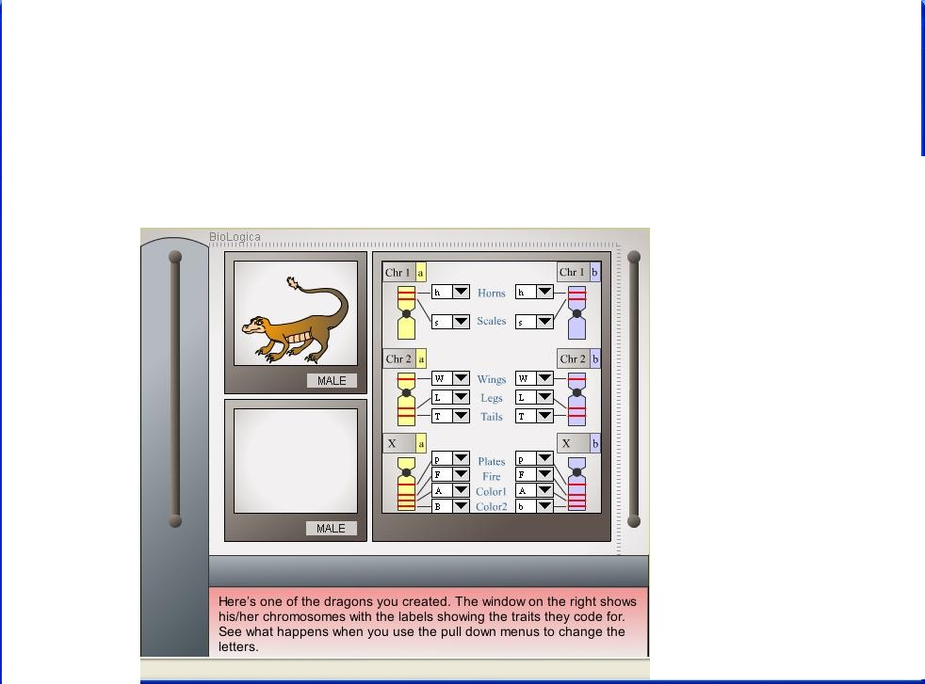
Genetics simulation
From Biologica Project – http://biologica.Concord.org

Slide 12
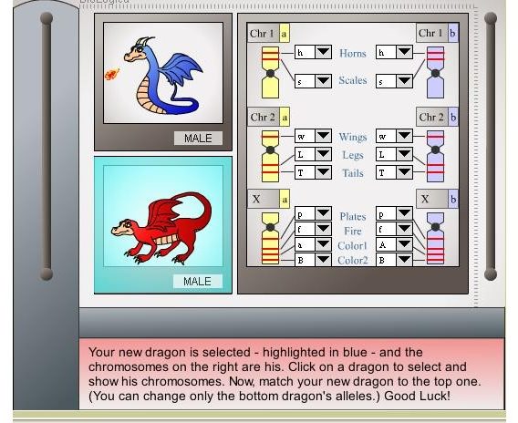
Genetics game
From Biologica Project – http://biologica.Concord.org
Notes:
Contrast the simulation and the game. Discuss how a simulation could be converted into a game.

Slide 13
Research vacuum
“Games are very motivating and have tremendous
potential in education, but despite a rapid growth in the research base, there is yet insufficient evidence to draw definitive conclusions.”
- Hannafin & Vermission, 2008.

Slide 14
Research shift
What features of games and simulations lead to learning?
Are games and simulations effective?
Value-added Research Approach

Slide 15
Value-added research approach
Game Version 1
Game Version 2
Notes:
Discuss value added approach – two or more versions of a game are tested and inferences made about optimal game features.

Slide 16

Match game types to goals
Strategy
Puzzle
Action
Learning
Goal
Adventure
Role-Play
Notes:
Discuss different learning goals that might benefit from various types of games.

Slide 17
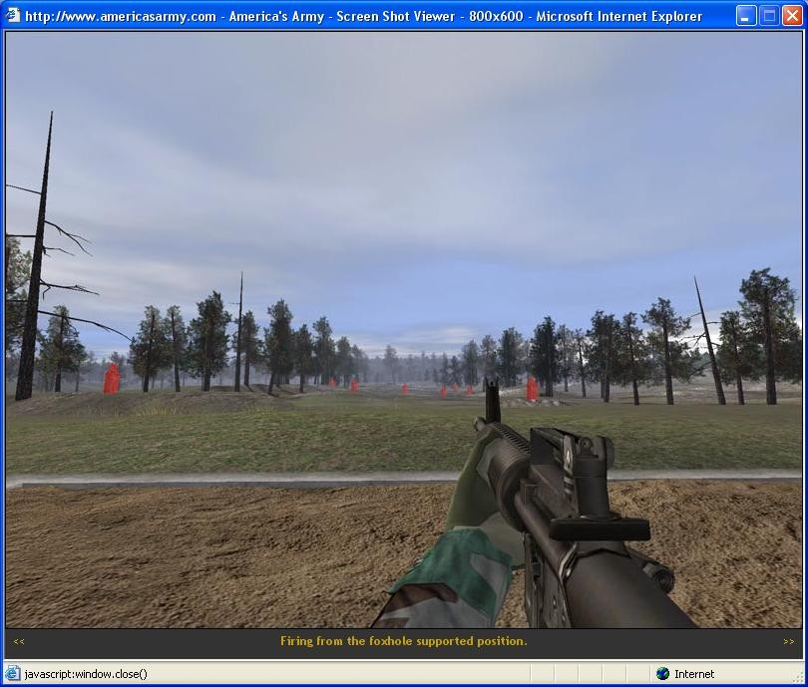
Make learning essential to progress
Notes:
America’s Army game

Slide 18
Make learning essential to progress
100
90
80
70
60
Percent Correct
SD = Significantly Different
Effect size = .65
50
40
SD
30
20
10
Relevant Irrelevant
Belanich et al, 2004
Notes:
Study on learning from America’s Army game.

Slide 19
Build in proven instructional strategies
Incorporate Explanatory Feedback
Add Self-Explanation Questions

Slide 20
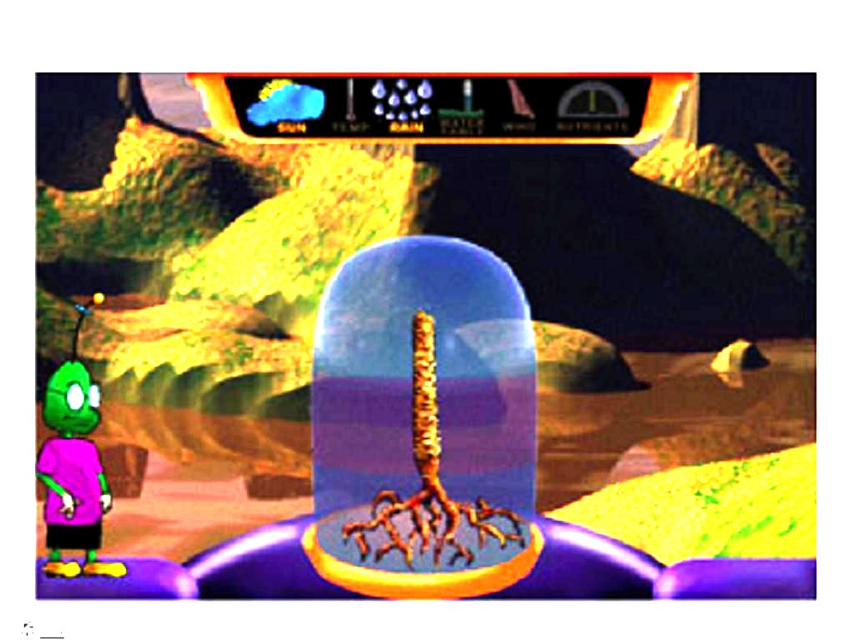
Incorporate explanatory feedback
Design-A-Plant Game

Slide 21
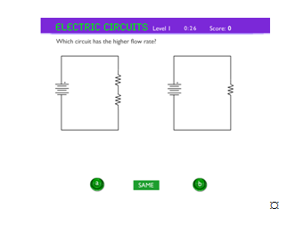
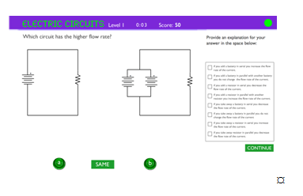
Add self-explanation questions
Which circuit has the higher flow rate?
Which circuit has the higher flow rate?
Select an explanation
for your answer below:
A. Base Version B. Self-Explanation Version
Circuit Game, Mayer & Johnson, 2010
Notes:
Discuss this research as an example of value-added research. What other proven techniques might be tested in games?

Slide 22
Better learning with SE questions
75
70
65
SD = Significantly Different
Effect size = 1.03
60
Proportion Correct on Transfer Test
55
50
SD
45
Game + Basic Game
Self-explanation
Questions
- Mayer & Johnson, 2010

Slide 23

Avoid discovery learning
Notes:
What are the disadvantages of discovery learning? What commercial games use discovery learning?

Slide 24
Guidance for inquiry simulations
Change 1 gene
on a single chromosome
2. Record dragon change:
3. Change paired gene on
corresponding chromosome
From Biologica Project – http://biologica.Concord.org
Notes:
When the goal is to teach a scientific method or systematic process, guide the learner through the steps and thinking process.

Slide 25
Manage complexity
Boyle’s Law
Concrete Version
5 10 15 20 25
This screen shows the relationship
between pressure and volume of
a gas. You can observe how the volume
of the gas changes by using the
pressure button.
Notes:
. Compare this simpler version with more abstract version on next slide

Slide 26
Manage complexity
Boyle’s Law
Abstract Version
This screen shows the relationship
between pressure and volume of
a gas. You can observe how the volume
of the gas changes by using the
pressure button.
5 10 15 20 25
Figure 10.12. A Concrete Simulation Interface (A) Led to Better Learning of Novice Learners
than Abstract Interface Adapted from Lee et al (2006).
Notes:
. Compare this more abstract version. Results showed that novices did better with simpler version but for learners with background did not matter. Review expertise reversal concept.

Slide 27
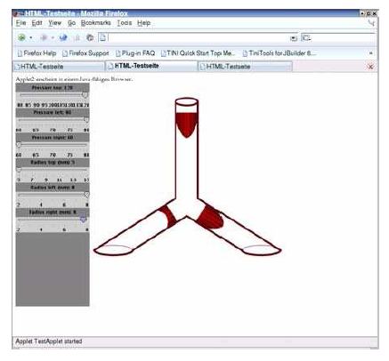
Ensure ease of use
HAEMOSIM, Holzinger et al, 2009
Notes:
This simulation on blood flow was effective ONLY when preceded by a 30 second video explaining how to use it.

Slide 28
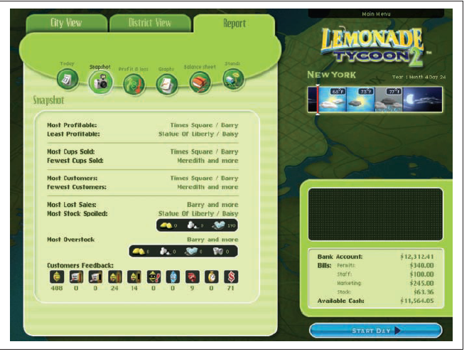
Make relevance salient
Notes:
Business students interested in decisions regarding marketing, inventory and other strategic decisions can see the relevance of the Lemonade Tycoon game.

Slide 29
END

