Slide 1
Educational Data Mining Overview
Ryan S.J.d. Baker
PSLC Summer School 2012

Slide 2
Welcome to the EDM track!
On behalf of the track lead, John Stamper, and all of our colleagues

Slide 3
Educational Data Mining
“Educational Data Mining is an emerging discipline, concerned with developing methods for exploring the unique types of data that come from educational settings, and using those methods to better understand students, and the settings which they learn in.”
www.educationaldatamining.org

Slide 4
Classes of EDM Method (Baker & Yacef, 2009)
Prediction
Clustering
Relationship Mining
Discovery with Models
Distillation of Data For Human Judgment

Slide 5
Prediction
Develop a model which can infer a single aspect of the data (predicted variable) from some combination of other aspects of the data (predictor variables)
Which students are off-task?
Which students will fail the class?

Slide 6
Clustering
Find points that naturally group together, splitting full data set into set of clusters
Usually used when nothing is known about the structure of the data
What behaviors are prominent in domain?
What are the main groups of students?
Conceptually Related to Factor Analysis
Geoff Gordon’s talk tomorrow

Slide 7
Relationship Mining
Discover relationships between variables in a data set with many variables
Association rule mining
Correlation mining
Sequential pattern mining
Causal data mining

Slide 8
Discovery with Models
Pre-existing model (developed with EDM prediction methods… or clustering… or knowledge engineering)
Applied to data and used as a component in another analysis

Slide 9
Distillation of Data for Human Judgment
Making complex data understandable by humans to leverage their judgment
Text replays are a simple example of this

Slide 10
Scheuer & McLaren (2011) also argue for distinct class
Parameter Estimation
Fitting parameters for a probabilistic model, and then using and interpreting these parameters

Slide 11
A related method

Slide 12
Knowledge Engineering
Creating a model by hand rather than automatically fitting model
Several trade-offs, but broadly…
Data mined models are easier to validate, and often achieve better agreement to other measures
Knowledge engineered models are easier to create and explain

Slide 13
Comments? Questions?

Slide 14
EDM Tools

Slide 15
PSLC DataShop
Many large-scale datasets
Tools for
exploratory data analysis
learning curves
domain model testing
Detail in talk by John Stamper tomorrow morning at 10am

Slide 16
Microsoft Excel
Excellent tool for exploratory data analysis, and for setting up simple models

Slide 17
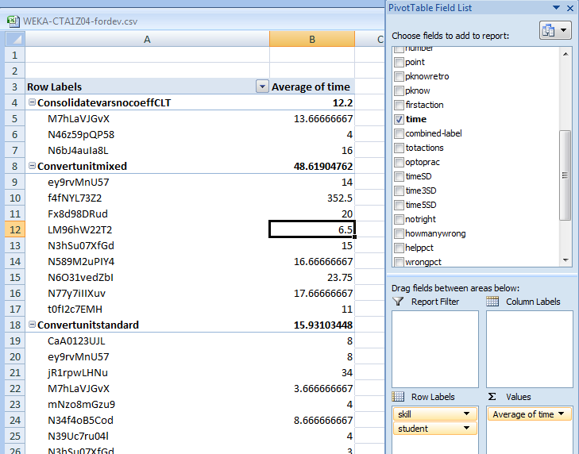
Pivot Tables

Slide 18
Pivot Tables
Who has used pivot tables before?

Slide 19
Pivot Tables
What do they allow you to do?

Slide 20
Pivot Tables
Facilitate aggregating data for comparison or use in further analyses

Slide 21
Equation Solver
Allows you to fit mathematical models in Excel
Let’s go through a simple example together

Slide 22
Equation Solver: Example
Let’s fit a Bayesian Knowledge Tracing model
We’ll discuss this model later
For now, it’s worth noting that classical BKT has four parameters per knowledge component
BKT predicts student knowledge and performance (correctness)
By fitting different values to the parameters, we get a better or worse fit to student performance
Using PSLC-SS-2012-Example-v1.xlsx
This is a small subset of my dissertation data from the Scatterplot Tutor, available in full form in the DataShop

Slide 23
Under SR type
=(J2-S2)^2
This finds the difference between the prediction (0 right now) and the correctness value (0 or 1)
Squaring it is a way to both get the absolute value, and magnify larger differences; very common in statistics

Slide 24
Go to sheet KC
These are the parameters for each skill

Slide 25
To the right of SSR type
=sum(data!T2:T20974)
This is the sum of squared residuals, again a very common way of evaluating models

Slide 26
To the right of r type
=CORREL(data!S2:S20974,data!J2:J20974)
This is the correlation between the model and the variable being predicted (correctness)

Slide 27
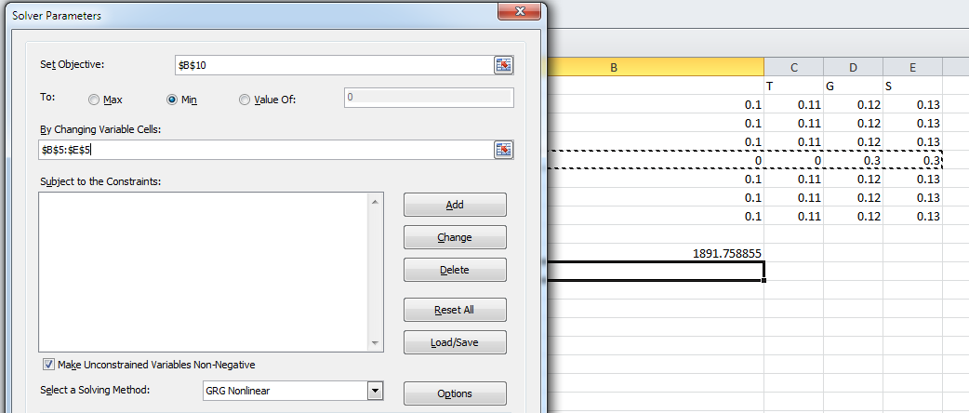
Now go into the Excel Equation Solver
And set up this model, and press solve

Slide 28
What changed?

Slide 29
What stayed the same?

Slide 30
Why is this useful?
You can specify a range of complex mathematical models
And much more quickly than you can implement them in software
Excel is usually where I test variants on Bayesian Knowledge Tracing before implementing them in Java

Slide 31
Note
Excel is a good starting point for this type of analysis… but not a good ending point
For example, the Equation Solver is not as good at finding optimal values for BKT as
Expectation Maximization
Brute Force/Grid-Search

Slide 32
Comments? Questions?

Slide 33
Suite of visualizations
Scatterplots (with or without lines)
Bar graphs

Slide 34
Weka and RapidMiner
Data mining packages
RapidMiner has become more popular in recent years among the EDM community
I prefer it too

Slide 35
Weka .vs. RapidMiner
Weka easier to use than RapidMiner
RapidMiner significantly more powerful and flexible (from GUI, both are powerful and flexible if accessed via API)

Slide 36
In particular…
It is impossible to do key types of model validation for EDM within Weka’s GUI
Such as multi-level cross-validation
RapidMiner can be kludged into doing so
No data mining tool really tailored to the needs of EDM researchers at current time…

Slide 37
SPSS
SPSS is a statistical package, and therefore can do a wide variety of statistical tests
It can also do some forms of data mining, like factor analysis

Slide 38
SPSS
The difference between statistical packages (like SPSS) and data mining packages (like RapidMiner and Weka) is:
Statistics packages are focused on finding models and relationships that are statistically significant (e.g. the data would be seen less than 5% of the time if the model were not true)
Data mining packages set a lower bar – are the models accurate and generalizable?

Slide 39
R
R is an open-source competitor to SPSS
More powerful and flexible than SPSS
But substantially harder to use

Slide 40
Matlab
A powerful tool for building complex mathematical models
Beck and Chang’s Bayes Net Toolkit – Student Modeling is built in Matlab

Slide 41
Comments? Questions?

Slide 42
Pre-processing
Tomorrow morning, John and Ken will talk about some of the great data available in DataShop

Slide 43
Wherever you get your data from
You’ll need to process it into a form that software can easily analyze, and which builds successful models

Slide 44
Common approach
Flat data file
Even if you store your data in databases, most data mining techniques require a flat data file
Like the one we looked at in Excel

Slide 45
Feature Distillation is Essential
But time-consuming…

Slide 46
Educational Data Mining Workbench (Rodrigo et al., 2012)
Provides support for feature distillation and for rapid data labeling (aka text replays)
Supports data in DataShop format, as well as other formats
Available for free at http://penoy.admu.edu.ph/~alls/downloads-2

Slide 47
Feature distillation
Can automatically distill 26 features for DataShop data used in previous analyses
Can distill features at the transaction (individual student action) level
Can also distill aggregated features at the level of clips, defined by
time intervals
number of actions
“begin” and “end” events

Slide 48
Data Labeling
Supports “text replay” data labeling of clips
Clips can be sampled either randomly or in stratified fashion

Slide 49
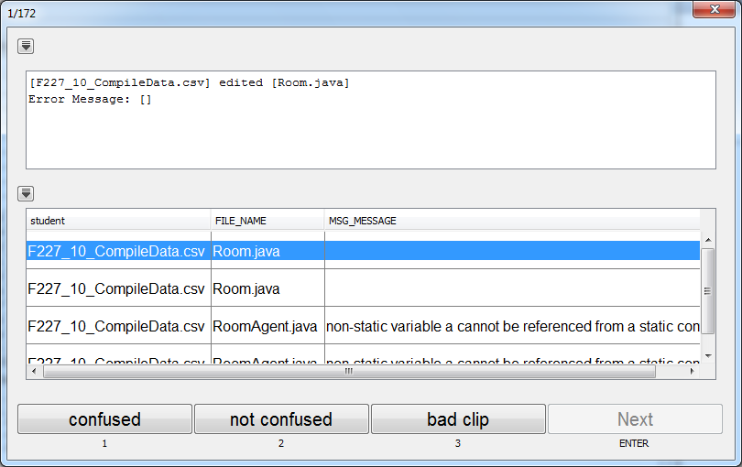
Data Labeling

Slide 50
Comments? Questions?

Slide 51
Time to work on projects

