Slide 1
Educational Data Mining Overview
John Stamper
PSLC Summer School 2011

Slide 2
Welcome to the EDM track!

Slide 3
Educational Data Mining
“Educational Data Mining is an emerging discipline, concerned with developing methods for exploring the unique types of data that come from educational settings, and using those methods to better understand students, and the settings which they learn in.”
www.educationaldatamining.org

Slide 4
Classes of EDM Method (Baker & Yacef, 2009)
Prediction
Clustering
Relationship Mining
Discovery with Models
Distillation of Data For Human Judgment

Slide 5
Prediction
Develop a model which can infer a single aspect of the data (predicted variable) from some combination of other aspects of the data (predictor variables)
Does a student know a skill?
Which students are off-task?
Which students will fail the class?

Slide 6
Clustering
Find points that naturally group together, splitting full data set into set of clusters
Usually used when nothing is known about the structure of the data
What behaviors are prominent in domain?
What are the main groups of students?

Slide 7
Relationship Mining
Discover relationships between variables in a data set with many variables
Association rule mining
Correlation mining
Sequential pattern mining
Causal data mining

Slide 8
Discovery with Models
Pre-existing model (developed with EDM prediction methods… or clustering… or knowledge engineering)
Applied to data and used as a component in another analysis

Slide 9
Distillation of Data for Human Judgment
Making complex data understandable by humans to leverage their judgment
Text replays are a simple example of this

Slide 10
Knowledge Engineering
Creating a model by hand rather than automatically fitting model
In one comparison, leads to worse fit to gold-standard labels of construct of interest than data mining (Roll et al, 2005), but similar qualitative performance

Slide 11
EDM track schedule
Tuesday 10am
Educational Data Mining with DataShop (Stamper)
Tuesday 11am
Item Response Theory and Learning Factor Analysis (Koedinger)
Tuesday 2:15pm
Principal Component Analysis, Additive Factor Model (Gordon)
Tuesday 3:15pm (optional)
Hands-on Activity: Data Annotation for Classification
Hands-on Activity: Learning Curves and Logistic Regression in R

Slide 12
EDM track schedule
Wednesday 11am
Bayesian Knowledge Tracing; Prediction Models
Wednesday 11:45am (optional)
Hands-on activity: Prediction modeling
Wednesday 3:15pm
Machine Learning and SimStudent (Matsuda)

Slide 13
Comments? Questions?

Slide 14
EDM Tools

Slide 15
PSLC DataShop
Many large-scale datasets
Tools for
exploratory data analysis
learning curves
domain model testing
Detail tomorrow morning

Slide 16
Microsoft Excel
Excellent tool for exploratory data analysis, and for setting up simple models

Slide 17
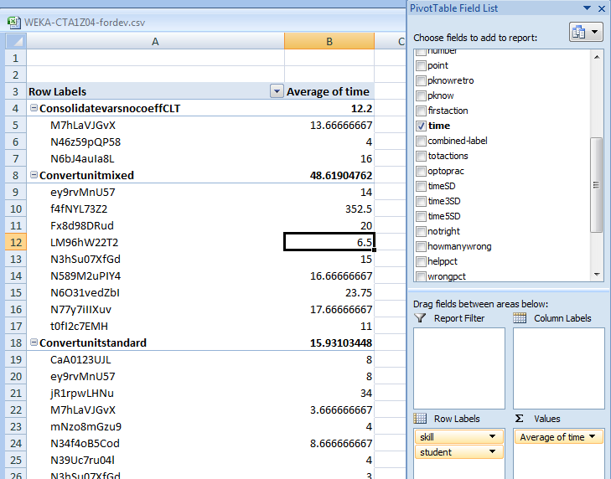
Pivot Tables

Slide 18
Pivot Tables
Who has used pivot tables before?

Slide 19
Pivot Tables
What do they allow you to do?

Slide 20
Pivot Tables
Facilitate aggregating data for comparison or use in further analyses

Slide 21
Excel Add-ins
Data Analysis
Statistical measures
T-tests, ANOVA, etc.
Equation Solver
Allows you to fit mathematical models in Excel
Simple regression models

Slide 22
Suite of visualizations
Scatterplots (with or without lines)
Bar graphs

Slide 23
Free data mining packages
Weka
RapidMiner

Slide 24
Weka .vs. RapidMiner
Weka easier to use than RapidMiner
RapidMiner significantly more powerful and flexible (from GUI, both are powerful and flexible if accessed via API)

Slide 25
In particular…
It is impossible to do key types of model validation for EDM within Weka’s GUI
RapidMiner can be kludged into doing so (more on this in hands-on session Wed)
No tool really tailored to the needs of EDM researchers at current time…

Slide 26
SPSS
SPSS is a statistical package, and therefore can do a wide variety of statistical tests
It can also do some forms of data mining, like factor analysis (a relative of clustering)

Slide 27
SPSS
The difference between statistical packages (like SPSS) and data mining packages (like RapidMiner and Weka) is:
Statistics packages are focused on finding models and relationships that are statistically significant (e.g. the data would be seen less than 5% of the time if the model were not true)
Data mining packages set a lower bar – are the models accurate and generalizable?

Slide 28
R
R is an open-source competitor to SPSS
More powerful and flexible than SPSS
But much harder to use – I find it easy to accidentally do very, very incorrect things in R

Slide 29
Matlab
A powerful tool for building complex mathematical models
Beck and Chang’s Bayes Net Toolkit – Student Modeling is built in Matlab

Slide 30
Comments? Questions?

Slide 31
Pre-processing
Where does EDM data come from?

Slide 32
Wherever you get your data from
You’ll need to process it into a form that software can easily analyze, and which builds successful models

Slide 33
Common approach
Flat data file
Even if you store your data in databases, most data mining techniques require a flat data file

Slide 34
Some useful features to distill for educational software
Type of interface widget
“Pknow”: The probability that the student knew the skill before answering (using Bayesian Knowledge-Tracing or PFA or your favorite approach)
Assessment of progress student is making towards correct answer (how many fewer constraints violated)
Whether this action is the first time a student attempts a given problem step
“Optoprac”: How many problem steps involving this skill that the student has encountered

Slide 35
Some useful features to distill for educational software
“timeSD”: time taken in terms of standard deviations above (+) or below (-) average for this skill across all actions and students
“time3SD”: sum of timeSD for the last 3 actions (or 5, or 4, etc. etc.)
Action type counts or percents
Total number of action so far
Total number of action on this skill, divided by optoprac
Number of action in last N actions
Could be assessment of action (wrong, right), or type of action (help request, making hypothesis, plotting point)

Slide 36
Any other recommendations?

Slide 37
Code Available
Ryan Baker has code available for EDM
http://users.wpi.edu/~rsbaker/edmtools.html
Distilling DataShop data
Bayesian Knowledge Tracing

Slide 38
Comments? Questions?

Slide 39
Time to work on projects

