Slide 1
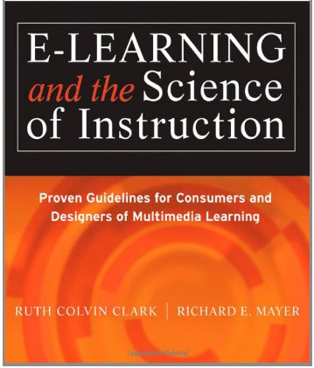
Applying the Segmenting and Pretraining Principles (Chapter 10)
Ken Koedinger

Slide 2
Which kind of processing are Segmenting & Pretraining targetting?
Extraneous
Essential or intrinsic
Generative or germane
Essential, according to the book
If essential processing is overloaded, what kind of processing suffers?
Generative

Slide 3
What are some generative processes?
Hint: Think of KLI.
Generative process are learning processes
Learning processes in KLI are
Memory & fluency building
Induction & refinement
Sense-making & understanding
As we discuss segmenting & pre-training examples, think about which of these generative/learning processes are needed

Slide 4
Segmenting Principle
Which is better for student learning?
A. Let a lesson “play” like a video so learners have a continuous picture of the entire procedure.
B. Let learners control the sequence by selecting screens in small bites so they can work at their own rate.
Example:

Slide 5
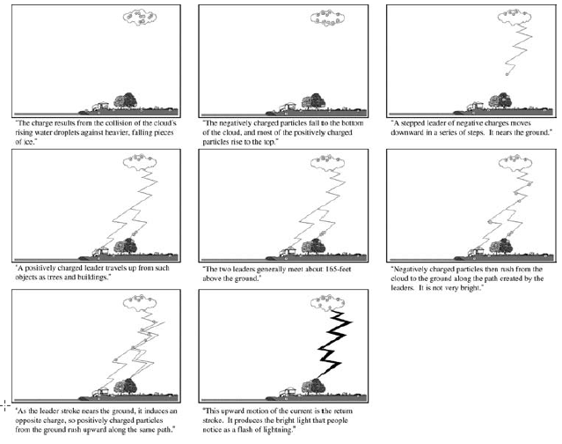
Lesson Complexity produces a need for Segmentation
Lightning lesson has many elements
warm and cold air, updrafts & downdrafts, positive & negative particles in the cloud, positive & negative particles on the ground, leaders & return strokes...
Can be broken into sixteen segments
each describes 1-2 major steps in causal chain

Slide 6
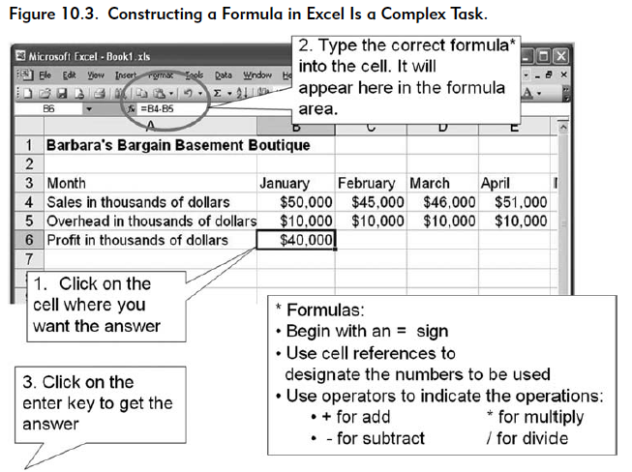
Break a complex lesson into smaller parts

Slide 7
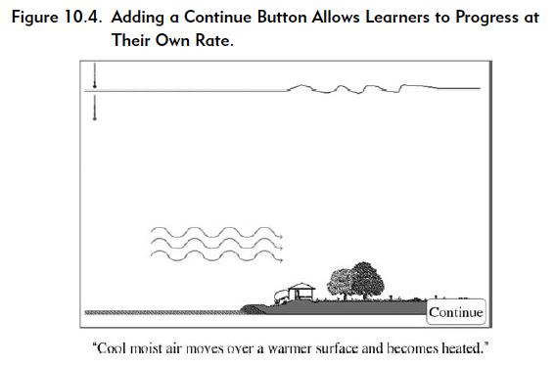
Student control may help (but see later chapter …)

Slide 8
Which of prior studies we have discussed used “segmenting”?
Substitution exercises in Heffernan paper on algebra symbolization
Decomposition planning exercises in Koedinger paper on geometry area

Slide 9
Why?
When an unfamiliar learner receives a continuous presentation containing a lot of interrelated concepts, the likely result is that the cognitive system becomes overloaded—too much essential processing is required.
The learner does not have sufficient cognitive capacity to engage in the essential processing required to understand the material.

Slide 10
What generative/learning processes are involved in examples above?

Slide 11
How does CTA aid application of this principle?

Slide 12
Pretraining Principle
Which is better for student learning?
A. Teach content in context of target procedures
B. Separate key concepts from the procedure.
Example:

Slide 13
Segmenting Principle
Which is better for student learning?
A. Let a lesson “play” like a video so learners have a continuous picture of the entire procedure.
B. Let learners control the sequence by selecting screens in small bites so they can work at their own rate.
Example:

Slide 14
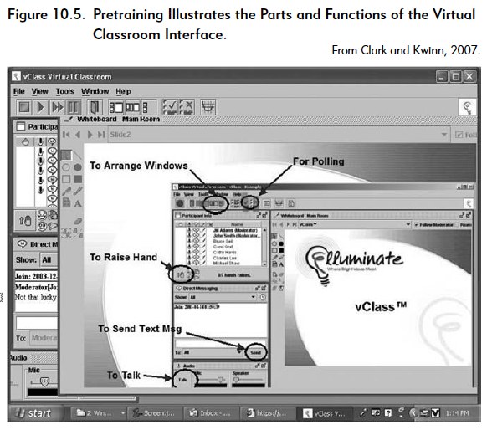
Pretraining
Ensure that learners know the names and characteristics of key concepts

Slide 16
Why?
Pretraining can help beginners to manage their processing of complex material by reducing the amount of essential processing they do at the time of the presentation.
If they already know what terms like “upper esophageal sphincter” mean, they can devote their cognitive processing to building a mental model of how that component relates to others in the causal chain
The pretraining principle helps manage the learner’s essential processing by redistributing some of it to a pretraining portion of the lesson

