Slide 1
Metacognition and Motivation: Goldilocks effects in Engaged Learning
Philip Pavlik Jr.
PSLC M&M Talk
November 11, 2010

Slide 2
Basic Constructs of M&M Model
Proxy for Active Engagement of Prior Learning
Interaction of Proximal Efficacy and Task Difficulty
Ease
Strategy
inverted U
linear increasing
Assistance Dilemma
Linear, but perhaps moderated by Interest or Strategy Knowledge?
Use
Perception of Affordances for Learning
Notes:
Question phrasing

Slide 3
Goals of the overall project
Understand how to maximize metacognitive engagement with tasks
  Hypothesis 1
    Easiness reports are a proxy for where the student is on the assistance dilemma curve.
      Too much or too little easiness should effect both the perception of and the actual amount of usefulness and engagement people experience
      How can we measure easiness
        Task is excellent, because it produces data on
        Preset difficulty (spacing)
          Student perceived difficulty
          Student behavioral difficulty
  Hypothesis 2
    Usefulness reports are a proxy for the students perception of educational affordances
      Usefulness may be an important mediator since it measures whether a student notices the affordances of appropriate difficulty (is the task in the learning flow zone?)
      Student noticing the appropriate difficulty (perceived ZPD) on instruction triggers an engagement with learning
  Hypothesis 3
    Strategy use is a proxy for executive engagement
    Engagement (executive attention) is a choice that is motivated by appropriate affordances for engagement
      How can we make engagement appealing to students
      Perhaps engagement can be considered a product of the assistance dilemma
      Too much assistance or too little assistance hurts engaged learning

Slide 4
Experiment 1: Fall 2009, Short Review
Experiment 1
  MSLQ administered in Sue-mei Wu’s Chinese LearnLab
  Vocabulary Practice for 2 units
    Each unit randomized as hard or easy (hard= less repetition, easy= more repetition)
    Difficulty, usefulness and strategy use questions during practice
  Post-survey
Goals
  Determine how student MSLQ factors mediate the experience of difficulty during learning
  Determine how strategy use reporting and usefulness reporting interact with easiness reporting and MSLQ factors

Slide 5
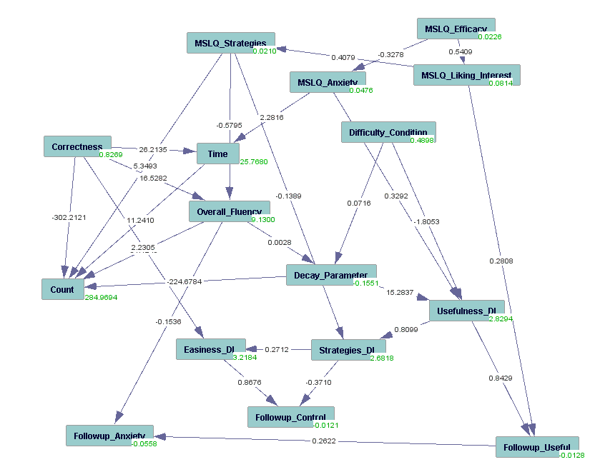
Experiment 1: Hypotheses and Findings
Before Practice
exploratory SEM model created with Tetrad software.
During Practice
After Practice

Slide 6
Experiment 2: Spring 2010, Basics
Experiment 2
  MSLQ (abbreviated 4 factor version) administered in Sue-mei Wu’s Chinese LearnLab
  Detailed Likert-like-scale vocabulary learning strategy survey
  Vocabulary Practice for 4 units
    Each unit students controlled difficulty with slider control (random starting difficulty)
    Difficulty, usefulness and strategy use questions during practice (Thrust Goal 1)
  Post-survey of easiness, usefulness, strategies overall
  Pre and post tests of vocabulary content (outside the tutor)

Slide 7
Experiment 2: Goals
Goals
  Test/ determine the basic model shown earlier
    Analysis is progress
      Conventional correlations
      acyclic Causal SEM models
      Dynamic Systems SEM
  Show effects on robust learning
  Basic goal -- Evaluate interventions aimed at supporting different metacognitive abilities :Thrust goal 2
  Model can be used to create interventions to support metacognitive engagement with the task
    Describe what levers cause engagement

Slide 8
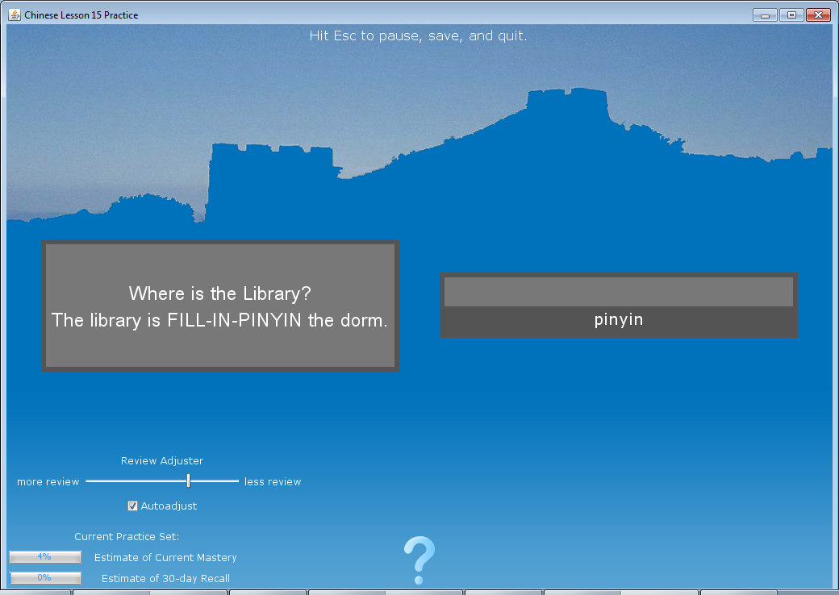
Experiment 2: Interface

Slide 9
Experiment 2: The Data
3 Temporal Tiers
  Pre-survey and Pre-test
    MSLQ Items (16 items)
    Strategy Items (6 items)
    Pre-Quiz (16)
  Practice Data
    Correctness
    Count (usually about 200 events per session)
    Sessions (max 4)
    Periodic Survey items (every 2 minutes)
  Post-survey and Post-test
    Pre Survey (23 items)
    Post-Quiz (16 items)

Slide 10
Experiment 2: Main Periodic Survey (psurvey) Items, every 2 minutes, random order by subject
How easy was the recent practice?
  too hard
  just right
  too easy
How useful for learning was the recent practice?
  not useful
  useful
  very useful
Were you able to use any learning strategies during the recent practice?
  mostly used repetition
  mix of strategy and repetition
  mostly used strategies

Slide 11
Experiment 2: Factor Analysis Pre-Survey
7 Factors
Goodness-of-fit Test
  Chi-Square df Sig.
  66.863 98 .993
Factors
  Interest - I am very interested in the content area of this course.
  Anxiety - When I take a test I think about how poorly I am doing compared with other students.
  CanUnderstand - I'm confident I can understand the most complex material presented by the instructor in this course.
  NaturalStrat - Sound symbolism - in this strategy you link the Chinese word by considering how it sounds and linking that with the meaning.
  Planning - I make simple charts, diagrams, or tables to help me organize course material.
  CanPerform - I believe I will receive an excellent grade in this class.
  ArtificialStrat - Keyword link - in this strategy you think of a native language word that sounds like the Chinese word and then you link this similar sounding word with the meaning.

Slide 12
Experiment 2: Factor Analysis Post-Survey
6 Factors
  Goodness-of-fit Test
      Chi-Square df Sig.
      90.751 130 .996
Factors
  Love - I found the practice so useful I wished I could have used it for other lessons.
  SpecificLike - I found the Hanzi prompts where the student types pinyin to be useful.
  LikeControl - I would like to be able to adjust how often new items are introduced during practice.
  Repetition(f14) - I tried to learn the items during practice by repeating them to myself, rather than using any specific learning strategies.
  OthCommit(f12) - I practiced less than I really wanted because of other commitments (e.g. work in another class).
  DislikePsurvey - I found the frequent questions about strategies, difficulty, and usefulness during practice to be annoying.

Slide 13
Experiment 2: Full Dataset Correlations with Survey’s (correlations, so causation is unknown, but temporal order may exist)
ArtificialStrat – Spacing
  -.40, p=.002
Anxiety – UserSpacing
  -.36,p=.045
Interest – LikeControl
  -.29,p.032
Anxiety – Love
  .278, p=.056
CanPerform – Love
  -.33, p=.022
CanPerform -- OthCommit
  -.33, p=.02
Planning – DislikePsurvey
  -.31, p=.035
Spacing – Repetition
  .293, p=.035
UserSpacing – LikeControl
  .46, p=.012
UserSpacing – Love
  -.396, p=.034
Easy – Love
  .29, p=.037
Useful – Love
  .52,p=0.00007
Strategy – Love
  .535,p=0.00004

Slide 14
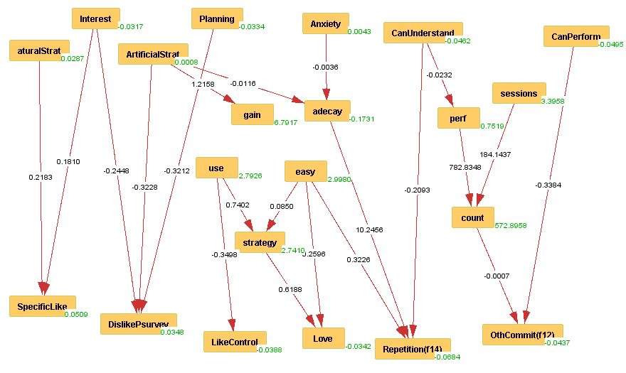
Experiment 2: Linking it up with exploratory SEM (subjects with >300 trials) (38 total)
Dynamic System Vars
exploratory SEM model created with Tetrad software.

Slide 15
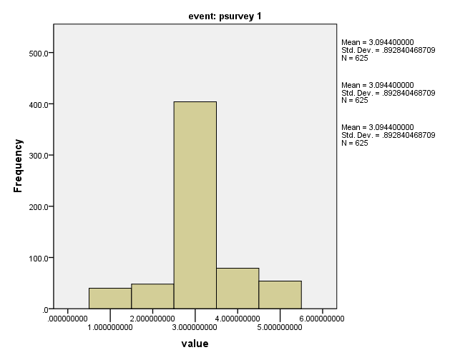
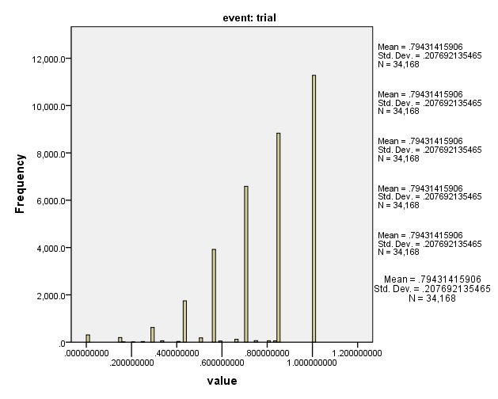
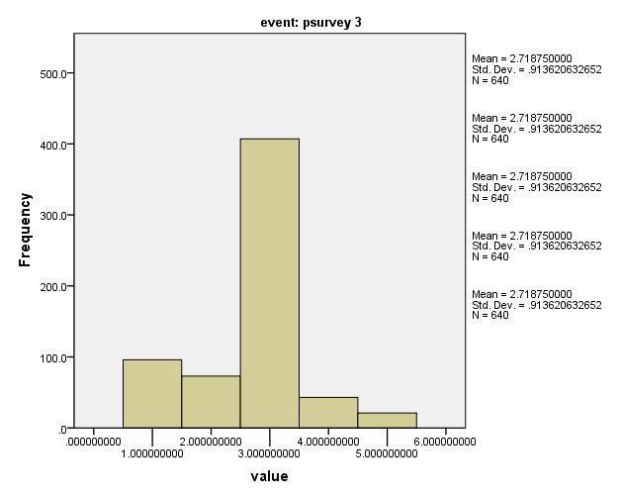
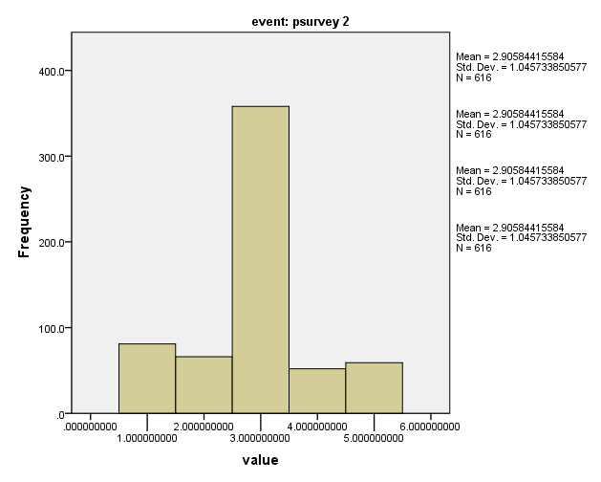
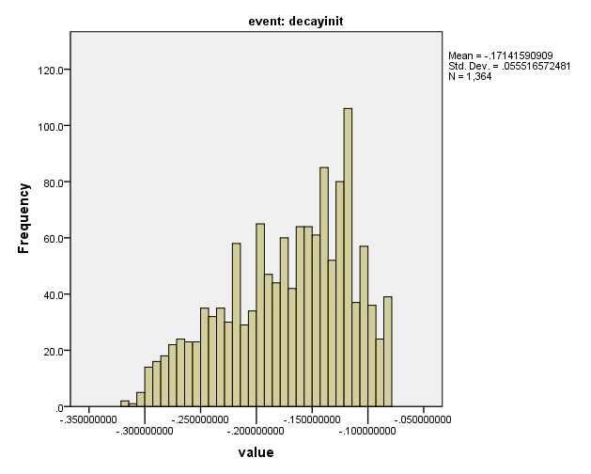
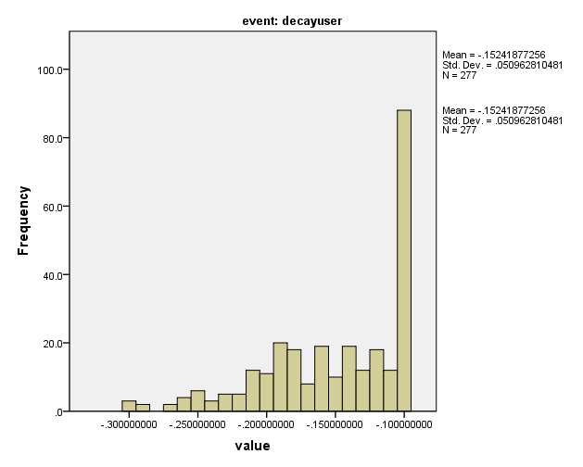
Experiment 2: Histograms of dynamic variables
Performance
(Last 7 trials % Correct)
Easy?
Strategies?
Useful?
Spacing
UserSpacing

Slide 16
Experiment 2: Dynamical System within Practice
Goal: link to pre-post results

Slide 17
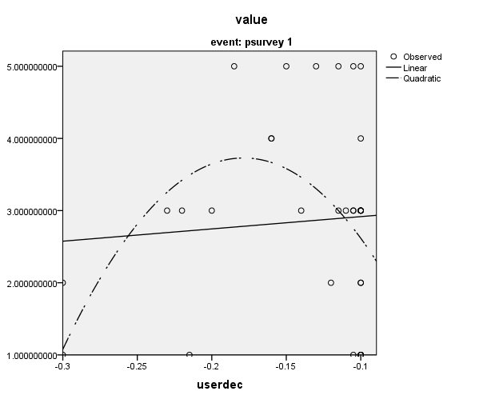
Experiment 2: UserSpacing → Easiness
High or low user selected spacing makes it harder
Probably driven by a few people making bad choice to have less review
  Why?

Slide 18
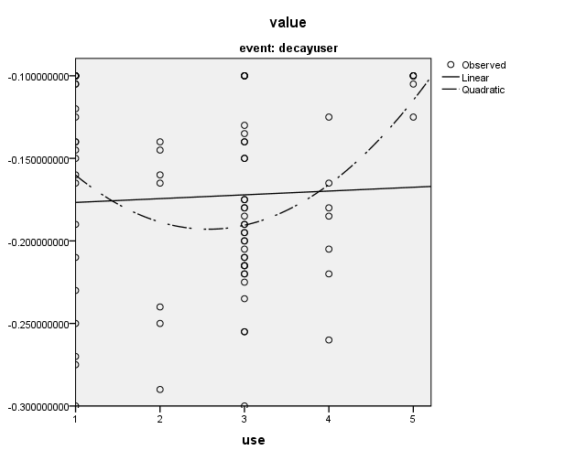
Experiment 2: Use → UserSpacing
If people find it very useful or very useless, they request wide spacing (less review)

Slide 19
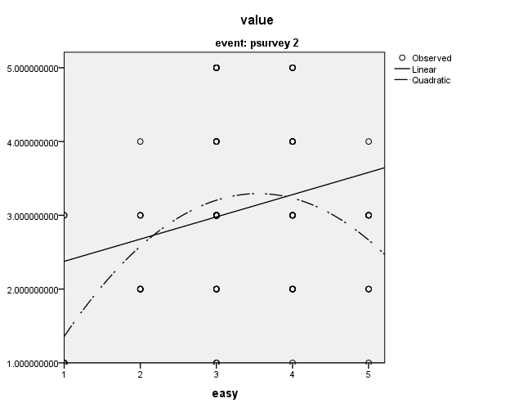
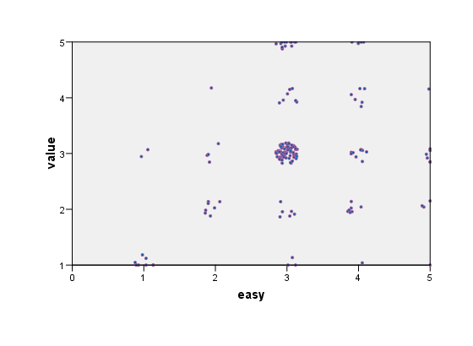
Experiment 2: Easy → Useful
Fairly strong inverted-U
If it is too easy or too hard, usefulness suffers

Slide 20
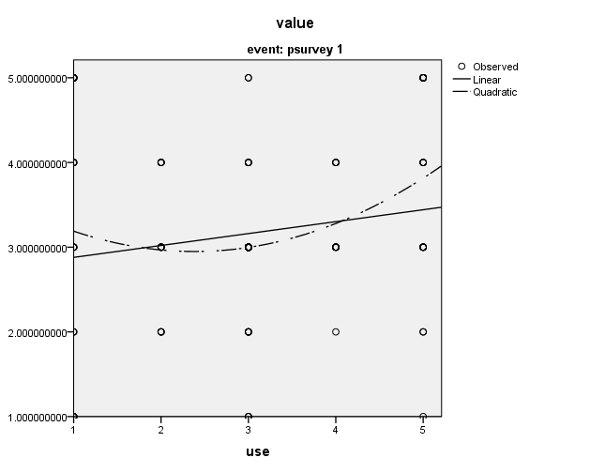
Experiment 2: Useful → Easy
If it is very useful or very useless, people find it easy
  People who find it useless may think task is trivially easy
    i.e. doesn’t matter if they get lost wrong, they may report it is easy as a categorical task perception
  People who find it useful probably work harder, making it easier

Slide 21
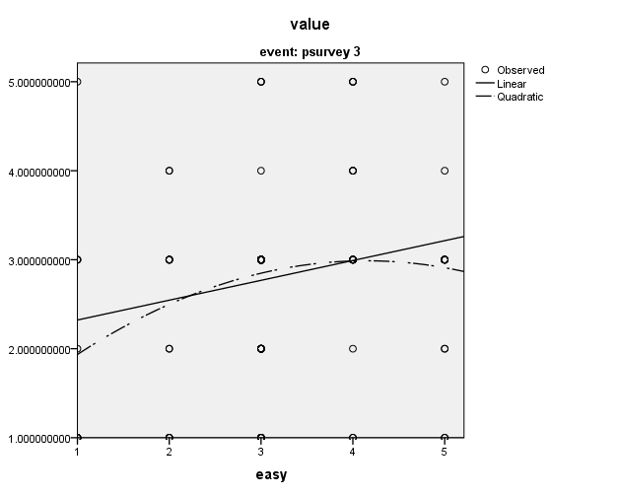
Experiment 2: Easy → Strategy
Both too easy and too hard can effect strategies, but it is better to be too easy

Slide 22
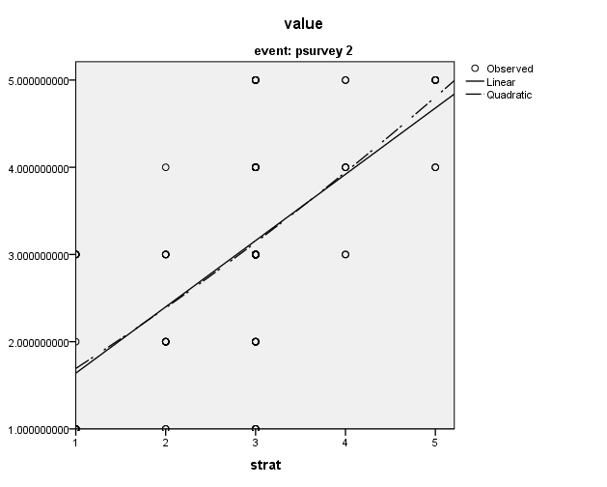
Experiment 2: Strategy → Useful
Strong linear

Slide 23
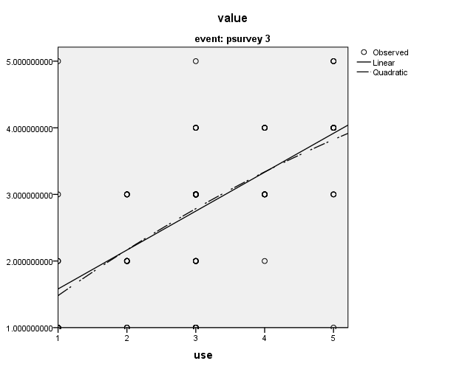
Experiment 2: Useful → Strategy
Strong linear

Slide 24
Experiment 2: What next
Look for fine grained effects of initial decay manipulations (as opposed to tracking decay in the current model) on dynamic variables or gain scores by unit
Consider pre-survey factors as covariates in dynamical model
Look for relationships of dynamic variables in each unit with
  student gain
  student count of trials
  gains score for unit
Look for how dynamic variables predict post survey results

Slide 25
Utility of the approach
Discover the levers to manipulate motivation to improve metacognition
Prescriptions for M&M
  Make it not too hard, not too easy
  Motivation makes metacognition
  Help people see opportunities for strategy
    Affordances for strategy
  Strategic engagement is motivating
  Several components to strategic engagement
    Just right difficulty
    Knowledge of strategy
    Perception of applicability

Slide 26
Year 2
In a similar way, the new hypothesis in the current year is that we will see changes in explicit strategy choice as a function of judged-difficulty.
Metacognitive control theory (Son & Metcalfe, 2000; Son & Sethi, 2006) supposes that students will allocate effort in relation to both the amount of time they have, and the judged-difficulty of the candidate tasks.
  We leave time open ended to look on at the effect of spacing on both judged difficulty and
In pursuing this theory, this project addresses the M&M Thrust Goal 2, to “Evaluate interventions aimed at supporting different metacognitive abilities.”

Slide 27
Experiment 3: New task tailored to M&M thrust
To address this we have developed a task that uses the optimal scheduling flashcard algorithm to select which Hanzi character to practice next, but:
  allows the students to choose the exercise for each character when it comes up
    select one of several exercises including: providing the English meaning, providing the Pinyin, providing the phonetic radical, providing the semantic radical
Students strategy choice will then allow them to compensate for difficulty because the student can choose to review a component of the character seen recently (an easy choice) or they may practice a new component of the character (a more difficult choice).
Students can also select whether they test or study each item selected for practice

Slide 28
Experiment 3: Conditions
This study will have three levels of difficulty (more widely spaced repetitions) and provide explicit opportunities for strategy choice built into the flashcard practice.
Experiment is a big SNAFU
  Low participation since I was not included on the syllabus
  High attrition 50%
  Programmer got everything else right, but missed recording the choice of student practice
    Probably still have difference is latency as a result of choices
    Still have periodic survey reports
    Data worth analyzing, but will be frustrating

Slide 29
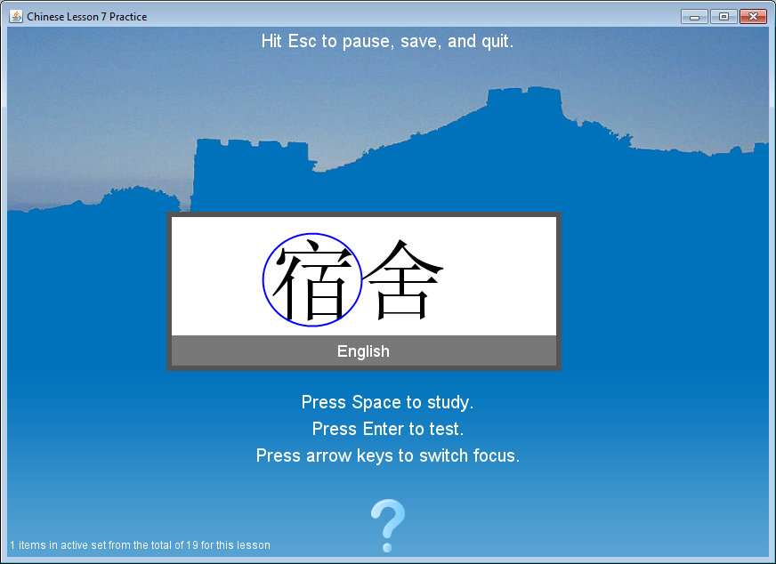
Experiment 3: Example of tested interface

Slide 30
Experiment 4
Experiment 4 will investigate the benefit of setting spacing at a group optimal level and then having it automatically adjust, versus setting it at a very easy level and having it automatically adjust
  The hypothesis is that having low initial difficulty will encourage strategy use early, and that this will persist even after the flashcard system difficulty automatically adjusts up to the same level.
New results put this in some question
  Too easy might have significant negative effects
Perhaps it makes more sense to have optimal spacing for whole experiment

Slide 31
Learnlab Issues Going Forward
How to get adequate subjects
  in context of PSLC LearnLab model
  or not
Perhaps a MacWhinney model makes more sense on second analysis?
  How to deal with content creation problem?
  Standard content
Cumulative practice issue
  Units are not optimal for optimization (too small)
  Chinese academic word list?
Other venues
  Twitter post for Chinese learners?

Slide 32
Conclusions
Potential of method proven
Supports model of student perception of strategic affordances as mediator of engagement
Shows slider may work for some subject, but hurt others
Bimodal slider use indicates potential for a 2 mode tutor, rather than slider control
  e.g. “test yourself” and “practice” modes
  Might result in much cleaner data for practice mode
Suggests manipulations of usability that improve perception of usefulness will increase strategy use
Suggests that manipulations of easiness need to hit the goldilocks zone to maximize strategic engagement
  mediated effect

