Slide 1
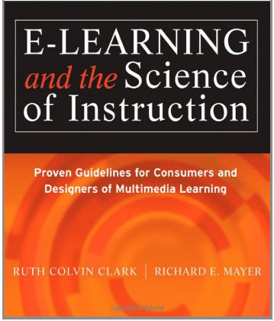
Does Practice Make Perfect?
(Chapter 12)
Ken Koedinger

Slide 2
Psychology MOOC Analysis
Hot off the press!
Kind of example you can only get from CMU!
See OLI Psychology Practice Activities
What’s best for learning?
  Doing activities
  Watching video
  Doing readings
  Some combination

Slide 3
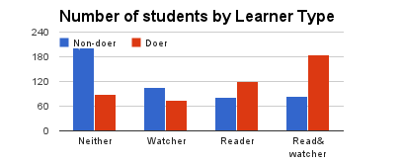
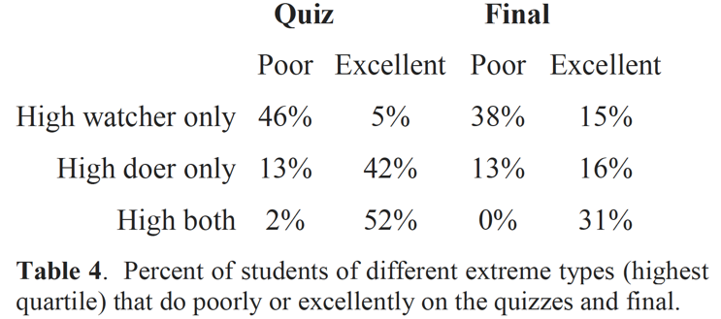
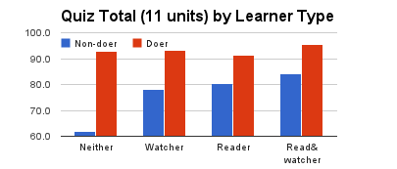
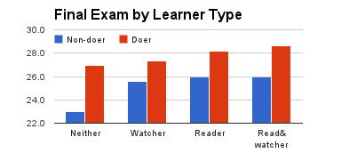
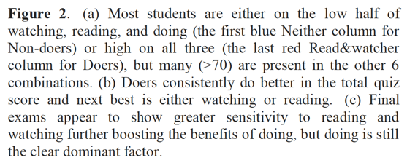
Results

Slide 4
Agenda:
What is Practice?
Practice Versus Deliberate Practice
Add Sufficient Practice
Mirror the Job
Provide Effective Feedback
Distribute Practice Effectively

Slide 5
Chapter 12 Objectives
Distinguish between practice and deliberate practice
Apply evidence on the following:
  How much practice to include
  What kind of practice is best
  What kind of feedback is best
  How to distribute practice exercises
  How to layout practice exercises
  Transitioning from examples to practice

Slide 6
What is practice?
Interactions that promote psychological engagement with the content in ways that help learners build knowledge and skills related to the learning goals.

Slide 7
Low High
Psychological Activity
Low High
Behavioral Activity
Adapted from Stull and Mayer, 2007
Notes:
In practice, it’s imprtant to design activities that promote meaningful learning. Most practice exercises should fall into the upper right quadrant. The next slides will mention several format alternatives for e-learning.

Slide 8
Interaction Formats
Common formats for e-learning practice:
Multiple choice
Simulation
Multiple select
Drag and drop
Notes:
What is important is the question engages the learner psychologically in ways congruent with the application environment. The next slides give a few examples of different formats.

Slide 9


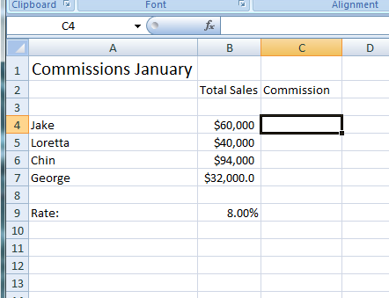
Multiple choice
Using Spreadsheets in your Small Business
Lesson 2: Working with Formulas
Which formula is
most efficient to calculate all commissions:
= B4*B9
= B4/B9
=B4*$B9$
=B4*$B$9
X
Incorrect. To apply the same formula to all sales staff, you need to use absolute cell references in which the column and row values are preceded by a $. Try Again.
Notes:
Discuss the concept that the format is less important than the psychological processes promoted. A multiple choice question can be a regurgitate question or an application question.

Slide 10
Simulation
Using Spreadsheets in your Small Business
Lesson 2: Working with Formulas
Type into Cell C4
the correct formula to calculate Jake’s
commission.
Notes:
Most simulations are relevant to the learning goal as they require the learner to respond according to the instructional objective. This is an example of a software operational simulation. Chapter 16 will discuss simulations in greater detail.

Slide 11
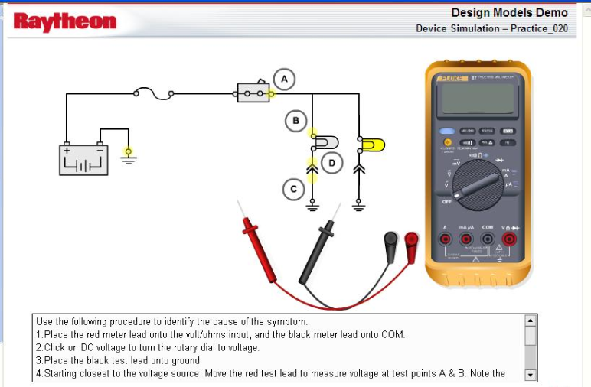
Simulation
Notes:
Most simulations are relevant to the learning goal as they require the learner to respond according to the instructional objective. This is an example of equipment operational simulation

Slide 12
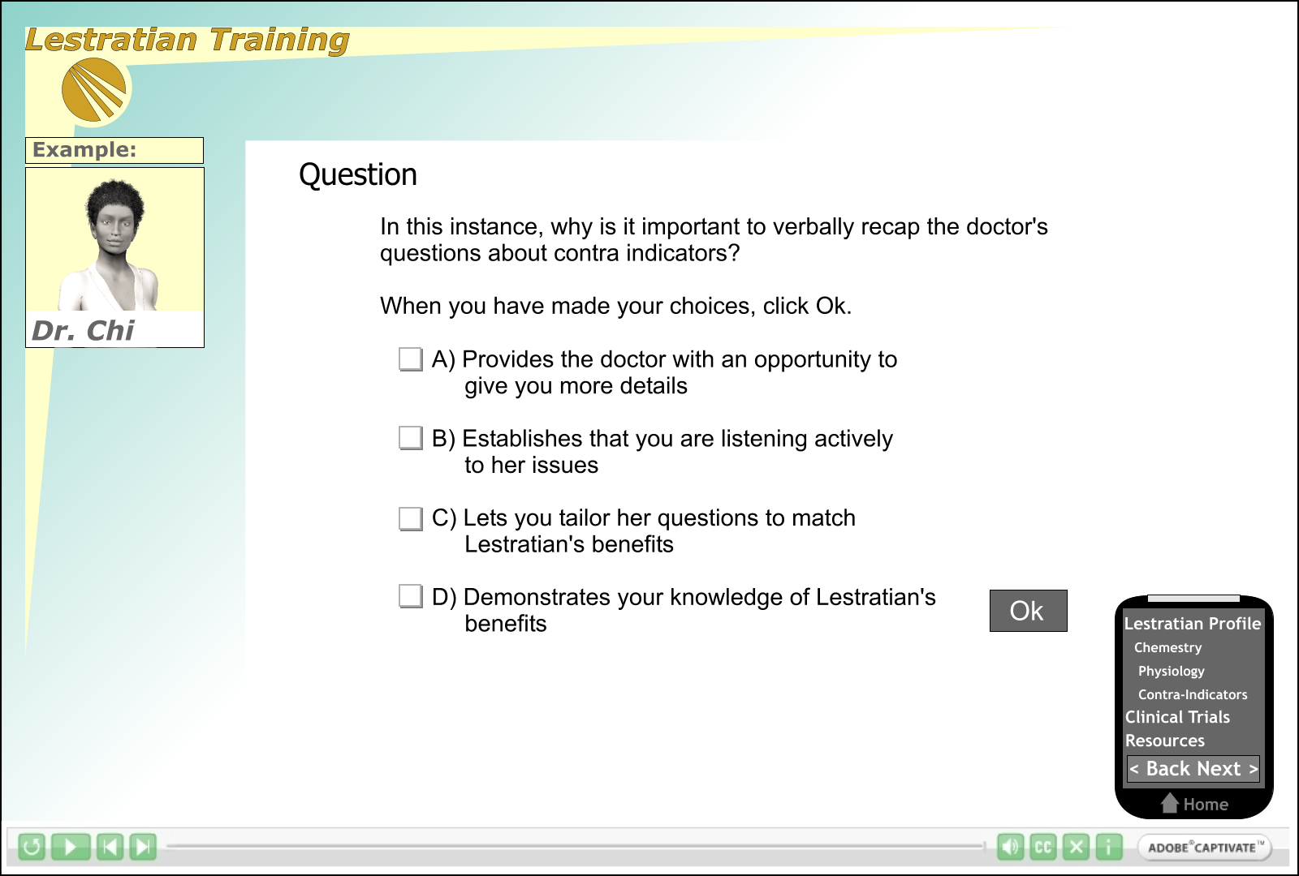
Multiple select
Notes:
Multiple select questions require the learner to identify several correct items. It can be more difficult to give specific feedback on each item in this format.

Slide 13
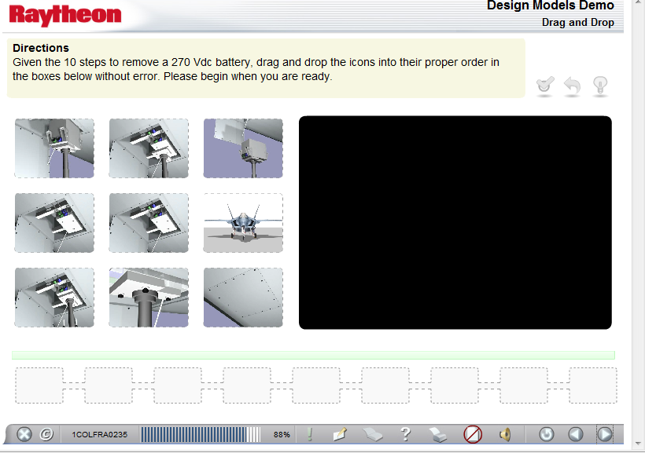
Drag and Drop
Notes:
Drag and drop requires the learner to correctly sequence or identify several items.

Slide 14
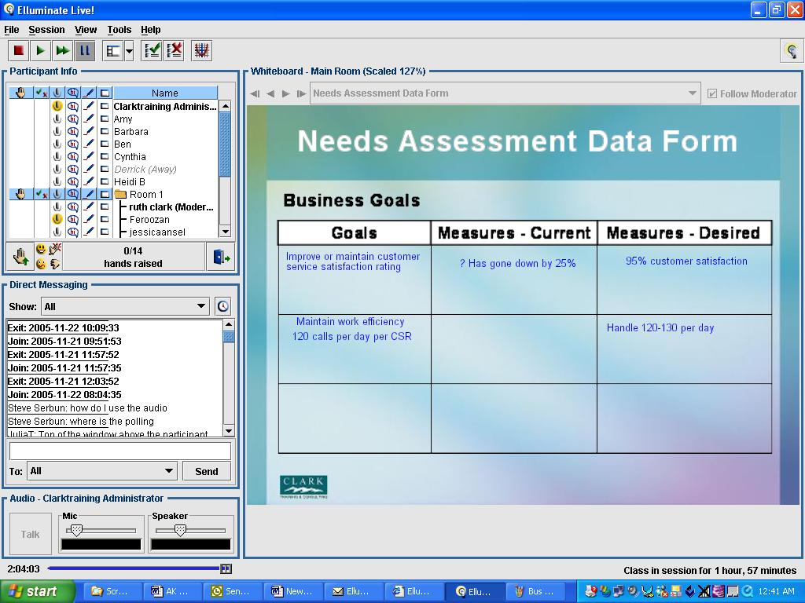
Virtual classrooms
Notes:
Virtual classrooms allow diverse interactions including chat, polling, and team projects in break out rooms.

Slide 15


Practice Vs Deliberate practice
Effortful exertion to improve performance
Intrinsic motivation to engage in task
Carefully tailored practice tasks that focus on
areas of weakness
4. Feedback
5. Continued repetition over a number of years
Notes:
Ask for examples of practice versus deliberate practice experiences. Derive the key features of deliberate practice from discussion. After discussion add the list to the slide.

Slide 16
Practice guidelines
How Much?
What kind?
Feedback?
Where?
Multimedia
Worked Examples
Psychological Activity
Low High
Behavioral Activity
Notes:
Organizer for question: How much practice do I need?

Slide 17
Is more practice better?
Lesson A
Lesson B
Example 1
Practice 1
Practice 2
Practice 3
Example 1
Practice 1
Practice 2
Practice 3
Practice 4
Practice 5
Practice 6
Notes:
Ask students – which lesson will result in better learning?

Slide 18
The power law of practice
Time to Complete Laparoscope Task
0 10 20 30 40 50 60 70 80 90
1 2 3 4 5 6 7 8 9 10 11 12
Session
Notes:
Summarize power law of practice

Slide 19
The costs of practice
 | 66 Practices | 22 Practices
Test Scores | 32.25 | 28.26
Time | 146 | 83
- Schnackenberg et al, 1998
Notes:
Emphasize that a small improvement in learning required a big investment in time. What is the ROI?

Slide 20
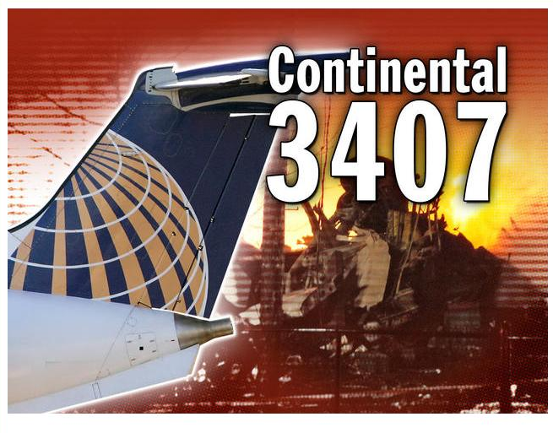
How Critical is the Skill?
Notes:
Investigation of this Buffalo fatal crash found training as one contributing factor. The stall maneuver had been ‘covered’ in the ground school but not practiced in a simulator. Task criticality will dictate the amount of practice needed.

Slide 21
Practice guidelines
How Much?
What kind?
Feedback?
Where?
Multimedia
Worked Examples
Psychological Activity
Low High
Behavioral Activity
Notes:
Organizer for question: What kind of practice is best?

Slide 22
Which is better?
Which statement is correct about Lestratin?
Should not be used for patients with diabetes
A good option for prenatal weight management
A long-term solution for childhood obesity
Notes:
Compare and contrast this practice with the practice on the following slide.

Slide 23
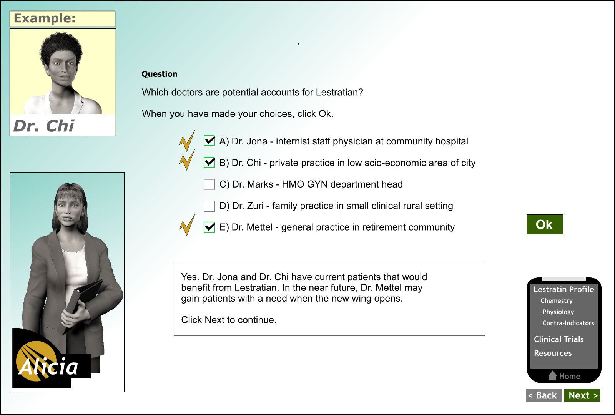
Which is better?
Notes:
This practice includes more context than the previous practice requiring the learner to apply drug facts to job decisions.

Slide 24
Mirror the job
Goal
Job
Tasks
Objectives
Test
Practice
Notes:
Best learning emulates context of the workplace.

Slide 25
Practice guidelines
How Much?
What kind?
Feedback?
Where?
Multimedia
Worked Examples
Psychological Activity
Low High
Behavioral Activity
Notes:
Organizer for question: Importance of feedback

Slide 26
Which is better?
Using Spreadsheets in your Small Business
Lesson 2: Working with Formulas
Which formula is
most efficient to calculate all commissions:
= B4*B9
= B4/B9
=B4*$B9$
=B4*$B$9
X
Incorrect. Click Next to continue.
Notes:
Compare feedback on this slide with next slide

Slide 27
Which is better?
Using Spreadsheets in your Small Business
Lesson 2: Working with Formulas
Which formula is
most efficient to calculate all commissions:
= B4*B9
= B4/B9
=B4*$B9$
=B4*$B$9
X
Incorrect. To apply the same formula to all sales staff, you need to use absolute cell references in which the column and row values are preceded by a $. Try Again.
Notes:
Compare feedback on this slide with previous slide . Which is more effective and why?

Slide 28
Feedback
Among the top 10 influences
on achievement
1/3 of FB Interventions
DECREASED performance
- Hattie (2009); Kluger & DeNisi, 1996
Notes:
Although feedback is a powerful instructional method, some types of feedback can actually depress learning.

Slide 29
Feedback study in Design-A-Plant
A
B
Your answer is correct
Yes, in a low sunlight
environment, a large leaf
has more room to make
food by photosynthesis.
Notes:
Corrective vs explanatory feedback in game compared - which is best?

Slide 30
50
40
Explanatory
Feedback
Corrective
Feedback
30
Scores on Transfer Test
SD
20
SD = Significant Difference
10
. Based on Data from Experiment 1 Moreno, 2004.
Notes:
Explanatory feedback is more effective.

Slide 31
Which feedback is better?
A
B
Good Job – you earned
B+
80% correct– Let’s review
absolute versus relative
cell references.
Notes:
Polling – this question points to the distribution of practice within a lesson

Slide 32


Focus on task – not ego
Notes:
Feedback including praise that draws attention to the self will diminish value of that feedback compared to feedback that draws attention to the task.

Slide 33

Which feedback is better?
p. 13
A
B
Good Job – you earned
B+
80% correct– Let’s review
absolute versus relative
cell references.

Slide 34
Practice guidelines
How Much?
What kind?
Feedback?
Where?
Multimedia
Worked Examples
Psychological Activity
Low High
Behavioral Activity
Notes:
Organizer for question: spaced vs massed practice

Slide 35
How should practice be spaced?
A
B
5 minute lesson with six practices
2 in the first section
2 in the middle
2 at the end
5 minute lesson with
six practices
3 in the middle
3 at the end
Notes:
Ask students to select the most effective lesson

Slide 36
Interpret the data
Spaced
100%
Massed
80%
60%
Test Scores
40%
20%
0%
1 week 4 weeks
Test time after Learning
. Based on data from Rohrer& Taylor, 2006 Experiment 1
Notes:
Discuss massed versus spaced practice. Spaced practice likely results in more rehearsal in WM and thus better long term retention

Slide 37
Which lesson is better?
A
B
5 minute lesson with six practices
2 in the first section
2 in the middle
2 at the end
5 minute lesson with
six practices
3 in the middle
3 at the end
Notes:
Polling – this question points to the distribution of practice within a lesson

Slide 38
Ways to spread practice
Among Lessons
Lesson A = 5 practices
Lesson B = 3 Lesson A, 5 from Lesson B
Lesson C = 2 Lesson A, 3 from B, and 5 from C
Among Learning Events
Extended learning
events over time and
media
Notes:
xxx Training Presenter Guide
38
Discussion of ways to organize lessons and courses to maximize spacing effect
Note: as you use this slide though the course, gray-out the section of the objective previously covered

Slide 39
Which is better?
PLAN A PLAN B
3 area practices: circle,
rectangle, triangle
3 area practices: circle,
rectangle, triangle
3 area practices: circle
rectangle, triangle
3 practices on area of a circle
3 practices on area of a rectangle
3 practices on area of a triangle
www.Clarktraining.com
Notes:
Which plan is mixed and which is blocked?

Slide 40
Interpret the data
Mixed Practice
100%
Blocked Practice
80%
60%
Test Scores
40%
20%
0%
Practice Test
Based on data from Rohrer& Taylor, 2009
Notes:
When does it make sense to consider mixed practice? When would blocked practice be better?

Slide 41
Practice guidelines
How Much?
What kind?
Feedback?
Where?
Multimedia
Worked Examples
Psychological Activity
Low High
Behavioral Activity
Notes:
Organizer for question: apply multimedia principles to practice

Slide 42
Multimedia principles
Using Spreadsheets in your Small Business
Lesson 2: Working with Formulas
Which formula is
most efficient to calculate all commissions:
= B4*B9
= B4/B9
=B4*$B9$
=B4*$B$9
X
Incorrect. To apply the same formula to all sales staff, you need to use absolute cell references in which the column and row values are preceded by a $. Try Again.
Notes:
Discuss the use of multimedia, modality, contiguity, coherence principles in this example.

Slide 43
Practice guidelines
How Much?
What kind?
Feedback?
Where?
Multimedia
Worked Examples
Psychological Activity
Low High
Behavioral Activity
Notes:
Organizer for question: apply multimedia principles to practice

Slide 44
Fading of worked examples
= Worked in Lesson
= Worked by the Learner
Step 1
Step 2
Step 3
Step 1
Step 2
Step 3
Step 1
Step 2
Step 3
Step 1
Step 2
Step 3
Worked
Example
Completion
Example 1
Completion
Example 2
Assigned
Problem
Notes:
Review fading as a way to gradually remove instructional guidance as learner gains expertise

