Slide 1
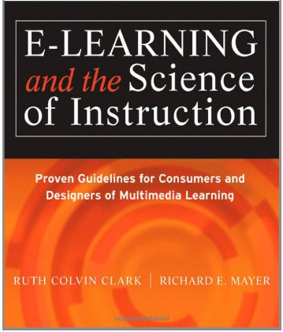
Applying the Personalization Principle (Chapter 9)
Ken Koedinger

Slide 2
Personalization Principle
Which is better for student learning?
Conversational style of instruction
Formal style of instruction
Example: “You should be very careful if you open any containers with pyrotechnics” vs. “Exercise caution when opening containers that contain pyrotechnics”

Slide 3
Personalization Principle
Which is better for student learning?
Conversational style of instruction
Formal style of instruction

Slide 4
Personalization Principle
Which is better for student learning?
A. Formal style of instruction.
B. Conversational style of instruction
Example: “Exercise caution when opening containers that contain pyrotechnics” vs. “You should be very careful if you open any containers with pyrotechnics”
B. Conversational
Why?
Humans strive to make sense of presented material by applying appropriate processes. Conversational instruction better primes appropriate processes because when people feel they are in a conversation they work harder to understand material.

Slide 5
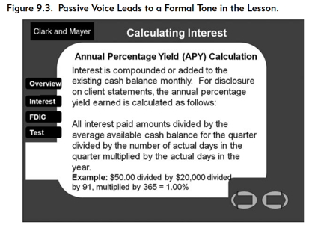
Use Conversational Rather Than Formal Style

Slide 6
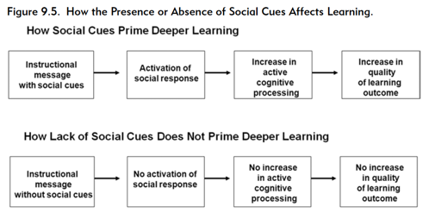
Why?

Slide 7
Promote Personalization Through
Voice Quality
Polite Speech

Slide 8
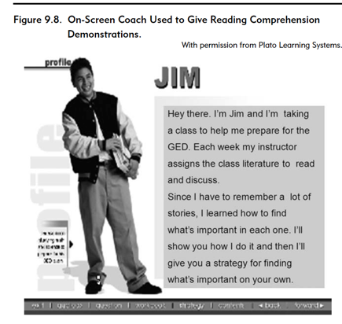
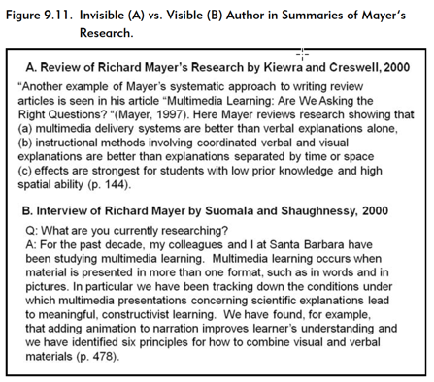
Other Kinds of Personalization
Use Effective On-Screen Coaches to Promote Learning
Make the Author Visible to Promote Learning?

Slide 9
What we don’t know about Personalization
when does it becomes counterproductive by being distracting or condescending
Conditions under which the visible author technique can be effective
Which features of an agent promote learning, such as the role of gesturing, eye fixations, and locomotion.
Which specific types of learners benefit more than others from the personalization principle

Slide 10
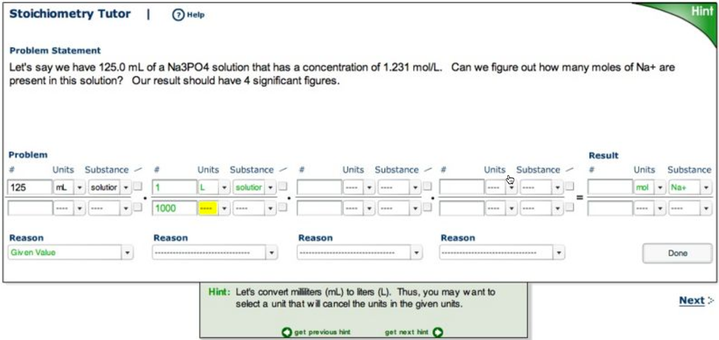
Chemistry example

Slide 11
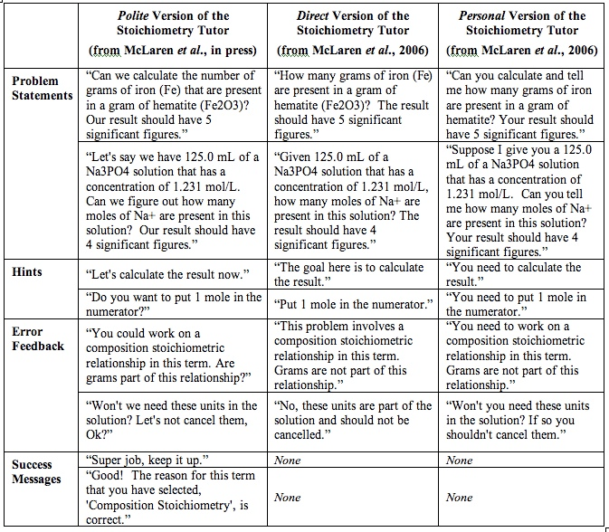

Slide 12
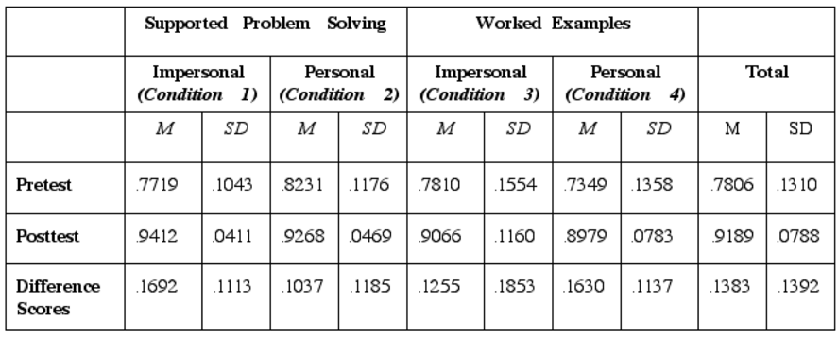
The impersonal conditions (gain of .15) performed slightly better than the personal conditions (gain of .13)

Slide 13
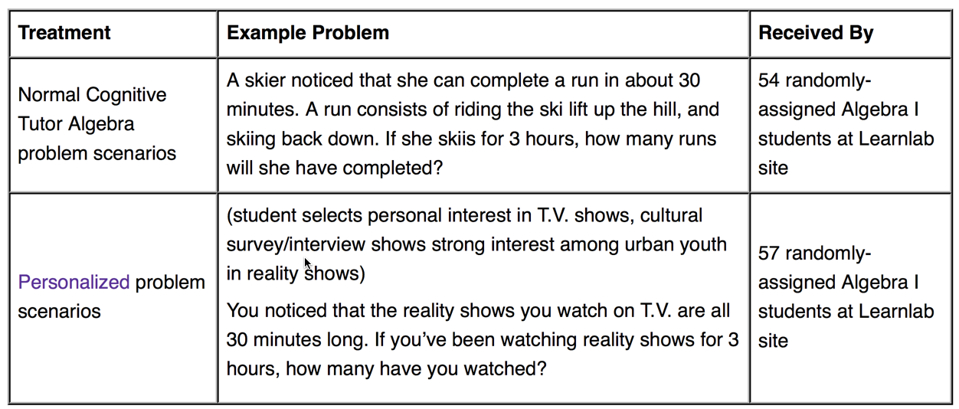
Algebra Cognitive Tutor example
Work by Candace DiBiano ….
Personalization had a positive overall effect on student performance. If a student had a 50% base chance of getting a problem correct on the first attempt, personalization would increase that chance to 55.3%.

Slide 14
Summary of Personalization Guidelines
Content & coaching
Instructional content is presented in conversational language using “you,” “your,” “I,” “our,” & “we”
Course author expresses own point of view or experience in ways that are relevant to the instructional goals
Coaching is provided via conversational narration from on-screen characters (that is, pedagogical agents)
Agents
need not look realistic but should exhibit human behaviors
dialog is presented via audio narration
voice quality & script are natural & conversational.
serve a valid instructional purpose

