Slide 1
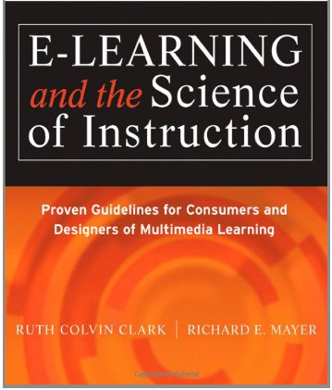
Applying the Guidelines (Chapter 17)
Ken Koedinger

Slide 2
Presentation guidelines
Content
E-learning unit goals & relevant background research
Example assessment tasks, e-learning screens
Illustrate how you implemented principles
Example data from CTA or prototype tests
Interesting/surprising insight(s) from your data
Fire hose presentation
2 minute “ad” for your poster
Send me 1 slide by 9:30am on the day your presentation
Poster
I’ll provide 36” x 42” poster board & pins
You bring 9-12 slide print-outs to pin on board

Slide 3
Tips on Experimental Design
What we have covered already:
Evidence-Based Practice, chapter 3
Redo Ch3 quiz, see slides, see text
Video on A/B testing in Games & Sim slides
Examples of experimental studies
In the chapters as support for principles
In papers: Feldon

Slide 4
Experimental design tips/issues (based on talking with you last time)
Consider as your control:
“Business-as-usual” – how do students currently learn in your domain
An existing product(s) are like yours – a (quick) competitive analysis is a way to identify and justify a control condition
Think about your justification for your innovative principle, what did you contrast with? That can be your control
Think about your experiment from a product marketing point of view
Don’t forget good experimental design
Try to change just one thing
Be aware when you are not, make it clear in your write up
some “focused gambling” (changing multiple factors based on theory) can be OK, but you need to justify it & point it out
OK to compare A to D, but acknowledge in your write-up that you know what B and C (tighter controls) could be
Controlling for instructional time vs. instructional tasks

Slide 5
Applying the Guidelines
Text provides guidelines or principles
mostly about the I in KLI
Other readings on Cognitive Task Analysis
mostly about the K in KLI
How does the L come in?
Note: Don’t forget induction
Many projects have key skill KCs (non-verbal, variable condition), but some emphasize sense-making & memory, but not induction!
Induction produces most of the 70% (Clark’s rule!) outside conscious awareness
Key power this course can give you for professional design: How do you reason about what you cannot observe (K & L)?
Two answers: Cognitive Task Analysis & Learning Theory behind Principles

Slide 6
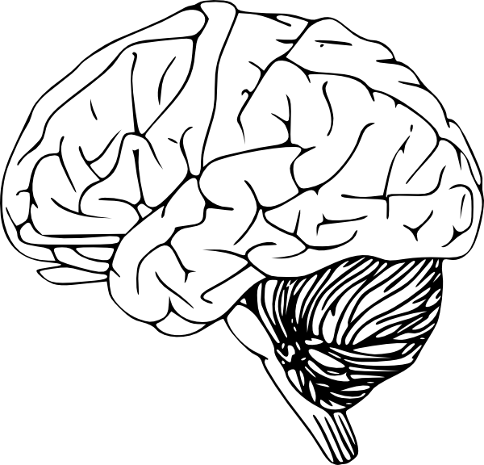
Knowledge-Learning-Instruction Framework (called KLI, rhymes with key)
Instructional events
Explanation, practice, text, rule, example, teacher-student discussion
Assessment events
Question, feedback, step in ITS
Exam, belief survey
KEY
Ovals – observable
Rectangles - inferred
Arrows – causal links
Learning events
Knowledge Components
Koedinger, Corbett & Perfetti. (2012). The Knowledge-Learning-Instruction (KLI) framework: Bridging the science-practice chasm to enhance robust student learning. Cognitive Science.

Slide 7
Instructional Design Big Picture
Goal
Setting
Assessment Task Design
Data
Model
Instructional Design
Data
Theory
Intuition & experience
Where does experimentation fit?

Slide 8
Educational design today & beyond
Today’s educational technology as like Ford’s original car, the Model T
Better than horse drawn carriage, but no where near a jet airplane
How can we get there?

Slide 9
Analogy to Wright brothers
“Like everything else the Wright brothers did up to this point, they applied a scientific method:
break bigger problems down into smaller ones,
study as much as possible what people have discovered before,
understand the principles and the theory behind the particular problem you're trying to solve,
and do some experiments to work out the particulars.”
From http://www.wright-house.com/wright-brothers/wrights/1903.html
Notes:
Orville wrote of his childhood: "We were lucky enough to grow up in an environment where there was always much encouragement to children to pursue intellectual interests; to investigate whatever aroused curiosity."
One activity Bishop Wright initiated was for debates in which two family members would each defend one side, then switch and defend the other side.

Slide 10
The “function space”
All the principles make a huge design space
Search the “function space” in choosing among principles
See KLI & Instructional Complexity papers

Slide 11
Instructional Complexity How many instructional options are there?
More help, passive
More challenge, active
What’s best?
Focused practice
Gradually widen
Distributed practice
Study examples
50/50Mix
Test on problems
Study
Study
50/50
Test
Study
50/50
Test
Concrete
Mix
Abstract
Concrete
Mix
Abstract
Immediate
Delayed
No feedback
Immediate
Delayed
No feedback
Block topics in chapters
Interleave topics
Block topics in chapters
Fade
Interleave topics
Fade
Explain
Mix
Ask for explanations
Explain
Mix
Ask for explanations
Many other choices: animations vs. diagrams vs. not, audio vs. text vs. both, …
Koedinger, Booth, Klahr (2013). Instructional Complexity and the Science to Constrain It. Science.
>3^{15*2} = 205 trillion options!
Notes:
LearnLab has explored many of these combinations in over 300 “in vivo” studies in OLI and other courses

Slide 12
Use “functions” to help search the design space
Education happens as follows :
The function (or purpose) of instruction is to facilitate learning processes
Learning processes function to create KCs
The function of KCs is to produce success in performance (on tasks in real world & on assessments)
Instructional design works backwards:
Goals & Assessment: What are your instructional goals & what tasks indicate student achievement of them?
What KCs are needed? Do CTA What kind of KC is needed (fact, skill, or principle)?
What learning processes are best for these kinds of KCs?
What instructional principles best enhance those learning processes?

Slide 13
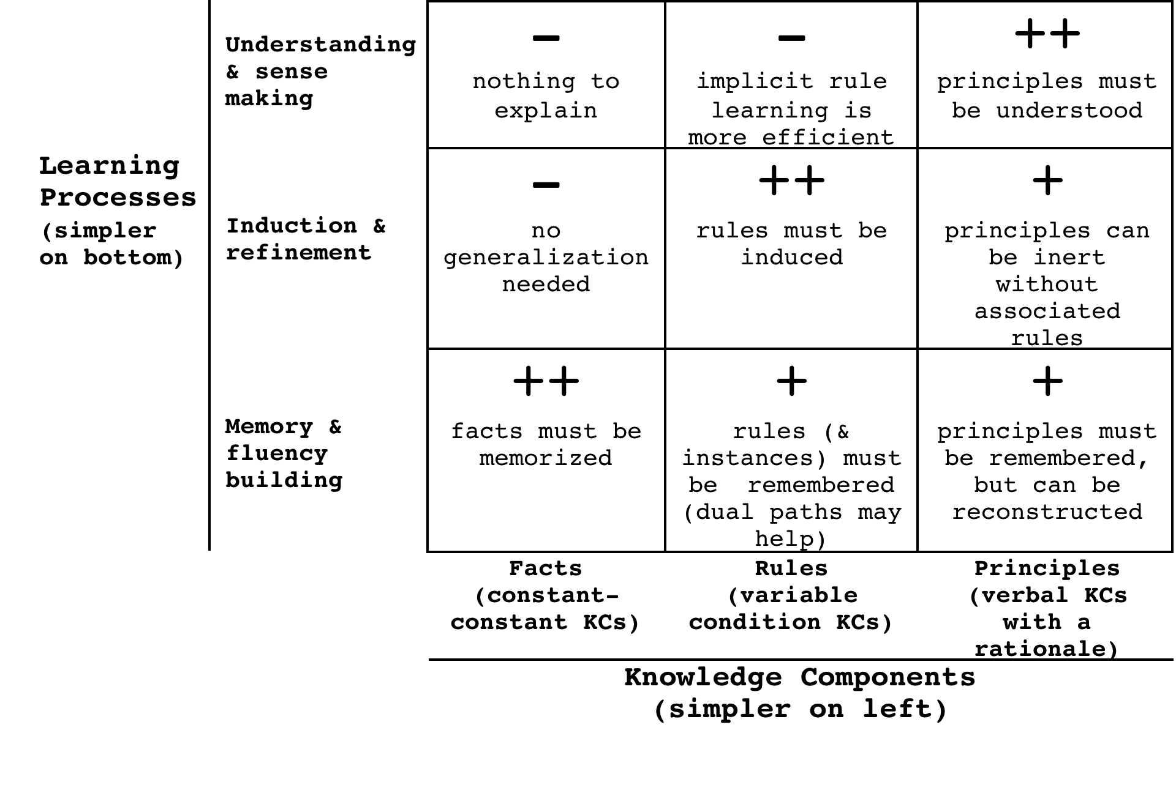
What kind of KC are you teaching? What learning process is best for it?
Notes:
More complex knowledge requires more complex learning processes
Constant vs. variable condition & response
Facts (constant condition KCs) require memory
Rules (variable condition KCs) require induction
Non-verbal vs. verbal knowledge
KCs can be in non-verbal or verbal form or both
Require different learning processes
KCs with rationales can be (re)discovered in addition to be instructed
Principles (verbal, variable, with rationale) require sense making

Slide 14
Learning Process theory – three broad categories
Cognitive Theory:
ACT-R models of spacing, testing effects & instructional efficiency (e.g., Pavlik)
SimStudent models of learning by example & by tutoring
Inductive logic, discrimination trees, probabilistic grammars (e.g., Matsuda, Cohen , Li, Koedinger)
Transactivity+ analysis of peer & classroom learning dialogues (e.g., Rose, Resnick)
Fluency building Memory, speed, automaticity
Induction processes Classification, co-training, discrimination, analogy, non-verbal explanation-based learning
Sense-making processes Reasoning, experimentation, explanation, argument, dialogue
Notes:
This list of learning processes is selectively drawn from relevant cognitive psychology and cognitive science mechanisms of learning, but also from machine learning (mostly in the middle), linguistics and education (mostly at the bottom).
To be sure, there are other instances of machine learning research and application in PSLC (e.g., for data mining), but the pointers here are in the context of modeling human learning.
An interesting open question: To what extent are these layers of abstraction, in the CS sense, whereby the “lower-level” processes, fluency/refinement, are closer-to-brainware implementations of the “higher-level” processes, refinement/sense-making?

Slide 15
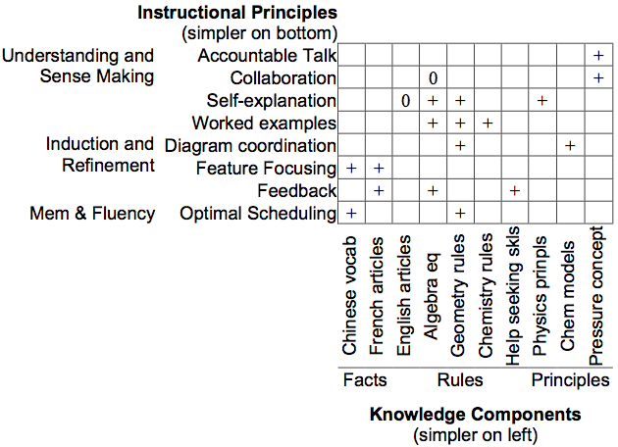
What learning process is needed? What instructional principle best supports such learning?
Koedinger et al. (2012). The Knowledge-Learning-Instruction (KLI) framework: Bridging the science-practice chasm to enhance robust student learning. Cognitive Science.
Notes:
A key goal of the KLI framework is as tool to generate novel hypotheses … The “knowledge-dependency” hypothesis: Effectiveness of instructional methods depends on kinds of KC. This hypothesis is in contrast to plausible competing hypotheses like 1) instructional principles are domain general, 2) instructional principles are dependent on domain characteristics.
Defining KC complexity: See slide further below for theory and slide above for empirical grounding (time course of execution).
Instructional complexity: Also, defined in terms of description length and time course of execution (step time in DataShop).

Slide 16
The Short List
Koedinger, Boothm & Klahr (2013). Instructional complexity and the science to constrain it. Science, 342(6161), 935-937.
Memory/Fluency | 1 | Spacing | Space practice across time > mass practice all at once
 | 2 | Scaffolding | Sequence instruction toward higher goals > no sequencing
 | 3 | Exam expectations | Students expect to be tested > no testing expected
 | 4 | Testing | Quiz for retrieval practice > study same material
 | 5 | Segmenting | Present lesson in learner-paced segments > as a continuous unit
 | 6 | Feedback | Provide feedback during learning > no feedback provided
Induction/Refinement | 7 | Pretraining | Practice key prior skills before lesson > jump in
 | 8 | Worked example | Worked examples + problem-solving practice > practice alone
 | 9 | Concreteness fading | Concrete to abstract representations > starting with abstract
 | 10 | Guided attention | Words include cues about organization > no organization cues
 | 11 | Linking | Integrate instructional components > no integration
 | 12 | Goldilocks | Instruct at intermediate difficulty level > too hard or too easy
 | 13 | Activate preconceptions | Cue student's prior knowledge > no prior knowledge cues
 | 14 | Feedback timing | Immediate feedback on errors > delayed feedback
 | 15 | Interleaving | Intermix practice on different skills > block practice all at once
 | 16 | Application | Practice applying new knowledge > no application
 | 17 | Variability | Practice with varied instances > similar instances
Sense-making/Understanding | 18 | Comparison | Compare multiple instances > only one instance
 | 19 | Multimedia | Graphics + verbal descriptions > verbal descriptions alone
 | 20 | Modality | Verbal descriptions presented in audio > in written form
 | 21 | Redundancy | Verbal descriptions in audio > both audio & written
 | 22 | Spatial contiguity | Present description next to image element described > separated
 | 23 | Temporal contiguity | Present audio & image element at the same time > separated
 | 24 | Coherence | Extraneous words, pictures, sounds excluded > included
 | 25 | Anchored learning | Real-world problems > abstract problems
 | 26 | Metacognition | Metacognition supported > no support for metacognition
 | 27 | Explanation | Prompt for self-explanation > give explanation > no prompt
 | 28 | Questioning | Time for reflection & questioning > instruction alone
 | 29 | Cognitive dissonance | Present incorrect or alternate perspectives > only correct
 | 30 | Interest | Instruction relevant to student interests > not relevant

Slide 17
KLI Summary
Fundamental causal chain:
Changes in instruction yield changes in learning yield changes in knowledge yield changes in robust learning measures.
Observed
Inferred
Design process starts at the end
Specify goals & performances on tasks that demonstrate achievement
Specify the knowledge needed to perform & what kind of knowledge it is
KC type indicates what learning processes are needed
Pick instructional principles that best support those learning processes
Notes:
KC types: condition, response, verbal, rationale

Slide 18
Extras

Slide 19
KLI explains discrepancy: Target Knowledge => Learning process needed => optimal Instruction
Many examples support
Worked examples
Worked examples
Testing effect
Testing effect
Eliciting recall supports
Aids fact learning, but suboptimal for rules
Aid rule learning, but suboptimal for facts

Slide 20
Self-explanation is optimal for principles but not for skills
Self-explain
Self-explain
Prompting students to self explain enhances
Supports verbal knowledge & rationale
Impedes non-verbal rule induction

Slide 21
Questions to for study regarding guidelines (a couple sample answers follow)
1. If you are being careful and scientific in selecting or developing an e-learning course or course module, what would you do, in the ideal world, that is even better than applying the Guidelines?
2. With respect to the multimedia principles, give a pair of example situations where you would make a different, scientifically-justified decision about whether or how a principle is applied in one situation than in the other. Pick one situation where you would apply a principle and another situation that is an exception, a case where you would not apply the same principle or would apply it differently. Try to make these situations a "minimal pair" where just one critical feature changes from one situation to other but all the other features of the two situations are the same. (Hint: In addition to what the textbook says about conditions of applicability of or exceptions to the principles, also consider the KLI Framework's notion of knowledge dependency.)
3. Provide a second different pair of examples to answer question 2.
4. Do the same as #2, but with respect to the job task principles.
5. Provide a second different pair of examples to answer question 4.
6. Provide yet another pair of examples along the lines of question 2, but for any principle in the book.
7. Does the screen in Figure 17.1 really violate the coherence principle? If so, why? If not, why not? What principle and guideline number (among 1-23) is applied in Figure 17.2 by doing the following: "The procedure is broken into a few steps organized with the tabs for ..."? What guideline # is applied in Figure 17.3 to make it so "controls allow the learner to apply as desired"?
9. Which guideline numbers are applied to create 17.5 and improve on 17.4? Which guidelines are violated in 17.5? And which one's make 17.6 better?
10. Do a similar analysis to that in questions 8 and 9 for either Sample 2 (starting on p. 414) or Sample 3 (starting on p. 418)?

Slide 22
1. If you are being careful and scientific in selecting or developing an e-learning course or course module, what would you do, in the ideal world, that is even better than applying the Guidelines?

Slide 23
1. If you are being careful and scientific in selecting or developing an e-learning course or course module, what would you do, in the ideal world, that is even better than applying the Guidelines?
If I am understanding the question correctly, instead of just applying the Guidelines as per the suggestion of the book, to be more careful and scientific, you should perform a CTA-based process, much like the project outline of this course. Additionally, you should delve into the research in your specific (and related) domains of learning to see if there are research-supported outcomes of applying different principles. Also, you should consider building your e-course out of some research-based framework, potentially the KLI Framework, that has been used for domains similar to yours. Also, throughout the development process, you should iteratively test your design with novices and experts alike, but ideally with the target student audience for your e-course. You should also create good evaluation techniques for your course to see if your design has made an improvement in learning in your area of focus for the course. To help others, you could publish your results to the e-learning community, which would also serve as an evaluation of your process and outcomes.
Wow, that was comprehensive. I'd just like to add that in an ideal world with infinite time and resources, it would be possible and optimal to run controlled experiments to test the real world impact of presence/absence of each feature and the different options in each instructional design decision.

Slide 24
With respect to the multimedia principles, give a pair of example situations where you would make a different, scientifically-justified decision about whether or how a principle is applied in one situation than in the other.

Slide 25
#2 - contrasting application of Multimedia principles
In designing a poetry tutor, the structure of the text and words is equally important to see as it is to hear, thus it would be justified to violate the redundancy principle. However, in designing a spoken word poetry tutor, the structure of the text is not a vital knowledge component to be learned, but instead performance accompanying the narration would be important. Thus in designing a spoken work tutor, animation or video accompanying narration of the poem would be more appropriate than the text of the poem as reinforced by the redundancy princip

Slide 26
END

