Slide 1
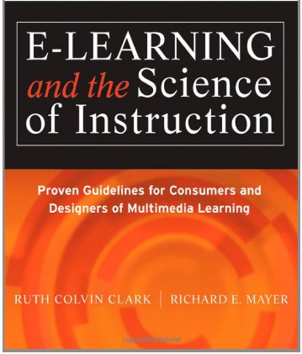
E-Learning Promise & Pitfalls
Chapter 1
Ken Koedinger
Based on slides from Ruth Clark

Slide 2
Chapter 1 objectives
Evaluate research evidence on media comparisons
Classify kinds of e-learning
  Timing: synchronous & asynchronous
  Lessons: inform, perform procedure or perform principle
  Architectures: receptive, directive, or guided discovery
Identify the good, bad, & ugly of e-learning
  Promises & pitfalls

Slide 3
Overview
What is e-learning & is it better?
Promises & pitfalls
Inform vs. perform
Three e-learning architectures

Slide 4
What is e-Learning?
Instruction delivered on a digital device that:
Includes content relevant to learning objective
Uses media elements such as words & visuals to deliver content
Uses instructional methods such as examples, practice & feedback to promote learning
Helps learners build new concepts & skills

Slide 5


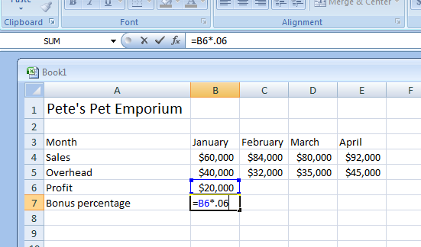
Asynchronous e-learning
Content + Media Elements + Methods
Self-study
Anywhere
Anytime
Using Spreadsheets in your Small Business
Lesson 2: Working with Formulas
Play>
All Excel formulas begin with an equal sign. Formulas also can include cell references, mathematical operators, and numbers. Using a cell reference allows you to quickly update your calculations when your data changes. Click on the play button on the spreadsheet above to see a short demonstration.
Notes:
Discuss differences between asynchronous and synchronous e-learning. Ask for experiences with asynchronous e-learning

Slide 6
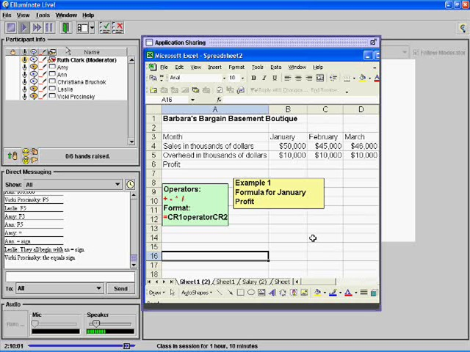
Synchronous e-learning
Content + Media Elements + Methods
Instructor-led
Same time
Anywhere
When recorded
=> asynchronous
Notes:
This image is “synchronous” because it is in online application where the attendees, shown in the top left, are all together at the same time (probably listening to the same live audio given by the “moderator”).
Discuss differences between asynchronous and synchronous e-learning. Ask for experiences with asynchronous e-learning

Slide 7
E-Learning in your organization
(or one you are familiar with)
Percentage of overall digital instruction?
Percent e-learning asynchronous?
Percent e-learning synchronous?
Percent available both asynchronously and synchronously
Topics
Notes:
The ASTD State of the Industry Report gives statistics on use of e-learning in business and industry for the previous year. Use this slide to get student input on e-learning types and use in their organization. See http://www.astd.org/Publications/Research-Reports/2013/2013-State-of-the-Industry

Slide 8
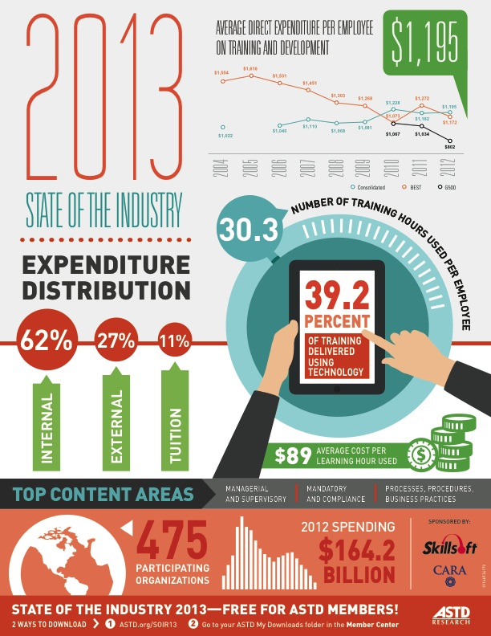
See Association for Talent Development website
Report on industry trends
http://www.astd.org/Professional-Resources/State-Of-The-Industry-Report
Job opportunities:
http://jobs.astd.org/

Slide 9


Where do students learn better?
A. Classroom
B. Computer
Notes:
Vote: Where would you learn statistics better? F2F classroom or asynchronous online? Ask for reasons.

Slide 10



Media comparison studies
A
B
C
How to Read a Micrometer
Notes:
Ask students to vote for which media they thought was best in this study. Refers to 1947 U.S. Army media comparison study.

Slide 11
Media comparison studies
A
B
C
When Instructional Methods are the same,
no differences in learning!
Notes:
Emphasize that all 3 versions used same words and visuals.

Slide 12
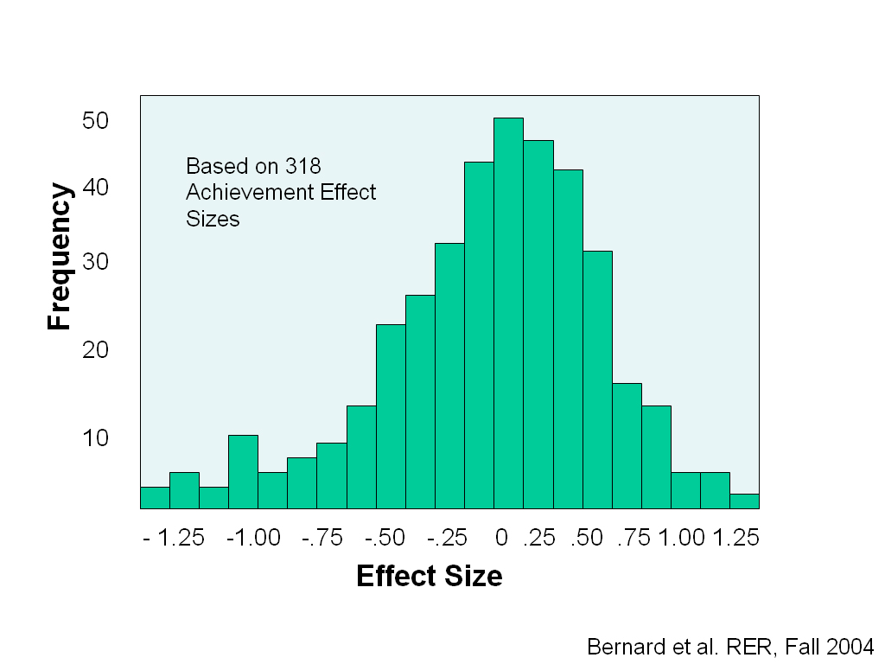
Notes:
Effect sizes explained in Ch 3. For now, effect size of 0 indicates no practical importance. Histogram illustrates that most comparisons are close to 0 range, but there are large positive and negative effects (“outliers”) on both sides. A positive effect of .25 is OK, .5 is good, 1.0 is large.

Slide 13
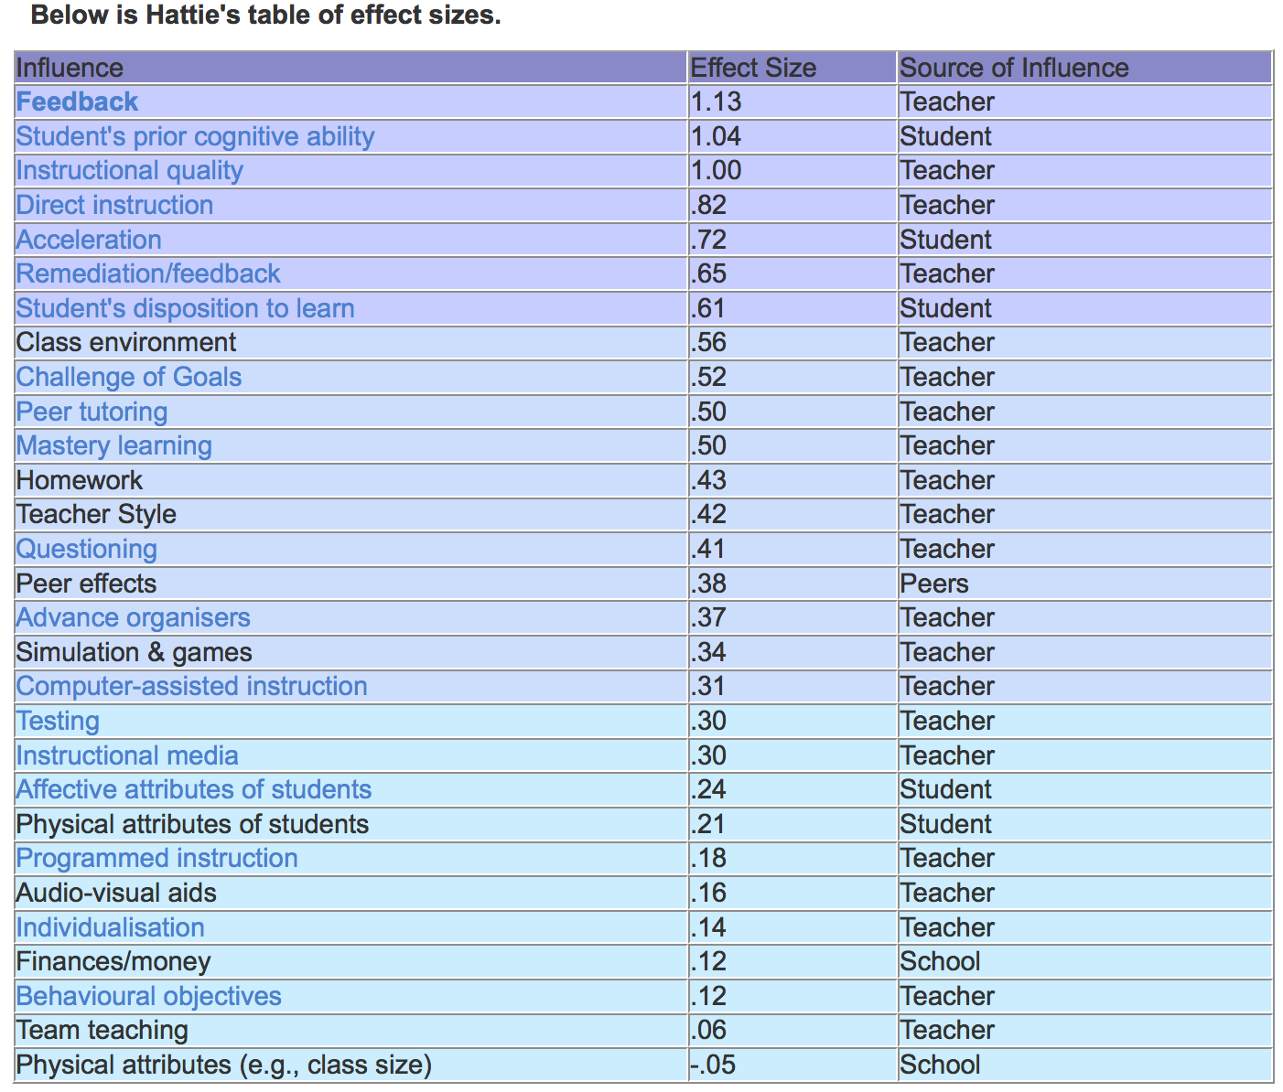
Found at http://www.teacherstoolbox.co.uk/T_effect_sizes.html
See also http://www.tdschools.org/wp-content/uploads/2013/08/The+Main+Idea+-+Visible+Learning+for+Teachers+-+April+2013.pdf

Slide 14




Media not equivalent
Notes:
Discuss features of different media. For example, pod casts limited to audio.

Slide 15
Overview
What is e-learning & is it better?
Promises & pitfalls
Inform vs. perform
Three e-learning architectures

Slide 16
Promises of e-Learning
Customized Training
Engagement in Learning
Multimedia
Acceleration of Expertise through Scenarios

Slide 17
Customized instruction
incorrect
correct
QUESTION
REVIEW
NEXT TOPIC
Notes:
Introduce the concept of adaptive instruction – use pretest as a simple example. Ask for student experiences with adaptive instruction

Slide 18
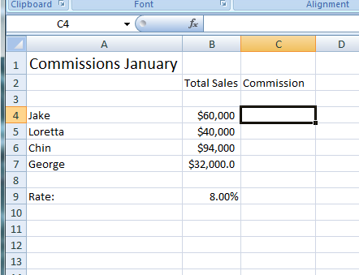
Engagement in learning
Using Spreadsheets in your Small Business
Lesson 2: Working with Formulas
Which formula is most efficient to calculate all commissions:
= B4*B9
= B4/B9
=B4*$B9$
=B4*$B$9
X
Incorrect. To apply the same formula to all sales staff, you need to use absolute cell references in which the column and row values are preceded by a $. Try Again.
Notes:
Discuss learner-centered instruction. Discuss how learner centered can be implemented in ILT, synchronous, asynchronous e-learning.

Slide 19
The engagement matrix
Low High
Psychological Activity
Low High
Behavioral Activity
Adapted from Stull and Mayer, 2007
Notes:
The matrix will be a recurrent theme of the book. Ask students to give examples that match each quadrant. Stress that behavioral engagement does not necessarily mean psychological engagement.

Slide 20
Multimedia
Using Spreadsheets in your Small Business
Lesson 2: Working with Formulas
Other
Outsourcing
Play >
Internal (Salaries, Development, Admin)
All Excel formulas begin with an equal sign. Formulas also can include cell references, mathematical operators, and numbers. Using a cell reference allows you to quickly update your calculations when your data changes. Click on the play button on the spreadsheet above to see a short demonstration.
Notes:
The computer is a flexible medium allowing for delivery of text, graphics (still and animated) and sounds

Slide 21
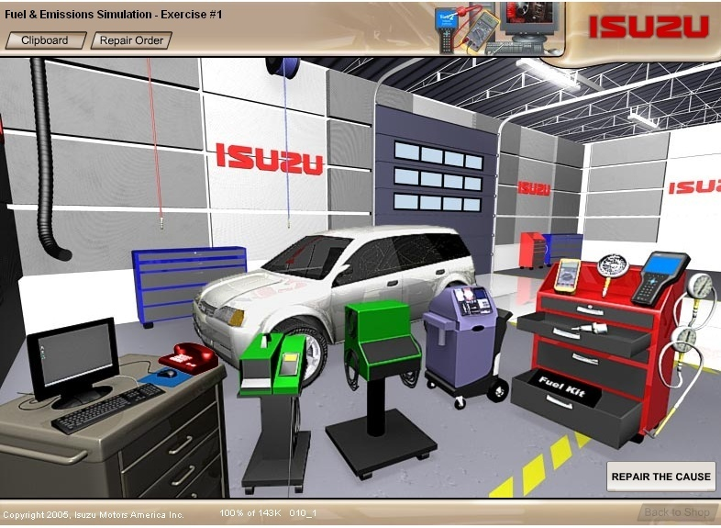
Acceleration of expertise
Notes:
By practicing in simulations, skills that are scarce or impractical to build in the real world can be accelerated.

Slide 22
Pitfalls of e-Learning
Too Much of a Good Thing
Not Enough of a Good Thing
Losing Sight of the Goal
Discovery Learning

Slide 23
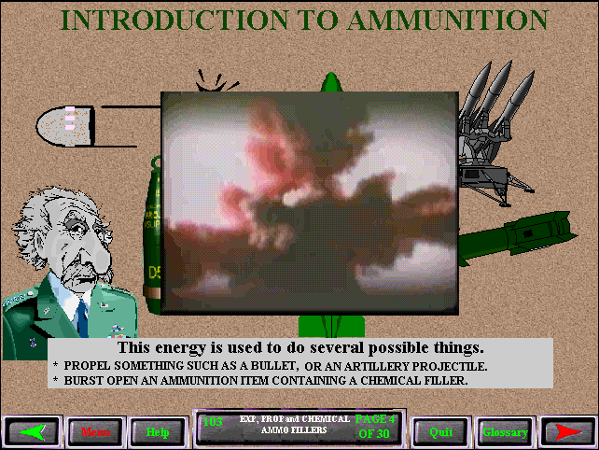
Too much of a good thing
Other
Outsourcing
Internal (Salaries, Development, Admin)
Notes:
This sample uses audio for bullets and bomb blasts. If you have a playable example, replace this screen shot.

Slide 24
Not enough of a good thing
Other
Outsourcing
Internal (Salaries, Development, Admin)
Notes:
By creating a wall of words, this lesson does not utilize graphics and audio capabilities

Slide 25

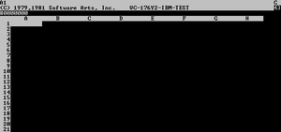
Losing sight of the goal
Using Spreadsheets in your Small Business
Introduction
Did you know….?
VisiCalc
Dan Bricklin , one of the inventors of the electronic spreadsheet, watched his university
professor create a table of calculation results on a blackboard. When the professor
found an error, he had to tediously erase and rewrite a number of sequential entries in the table.
This gave Bricklin the idea to replicate the process on a computer, using the blackboard as the model to view results of underlying formulas. This idea resulted in VisiCalc the first electronic spreadsheet which became the ‘killer app ‘ for the Apple II computer!
Notes:
Discussion: When might this storyboard from an Excel class be an example of losing sight of the goal and when not?

Slide 26
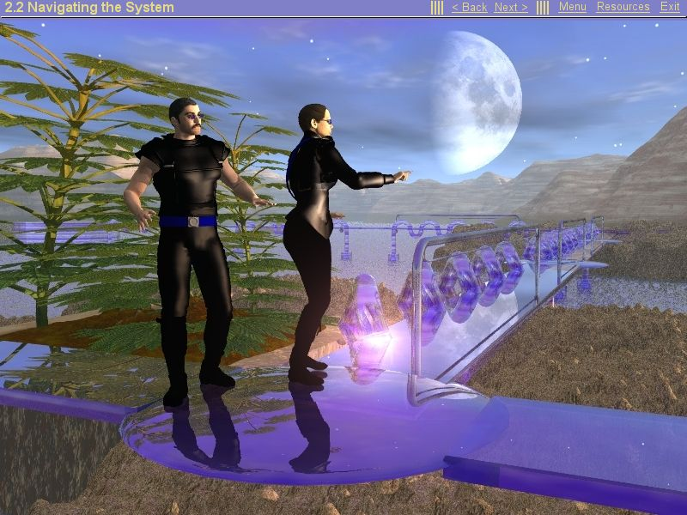
Discovery learning
Other
Outsourcing
Internal (Salaries, Development, Admin)
Notes:
This fantasy game required learners to explore the environment to discover facts about the new product. Why has discovery learning proven to be ineffective?

Slide 27
Overview
What is e-learning & is it better?
Promises & pitfalls
Inform vs. perform
Three e-learning architectures

Slide 28
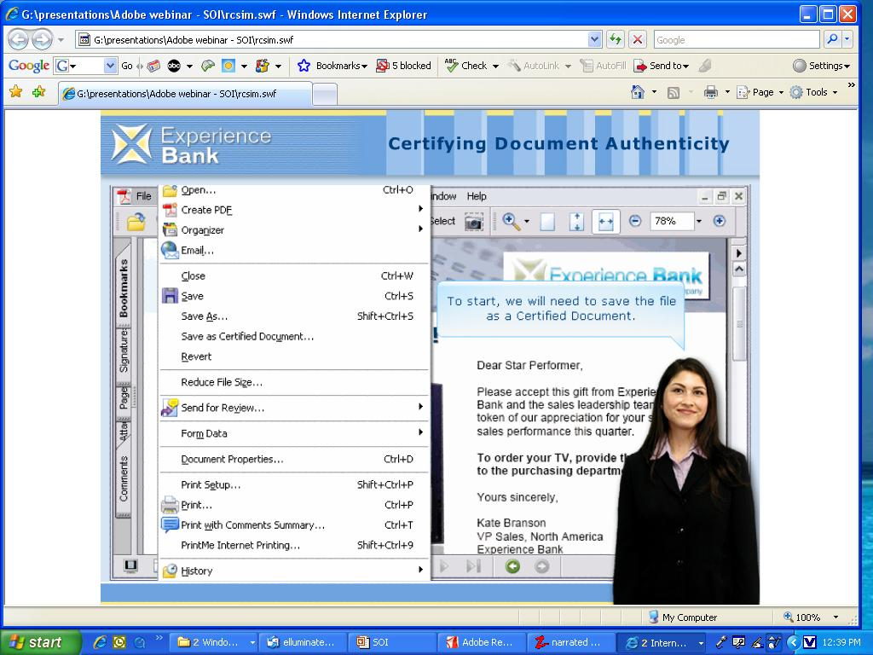
Goals: Inform Vs perform
Inform
Perform
To present information
To build skills
Notes:
Ask for examples of inform versus perform goals from student’s organizations

Slide 29
Perform goals: Near Vs Far transfer
Near
Far
To build procedural skills
Routine tasks
To build strategic skills
Problem-solving tasks
Notes:
Ask for examples of near and far transfer learning from student’s experiences.

Slide 30
Practice: Near vs Far Transfer
A. Changing a tire
B. Conducting performance review
C. Calibrating a zygometer
D. Flying Boeing 747
E. Baking a pie
Notes:
Ask students to identify each as near or far. Answers: Near = a, c; Far = b Both = d or e.

Slide 31
Overview
What is e-learning & is it better?
Promises & pitfalls
Inform vs. perform
Three e-learning architectures

Slide 32

Three architectures
Receptive
Directive
Guided Discovery
Other
Outsourcing
Internal (Salaries, Development, Admin)

Slide 33

Receptive
Notes:
A video lesson on science topics such as volcanic eruptions are typically receptive .
Ask for examples. Wikipedia? Khan video?
Advantages and disadvantages.

Slide 34
Directive
Using Spreadsheets in your Small Business
Lesson 2: Working with Formulas
Play >
All Excel formulas begin with an equal sign. Formulas also can include cell references, mathematical operators, and numbers. Using a cell reference allows you to quickly update your calculations when your data changes. Click on the play button on the spreadsheet above to see a short demonstration.
Notes:
Most technology ‘how to’ lessons follow a directive approach: short topics, frequent interactions with immediate feedback. Khan video? Khan web site?
Advantages and disadvantages.

Slide 35
Guided discovery
Notes:
This scenario-based learning case study allows learners to use shop test equipment for troubleshooting. Ask for examples of guided discovery. Discuss advantages and disadvantages

Slide 36
Chapter 1 objective summary
Evaluate research evidence on media comparisons
Classify kinds of e-learning
  Timing: synchronous & asynchronous
  Lessons: inform, perform procedure or perform principle
  Architectures: receptive, directive, or guided discovery
Identify the good, bad, & ugly of e-learning
  Promises & pitfalls

