Slide 1
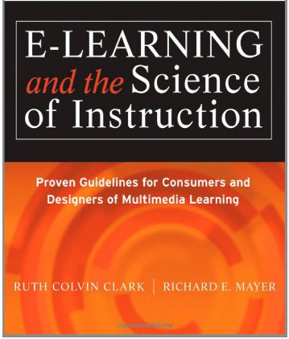
Applying the Contiguity Principle
Chapters 5

Slide 2
Media Element Principles of E-Learning
1. Multimedia
2. Contiguity
3. Modality
4. Coherence
5. Redundancy
6. Personalization

Slide 3
Contiguity Principle
Which is better for student learning?
  A. When corresponding words & pictures are presented far from each other on the page or screen
  B. When corresponding words & pictures are presented near each other on the page or screen
  Example: “Ice crystals” label in text off to the side of the picture or next to cloud image in the picture

Slide 4
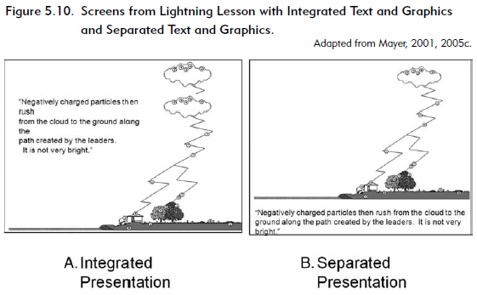

Slide 5
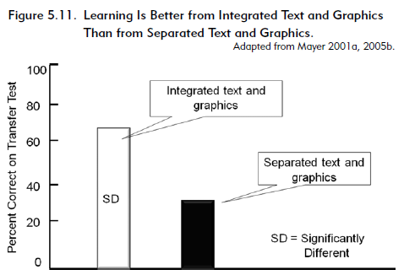

Slide 6
Evidence that contiguity principle supports learning
Studies that demonstrate integrated text graphics correlated to problem-solving transfer test performance.
  Mayer 1989b;Mayer, Steinhoff, Bower, and Mars, 1995; Moreno and Mayer, 1999a.
Similar findings with training programs for technical tasks.
  Chandler and Sweller, 1991; Pas and Van Merrienboer, 1994b; Sweller and Chandler, 1994; Sweller, Chandler, Tierney, and Cooper, 1990.
Successful learners, through eye-tracking, were observed to read a portion of text, search a diagram for the object being described, then read a portion of text, search a diagram related to that text, and so forth.
  Hegarty, Carpenter, and Just, 1996.

Slide 7
Contiguity Principle
Which is better for student learning?
  A. When corresponding words & pictures are presented far from each other on the page or screen
  B. When corresponding words & pictures are presented near each other on the page or screen
  Example: “Ice crystals” label in text off to the side of the picture or next to cloud image in the picture
B. Near
Why?
Students do not have to use limited mental resources to visually search the page. They are more likely to hold both corresponding words & pictures in working memory & process them at the same time to make connections.

Slide 8
Common violations of the contiguity principle
Visuals & explanatory text are separated, one before the other, & partially obscured because of scrolling screens.
Feedback is displayed on a separate screen from the practice or questions
Links leading to an onscreen reference appear in a second browser window that covers the related information on the initial screen
Directions to complete practice exercises are placed on a separate screen from the application screen in which the directions are to be followed

Slide 9
What to look for in applying Contiguity
Screens that place explanatory text adjacent to the graphic they describe
Feedback that appears on the same screen as the question
Procedural directions that appear on the same screen in which the steps are to be applied in an exercise
Use of techniques such as pop-up text and reduced graphics that support integration of text and graphics

Slide 10
Contiguity example in Cognitive Tutors

Slide 11
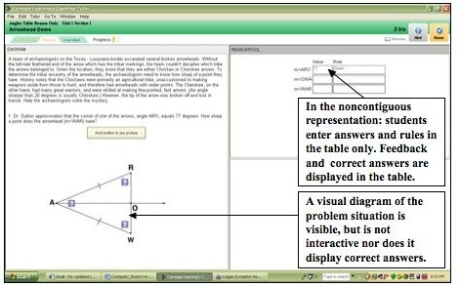

Slide 12
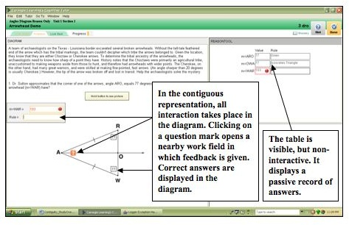

Slide 13
Modality Principle
Which is better for student learning?
  A. Spoken narration & animation
  B. On-screen text & animation
  Example: Verbal description of lightning process is presented either in audio or text

Slide 14
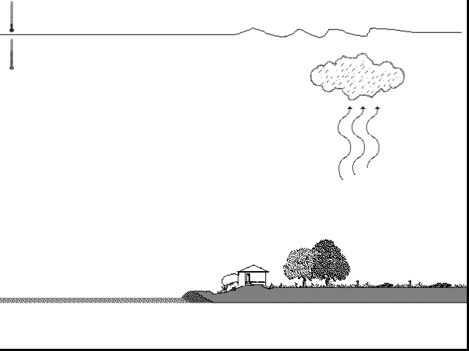
Words as Narration
“As the air in this updraft cools, water vapor condenses into water droplets and forms a cloud.”
Words as On-Screen Text
As the air in this updraft cools, water vapor condenses into water droplets and forms a cloud.

Slide 15
Modality effect: People learn better when words are presented as
narration (dark bars) rather than as on-screen text (white bars).
100
80
60
Animation with narration
Percent correct
Animation with text
40
20
0

Slide 16
END

Slide 17
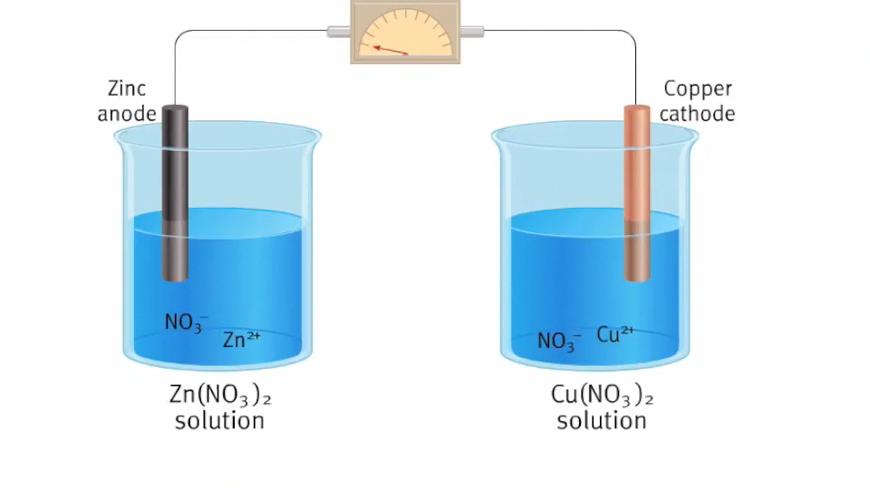
Example Animation

Slide 18
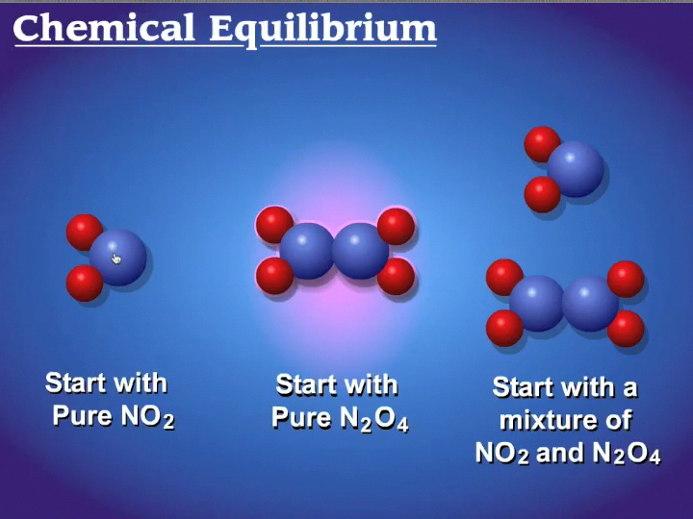
Notes:
Potential violation since the learner has to split their attention between the two competing visuals?

Slide 19
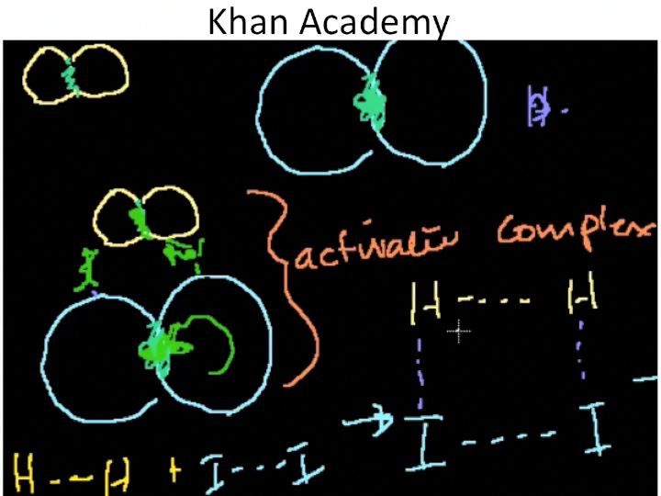

Slide 20
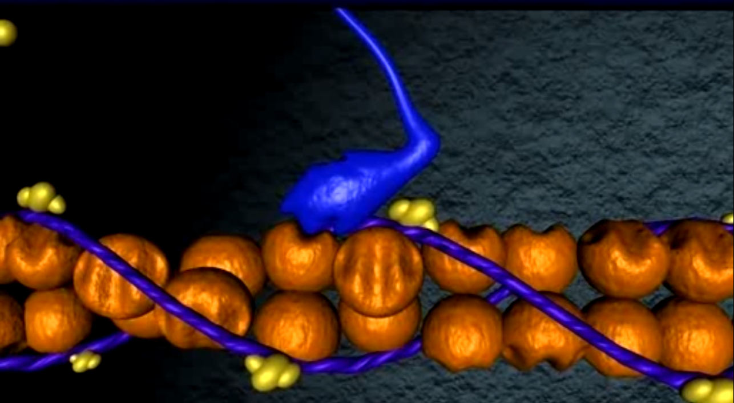
Muscle Contractions
http://www.youtube.com/watch?v=gJ309LfHQ3M
Notes:
Some questions: Would this have been better as still frames? Too much terminology to keep track of as the video progressed?

Slide 21
Support for Design Principles
Many design principles proposed
  Too few have theoretical rationales
  Even fewer have been validated in multiple replicated studies
Mayer’s work is great example
  Principles in book don’t cover every issue
  But, are great examples of kind of theoretical & experiment support that is needed for principles

