Slide 1
Rational/Theoretical Cognitive Task Analysis
Ken Koedinger
Key reading: Zhu, X., & Simon, H. A. (1987). Learning mathematics from examples and by doing. Cognition and Instruction, 4(3), 137-166.

Slide 2
Kinds of Cognitive Task Analysis
Where does Chick Sexing example fit?
Notes:
Marsha Lovett’s 2x2 distinction

Slide 3
Kinds of Cognitive Task Analysis
Where does Zhu & Simon fit?
Notes:
Marsha Lovett’s 2x2 distinction

Slide 4
Rational Cognitive Tasks Analysis: Where is it in the Big Picture?
Goal
Setting
Assessment Task Design
Data
Model
Instructional Design
Data
A
Theory
Intuition & experience
C
B

Slide 5
Cognitive Task Analysis focuses on underlying cognitive processes
CTA is a set of methods to specify the cognitive structures and processes associated with task performance
The focal point is the underlying cognitive processes, rather than observable behavior
Is specifying subtasks the same as specifying underlying cognitive processes?
How are they similar?
How are they different?
Notes:
Clark & Estes reference Cooke (1992a) for the first bullet and (Redding, 1989) for the third.
Cooke, N.J. (1992). The implications of cognitive task analyses for the revision of the Dictionary of Occupational Titles. In W. J. Camara (Ed.), Implications of Cognitive Psychology and Cognitive Task Analysis for the Revision of the Dictionary of Occupational Titles, Washington D.C.: American Psychological Association.
Clark and Estes (1996) define Cognitive Task Analysis (CTA) as "the general term used to describe a set of methods and techniques that specify the cognitive structures and processes associated with task performance. The focal point is the underlying cognitive processes, rather than observable behaviors. Another defining characteristic of CTA is an attempt to describe the differences between novices and experts in the development of knowledge about tasks (Redding, 1989)."
The definition of CTA suggested by this quote from Feldon (2007) "the use of structured knowledge elicitation techniques (e.g., cognitive task analysis)" emphasizes the approach of eliciting knowledge from experts, presumably through more direct approaches of interviews or think alouds. Whether the more indirect approach of using extensive student performance data to do knowledge component analysis via educational data mining would be a version of CTA is thus perhaps open.
Clark and Estes (1996) highlight the general value of task analysis: "Prior to task analysis, job training was accomplished almost exclusively by observational learning on-the-job ("sit by Nelly") and formal apprenticeships. Both these methods required a great deal of time and produced variable results for a couple of reasons. First, the role model did not always know what behaviors to highlight for the learner, for reasons discussed later. Second, some very critical steps or decisions occur very rarely and so are inefficient to observe in real-time."
Redding, R.E. (1989). Perspectives on cognitive task analysis: The state of the state of the art. Proceedings of the Human Factors Society 33rd Annual Meeting. Clark and Estes (1996) define Cognitive Task Analysis (CTA) as "the general term used to describe a set of methods and techniques that specify the cognitive structures and processes associated with task performance. The focal point is the underlying cognitive processes, rather than observable behaviors. Another defining characteristic of CTA is an attempt to describe the differences between novices and experts in the development of knowledge about tasks (Redding, 1989)."
The definition of CTA suggested by this quote from Feldon (2007) "the use of structured knowledge elicitation techniques (e.g., cognitive task analysis)" emphasizes the approach of eliciting knowledge from experts, presumably through more direct approaches of interviews or think alouds. Whether the more indirect approach of using extensive student performance data to do knowledge component analysis via educational data mining would be a version of CTA is thus perhaps open.
Clark and Estes (1996) highlight the general value of task analysis: "Prior to task analysis, job training was accomplished almost exclusively by observational learning on-the-job ("sit by Nelly") and formal apprenticeships. Both these methods required a great deal of time and produced variable results for a couple of reasons. First, the role model did not always know what behaviors to highlight for the learner, for reasons discussed later. Second, some very critical steps or decisions occur very rarely and so are inefficient to observe in real-time."

Slide 6
How Rational CTA relates to CTA definitions
Rational CTA is the process of creating a model of these “underlying cognitive processes”
Sometimes called a “cognitive model”
Used by some to mean a working computer simulation of human thinking
Used by others to mean a precise specification in some representational format

Slide 7
CTA Output: Skill hierarchy

Slide 8
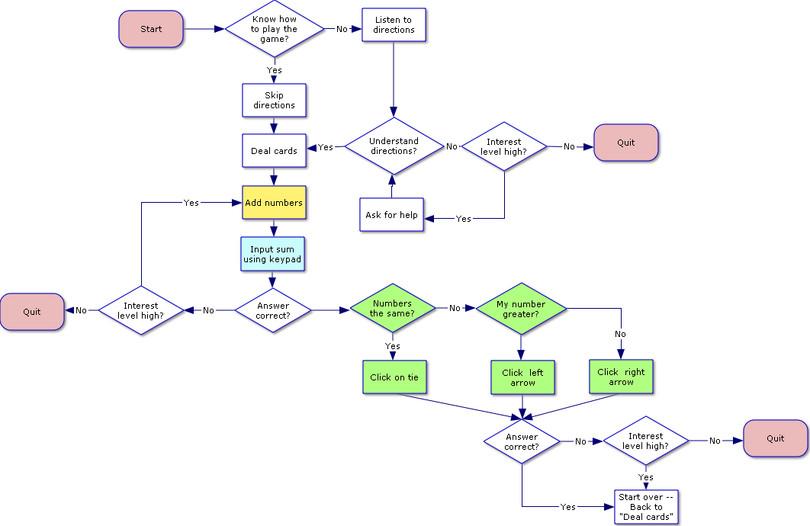
Alternative way of describing a model: Flow charts
Legend
Diamonds= junctures in thought process
Rectangles = actions
Rounded Rectangles = start or termination of cognitive process or procedure
Yellow = simple addition
Light blue = numerical notation
Light green = numerical magnitude comparison

Slide 9
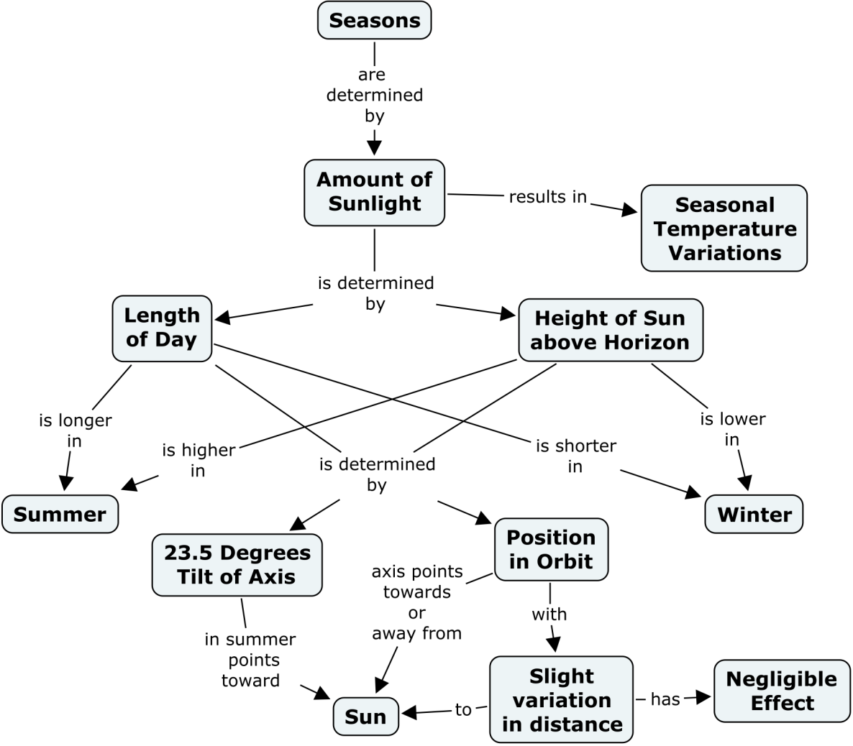
Alternative way of describing a model: Concept map
Source: http://cmap.ihmc.us/publications/researchpapers/theorycmaps/theoryunderlyingconceptmaps.htm

Slide 10
Also recall prior examples of CTA output
Lovett examples: Goal tree & if-then production rules
Feldon: if-then production rules

Slide 11
Zhu & Simon paper
Zhu, X., & Simon, H. A. (1987). Learning mathematics from examples and by doing. Cognition and Instruction, 4(3), 137-166.

Slide 12
Which of the production rules 1-7 directly applies at the start of the following problem x² + 2x - 24? Hint: The result of production rule 2 are the “factors” needed in rules 3-6.

Slide 13
Which of the production rules 1-7 applies to the following problem x² + 2x - 24 after possible factors of 24 have been identified?

Slide 14
Interpreting think aloud
What happens in lines 10 and 11 of the verbal protocol in Table 1 of the paper?
Why does the student say "That is wrong"?
Is anything about the design of the instructional material that may facilitate the students’ metacognitive self-correction?

Slide 15
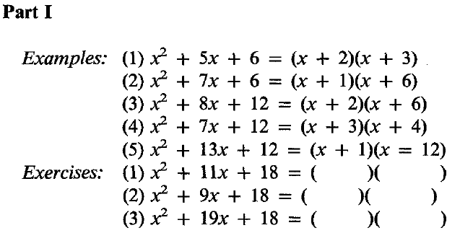
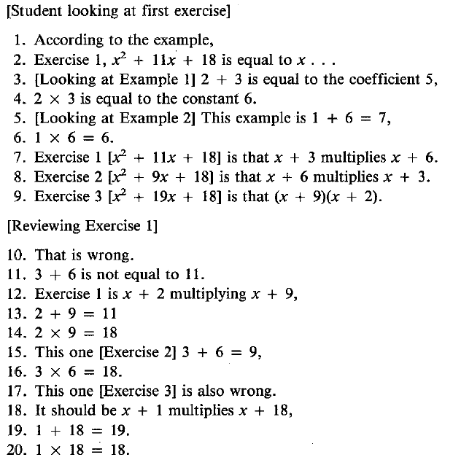
Example think aloud from math student
Does this protocol show signs of learning?
If so, where? How?
Notes:
Table 1 in Zhu & Simon

Slide 16
How instructional design affords student self-correction
From last year’s discussion post:
I believe the mechanism that the student likely utilized to realize the error was a comparison of the answers for exercises 1 & 2, realizing that two equal factorizations cannot yield different quadratic equations. In fact, the instruction seems to be organized such that most students are likely to apply only the multiplicative factors of the constant term rule, and given an equal constant term for the first 3 problems, the student is forced to observe the relationship between the linear term coefficient and how that affects the choice of factors of the constant term.

Slide 17
A task sequencing (or “outer loop”) design principle
“Contrasting cases” or “minimal pairs”
A special case of example/problem variability
Recall the mention of Paas & VanMerrienboar
Create a sequence of tasks that share irrelevant or “surface” features, but chance only one relevant or “deep” feature
Structural variability with surface similarity
Zhu & Simon use this principle, but do not comment on it (expert blind spot!)

Slide 18
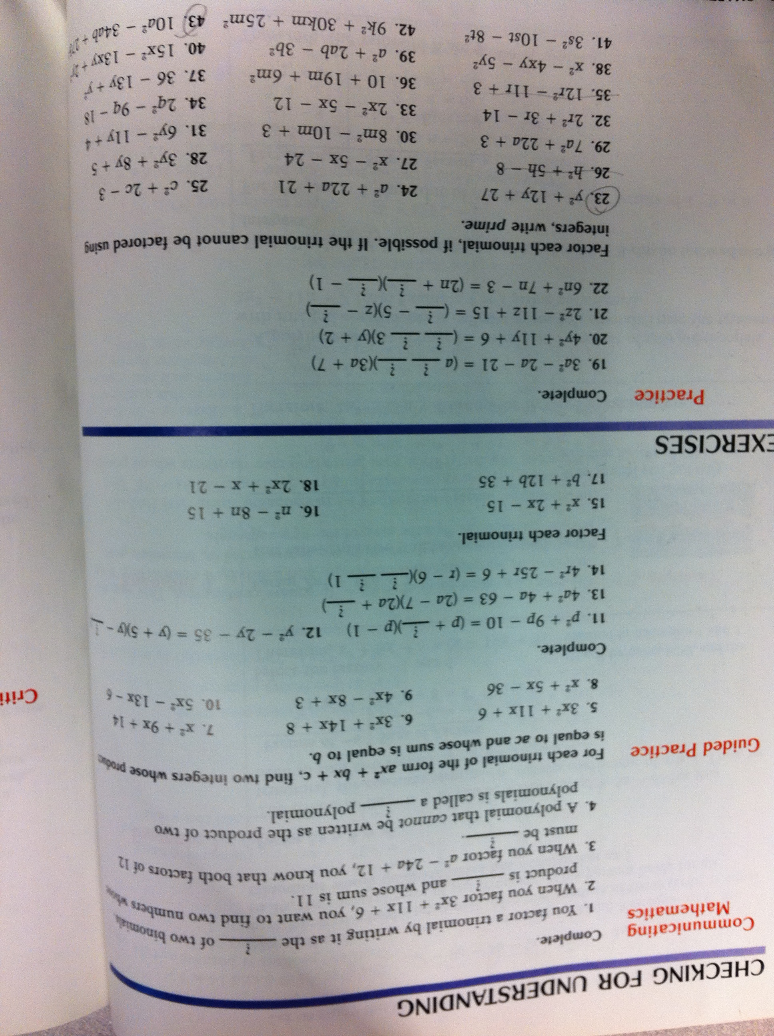
Some textbooks capture elements of the Zhu & Simon approach

Slide 19
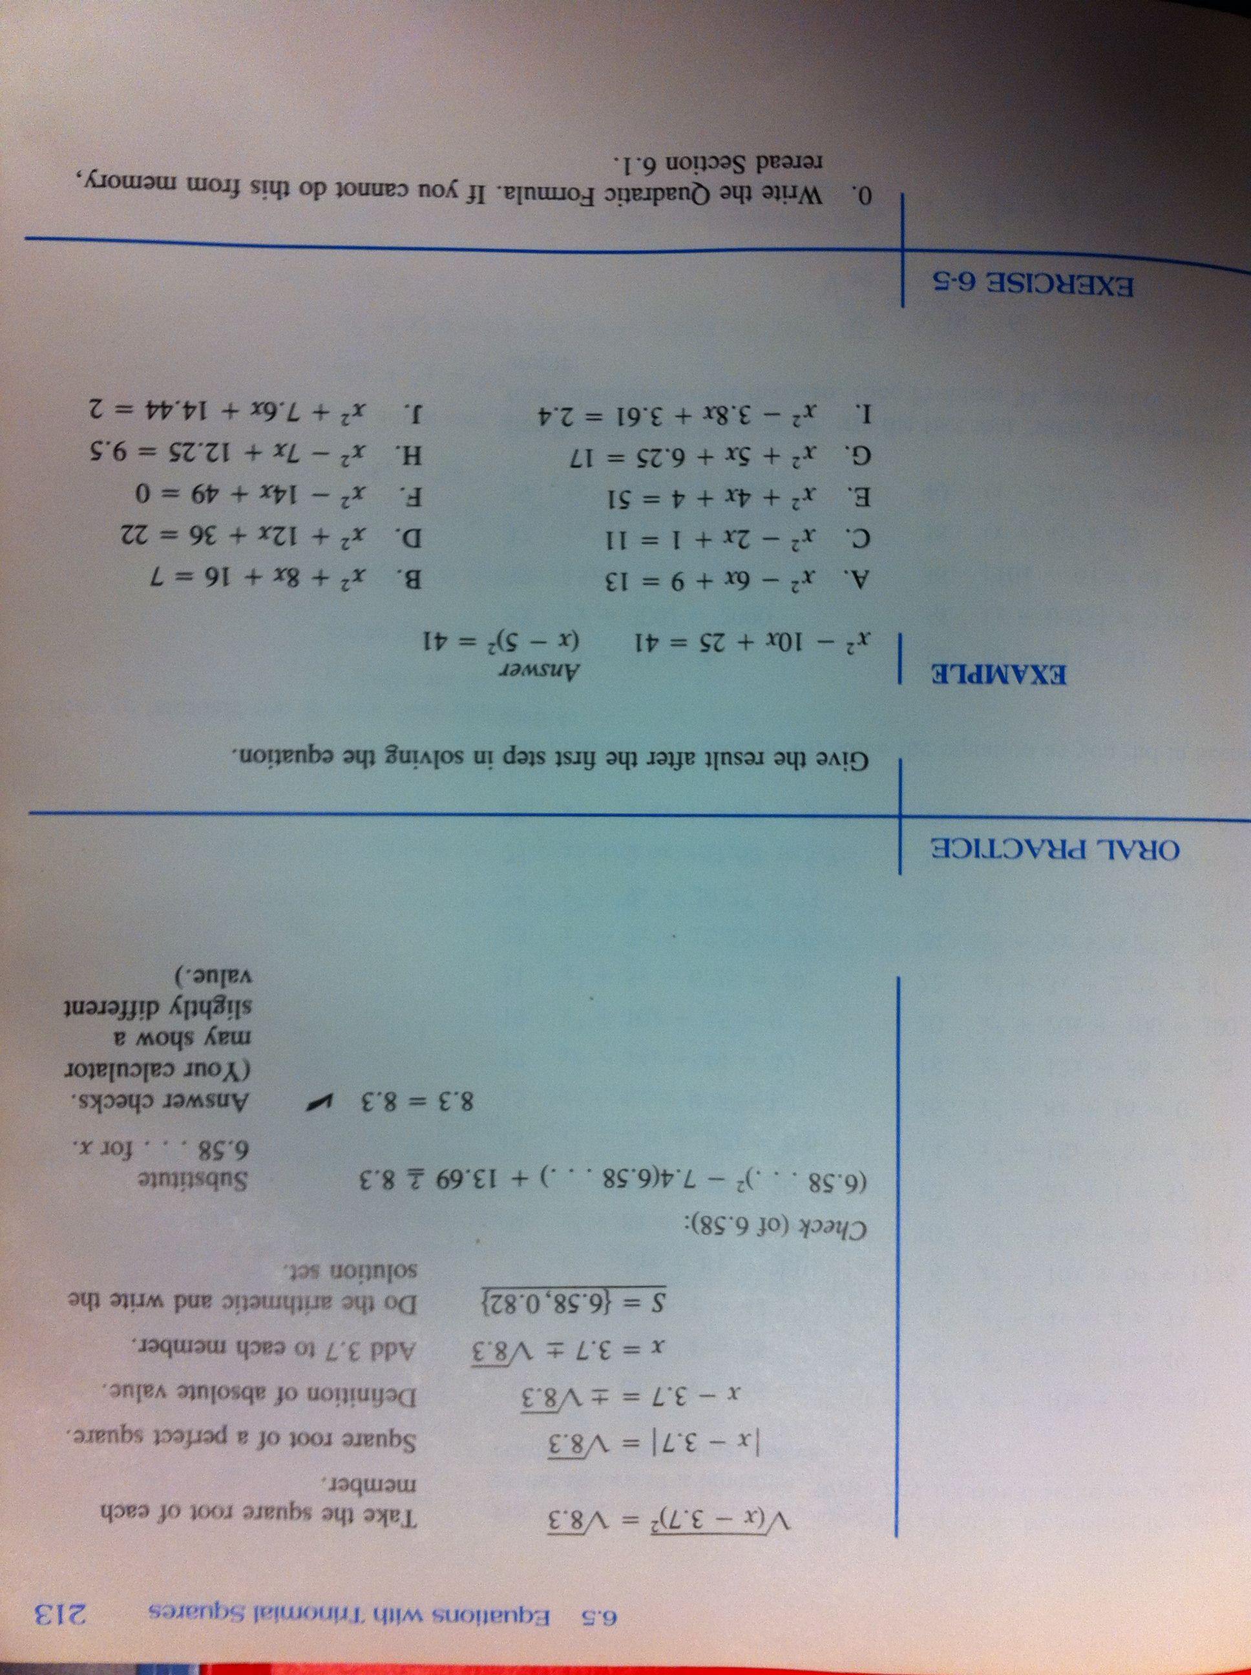
More typical textbooks do not …
Provides one example and then lots of highly similar tasks, with different surface variations and but similar deep structure (mostly same procedure to solve).
Notes:
More typical textbook instruction.

Slide 20
The importance of tasks
Why focus on tasks? Why not just ask an expert? Why not (just) topics, learning objectives, standards?
Tasks give you data & allow you to interpret it
Tasks are what you want your students to be able to do
Descriptions of topics, learning objectives, or standards are often ambiguous & too broad to guide innovative instructional design

Slide 21
Tasks give you data & allow you to interpret it
Tasks & task performance are what you can directly observe
Cognitive processes (KCs) can only be inferred – they are an interpretation of observations
Compare with the “interpretation principle” in Contextual Inquiry (an HCI technique)
You, not your expert, should be the one interpreting observations & making inferences about underlying cognitive process

Slide 22
What are “benchmark tasks”?
The idea of benchmark tasks is to get a range or variety of tasks that span kinds of performances you want students to be good at
They should range across content, across conditions/cues (different framings of the task), & across difficulty levels

Slide 23
What is an example task in your domain?
How many already have found or created a task? If not, do you have an idea?
Do you have it written down? Or copied from a one of your resources?
If not, take 5 minutes to write down a task
If so, do some rational CTA
what are the subtasks?
what cognitive processes are needed to complete these subtasks?
If you have done some rational CTA, try a think aloud with one of your class mates

