Slide 1

Leveraging Examples in e-Learning
(Chapter 11)
Ken Koedinger

Slide 2
Chapter 11 Objectives
Identify types of worked examples
Design a faded worked example
Extending worked examples
  Add self-explanation questions
  Apply multimedia principles
  Use variation & comparison to design for far transfer learning
www.Clarktraining.com

Slide 3
Agenda
What Are Worked Examples?
Fading Principle
Self-Explanations Principle
Multimedia Principle
Transfer Principle

Slide 4
What is a worked example?
A step-by-step demonstration of how to perform a task or solve a problem

Slide 5
Problem: From a ballot box containing 3 red balls and 2 white balls, two balls are randomly drawn. The chosen balls are not put back into the ballot box. What is the probability that the red ball is drawn first and a white ball is second?
First
Solution
Step
Total number of balls: 5
Number of red balls: 3
Probability of red ball first 3/5 = .6
Second
Solution
Step
Total number of balls
after first draw: 4(2 red and 2 white balls)
Probability of a white ball second: 2/4 = .5
Probability that a red ball is drawn
first and a white ball is second: 3/5 x ½ = 3/10 = .3
Answer:
The probability that a red ball is drawn first and white ball is second is 3/10 or .3.
Third
Solution
Step
Next
Notes:
The early research on worked examples used algebra or statistics problems similar to this.

Slide 6
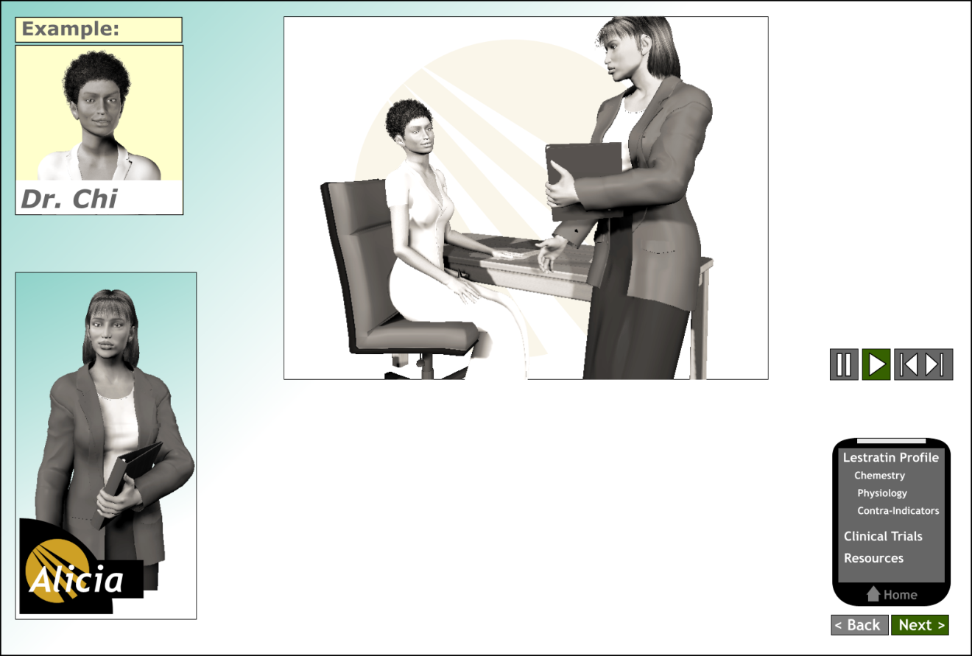
A modeling worked example: Interpersonal
Audio
Dr. Chi: I have a lot of overweight patients in my practice, can you just highlight the contra-indications?
Alicia: The key ones are pregnant or nursing mothers, any liver disease, and patients with a history of depression although your Lestratin drug sheet lists others. Are many of your overweight and obese patients already taking weight-reducing drugs?
Notes:
A modeled worked example – These use video or animation to model interpersonal skills

Slide 7
A modeling worked example:
Expert gives a think aloud
To estimate a solution, I work from the inside of the equation out. First I estimate the square root of 423 which will be a bit over 20. Then I multiply 20 by 2 to equal 40. Third I divide by …….
Notes:
A cognitive modeled example shows a tutor walking learners through the steps to solve a problem. A cognitive modeled worked example focuses on making thinking processes salient.

Slide 8
Evidence for worked examples
Outcomes | WE/Practice Pairs | All Practice
Training Time (sec) | 32.0 | 185.5
Training Errors | 0 | 2.73
Test Time | 43.6 | 78.1
Test Errors | .18 | .36
- Sweller & Cooper, 1985
Notes:
One of the first experiments showing faster and better learning with worked-examples paired with practice compared to all practice in algebra lesson.

Slide 9
What is the rationale for worked examples?

Slide 10
Agenda
What Are Worked Examples?
Fading Principle
Self-Explanations Principle
Multimedia Principle
Transfer Principle

Slide 11
Worked examples & expertise reversal
EXPERT
NOVICE
Learning Outcome
WORKED EXAMPLES NO WORKED EXAMPLES
Notes:
A generic illustration of expertise reversal with worked examples. Review expertise reversal discussed under multimedia and modality principles. Review factorial experiment concept.

Slide 12
Fading of worked examples
= Worked in Lesson
= Worked by the Learner
Step 1
Step 2
Step 3
Step 1
Step 2
Step 3
Step 1
Step 2
Step 3
Step 1
Step 2
Step 3
Worked
Example
Completion
Example 1
Completion
Example 2
Assigned
Problem
Notes:
Discuss fading as a way to gradually remove instructional guidance as learner gains expertise

Slide 13
Problem: The bulb of Mrs. Dark’s dining room table is defective. Mrs. Dark
had 6 spare bulbs on hand. However, 3 of them are also defective. What is
the probability that Mrs. Dark first replaces the original defective bulb with
another defective bulb before then replacing it with a functioning one?
First
Solution
Step
Total number of spare bulbs: 6
Number of defective spare bulbs: 3
Probability of a defective bulb first 3/6=1/2 = .5
Second
Solution
Step
Total number of spare bulbs
After a first replacement trial: 5(2 defective and 3 functioning spares)
Probability of a functioning bulb second: 3/5 = .6
Probability of first replacing the original Please enter
defective dining room bulb with a defective ? The numerical
bulb first and then replacing it with a answer below:
functioning one:
Third
Solution
Step
Next
Notes:
In this faded probability problem, the learner must fill in step 3. The next worked example, would require filling in steps 2 and 3.

Slide 14
Agenda
What Are Worked Examples?
Fading Principle
Self-Explanations Principle
Multimedia Principle
Transfer Principle

Slide 15
Self-explanation question
Problem: From a ballot box containing 3 red balls and 2 white balls, two balls are randomly drawn. The chosen balls are not put back into the ballot box. What is the probability that a red ball is drawn first and a white ball is second?
Probability Rules/
Principles:
First
Solution
Step
Total number of balls: 5
Number of red balls: 3
Probability of a defective bulb first 3/5= .6
Probability of
an event
b) Principle of
complementarity
c) Multiplication
Principle
d) Addition
Principle
Please enter the letter of the rule/principle
used in this step:
Next
Notes:
Often learners skip examples or process in a shallow manner. Adding a SE question to a worked step promotes deeper processing of the example.

Slide 16
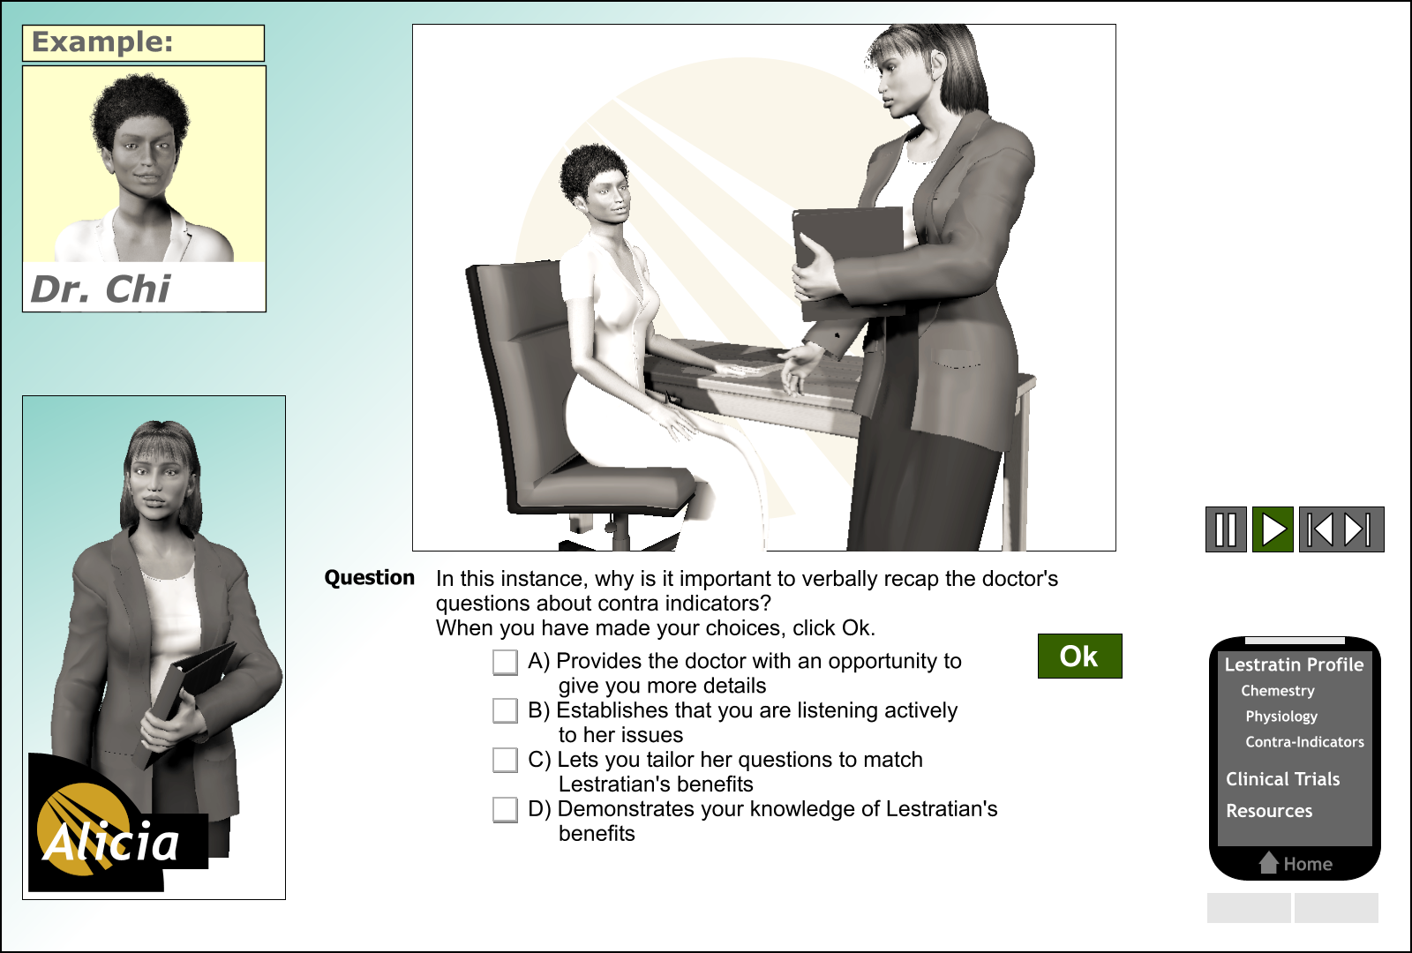
Self-explanation question: modeled example
Notes:
Self-explanation questions encourage learners to process the worked example deeply.

Slide 17
Better learning with SE questions added
100
80
With Questions
60
Proportion Correct
SD
40
No Questions
20
From Experiment 2, Near Transfer learning, Atkinson et al (2003)

Slide 18
Self-Explanation in Geometry Cognitive Tutor

Slide 19
Agenda
What Are Worked Examples?
Fading Principle
Self-Explanations Principle
Multimedia Principle
Transfer Principle

Slide 20
Examples in text, video and animation
Topic
How to make information meaningful to students
Learners
Student teachers average age 27 years
Time
50 minutes
- Moreno, Ortegano-Layne, 2008
Notes:
This research pertains to best format for modeling worked examples. All students took pretest, reviewed on-line lesson on how to make information meaningful to students and then no example (control) or reviewed classroom examples presented in text, video, and animation. Students rated program, and completed application test. Test responses coded as model answers – modeled in example and novel applications.

Slide 21

Which led to better learning?
Example in Text
Example in Video
Example in animation
Notes:
Ask students to select version they thought led to best learning
All students took pretest, reviewed on-line lesson on how to make information meaningful to students and then no example (control) or reviewed classroom examples presented in text, video, and animation. Students rated program, and completed application test. Test responses coded as model answers – modeled in example and novel applications.

Slide 22
Interpret the results
8
7
6
SD = significant
difference
5
Test Score
0- 10
SD
4
SD
3
2
1
No Example Text Video Animation
EXAMPLE FORMAT
Based on data from Moreno & Ortegano-Layne, 2008
Notes:
Both video and animation led to better learning than text which did not differ significantly from no example. Based on this experiment, modeling examples better with more realistic visuals. Would like to see a treatment that used still photo graphs to compare with video and animation.

Slide 23
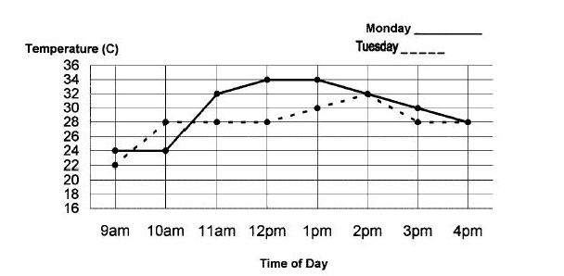
Modality-contiguity in worked examples
To Find Temperature Differences On Different Days
3. Subtract the lower
temperature from the
higher temperature
1. Select a time
of day
2. Locate the two dots
directly above the time
1. Select a time of day
Adapted from Leahy, Chandler, & Sweller, 2003
Notes:
Three vesrions were tested: audio, text, and text plus audio. Best was audio. When using text for worked examples, integrate text into visual. Call outs are one good technique. Discuss exceptions such as self-explanation we or faded WE where learner needs to refer to steps.

Slide 24
Use a familiar context or pretraining
Be sure to use content familiar to your learners in worked examples
Goal is to teach instructional designers how to write a learning objective:
Given bathroom tools, the learner will brush their
teeth to result in fewer than 3 spots with the red
dye test.
Notes:
Ask if students have encountered examples that were confusing because of the context.

Slide 25
Agenda
What Are Worked Examples?
Fading Principle
Self-Explanations Principle
Multimedia Principle
Transfer Principle

Slide 26
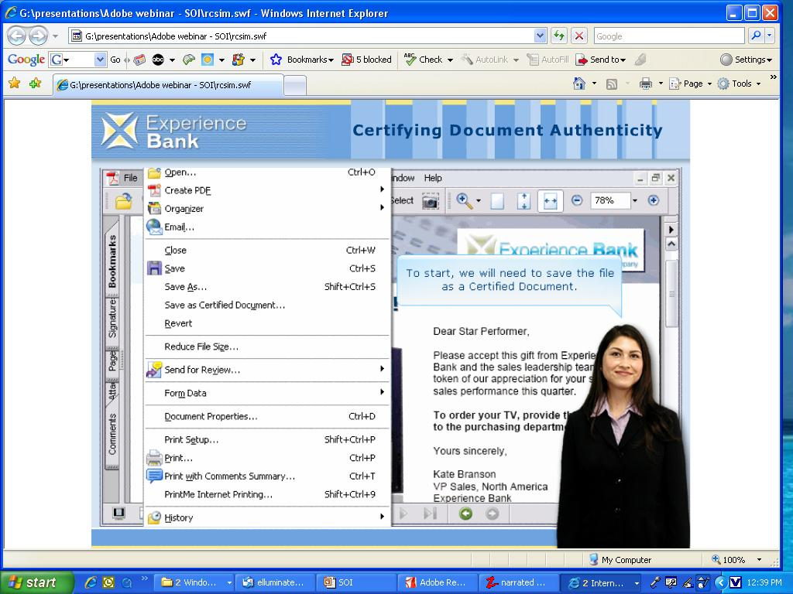
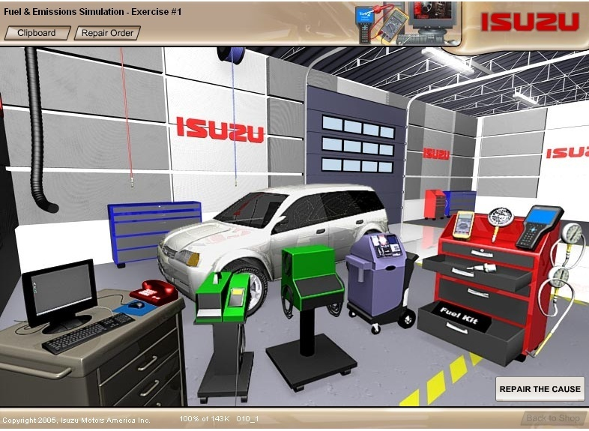
Perform goals: Near Vs Far transfer
Near
Far
To build procedural skills
Routine tasks
To build strategic skills
Problem-solving tasks
Notes:
Review concepts of near and far transfer from chapter 1.

Slide 27
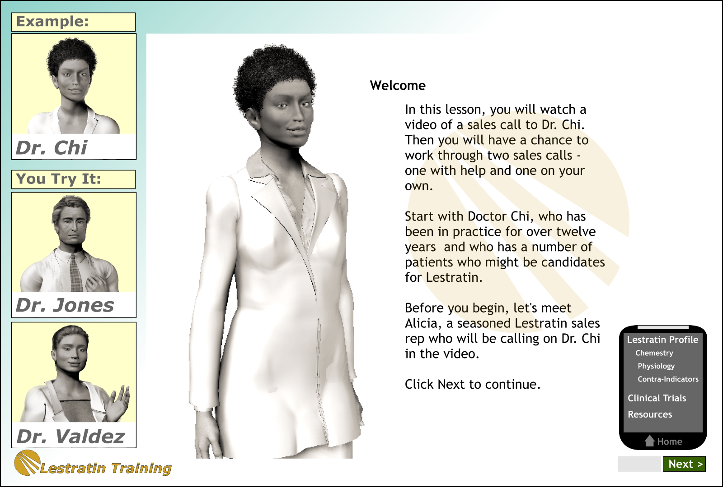
Varied context worked examples
Notes:
Ask: what principles does this example reflect. Answers: fading and varied context for far transfer learning.

Slide 28
Varied context worked examples
4.0
Different Context
SD = significant
difference
3.0
SD
Test Scores
Same Context
2.0
1.0
From Experiment 3, Quilici and Mayer (1996)
Notes:
Content was types of statistical tests

Slide 29
Power of comparison of examples
Separate Examples
Lesson
Comparison Examples
Lesson
Shipping
Example
Travel
Example
Shipping
Example
+
Travel
Example
Active Comparison of Examples Lesson
Shipping
Example
Shipping
Example
+
Travel
Example
with questions
Gentner, Lowewenstein and Thompson, 2003
Notes:
Review contiguity and active processing of examples supported or not supported by these layouts.

Slide 30
Interpret results
Active Comparison
100
Comparison
Separate Cases
80
SD
No Training
60
Proportions of Pairs Forming SafeGuard Contracts
SD = significant
difference
40
20
Adapted from Gentner, Loewenstein, and Thompson (2003)

Slide 31
If time, can discuss other related work
Worked examples experiments in cognitive tutors
  Less time, with equal or better learning
Geometry self-explanation result
  Takes longer per problem but better transfer
  Contrast: self-explanation for English articles
    Result?
Battleship Numberline example – designing based on knowledge components

Slide 32
Extras

Slide 33
The fortress and tumor problems
Notes:
Review the research on fortress and tumor problem

Slide 34
Solutions
Fortress story | Hint | % who solved tumor prob.
Not Given | None | 10%
Given | None | 30%
Given | Given | 75%
Notes:
Ask learners to derive the principle from the results

