Slide 1
Multimedia-Supported Metaphors for Meaning Making in Mathematics
Moreno & Mayer (1999)

Slide 2
Learning Computational Procedures
RULE BUILDING | MODEL BUILDING
Application of general rules to problems | Mental model construction of problem situations
From drill & practice to production rules | From Gestalt to situational contexts
Abstract and disembodied reasoning | Making connections between new info and existing models

Slide 3
Metaphor as an Aid to Math Cognition
Image-based (modern) vs. abstract (traditional) reasoning
Conceptual system metaphorical in nature?
Metaphorical reasoning fundamental way of human thinking?
Analogical reasoning foundational to learning?

Slide 4
THE RESEARCH QUESTION
How can multimedia environments introduce metaphors to promote the construction of appropriate mental models in young learners?

Slide 5
The Number Line
Central conceptual structure necessary for children’s arithmetic learning
Grounding metaphor, “arithmetic-is-motion,” helps students relate mathematical ideas to everyday experiences
Effective concrete manipulative makes sense to students

Slide 6
Instructional Methodology
Single representation (SR) - learning arithmetic procedure with symbolic form only (without explanations)
Multiple representation (MR) - learning arithmetic procedure by seeing and coordinating symbolic with visual and verbal explanations (MULTIMEDIA LEARNING)

Slide 7
Multimedia Learning: A Conflict?
MR Theory: teaching with more representations facilitates learning by providing several mutually referring sources
Cognitive Load Theory: mental integration of multiple sources of information may generate a heavy cognitive load detrimental to learning

Slide 8
Predictions
Based on MR Theory: MR students show greater improvement than SR students
Based on Cognitive-Load Theory: SR students show greater improvement than MR students
Reconciled theories: MR learning more effective for students with automated basic arithmetic skills (cognitive space “freed” for making connections among visual, verbal, and symbolic representations)

Slide 9
Measures of Learning
Pretest to posttest gains
Pattern of improvement across four trials
Changes in strategies used to generate incorrect answers between pretest and posttest

Slide 10
EXPERIMENT 1
Participants
60 sixth grade students
Uninstructed in signed addition or subtraction
90th percentile of math achievement
Design
SR and MR groups divided into high and low achievers
Pretest and posttest have easy and difficult problems

Slide 11
EXPERIMENT 1 Materials
Pretest and Posttest
Identical
18 problems (including 2 transfer types with zeros)
Difficulty level determined by pretest performance median
Computer-based materials
4 training sessions
16 problems/session in 2 “doses”
Log files for each session

Slide 12
Experiment 1 Procedure
Paper-and-pencil pretest; at or below median is low-achieving
Four training sessions over two weeks
Groups
SR group: symbolic representation and feedback
MR group: symbolic as well as verbal and visual (dynamic) representation and feedback
Paper-and-pencil posttest

Slide 13
Experiment 1 Scoring
Gain score overall for each student
Gain score session-to-session for each student
Strategy change
Negative bias bug: negative sign interpreted as subtraction operator. Ex. -8 + - 1 = 7 or -7
Conceptually good bug: negative sign not perceived as subtraction operator. Ex. -8 + - 1 = 9

Slide 14
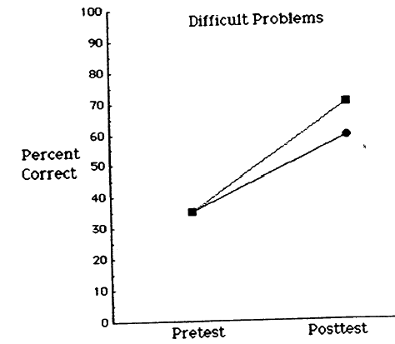
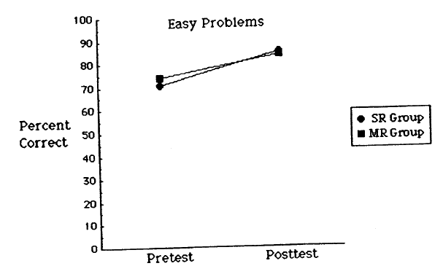
Results: Overall Gain Scores
Mean difference of SR and MR groups not significant
Re-analyze as treatment x problem type: most room for improvement on difficult problems?
Significant Interaction!

Slide 15
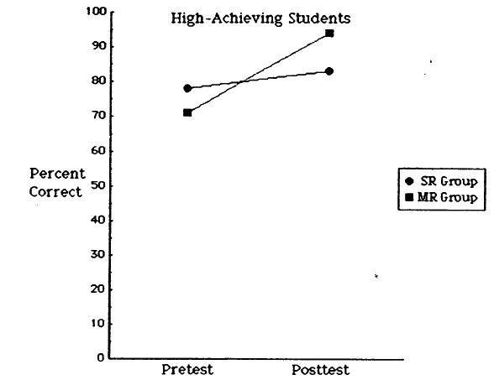
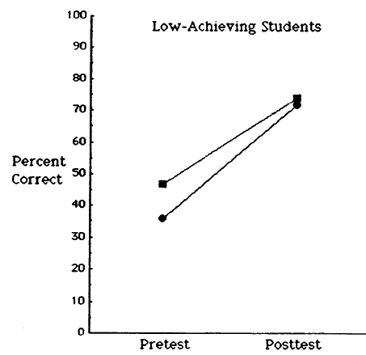
Further Analysis of Gain Scores
Previous results support MR theory
Hybrid theory predicts MR superior to SR for high achievers
MR group > SR group only for high achieving students

Slide 16
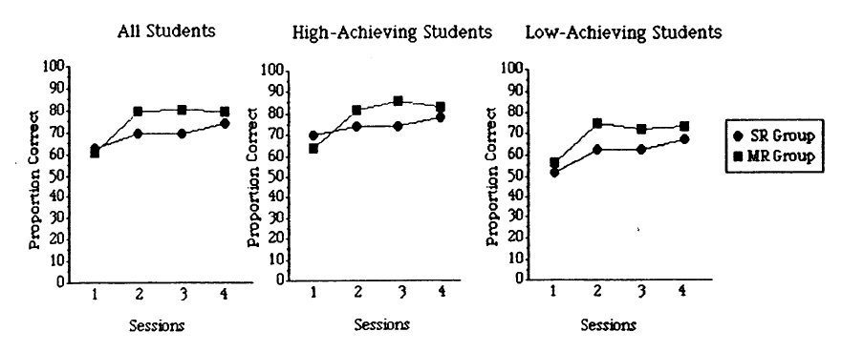
Results: Session-to-session gain scores
MR Theory: MR group faster than SR group
Cognitive Load Theory: SR group faster than MR group
Hybrid Theory: MR group faster only for high achievers
Results consistent with a hybrid theory: significant difference in learning rate for high but not low achievers dependent on treatment group.

Slide 17
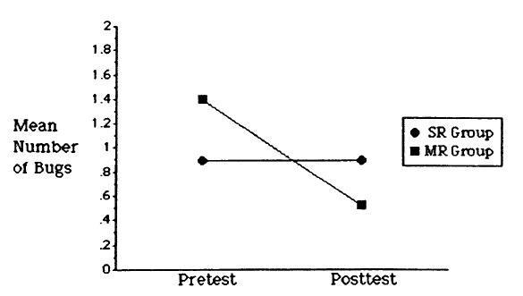
Results: Strategy Change
Group x test interaction
MR group reduces negative bias significantly more than SR group

Slide 18
Experiment 2
Experiment 1: results consistent with a hybrid theory. MR is more effective than SR when learner’s working memory not overloaded with instructional presentation.
Experiment 2: role of cognitive load in learning with MR
For low and high spatial ability
For low and high memory span

Slide 19
Experiment 2 Method
Participants from same population
Pretest, posttest, MR sessions from Experiment 1
Cognitive Tests
Spatial ability: cube comparisons and paper folding
Memory span: auditory letter span and number comparison

Slide 20
Results
High spatial ability students outperform significantly low spatial ability students when presented with MR training (consistent with hybrid theory)
High working memory span students outperform, but not significantly, low working memory span students
Overall, MR influenced by ability of learners to handle cognitive load of information in multiple forms needing processed.

Slide 21
Instructional Implications
Empirical support for using coordinated MRs when designing software to teach mathematical procedures
MRs for example problems most beneficial for students with strong knowledge of basic arithmetic skills learning to solve difficult problems
Role of individual differences (cognitive load) in learning processes
Do results from math domain apply to other areas within or outside the domain?

