Slide 1
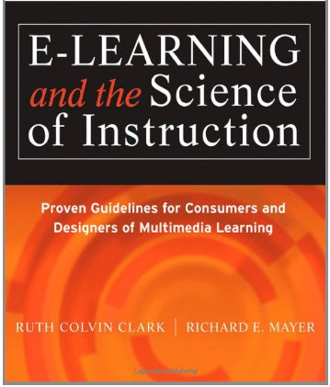
Applying the Coherence Principle (Chapter 8)
Ken Koedinger

Slide 2
Coherence Principle
Which is better for student learning?
A. When extraneous, entertaining material is included
B. When extraneous, entertaining material is excluded
Example: Including a picture of an airplane being struck by lightning

Slide 3
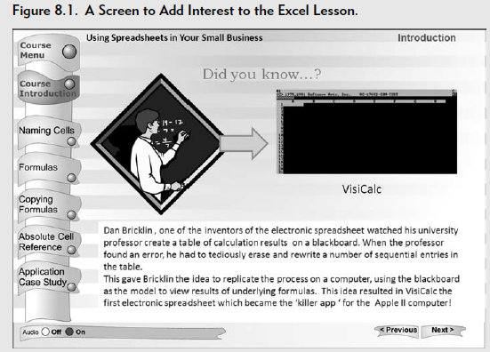
Coherence Principle
Which is better for student learning?
A. When extraneous, entertaining material is included
B. When extraneous, entertaining material is excluded

Slide 4
Coherence Principle
Which is better for student learning?
A. When extraneous, entertaining material is included
B. When extraneous, entertaining material is excluded
Example: Including a picture of an airplane being struck by lightning
B. Excluded
Why?
Extraneous material competes for cognitive resources in working memory and diverts attention from the important material

Slide 5
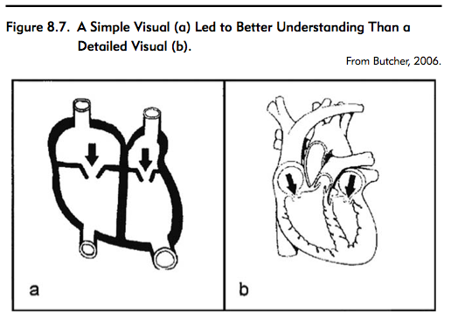
Use simpler visuals
✖
✔
Notes:
For example, the text notes of a few studies where examples of simpler visuals were employed for the same thing yielded better results, one of which was college students learning about the human heart. After giving one group a simple image and the other a more realistic image, the group with the simpler image performed better on questions of how the heart works. Similar results were found from teaching mitosis using simple images versus photographs from microscopes. → it seems that realism can overwhelm the learner at times.

Slide 6
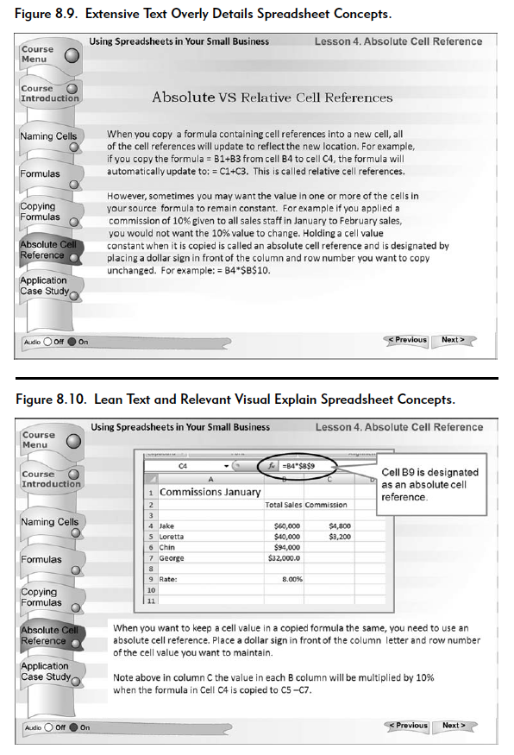

Slide 7
Some example web sites that may violate Coherence Principle
http://ippex.pppl.gov/interactive/
http://education-portal.com/academy/lesson/charles-horton-cooley-theory-microsociology.html
http://www.interactive-biology.com/1099/nutrition-and-energy-flow-principles-of-ecology-part-1-and-2/
http://e-learningforkids.org/Courses/EN/Measurement/index.html

