Slide 1
KLI & selecting appropriate instructional principles
Ken Koedinger

Slide 2
Knowledge Components
Definition: An acquired unit of cognitive function or structure that can be inferred from performance on a set of related tasks
Includes:
skills, concepts, schemas, metacognitive strategies, malleable habits of mind, thinking & learning skills
May also include:
malleable motivational beliefs & dispositions
Does not include:
Fixed brain structure or “cognitive architecture”, transient states of cognition or affect
Components of “intellectual plasticity”

Slide 3
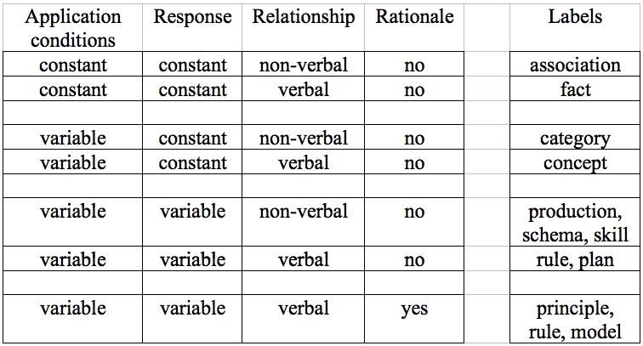
KCs vary in generality, explicitness & discoverability
Different KCs require different learning processes: facts require memory, concepts require categorization, skills and schemas require induction, principles require sense making

Slide 4
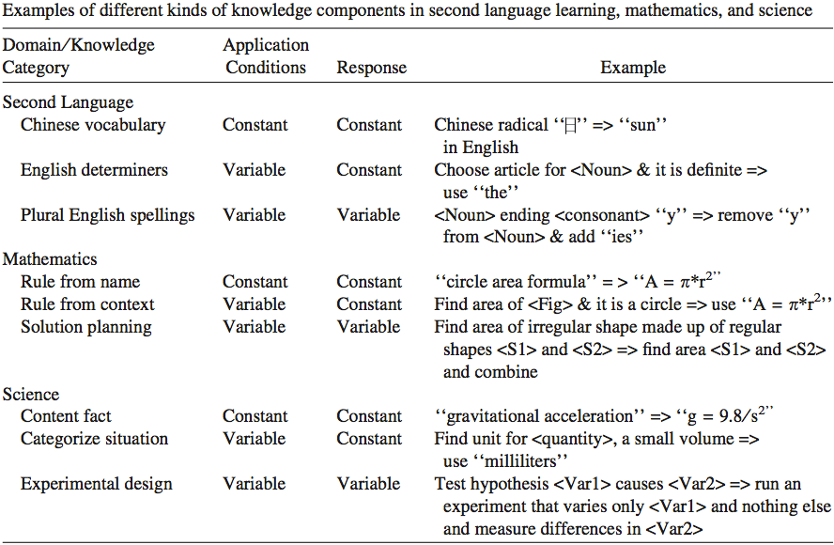
Examples of kinds of KCs

Slide 5
KLI & Instructional Design
Fundamental causal chain:
Changes in instruction yield changes in learning yield changes in knowledge yield changes in robust learning measures.
Observed
Inferred
Design process starts at the end
What is the knowledge students acquire?
KC type indicates what learning processes are needed, what instruction is optimal
KC types: condition, response, verbal, rationale

Slide 6
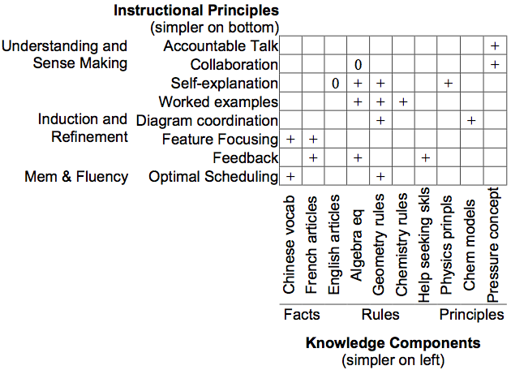
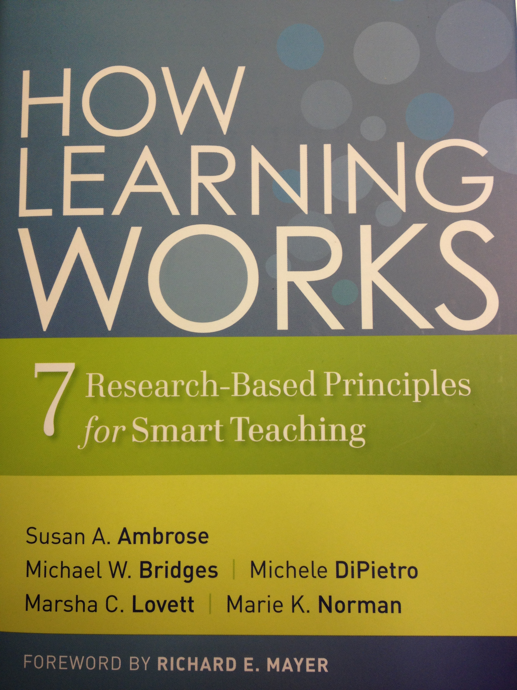
LearnLab’s >300 in vivo experiments => Optimal instruction depends on knowledge goals
Notes:
A key goal of the KLI framework is as tool to generate novel hypotheses … The “knowledge-dependency” hypothesis: Effectiveness of instructional methods depends on kinds of KC. This hypothesis is in contrast to plausible competing hypotheses like 1) instructional principles are domain general, 2) instructional principles are dependent on domain characteristics.
Defining KC complexity: See slide further below for theory and slide above for empirical grounding (time course of execution).
Instructional complexity: Also, defined in terms of description length and time course of execution (step time in DataShop).

Slide 7
KLI: More complex learning processes are needed for more complex knowledge
Notes:
More complex knowledge requires more complex learning processes
Constant vs. variable condition & response
Facts (constant condition KCs) require memory
Rules (variable condition KCs) require induction
Non-verbal vs. verbal knowledge
KCs can be in non-verbal or verbal form or both
Require different learning processes
KCs with rationales can be (re)discovered in addition to be instructed
Principles (verbal, variable, with rationale) require sense making

Slide 8
“KLI dependency” explanation: Target Knowledge => Learning processes => Which kinds of instruction are optimal
Many examples support
Worked examples
Worked examples
Eliciting recall supports
Testing effect
Testing effect
Aids fact learning, but suboptimal for rules
Aid rule learning, but suboptimal for facts

Slide 9
KLI: Self-explanation is optimal for principles but not rules
Prompting students to self explain enhances
Self-explain
Self-explain
Supports verbal knowledge & rationale
Impedes non-verbal rule induction

