Slide 1

How Do People Learn
From e-Courses?
Chapter 2
+ Instructional Complexity
Ken Koedinger
Based on slides from Ruth Clark

Slide 2
Plan for today
Finish introductions from last time (15 min)
Project idea discussion (15 min)
Brief review of Chpt 1, quiz, activity (25 min)
Review of Chpt 2 & instr complexity (25 min)
Next time (5 min)

Slide 3
Introductions
First and last name
  If either is tricky to pronounce give a clue,
  such as “Koedinger” rhymes with “play ringer”
Degree program here at CMU
For a e-learning design project
  Do you have a content area that you are particularly interested in?
  Do you have a technology you are particularly interested in?
  Any other ideas for a possible project?
Notes:
Write on a piece of paper. Tell your neighbor. Tell us all.

Slide 4
Project ideas
Get on Blackboard
  An example project final report
  Rubric for step 1 with embedded examples
Questions about projects?
  Questions about step 1?
Take a look at Discussion board posts
  Who’s decided on a project domain?
  Who has a partner?
  Who wants a partner?

Slide 5
Plan for today
Finish introductions from last time (15 min)
Project idea discussion (15 min)
Brief review of Chpt 1, quiz, activity (25 min)
  See Chpt1 slides available online
  Quiz results were good …
  Questions?
  Class activity: Promises & pitfalls review of e-learning examples
Review of Chpt 2 & instr complexity (25 min)
Next time (5 min)

Slide 6
Class activity: Step 1
Note: Please turn in your example & the 2 reviews of it
Review your example of e-learning you brought to class
Identify the following:
  Promises
  Pitfalls
  Is it inform or perform?
  If perform, is it near or far transfer?
  What architecture(s) do you see?

Slide 7
Class activity: Step 2
Note: Please turn in your example & the 2 reviews of it
Find a partner & exchange examples
Review their example
Identify:
  Promises
  Pitfalls
  Is it inform or perform?
  If perform, is it near or far transfer?
  What architecture(s) do you see?

Slide 8
Class activity: Step 3
Note: Please turn in your example & the 2 reviews of it
Compare your answers
Try to resolve differences
Any hard to resolve?

Slide 9
Plan for today
Finish introductions from last time
Project idea discussion
Reading discussion
  Brief review of Chpt 1 & quiz
  Review of Chpt 2 & instructional complexity
Class activity: Promises & pitfalls review of e-learning examples
Next time

Slide 10
Plan for today
Finish introductions from last time (15 min)
Project idea discussion (15 min)
Brief review of Chpt 1, quiz, activity (25 min)
Review of Chpt 2 & instr complexity (25 min)
Next time (5 min)

Slide 11
Chapter 2 objectives
Distinguish:
  technology-centered vs. learner-centered
  learning vs. instruction
  3 forms of cognitive processing/load during learning
Identify:
  3 metaphors for learning
  3 learning principles & processes
Apply four key events of learning

Slide 12
Hot technologies that are or may be relevant to learning?
See slides at the end of first lecture deck
[What do you see as hot technologies?]
Notes:
Ask: What are some hot technologies that are or may be relevant to learning? And take notes.
Some from 2013 class:
3-d printing, head-mounted display (occulus rift), google glass, myo (muscle movement), leap motion, Kinnect
Mobile technologies – connecting to robots
Near field communication (NFCs) – tracking
Others:
Social media, simulations, games, virtual worlds, search engines, tangible interaction

Slide 13
A technology-centered vs. learner-centered approach to e-learning
Are hot technologies the central focus
of e-learning design?
No, meeting learners’ needs should be
Should these be avoided?
No. These technologies may help & are worth consideration, but should be evaluated
Notes:
Make a list of ‘hot’ technologies. Then frame questions that reflect a technology-centric and learner-centric views of these technologies. Give examples of technology-centered approaches versus learner-centered approaches.

Slide 14
What is learning?
A change in what the learner knows – demonstrated by behavior
The change is caused by the learner’s experience
This experience can be influenced by instruction
Can learning occur without instruction? Examples?
Learning results from what the student does and thinks
and only from what the student does and thinks.
The teacher can advance learning only by
influencing what the student does to learn.
—Herbert Simon
Notes:
What are some ways that students can demonstrate learning?
What are some forms of learning that are NOT the result of an instructional episode?

Slide 15
What is instruction?
A manipulation of the learner’s experiences to foster learning
  Something the instructional professional does
    Not just during class, but what they do in planning & creating materials, homework, projects, collaborative discussions – i.e., all aspects of the learning environment
  The goal of the manipulation is to change what the learner knows
Notes:
Give some examples of things that instructional professionals do intended to cause learning. When might instruction be successful and when not successful?

Slide 16
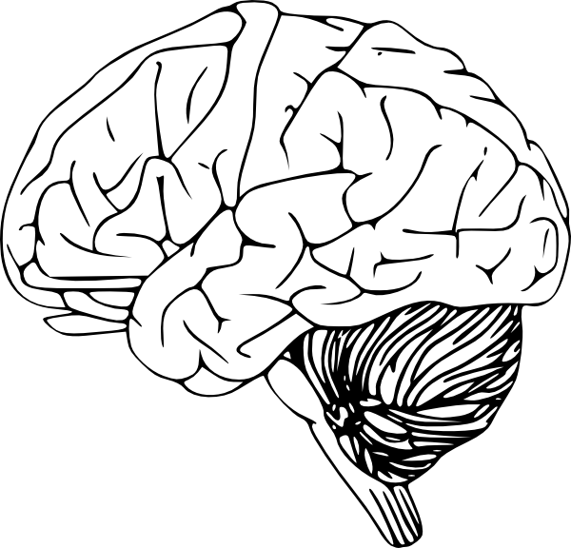
How do definitions compare with KLI?
Instructional events
Explanation, practice, text, rule, example, teacher-student discussion
Assessment events
Question, feedback,
step in ITS
Exam, belief survey
KEY
Ovals – observable
Rectangles - inferred
Arrows – causal links
Learning events
Knowledge Components
Notes:
Learning: A change in what the learner knows – demonstrated by behavior.
The change is caused by the learner’s experience

Slide 17
Mapping onto KLI
Learning is
a change in
Instruction is a manipulation of the learner’s experiences to foster learning
what the learner knows
demonstrated by behavior
Change is caused by the learner’s experience
Instructional events
Explanation, practice, text, rule, example, teacher-student discussion
Assessment events
Question, feedback,
step in ITS
Exam, belief survey
Learning events
Knowledge Components
Notes:
Differences:
Behavior is broader than assessment event, which is observed/recorded behavior that if often elicited by provided tasks
The “learner’s experience” has a psychological component (the learning event) and an observable component, which can be different than the instructional event (e.g., if learner does not look at a provided diagram)

Slide 18
Three metaphors for learning
S R
1. Response Strengthening
Outsourcing
2. Information Acquisition
3. Knowledge Construction
Notes:
Ask students to give examples of instruction based on each metaphor. Discuss behavioral views of learning, receptive views of learning, and knowledge construction views. Discuss how the 3 architectures of learning (receptive, directive, guided discovery) may reflect each of these metaphors.

Slide 19
Three metaphors for learning
Metaphor of Learning | Learning Is: | Learner is: | Instructor is:
Response strengthening | Strengthening or weakening of associations | Passive recipient of rewards and punishments | Dispenser of rewards and punishments
Information acquisition | Adding information to memory | Passive recipient of information | Dispenser of information
Knowledge construction | Building a mental representation | Active sense maker | Cognitive guide
For later: How are these similar or different from KLI’s learning processes?

Slide 20
Three learning principles
Limited capacity
Dual channels
Active processing
Notes:
Do the word list activity to illustrate the 3 learning principles. No one recalls all of the words due to limited capacity but the words most recalled are concrete due to dual channels and active processing.

Slide 21
Experiment
Listen and then write
Pens down, listen to list A
Write as many as you can recall
Pens down, listen to list B
Write as many as you can recall
Notes:
Tell students you will state a list of words and when you are done, they should write down all they can recall. Read aloud list A and allow students time to write. Repeat with list B. Then show the list on the next slide and take average numbers of words listed.
A: Rose Computer Bird Cloud Scissors Book Dress Marker Bedroom Chair Calendar Pink Ocean Gutter Bread Clock
B: Ethics Hire Terse Noun Problem Manage Design Retro First Solution Color Liquid Pattern Basic Account Integrity

Slide 22
Count how many in each list
List A
Rose
Computer
Bird
Cloud
Scissors
Book
Dress
Marker
Bedroom
Chair
Calendar
Pink
Ocean
Gutter
Bread
Clock
List B
Ethics
Hire
Terse
Noun
Problem
Manage
Design
Retro
First
Solution
Color
Liquid
Pattern
Basic
Account
Integrity
Notes:
Calculate average numbers of words listed. Ask why usually more words are recalled in list A than in list B. Use this exercise to discuss the limits of working memory and dual channels.

Slide 23
How do three learning principles apply to example
Limited capacity?
You can’t remember all words
Dual channels
Concrete words are easier because
you can use 2 channels: visual & verbal
  Abstract words use only the verbal channel
Active processing
Recall better words you rehearse more or try to elaborate by connecting to other knowledge
Notes:
Do the word list activity to illustrate the 3 learning principles. No one recalls all of the words due to limited capacity but the words most recalled are concrete due to dual channels and active processing.

Slide 24
Cognitive theory of multimedia learning
MULTIMEDIA
SENSES
WORKING MEMORY
LONG-TERM
PRESENTATION
MEMORY
Words
Ears
selecting
Sounds
organizing
Verbal
words
words
Model
integrating
Prior
Prior
Knowledge
Knowledge
Pictures
Eyes
selecting
Images
organizing
Pictorial
images
images
Model
Notes:
We’ll talk more about later …

Slide 25
Cognitive load theory
Extraneous processing – depresses learning
Essential processing – complexity of content
Generative processing – facilitates learning
Note: Above is Mayer’s terminology (which I prefer), but some “cognitive load theorists
Many use the following instead:
  Extraneous load
  Intrinsic load
  Germane load
Notes:
Introduce 3 forms of cognitive load. Discuss cognitive load theory as an important modern psychological theory of learning.

Slide 26
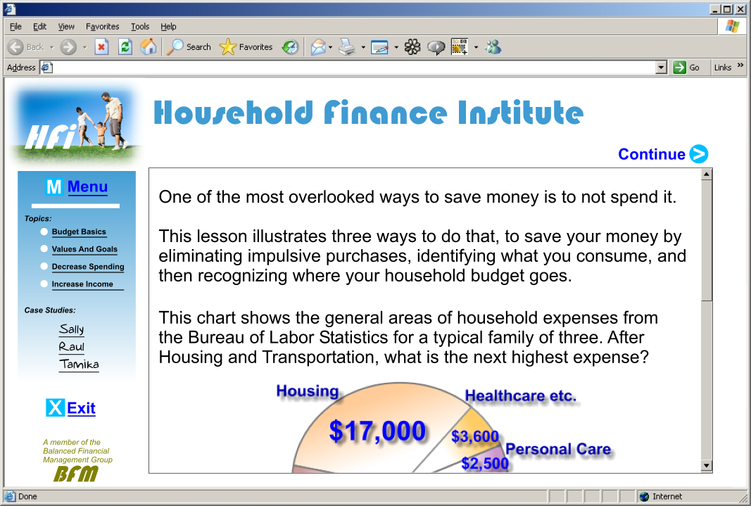
Extraneous processing
Notes:
Extraneous processing is undesirable mental load caused by poor instructional design decisions
such as this split attention screen
caused by poor placement of graphic and text on a scrolling screen.
An instructional goal is to minimize extraneous processing.

Slide 27
Essential processing
Which demands more mental processing
(to correctly respond)?
Write the meaning of this written phrase:
A che ora parte il treno?
Respond to this spoken question:
“Di che colore sono i suoi capelli?”
Determine the meaning of this question:
What is the best way to get downtown?
Respond to this question:
What is the best way to get downtown?
How might you confirm your hypotheses?
Notes:
From Clark: Essential processing refers to the complexity of the learning demand.
In language, listening to a verbal question and framing an answer
requires more mental processing & capacity
than reading and interpreting a written phrase.
Koedinger: B is longer (question rather than phrase) and requires the generation of an answer (as well as interpretation). Both increase essential processing. I’m not sure that listening is harder than reading, might be easier. There is a

Slide 28
Essential processing, example 2
Which demands more mental processing
(to correctly respond)?
Solve for x:
80 + 10 = x
Solve for x:
20 * 4 + 10 = x
Starting with 80, if I add 10, I get a number.
What number is it?
Starting with 20, if I multiply it by 20 and then add 10,
I get a number. What number is it?
Determining underlying processes needed to do tasks
is the goal of Cognitive Task Analysis, which we will discuss later
Notes:
From Clark: Essential processing refers to the complexity of the learning demand.
In language, listening to a verbal question and framing an answer
requires more mental processing & capacity
than reading and interpreting a written phrase.
Koedinger: B is longer (question rather than phrase) and requires the generation of an answer (as well as interpretation). Both increase essential processing. I’m not sure that listening is harder than reading, might be easier. There is a

Slide 29


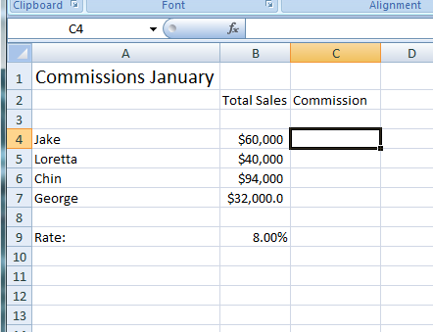
Generative processing
Using Spreadsheets in your Small Business
Lesson 2: Working with Formulas
Which formula is
most efficient to calculate all commissions:
= B4*B9
= B4/B9
=B4*$B9$
=B4*$B$9
Notes:
Generative processing is useful mental work that leads to learning. A good practice exercise is one form of generative processing. Relate generative processing to the engagement matrix introduced in Chapter 1. Generative processing depends on psychological processing not behavioral activity.

Slide 30
Managing cognitive load
Challenge | Description | Solution | Examples
Too much extraneous processing | The mental load from extraneous and essential processes exceeds capacity | Use instructional methods that decrease extraneous processing | Use audio to describe complex visuals Write lean text and audio narration
Too much essential processing | The content is so complex that it exceeds capacity | Use techniques to reduce content complexity | Segment content Use pretraining
Insufficient generative processing | The learner does not engage enough to learn | Incorporate methods to promote psychological engagement | Add practice Add relevant visuals
Insert table 2.2
Notes:
This is table 2.2 .

Slide 31
Key learning processes
MULTIMEDIA
SENSES
WORKING MEMORY
LONG-TERM
PRESENTATION
MEMORY
Words
Ears
selecting
Sounds
organizing
Verbal
words
words
Model
integrating
Prior
Prior
Knowledge
Knowledge
Pictures
Eyes
selecting
Images
organizing
Pictorial
New
Knowledge
images
images
Model
Selection
Retrieval
Integration
Load management
What’s missing in this diagram?
Cues to retrieve
Update to long-term memory

Slide 32

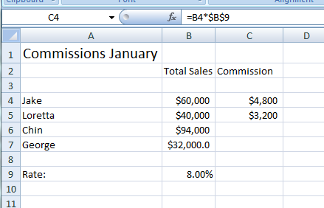
Selection, load management, integration, retrieval
Using Spreadsheets in your Small Business
Lesson 4: Absolute Vs Relative Cell
Cell B9 is designated as an absolute cell reference.
When you want to keep a cell value in a copied formula the same, you need to use an absolute cell reference. Place a dollar sign in front of the column letter and row number of the cell value you want to maintain.
Note above in column C the value in each B column will be multiplied by 10%
when the formula in Cell C4 is copied to C5 –C7.
Notes:
Discuss how this storyboard does or does not support selection, load management, integration, and retrieval. You may have additional storyboards to use for this discussion.

Slide 33
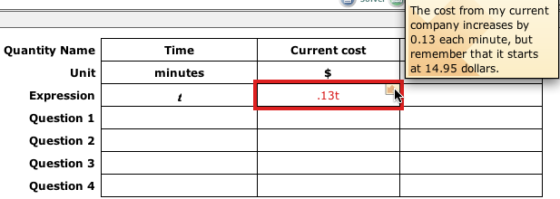
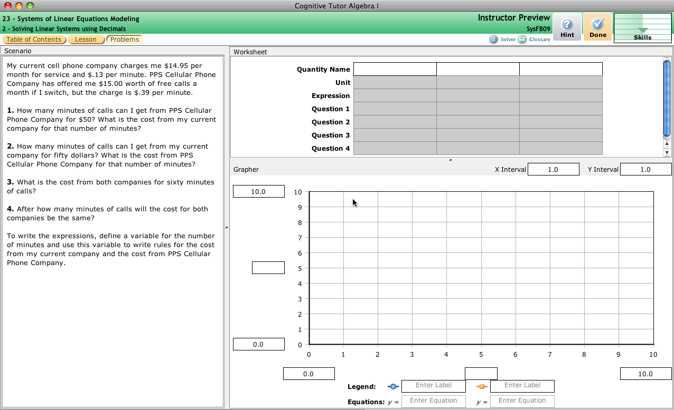
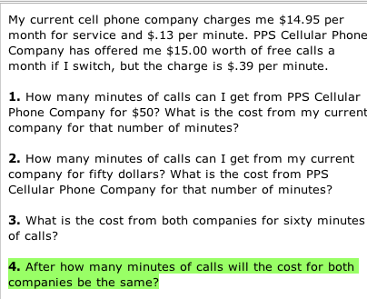
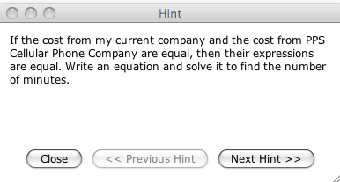
Selection, load management, integration, retrieval
Notes:
Discuss how this screen shot does or does not demonstrate support for selection, load management, integration, and retrieval

Slide 34
Instructional Complexity paper

Slide 35
Instructional Complexity
How many instructional options are there?
More help,
passive
More challenge, active
What’s best?
Focused practice
Gradually widen
Distributed practice
Study examples
50/50Mix
Test on
problems
Study
Study
50/50
Test
Study
50/50
Test
Concrete
Mix
Abstract
Concrete
Mix
Abstract
Immediate
Delayed
No feedback
Immediate
Delayed
No feedback
Block topics in chapters
Interleave topics
Block topics in chapters
Fade
Interleave topics
Fade
Explain
Mix
Ask for explanations
Explain
Mix
Ask for explanations
Many other choices: animations vs. diagrams vs. not, audio vs. text vs. both, …
Koedinger, Booth, Klahr (2013). Instructional Complexity and the Science to Constrain It. Science.
>3^{15*2} = 205 trillion options!
Notes:
We have been exploring many of these combinations in over 300 “in vivo” studies in OLI and other courses

Slide 36
Five Recommendations
Search in the “function space”
Experimental tests of instructional function decomposability
Massive online multifactor studies
Learning data infrastructure
School-researcher partnerships
Koedinger, Booth, Klahr (2013). Instructional Complexity and the Science to Constrain It. Science.
Notes:
[circle the function & theory rec’s & emphasize them]

Slide 37
Need better theory to guide experimentation!
Newell, A. (1973). You can't play 20 questions with nature and win. In Visual Information Processing.
Newell: Can’t play 20 questions with nature and win
Bradshaw: Why Wright brothers won the race to create first airplane
  Others searched in design space:
  what features lead to flying
  They searched in the function space:
  what features achieve needed functions, such as lift or thrust
Bradshaw, G. (1992). The airplane and the logic of invention. In Cognitive Models of Science.

Slide 38

PSLC Vision
Why? Chasm between science & educational practice
LearnLab = bridging infrastructure
  Educational technology as scientific instrument
  Science-practice collaboration structure
Purpose: Identify the conditions that cause robust student learning
A Key Output: KLI Framework
Notes:
Say: One of 6 science of learning centers”
The vision for the PSLC starts with the broad goals of understanding human learning and using that understanding to improve education. More specifically, we are working to fill the chasm that currently exists between learning science research and educational practice. A key indicator is the low hit rate of costly large-scale randomized control trials . It appears the science behind many of these trials may not have been sound and reliable enough (we believe in RFTs, but we need more science to build up to them).
2) Toward this end, we have created LearnLab …
Goals are to: Do rigorous science at scale. Create a two-way street. Have problems from practioners guide psychological research goals.
3) In general, our purpose is to “leverage cognitive … learning”.

Slide 39
The Short List
Koedinger, K. R., Booth, J. L., & Klahr, D. (2013). Instructional complexity and the science to constrain it. Science, 342(6161), 935-937.
Memory/Fluency | 1 | Spacing | Space practice across time > mass practice all at once
 | 2 | Scaffolding | Sequence instruction toward higher goals > no sequencing
 | 3 | Exam expectations | Students expect to be tested > no testing expected
 | 4 | Testing | Quiz for retrieval practice > study same material
 | 5 | Segmenting | Present lesson in learner-paced segments > as a continuous unit
 | 6 | Feedback | Provide feedback during learning > no feedback provided
Induction/Refinement | 7 | Pretraining | Practice key prior skills before lesson > jump in
 | 8 | Worked example | Worked examples + problem-solving practice > practice alone
 | 9 | Concreteness fading | Concrete to abstract representations > starting with abstract
 | 10 | Guided attention | Words include cues about organization > no organization cues
 | 11 | Linking | Integrate instructional components > no integration
 | 12 | Goldilocks | Instruct at intermediate difficulty level > too hard or too easy
 | 13 | Activate preconceptions | Cue student's prior knowledge > no prior knowledge cues
 | 14 | Feedback timing | Immediate feedback on errors > delayed feedback
 | 15 | Interleaving | Intermix practice on different skills > block practice all at once
 | 16 | Application | Practice applying new knowledge > no application
 | 17 | Variability | Practice with varied instances > similar instances
Sense-making/Understanding | 18 | Comparison | Compare multiple instances > only one instance
 | 19 | Multimedia | Graphics + verbal descriptions > verbal descriptions alone
 | 20 | Modality | Verbal descriptions presented in audio > in written form
 | 21 | Redundancy | Verbal descriptions in audio > both audio & written
 | 22 | Spatial contiguity | Present description next to image element described > separated
 | 23 | Temporal contiguity | Present audio & image element at the same time > separated
 | 24 | Coherence | Extraneous words, pictures, sounds excluded > included
 | 25 | Anchored learning | Real-world problems > abstract problems
 | 26 | Metacognition | Metacognition supported > no support for metacognition
 | 27 | Explanation | Prompt for self-explanation > give explanation > no prompt
 | 28 | Questioning | Time for reflection & questioning > instruction alone
 | 29 | Cognitive dissonance | Present incorrect or alternate perspectives > only correct
 | 30 | Interest | Instruction relevant to student interests > not relevant

Slide 40
For next time
By Monday: Hand in Examples Assignment
By Tuesday:
Readings
  Full read of
    Carver paper
    KLI Framework, sections 1-3
  Skim Bloom’s taxonomy
Discussion board posts on readings
Quiz on KLI
Two of you will provide summaries of KLI & Bloom’s taxonomy

Slide 41
Volunteers for summary on Thursday?

