Slide 1
Empirical Cognitive Task Analysis using Difficulty Factors Assessment
Ken Koedinger
Key reading:
Heffernan, N. & Koedinger, K. R. (1997). The composition effect in symbolizing: The role of symbol production vs. text comprehension: In Shafto, M. G. & Langley, P. (Eds.) Proceedings of the Nineteenth Annual Conference of the Cognitive Science Society, (pp. 307-312). Hillsdale, NJ: Erlbaum.

Slide 2
Cognitive Task Analysis (CTA)
A set of methods and techniques that specify the cognitive structures and processes associated with task performance
Focus on underlying cognitive processes,
rather than just observable behaviors
  The output of a CTA is a Cognitive Model,
  a precise specification of underlying cognitive processes in some representational format
From: Clark, R. E., & Estes, F. (1996). Cognitive task analysis. International Journal of Educational Research, 25(5), 403–417.
Notes:
Clark and Estes (1996) define Cognitive Task Analysis (CTA) as "the general term used to describe a set of methods and techniques that specify the cognitive structures and processes associated with task performance. The focal point is the underlying cognitive processes, rather than observable behaviors. Another defining characteristic of CTA is an attempt to describe the differences between novices and experts in the development of knowledge about tasks (Redding, 1989)."
The definition of CTA suggested by this quote from Feldon (2007) "the use of structured knowledge elicitation techniques (e.g., cognitive task analysis)" emphasizes the approach of eliciting knowledge from experts, presumably through more direct approaches of interviews or think alouds. Whether the more indirect approach of using extensive student performance data to do knowledge component analysis via educational data mining would be a version of CTA is thus perhaps open.
Clark and Estes (1996) highlight the general value of task analysis: "Prior to task analysis, job training was accomplished almost exclusively by observational learning on-the-job ("sit by Nelly") and formal apprenticeships. Both these methods required a great deal of time and produced variable results for a couple of reasons. First, the role model did not always know what behaviors to highlight for the learner, for reasons discussed later. Second, some very critical steps or decisions occur very rarely and so are inefficient to observe in real-time."
Clark & Estes reference:
Cooke, N.J. (1992). The implications of cognitive task analyses for the revision of the Dictionary of Occupational Titles. In W. J. Camara (Ed.), Implications of Cognitive Psychology and Cognitive Task Analysis for the Revision of the Dictionary of Occupational Titles, Washington D.C.: American Psychological Association.
Redding, R.E. (1989). Perspectives on cognitive task analysis: The state of the state of the art. Proceedings of the Human Factors Society 33rd Annual Meeting.

Slide 3
Do you have concrete tasks?
A short end of unit quiz/assessment?
Indicate the broad task category
  Example:
  “translating story problems into algebraic expressions”
But do not stop there!
Provide concrete tasks (questions/scenarios) that require a student to answer/perform
  Example:
  Sue made $72 washing cars. She decided to spend “m” dollars on a present for her mom and then use the remainder to buy presents for each of her 4 sisters. She will spend the same amount on each sister. How much can she spend on each sister?

Slide 4
What are steps to perform your task?
What are the physical observable steps?
What mental steps are needed?
  Inferring deep features from perceptual input
  Setting subgoals, breaking the task down
  Retrieving possibly relevant prior knowledge, evaluating its relevance, applying it
  Maintaining attention, persevering
What representation will you use to represent cognitive processes?
  See examples in prior lectures & papers

Slide 5
Lovett’s Rational CTA => Cognitive Model
20%
This goal sequence is (the top level of) the Cognitive Model

Slide 6
Lovett also used production rules in English to specify her Cognitive Model
Missing production (to set goal 3):
Characterize problem
If goal is to do an exploratory data analysis
& relevant variables have been identified
then
set a subgoal to identify variable types
Buggy production (skipping from goal 2 to 4):
Select any data representation
If goal is to do an exploratory data analysis
& relevant variables have been identified
then
set a subgoal to conduct an analysis by picking any data representation

Slide 7
Difficulty Factors Assessment

Slide 8
Difficulty Factors Assessment (DFA) is particularly good for some CTA purposes
DFA is a form of empirical descriptive CTA
  Uses data & focuses on students
  Also prescriptive when sample includes
  students who perform tasks particularly well
For a topic you want to teach,
DFA helps to decompose it into knowledge components
  What components are learners’ missing?
  What order do they acquire these components?
  Which components are particularly hard to acquire?
  What “hidden skills” must be acquired?
Good instruction targets what students don’t know & builds on what they do know

Slide 9
CTA using
Difficulty Factors Assessment (DFA)
Design & administer DFA
  Hypothesize task difficulty factors
  Design tasks to vary factors
  Administer as paper quiz or on-line
Analyze results
Create models
Redesign instruction

Slide 10
1a. Hypothesize task difficulty factors
Running example is from:
Koedinger & Nathan (2004). The real story behind story problems: Effects of representations on quantitative reasoning. The Journal of the Learning Sciences.
Rational CTA
  Example: Story problems are solved by translating to equations
  (this analysis turned out to be inaccurate)
Use prior experience in teaching or taking a similar course
  Start with test items or homework tasks
  Modify by reducing or increasing difficulty
Read relevant literature
Do think alouds, can be fast & informal

Slide 11
1b. Design tasks to vary factors
Result-unknown problems -- "Arithmetic"
Story
When Ted got home from his waiter job, he took the $81.90 he earned that day and subtracted the $66 he received in tips. Then he divided the remaining money by the 6 hours he worked and found his hourly wage. How much per hour does Ted make?
Word-equation
Starting with 81.9, if I subtract 66 and then divide by 6, I get a number. What is it?
Equation
(81.90 - 66) / 6 = x
Start-unknown problems -- "Algebra"
Story
When Ted got home from his waiter job, he multiplied his hourly wage by the 6 hours he worked that day. Then he added the $66 he made in tips and found he earned $81.90. How much per hour does Ted make?
Word-equation
Starting with some number, if I multiply it by 6 and then add 66, I get 81.9. What number did I start with?
Equation
x * 6 + 66 = 81.90
These 6 tasks arranged in a 2x3 matrix illustrate a relatively simple “task design space”

Slide 12
1b. Design tasks to vary factors, create forms
Difficulty factors involved
  Presentation type
    Story, Word, vs. Equation
  Unknown position
    Result-unknown vs. start-unknown
  Number type
    Whole vs. decimal numbers
Multiple quiz forms

Slide 13
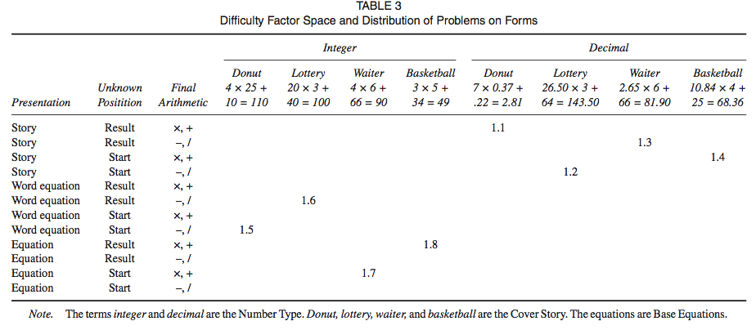
Difficulty Factor Space and
Latin Square Sampling
Story x Pres x Unkn-pos x Num-type x Major-Op
4 x 3 x 2 x 2 x 2 = 96 different tasks (or problems)
8 tasks/form, 12 forms
This matrix illustrates a complex task design space.

Slide 14
1c. Administer as paper quiz or on-line
This story problem DFA & others have been administered as paper quizzes
  Koedinger, K. R., Alibali, M. W., & Nathan, M. M. (2008). Trade-offs between grounded and abstract representations: Evidence from algebra problem solving. Cognitive Science, 32(2), 366-397.
  Baker, R. S. J. d., Corbett, A.T. & Koedinger, K. R. (2007). The difficulty factors approach to the design of lessons in intelligent tutor curricula. International Journal of Artificial Intelligence in Education, 17(4), 341-369.
  Rittle-Johnson, B. & Koedinger, K. R. (2005). Designing knowledge scaffolds to support mathematical problem solving. Cognition and Instruction. 23(3), 313-349
Some implemented on-line
  Koedinger, K.R. & McLaughlin, E.A. (2010). Seeing language learning inside the math: Cognitive analysis yields transfer. In S. Ohlsson & R. Catrambone (Eds.), Proceedings of the 32nd Annual Conference of the Cognitive Science Society. (pp. 471-476.) Austin, TX: Cognitive Science Society.

Slide 15
2. Analyze results: Quantitative
Anova: main effects, repXnumber interaction
Whole Number Problems
Decimal Number Problems

Slide 16
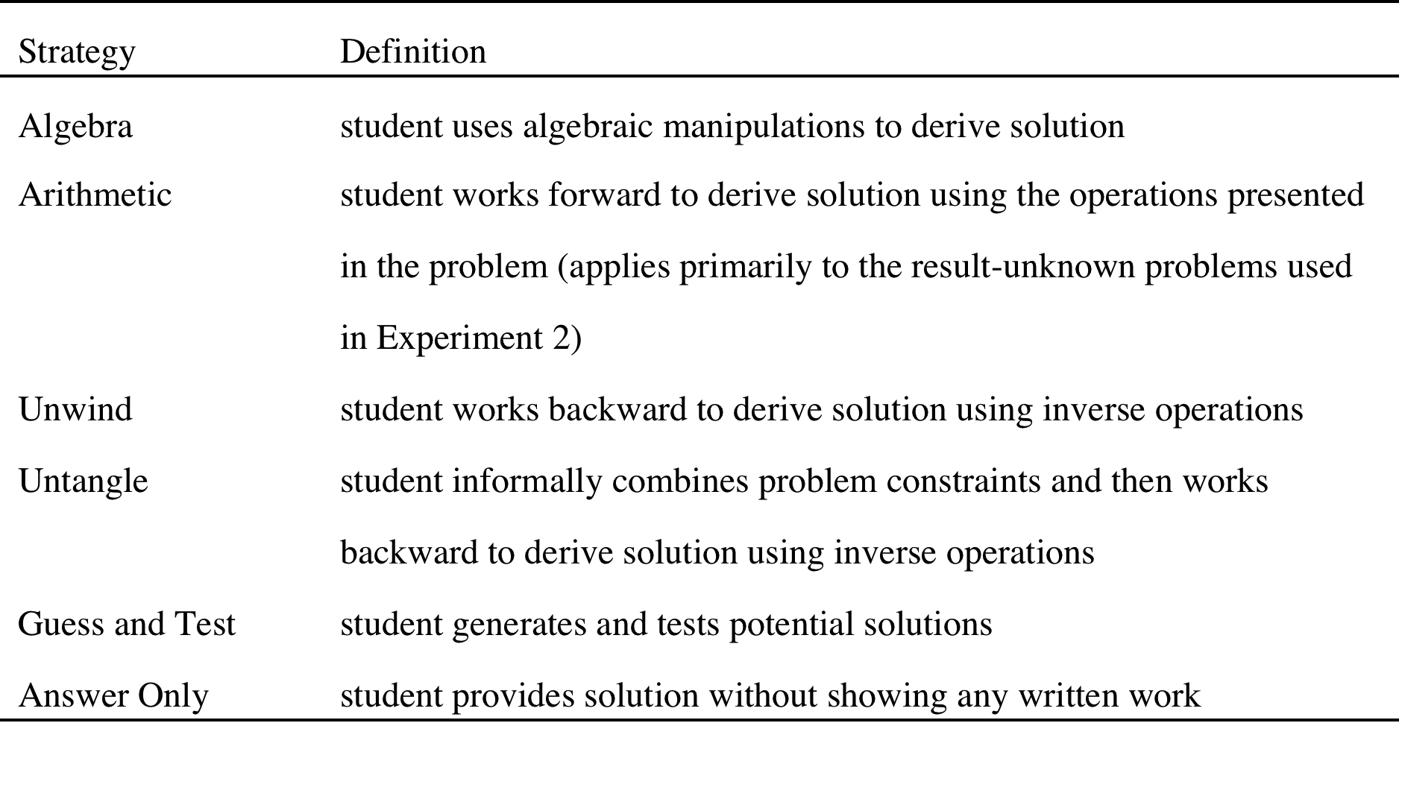
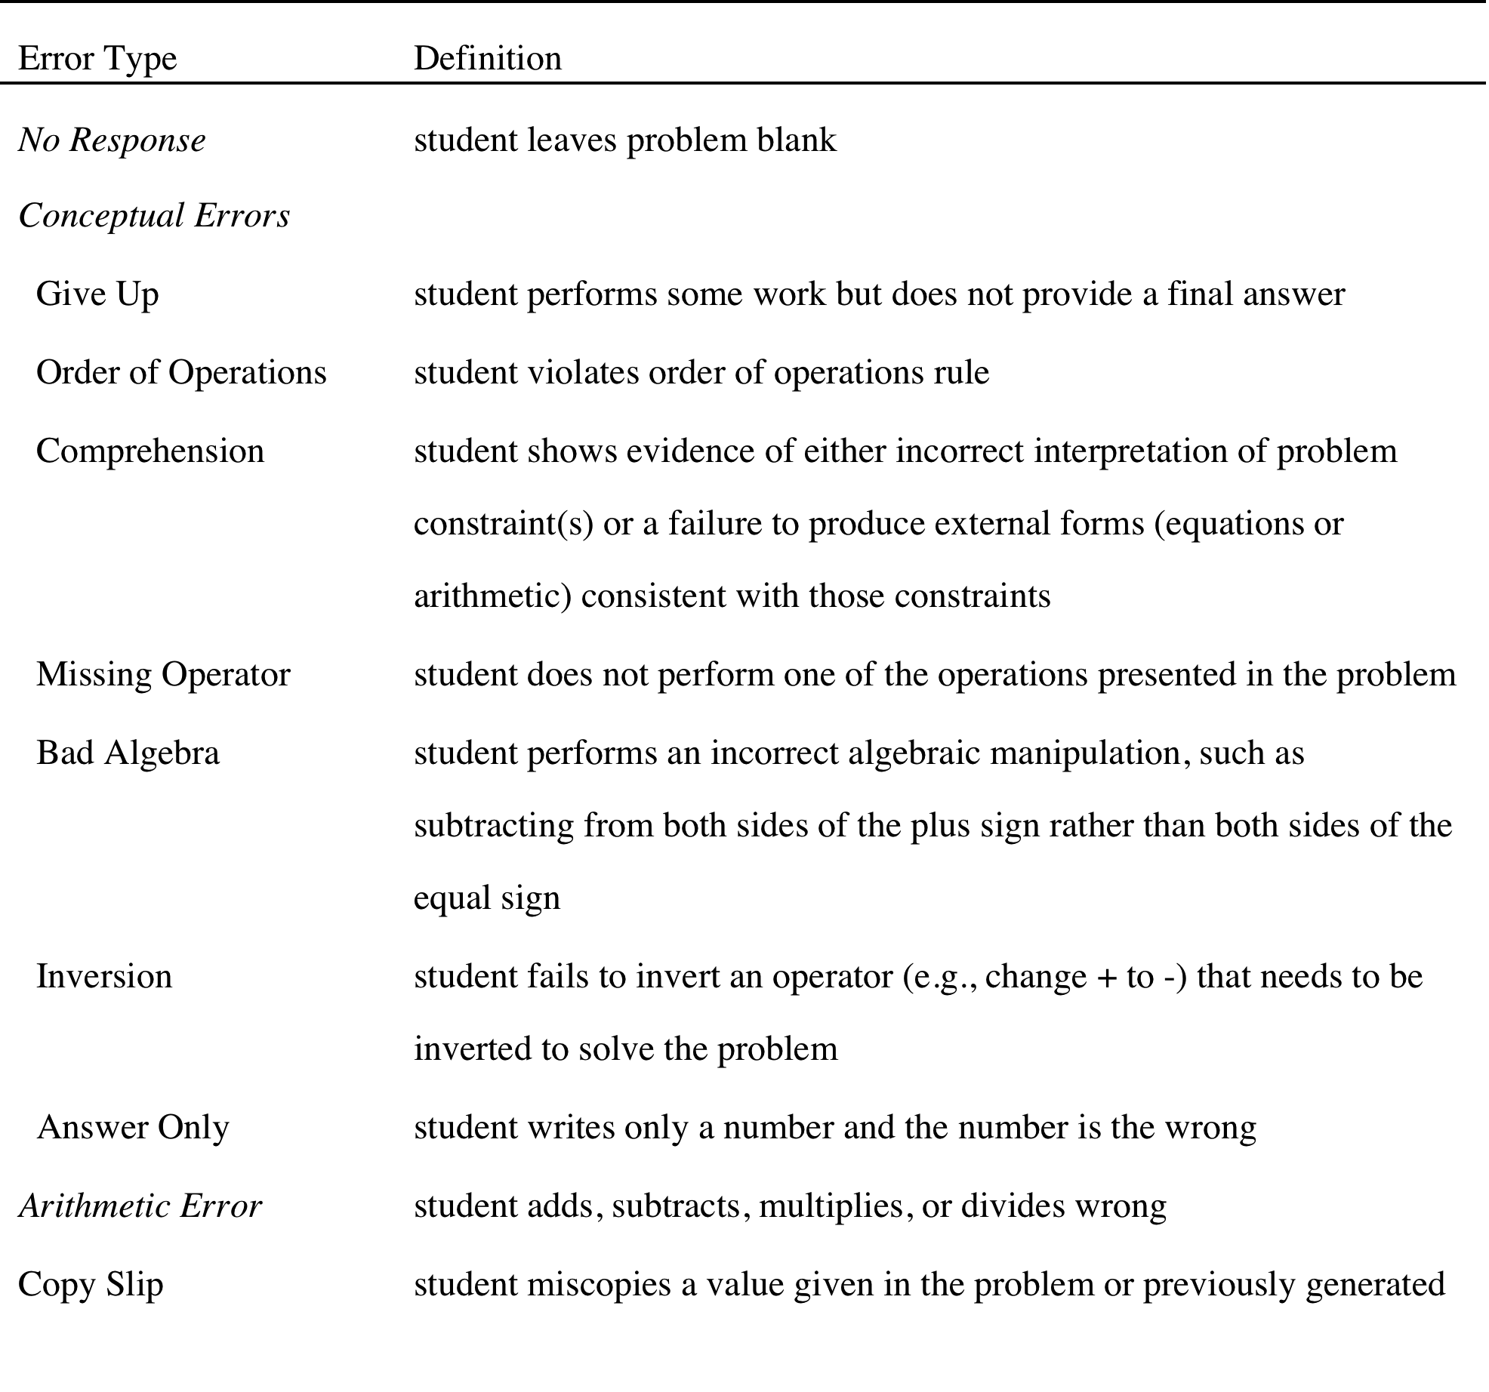
Analyze results: Qualitative
Strategy & error coding
  Similar to verbal data coding, but applied to written solutions
  Create coding dictionaries
  From follow-up paper: Koedinger, K. R., Alibali, M. W., & Nathan, M. M. (2008). Trade-offs between grounded and abstract representations: Evidence from algebra problem solving. Cognitive Science, 32.

Slide 17
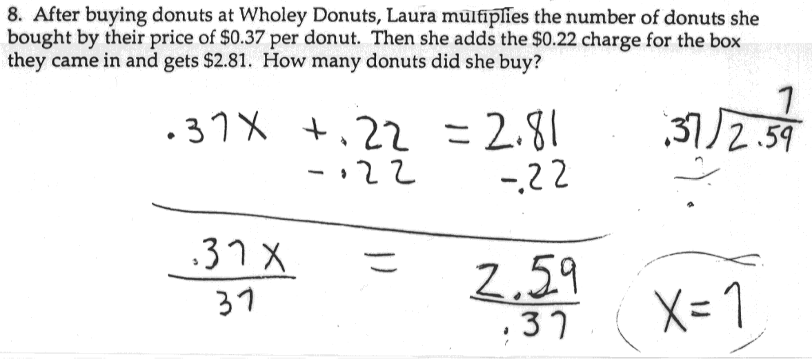
Normative translate and solve strategy

Slide 18
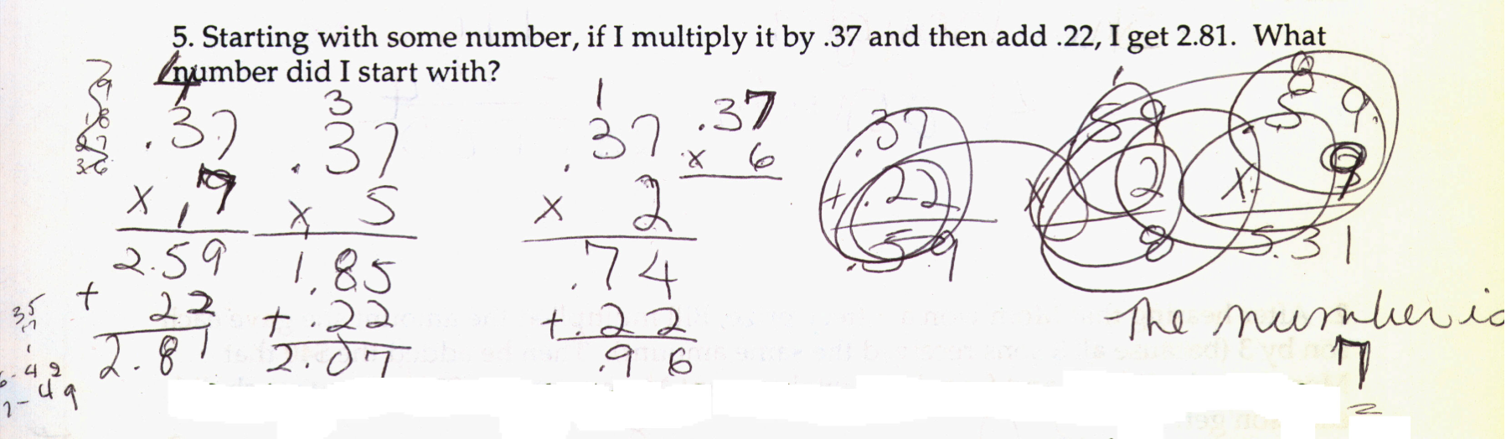
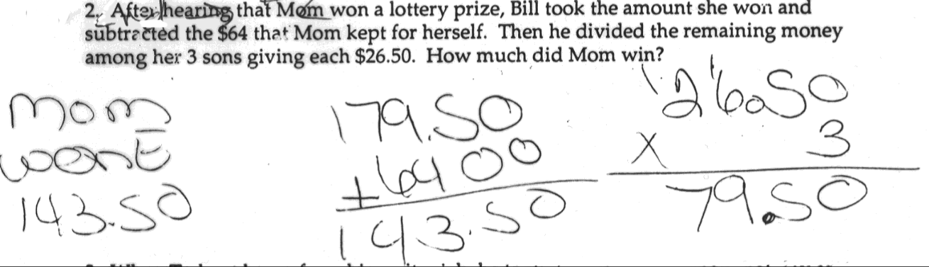
Informal Strategies

Slide 19
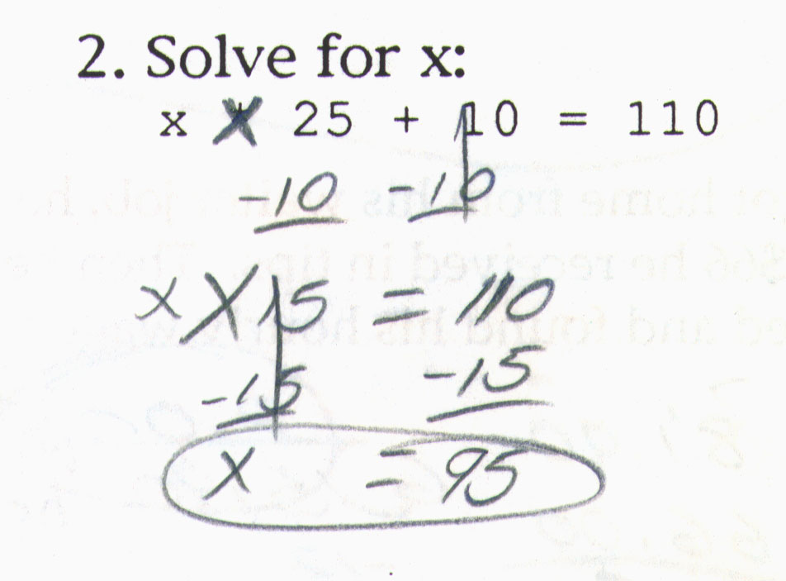
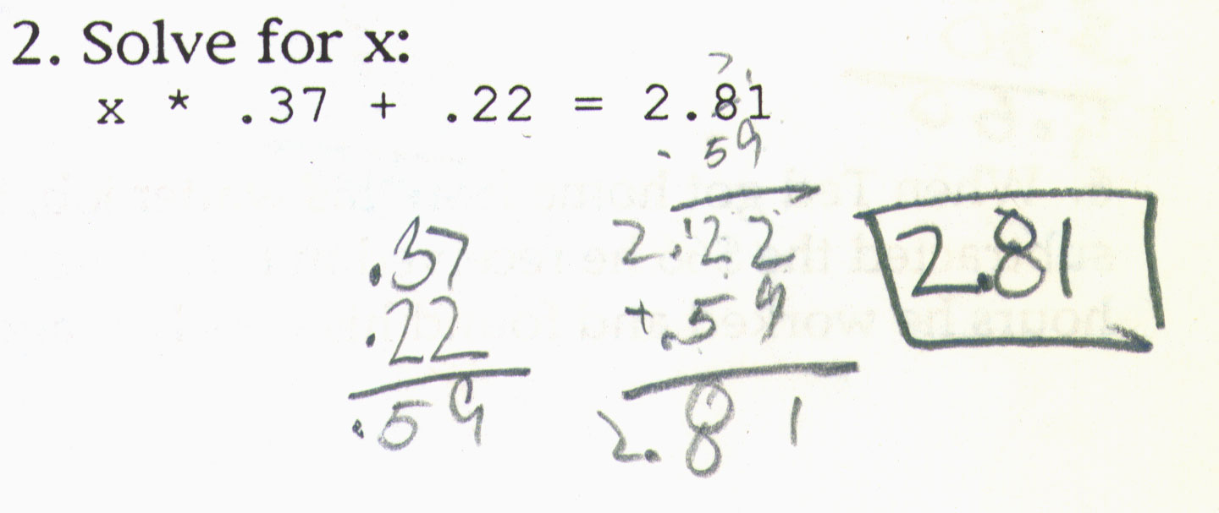
The foreign language of algebra: Difficulties with syntax & semantics

Slide 20
3. Create a cognitive model
Cognitive model
  Write production rules (in English is OK)
  Create mapping of a tasks to knowledge components
  (a “Q matrix”)
Learning progression: sequence of tasks
  For an example, see:
  Koedinger, K. R., Alibali, M. W., & Nathan, M. M. (2008). Trade-offs between grounded and abstract representations: Evidence from algebra problem solving. Cognitive Science, 32(2), 366-397.

Slide 21
Example Production Rule
English version
FOCUS-ON-LAST-RELATION
IF the goal is to solve a problem
and there is a quantitative relationship with
an unknown input,
a known input, &
a known output
THEN
focus on that quantitative relationship & try to solve for the unknown input
ACT-R 3.0 version
(p Focus-on-Last-Relation
=Goal> isa Problem-Goal
focus NIL
context =Equation
=REL> isa *Relation
equation =Equation
arg2 =Arg2
result =Res3
=Arg2> isa *Quantity
status Known
=Res3> isa *Quantity
status Known
==>
=Goal> focus =REL)

Slide 22
4. Redesign Instruction
Use Cognitive Model discoveries to design better:
Learning activities
Instruction & feedback
Task sequencing
Better adaptation to individuals

Slide 23
Example: Designing better algebra instruction using CTA results
Discovery from CTA
  Students can solve simple story problems, but the language of algebra is difficult
Instructional design idea
  Help students generalize abstract math from their own intuitive concrete solutions
  Similar to “progressive formalization” or “concreteness-fading” (Golstone & Son, 05)
Does it work?
  Test idea with an in vivo experiment

Slide 24
Textbook vs. Cognitively-Based Design
5
4
3
2
1
0
Learning Due to Tutor Variants
Pre to Post
Improvement
Score
Textbook
(Symbolize first)
Inductive Support
(Solve & then symbolize)
…Plumbing Co. charges $42 per hour plus $35 for the service call 1. …. write an expression …
2. How much for a 3 hour call?
3. What will bill be for 4.5 hours?
4. Find hours when bill is $140
1. 35 + 42h = d
2. 35 + 42*3 = 161
3. 35 + 42*4.5 = 224
4. 35 + 42h = 140
2. 35 + 42*3 = 161
3. 35 + 42*4.5 = 224
1. 35 + 42h = d
4. 35 + 42h = 140
Koedinger, K. R., & Anderson, J. R. (1998). Illustrating principled design: The early evolution
of a cognitive tutor for algebra symbolization. Interactive Learning Environments.
Notes:
Not significant
Analysis of covariance:
Post-hoc:
BAC > ABC:
ACB ~ ABC
These are large improvements, 36% better in induce condition:

Slide 25
Heffernan Reading:
Difficulty Factors Assessment example

Slide 26
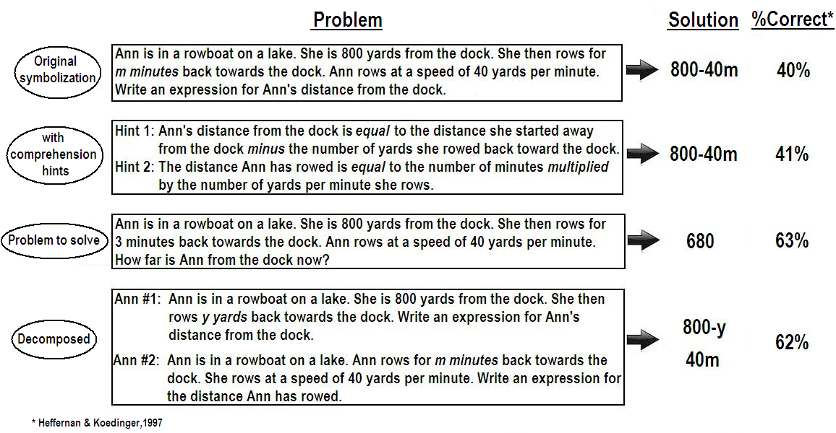
Difficulty Factors Assessment for Symbolization

Slide 27
Algebra learning as language learning
Students are better able to solve beginning algebra problems than translate to symbols
  64% vs. 18% correct! (Heffernan & Koedinger, 1998)
Why?
Translating a story problem to algebra is like translating English to Greek
  Difficulty is not comprehending the English, but generating the Greek

Slide 28
Producing correct algebra “sentences” is hard
DECOMPOSED VERSION
Sue made $72 washing cars. She decided to spend “m” dollars on a present for her mom. How much does she have left?
Sue has “x” dollars for presents for each of her 4 sisters. She will spend the same amount on each sister. How much she can spend on each sister?
CORE PROBLEM
Sue made $72 washing cars. She decided to spend “m” dollars on a present for her mom and then use the remainder to buy presents for each of her 4 sisters. She will spend the same amount on each sister. How much can she spend on each sister?
Correct Answers: (72 - m)/4 72 - m, x/4
Success rate: 40% 62% (~ .8 * .8)
Errors indicating
production difficulties:
72 - m or m/4
72 - m = n / 4 =
72 - m/4

Slide 29
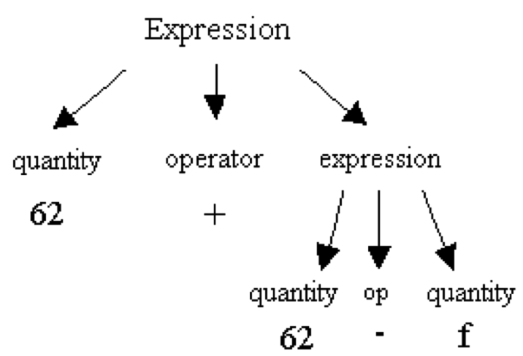
Example Production Rules
Works on one-step problems, not two-step:
If the goal is to symbolize quantity =Q,
=Q is the result of applying operator =Op to =Num1 and =Num2
=Op has symbol =Op-Sym
Then write “=Num1 =Op-Sym =Num2”
Works on two-step problems:
If the goal is to symbolize quantity =Q,
=Q is the result of applying operator =Op to expression =Expr1 and =Expr2
=Op has symbol =Op-Sym
Then write “=Expr1 =Op-Sym =Expr2”

Slide 30
From CTA to Instructional Design
Goal
Setting
Assessment Task Design
Data
Model
Instructional Design
Data
Theory
Intuition & experience
Can we create problems that isolate the key difficulty students experience in producing algebraic expression?
Yes:
  Substitute “x - 74” for w in “w / 4”

Slide 31
How to improve symbolization?
To improve learning on:
Practice this:
Or this:
?
 | Solution
Ms. Lindquist is a math teacher. Ms. Lindquist teaches 62 girls. Ms. Lindquist teaches f fewer boys than girls. Write an expression for how many students Ms. Lindquist teaches. | 62+62-f
Ms. Lindquist is a math teacher. Ms Lindquist teaches 62 girls. Ms Lindquist teaches b boys. Write an expression for how many students Ms. Lindquist teaches. | 62+b
Substitute 62-f for b in 62+b Write the resulting expression. | 62+62-f
Model suggests substitution practice!

Slide 32
From Instructional Design to Experimental Test
Goal
Setting
Assessment Task Design
Data
Model
Instructional Design
Data
Theory
Intuition & experience

Slide 33
In Vivo Experiment using “ASSISTment” technology
ASSISTment is an on-line formative assessment & tutoring system
  It teaches & tests at the same time
  Students use about weekly as part of regular middle school math classes
Study run in a single class period
  303 students randomly assigned to either substitution or one-step story practice
  5 pre-test problems, 4 instructional problems, 3 post-test problems

Slide 34
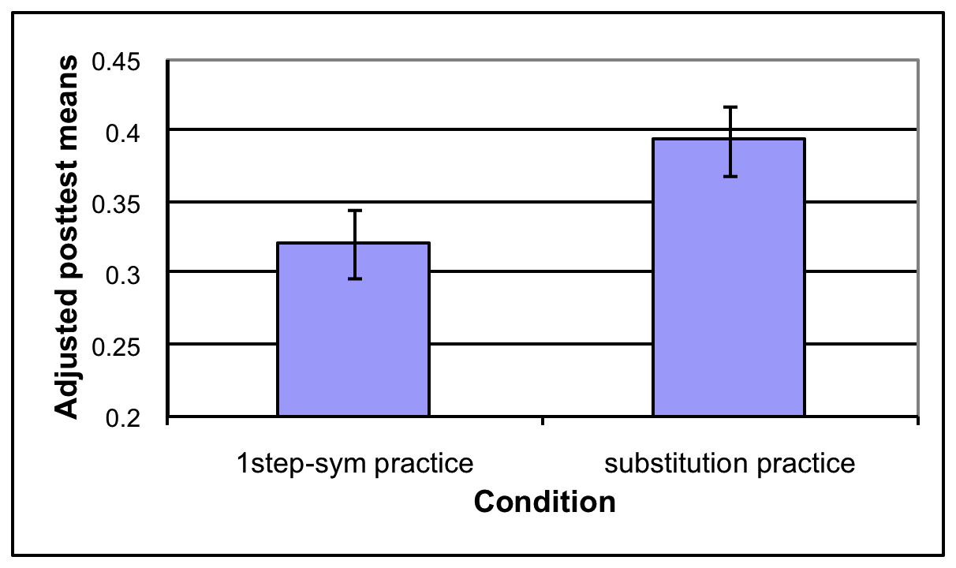
Substitution Practice Yields better Learning!
Two-Step Story: Ms. Lindquist is a math teacher. Ms. Lindquist teaches 62 girls. Ms. Lindquist teaches f fewer boys than girls. Write an expression for how many students Ms. Lindquist teaches.
Answer: 62+62-f
1-Step: Ms. Lindquist is a math teacher. Ms Lindquist teaches 62 girls. Ms Lindquist teaches b boys. Write an expression for how many students Ms. Lindquist teaches.
Answer: 62+b
Substitution exercise:
Substitute 62-f for b in 62+b
Write the resulting expression.
Answer: 62+62-f

Slide 35
Summary: Difficulty Factors Assessment (DFA) is particularly good for some CTA purposes
DFA is a form of empirical descriptive CTA
  Uses data & focuses on students
  Also prescriptive when sample includes
  students who perform tasks particularly well
For a topic you want to teach,
DFA helps to decompose it into knowledge components
  What components are learners’ missing?
  What order do they acquire these components?
  Which components are particularly hard to acquire?
  What “hidden skills” must be acquired?
Good instruction targets what students don’t know & builds on what they do know

