Slide 1
Educational Data Mining Overview
Ryan S.J.d. Baker
PSLC Summer School 2010

Slide 2
Welcome to the EDM track!

Slide 3
Educational Data Mining
“Educational Data Mining is an emerging discipline, concerned with developing methods for exploring the unique types of data that come from educational settings, and using those methods to better understand students, and the settings which they learn in.”
www.educationaldatamining.org

Slide 4
Classes of EDM Method (Baker & Yacef, 2009)
Prediction
Clustering
Relationship Mining
Discovery with Models
Distillation of Data For Human Judgment

Slide 5
Prediction
Develop a model which can infer a single aspect of the data (predicted variable) from some combination of other aspects of the data (predictor variables)
Which students are off-task?
Which students will fail the class?

Slide 6
Clustering
Find points that naturally group together, splitting full data set into set of clusters
Usually used when nothing is known about the structure of the data
What behaviors are prominent in domain?
What are the main groups of students?
Related to Principal Component Analysis
Geoff Gordon’s talk tomorrow

Slide 7
Relationship Mining
Discover relationships between variables in a data set with many variables
Association rule mining
Correlation mining
Sequential pattern mining
Causal data mining

Slide 8
Discovery with Models
Pre-existing model (developed with EDM prediction methods… or clustering… or knowledge engineering)
Applied to data and used as a component in another analysis

Slide 9
Distillation of Data for Human Judgment
Making complex data understandable by humans to leverage their judgment
Text replays are a simple example of this

Slide 10
A related method

Slide 11
Knowledge Engineering
Creating a model by hand rather than automatically fitting model
In one comparison, leads to worse fit to gold-standard labels of construct of interest than data mining (Roll et al, 2005), but similar qualitative performance

Slide 12
EDM track schedule
Tuesday 10am
Educational Data Mining with DataShop (Stamper, Koedinger)
Tuesday 11am
Item Response Theory and Learning Factor Analysis (Koedinger)
Tuesday 2:15pm
Principal Component Analysis, Additive Factor Model (Gordon)
Tuesday 3:15pm (optional)
Hands-on Activity: Data Annotation for Classification (Baker)
Hands-on Activity: Learning Curves and Logistic Regression in R (Koedinger)

Slide 13
EDM track schedule
Wednesday 11am
Bayesian Knowledge Tracing; Prediction Models (Baker)
Wednesday 11:45am (optional)
Hands-on activity: Prediction modeling (Baker)
Wednesday 3:15pm
Machine Learning and SimStudent (Matsuda)

Slide 14
Comments? Questions?

Slide 15
EDM Tools

Slide 16
PSLC DataShop
Many large-scale datasets
Tools for
exploratory data analysis
learning curves
domain model testing
Detail tomorrow morning

Slide 17
Microsoft Excel
Excellent tool for exploratory data analysis, and for setting up simple models

Slide 18
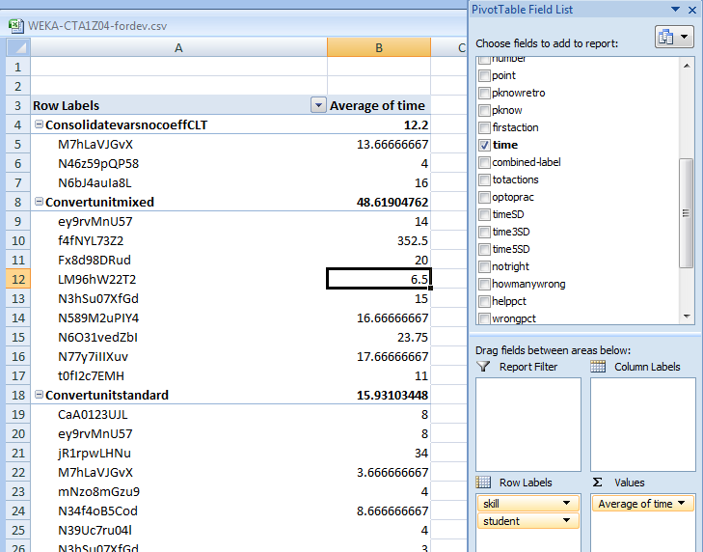
Pivot Tables

Slide 19
Pivot Tables
Who has used pivot tables before?

Slide 20
Pivot Tables
What do they allow you to do?

Slide 21
Pivot Tables
Facilitate aggregating data for comparison or use in further analyses

Slide 22
Equation Solver
Allows you to fit mathematical models in Excel
Let’s go through a simple example together

Slide 23
Equation Solver: Example
Let’s predict correctness from pknow, using a linear regression model
Using WEKA-CTA1Z04-examples.xlsx
You have this data set on your flashdrive
It’s from the DataShop – Hampton Algebra 2005-2006
I have formatted it for this example

Slide 24
Under pred type
=O2*$W$3+$W$2
And copy it down

Slide 25
Under pred type
=O2*$W$3+$W$2
And copy it down
Does anyone know why we use the $?

Slide 26
Under SR type
=(G2-S2)^2
This finds the difference between the prediction (0 right now) and the correctness value (0 or 1)
Squaring it is a way to both get the absolute value, and magnify larger differences; very common in statistics

Slide 27
To the right of const type
0

Slide 28
To the right of weight type
1
Note that you now have a model that is identical to pknow

Slide 29
To the right of SSR type
=SUM(T2:T2888)
This is the sum of squared residuals, again a very common way of evaluating models

Slide 30
To the right of r type
=CORREL(S2:S2888,G2:G2888)
This is the correlation between the model and the variable being predicted

Slide 31
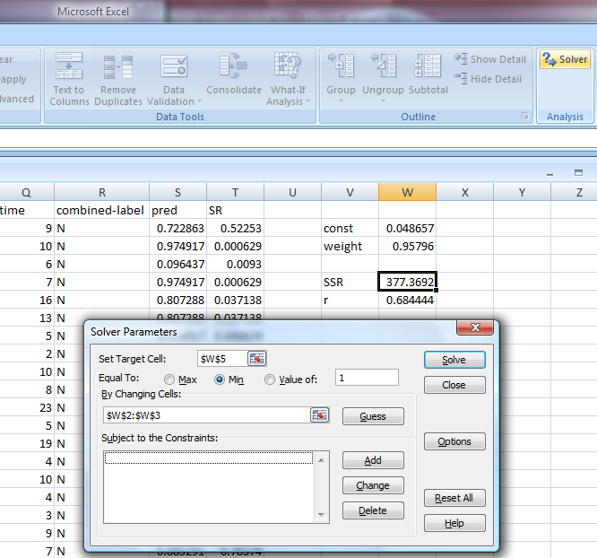
Now go into the Excel Equation Solver
And set up this model, and press solve

Slide 32
What changed?

Slide 33
What stayed the same?

Slide 34
We just built…
A very simple regression model
A much simpler model than what you can build in other packages

Slide 35
Why is this useful?
You can specify much more complex mathematical models than this
And much more quickly than you can implement them in software
For example, Excel is usually where I test variants on Bayesian Knowledge Tracing before implementing them in Java

Slide 36
Comments? Questions?

Slide 37
Suite of visualizations
Scatterplots (with or without lines)
Bar graphs

Slide 38
Weka and RapidMiner
Data mining packages
Weka is the most popular, but personally I prefer RapidMiner

Slide 39
Weka .vs. RapidMiner
Weka easier to use than RapidMiner
RapidMiner significantly more powerful and flexible (from GUI, both are powerful and flexible if accessed via API)

Slide 40
In particular…
It is impossible to do key types of model validation for EDM within Weka’s GUI
RapidMiner can be kludged into doing so (more on this in hands-on session Wed)
No tool really tailored to the needs of EDM researchers at current time…

Slide 41
SPSS
SPSS is a statistical package, and therefore can do a wide variety of statistical tests
It can also do some forms of data mining, like factor analysis (a relative of clustering)

Slide 42
SPSS
The difference between statistical packages (like SPSS) and data mining packages (like RapidMiner and Weka) is:
Statistics packages are focused on finding models and relationships that are statistically significant (e.g. the data would be seen less than 5% of the time if the model were not true)
Data mining packages set a lower bar – are the models accurate and generalizable?

Slide 43
R
R is an open-source competitor to SPSS
More powerful and flexible than SPSS
But much harder to use – I find it easy to accidentally do very, very incorrect things in R
Ken will demo R in a hands-on session

Slide 44
Matlab
A powerful tool for building complex mathematical models
Beck and Chang’s Bayes Net Toolkit – Student Modeling is built in Matlab
Geoff Gordon will give a hands-on demo of Matlab

Slide 45
Comments? Questions?

Slide 46
Pre-processing
Tomorrow morning, John and Ken will talk about some of the great data available in DataShop

Slide 47
Wherever you get your data from
You’ll need to process it into a form that software can easily analyze, and which builds successful models

Slide 48
Common approach
Flat data file
Even if you store your data in databases, most data mining techniques require a flat data file
Like the one we looked at in Excel

Slide 49
Some useful features to distill for educational software
Type of interface widget
“Pknow”: The probability that the student knew the skill before answering (using Bayesian Knowledge-Tracing or PFA or your favorite approach)
Assessment of progress student is making towards correct answer (how many fewer constraints violated)
Whether this action is the first time a student attempts a given problem step
“Optoprac”: How many problem steps involving this skill that the student has encountered

Slide 50
Some useful features to distill for educational software
“timeSD”: time taken in terms of standard deviations above (+) or below (-) average for this skill across all actions and students
“time3SD”: sum of timeSD for the last 3 actions (or 5, or 4, etc. etc.)
Action type counts or percents
Total number of action so far
Total number of action on this skill, divided by optoprac
Number of action in last N actions
Could be assessment of action (wrong, right), or type of action (help request, making hypothesis, plotting point)

Slide 51
Any other recommendations?

Slide 52
Distillation
I have code for distilling DataShop data which I would be happy to share with anyone
http://users.wpi.edu/~rsbaker/edmtools.html
But usually distillation functions are not particularly difficult to create
The only trick is usually knowing where to stop

Slide 53
Comments? Questions?

Slide 54
Time to work on projects

